Slide 1
Blended Learning International Train the Train (BLITT)
Google Searching
Damian Gordon
Lecturer in Computer Science
To Design, Develop, and Evaluate Quality Blended Learning

Slide 2
Google Searching
The Google search engine has become the standard way of finding information from web pages on the world-wide web.
To Design, Develop, and Evaluate Quality Blended Learning

Slide 3
Google Searching
How does Google searching work?
To Design, Develop, and Evaluate Quality Blended Learning

Slide 4
Google Searching
How does Google searching work?
The Google search engine uses the PageRank algorithm to do the search process and return results, the specifics of which are a closely guarded secret.
To Design, Develop, and Evaluate Quality Blended Learning

Slide 5
Google Searching
The PageRank algorithm
Larry Page and Sergey Brin developed the PageRank at Stanford University in 1996 as part of a research project about a new kind of search engine.
To Design, Develop, and Evaluate Quality Blended Learning

Slide 6
Google Searching
The PageRank algorithm
Sergey Brin had the initial idea that information on the web could be ordered in a hierarchy by "link popularity": “a page ranks higher as there are more links to it”.
To Design, Develop, and Evaluate Quality Blended Learning

Slide 7
Google Searching
But also: “the more sites that a webpage with the search phrase has, the higher the rating it will get (and the higher it’s “credibility score”)”.
To Design, Develop, and Evaluate Quality Blended Learning

Slide 8
Google Searching
And: “Also if two pages are pointed to by the same number of sites, but if for one of these pages each of the pointing sites have higher credibility scores that the sites pointing to the other page, then the first page will end up with a higher credibility score.”.
To Design, Develop, and Evaluate Quality Blended Learning

Slide 9
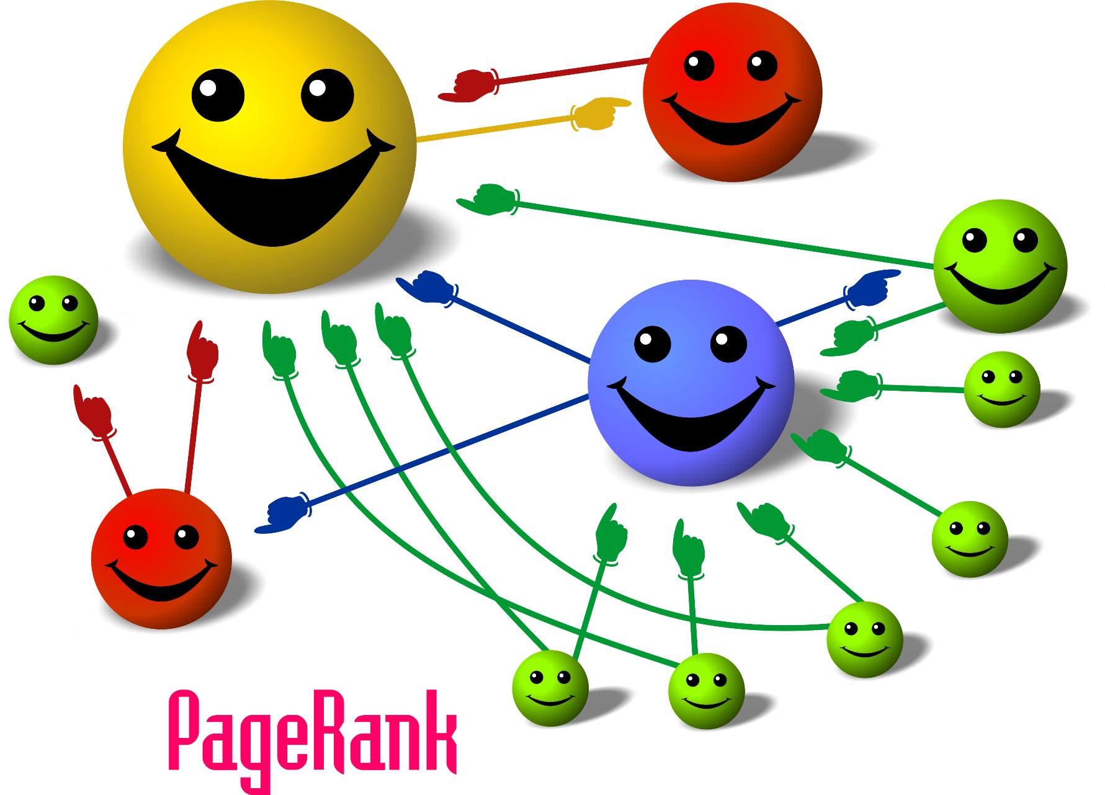
To Design, Develop, and Evaluate Quality Blended Learning

Slide 10
Google Searching
However, there are other ways to improve the order of webpage results that are returned form a search.
Including the following >>>
To Design, Develop, and Evaluate Quality Blended Learning

Slide 11
Google Searching
Money
Organizations and individuals can pay Google to improve their placement in the ranking of results returned.
To Design, Develop, and Evaluate Quality Blended Learning

Slide 12
Google Searching
Search Engine Optimization (SEO)
Organizations and individuals can hire companies that specialize in improving their placement in the ranking of results returned by doing things like:
To Design, Develop, and Evaluate Quality Blended Learning

Slide 13
Google Searching: SEO
1. Cross-linking pages on the same site, this increases the number of links pointing to each page
To Design, Develop, and Evaluate Quality Blended Learning

Slide 14
Google Searching: SEO
2. Cross-linking pages on different sites, these are called Link Farms.
To Design, Develop, and Evaluate Quality Blended Learning

Slide 15
Google Searching: SEO
3. Constantly updating the content on the site, which increases its rank.
To Design, Develop, and Evaluate Quality Blended Learning

Slide 16
Google Searching: SEO
4. Adding information to the “Header” page of the webpage (called the “metatag” section), that doesn’t appear on the browser, but is used in ranking the order of webpages.
To Design, Develop, and Evaluate Quality Blended Learning

Slide 17
Basic Google Search Operations
To Design, Develop, and Evaluate Quality Blended Learning

Slide 18
Google Search
I’m Feeling Lucky
To Design, Develop, and Evaluate Quality Blended Learning

Slide 19
Blended Learning
Google Search
I’m Feeling Lucky
To Design, Develop, and Evaluate Quality Blended Learning

Slide 20
Google Searching
This means
Look for webpages that have the words “Blended” and “Learning” in them, it doesn’t matter if the words are together on the page as long as they are somewhere in the page.
To Design, Develop, and Evaluate Quality Blended Learning

Slide 21
“Blended Learning”
Google Search
I’m Feeling Lucky
To Design, Develop, and Evaluate Quality Blended Learning

Slide 22
Google Searching
This means
Look for webpages that have the phrase (all together) “Blended Learning” in them. The words have to be together on the page.
To Design, Develop, and Evaluate Quality Blended Learning

Slide 23
Blended OR Learning
Google Search
I’m Feeling Lucky
To Design, Develop, and Evaluate Quality Blended Learning

Slide 24
Blended | Learning
Google Search
I’m Feeling Lucky
To Design, Develop, and Evaluate Quality Blended Learning

Slide 25
Google Searching
You can use “|” or “OR” and that means
Look for webpages that have either the word “Blended” or “Learning” in them, or both.
To Design, Develop, and Evaluate Quality Blended Learning

Slide 26
Blended | Learning TU Dublin
Google Search
I’m Feeling Lucky
To Design, Develop, and Evaluate Quality Blended Learning

Slide 27
Google Searching
This means
Look for webpages that have either the word “Blended” or “Learning TU Dublin” in them, or both.
To Design, Develop, and Evaluate Quality Blended Learning

Slide 28
(Blended | Learning) TU Dublin
Google Search
I’m Feeling Lucky
To Design, Develop, and Evaluate Quality Blended Learning

Slide 29
Google Searching
This means
Look for webpages that have either the word “Blended” or “Learning” in them, or both. But the pages must also contain “TU” and “Dublin” in them
To Design, Develop, and Evaluate Quality Blended Learning

Slide 30
Blended -learning
Google Search
I’m Feeling Lucky
To Design, Develop, and Evaluate Quality Blended Learning

Slide 31
Google Searching
This means
Look for webpages that have word “Blended” in it, but do not have or “Learning” in them
To Design, Develop, and Evaluate Quality Blended Learning

Slide 32
“Blended *”
Google Search
I’m Feeling Lucky
To Design, Develop, and Evaluate Quality Blended Learning

Slide 33
Google Searching
“*” is called the wildcard operator and it means
Look for webpages that have the word “Blended” followed by a space, followed by any other word. So “Blended Learning” would be found, but “Blended.” would not
To Design, Develop, and Evaluate Quality Blended Learning

Slide 34
“Blended *” TU Dublin
Google Search
I’m Feeling Lucky
To Design, Develop, and Evaluate Quality Blended Learning

Slide 35
Google Searching
“*” is called the wildcard operator and it means
Look for webpages that have the word “Blended” followed by a space, followed by any other word. So “Blended Learning” would be found, but “Blended.” would not. The page also has to have “TU” and “Dublin” in them
To Design, Develop, and Evaluate Quality Blended Learning

Slide 36
~Blended ~Learning
Google Search
I’m Feeling Lucky
To Design, Develop, and Evaluate Quality Blended Learning

Slide 37
Google Searching
“~” is called the tilde operator and it means
Look for webpages that have the words “Blended” and “Learning” in them, or look for words that are similar to them
To Design, Develop, and Evaluate Quality Blended Learning

Slide 38
“Blended Learning” 2012..2020
Google Search
I’m Feeling Lucky
To Design, Develop, and Evaluate Quality Blended Learning

Slide 39
Google Searching
“..” is called the range operator and it means
Look for webpages that have the phrase (all together) “Blended Learning” in them. The words have to be together on the page. And the page must also have one of the following numbers in it: 2012, 2013, 2014, 2015, 2016, 2017, 2018, 2019, 2020
To Design, Develop, and Evaluate Quality Blended Learning

Slide 40
Advanced Google Search Operations
To Design, Develop, and Evaluate Quality Blended Learning

Slide 41
site:www.damiantgordon.com blended
Google Search
I’m Feeling Lucky
To Design, Develop, and Evaluate Quality Blended Learning

Slide 42
Google Searching
This means
Look on the website www.damiantgordon.com for all of the occurrences of the word “Blended”
To Design, Develop, and Evaluate Quality Blended Learning

Slide 43
intitle:blended
Google Search
I’m Feeling Lucky
To Design, Develop, and Evaluate Quality Blended Learning

Slide 44
Google Searching
This means
Look for webpages that have the word “Blended” in the title of the page
To Design, Develop, and Evaluate Quality Blended Learning

Slide 45
allintitle:blended learning
Google Search
I’m Feeling Lucky
To Design, Develop, and Evaluate Quality Blended Learning

Slide 46
Google Searching
This means
Look for webpages that have the words “Blended” and “learning” somewhere in the title of the page
To Design, Develop, and Evaluate Quality Blended Learning

Slide 47
inurl:blended
Google Search
I’m Feeling Lucky
To Design, Develop, and Evaluate Quality Blended Learning

Slide 48
Google Searching
This means
Look for webpages that have the word “blended” as part of the webpage address (URL) of the page
To Design, Develop, and Evaluate Quality Blended Learning

Slide 49
allinurl:blended learning
Google Search
I’m Feeling Lucky
To Design, Develop, and Evaluate Quality Blended Learning

Slide 50
Google Searching
This means
Look for webpages that have both of the words “blended” and “learning” as part of the webpage address (URL) of the page
To Design, Develop, and Evaluate Quality Blended Learning

Slide 51
filetype:pdf blended
Google Search
I’m Feeling Lucky
To Design, Develop, and Evaluate Quality Blended Learning

Slide 52
Google Searching
This means
Look for pdf documents that have the word “blended” in them.
To Design, Develop, and Evaluate Quality Blended Learning

