Slide 1
Blended Learning International Train the Train (BLITT)
Google Searching (Ethics)
Damian Gordon
Lecturer in Computer Science
To Design, Develop, and Evaluate Quality Blended Learning

Slide 2
Google Searching
When you are typing in a phrase to search for, Google uses an autocompletion process help in searching.
To Design, Develop, and Evaluate Quality Blended Learning

Slide 3
Google Searching
The autocompletion works based on phrases that people have actually searched for in the past.
To Design, Develop, and Evaluate Quality Blended Learning

Slide 4
Google Searching
This can sometimes result in some very funny suggestions, however sometimes it results in suggestions that are not at all funny.
To Design, Develop, and Evaluate Quality Blended Learning

Slide 5
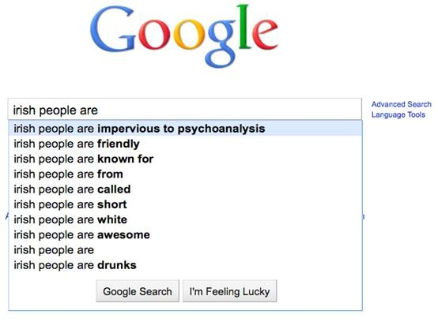
October
2010
To Design, Develop, and Evaluate Quality Blended Learning

Slide 6
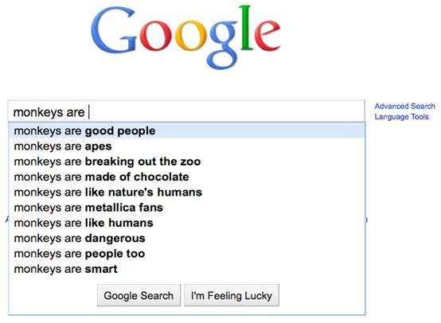
October
2010
To Design, Develop, and Evaluate Quality Blended Learning

Slide 7
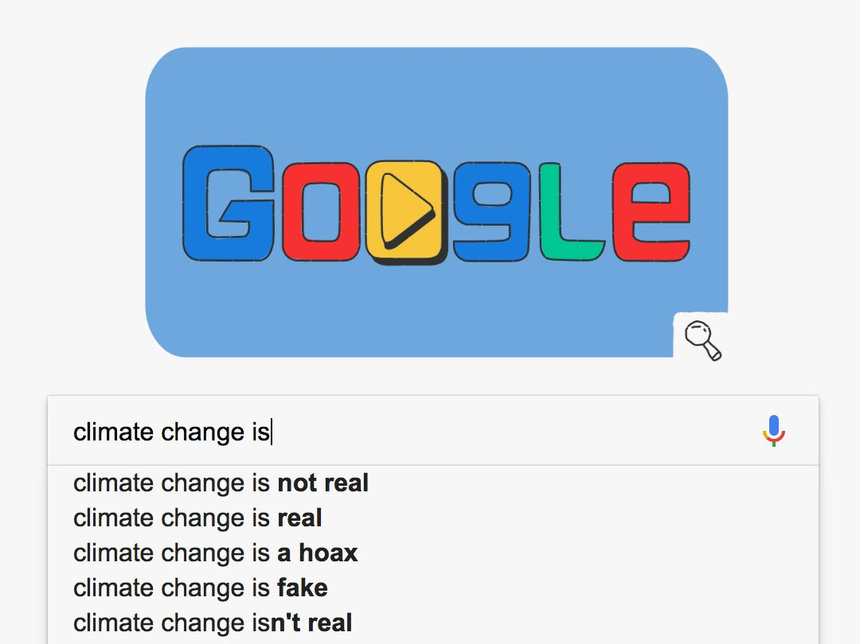
December
2018
To Design, Develop, and Evaluate Quality Blended Learning

Slide 8
Google Searching
Google image search has a few issues as well, it can sometimes promote gender-based stereotyping (These are all from December 2020).
To Design, Develop, and Evaluate Quality Blended Learning

Slide 9
Search: Teacher
To Design, Develop, and Evaluate Quality Blended Learning

Slide 10
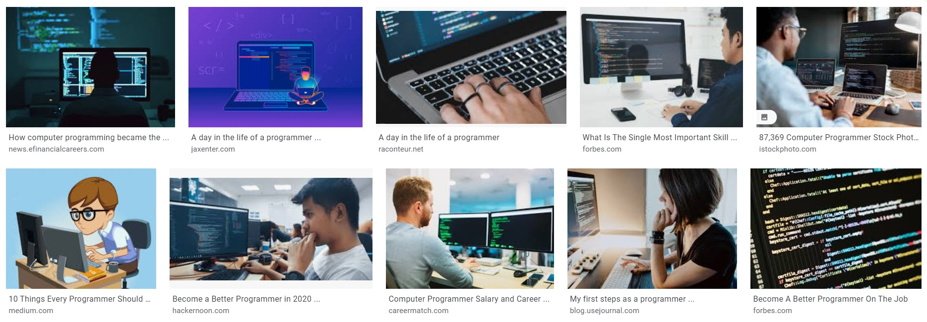
Search: Programmer
To Design, Develop, and Evaluate Quality Blended Learning

Slide 11
Search: Homemaker
To Design, Develop, and Evaluate Quality Blended Learning

Slide 12
Google Searching
There may be some evidence that Google itself is changing the ranking order of content for political reasons.
To Design, Develop, and Evaluate Quality Blended Learning

Slide 13
Google Searching
in 2019 senior Google engineer Gregory Coppola contacted watchdog group Project Veritas to talk about the Google bias that affects the information users get about political choices.
To Design, Develop, and Evaluate Quality Blended Learning

Slide 14
Google Searching
Coppola noticed that in 2014 Google search was neutral, but by 2016 it was showing clear bias for the US Democratic Party.
To Design, Develop, and Evaluate Quality Blended Learning

Slide 15
Google Searching
This was supported by Research Psychologist Robert Epstein who showed that biased search results generated by Google likely impacted undecided voters in a way that gave at least 2.6 million votes to Hillary Clinton.
To Design, Develop, and Evaluate Quality Blended Learning

Slide 16
Google Searching
Epstein showed that a lot of people think that if something is more highly rated on Google Search than another story, then it would be more important and more correct.
To Design, Develop, and Evaluate Quality Blended Learning

Slide 17
Google Searching
Epstein also noted that “searches for Hillary Clinton did not autocomplete to words that were popular searches if they reflected negatively on the Democratic candidate .”
To Design, Develop, and Evaluate Quality Blended Learning

Slide 18
Google Searching
Coppola doesn’t believe there is a vast conspiracy in Google, but rather that: “And in fact, I think it would only take a couple out of an organization of 100,000, you know, to make sure that the product is a certain way…”
To Design, Develop, and Evaluate Quality Blended Learning

Slide 19
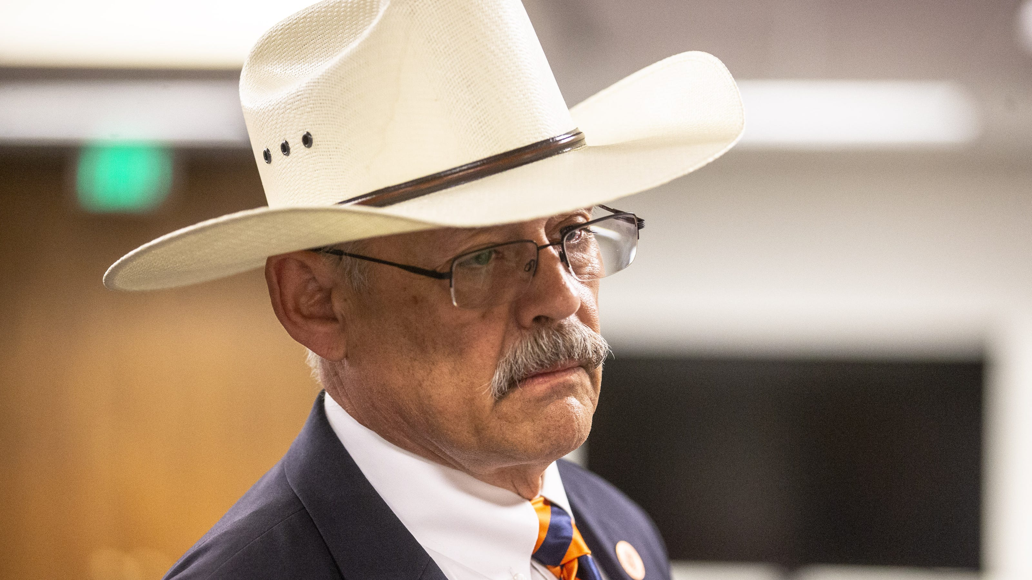
Google Searching
In October 2022, Mark Finchem (Republican candidate for Arizona secretary of state) tweeted that Google's search algorithm was biased against his campaign because its website did not come up in searches on his name.
To Design, Develop, and Evaluate Quality Blended Learning

Slide 20
Google Searching
Grid, a tech news website, found that that was true, but that Google apparently had nothing to do with it. Instead, the noindex tag, which tells webcrawlers not to list the site in results, was present in the META portion of the site's HTML code.
To Design, Develop, and Evaluate Quality Blended Learning

Slide 21
Google Searching
Whether that was the result of an error in coding the page was not known; the tag had apparently been added to it in late July. Finchem did not respond to Grid's request for an explanation when they called him.
Finchem lost the election.
To Design, Develop, and Evaluate Quality Blended Learning

