Slide 1
Blended Learning International Train the Train (BLITT)
Blended Learning Methodology
Damian Gordon
Lecturer in Computer Science
To Design, Develop, and Evaluate Quality Blended Learning

Slide 2
Instructional Design
Instructional Design is a way for teachers to create educational content that maximises the effectiveness, efficiency and appeal of instruction and other learning experiences.
There are many models to help do this, the most common one is called ADDIE.
To Design, Develop, and Evaluate Quality Blended Learning

Slide 3
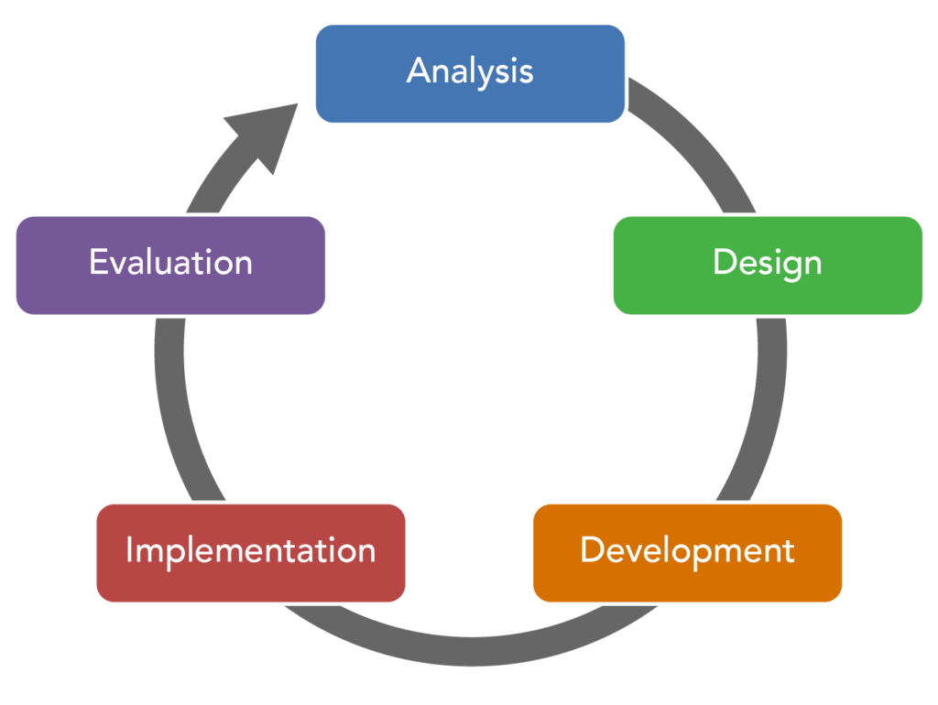
ADDIE Model
To Design, Develop, and Evaluate Quality Blended Learning

Slide 4
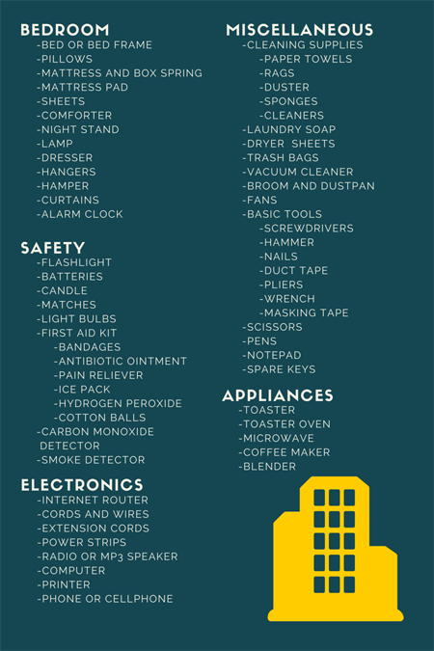
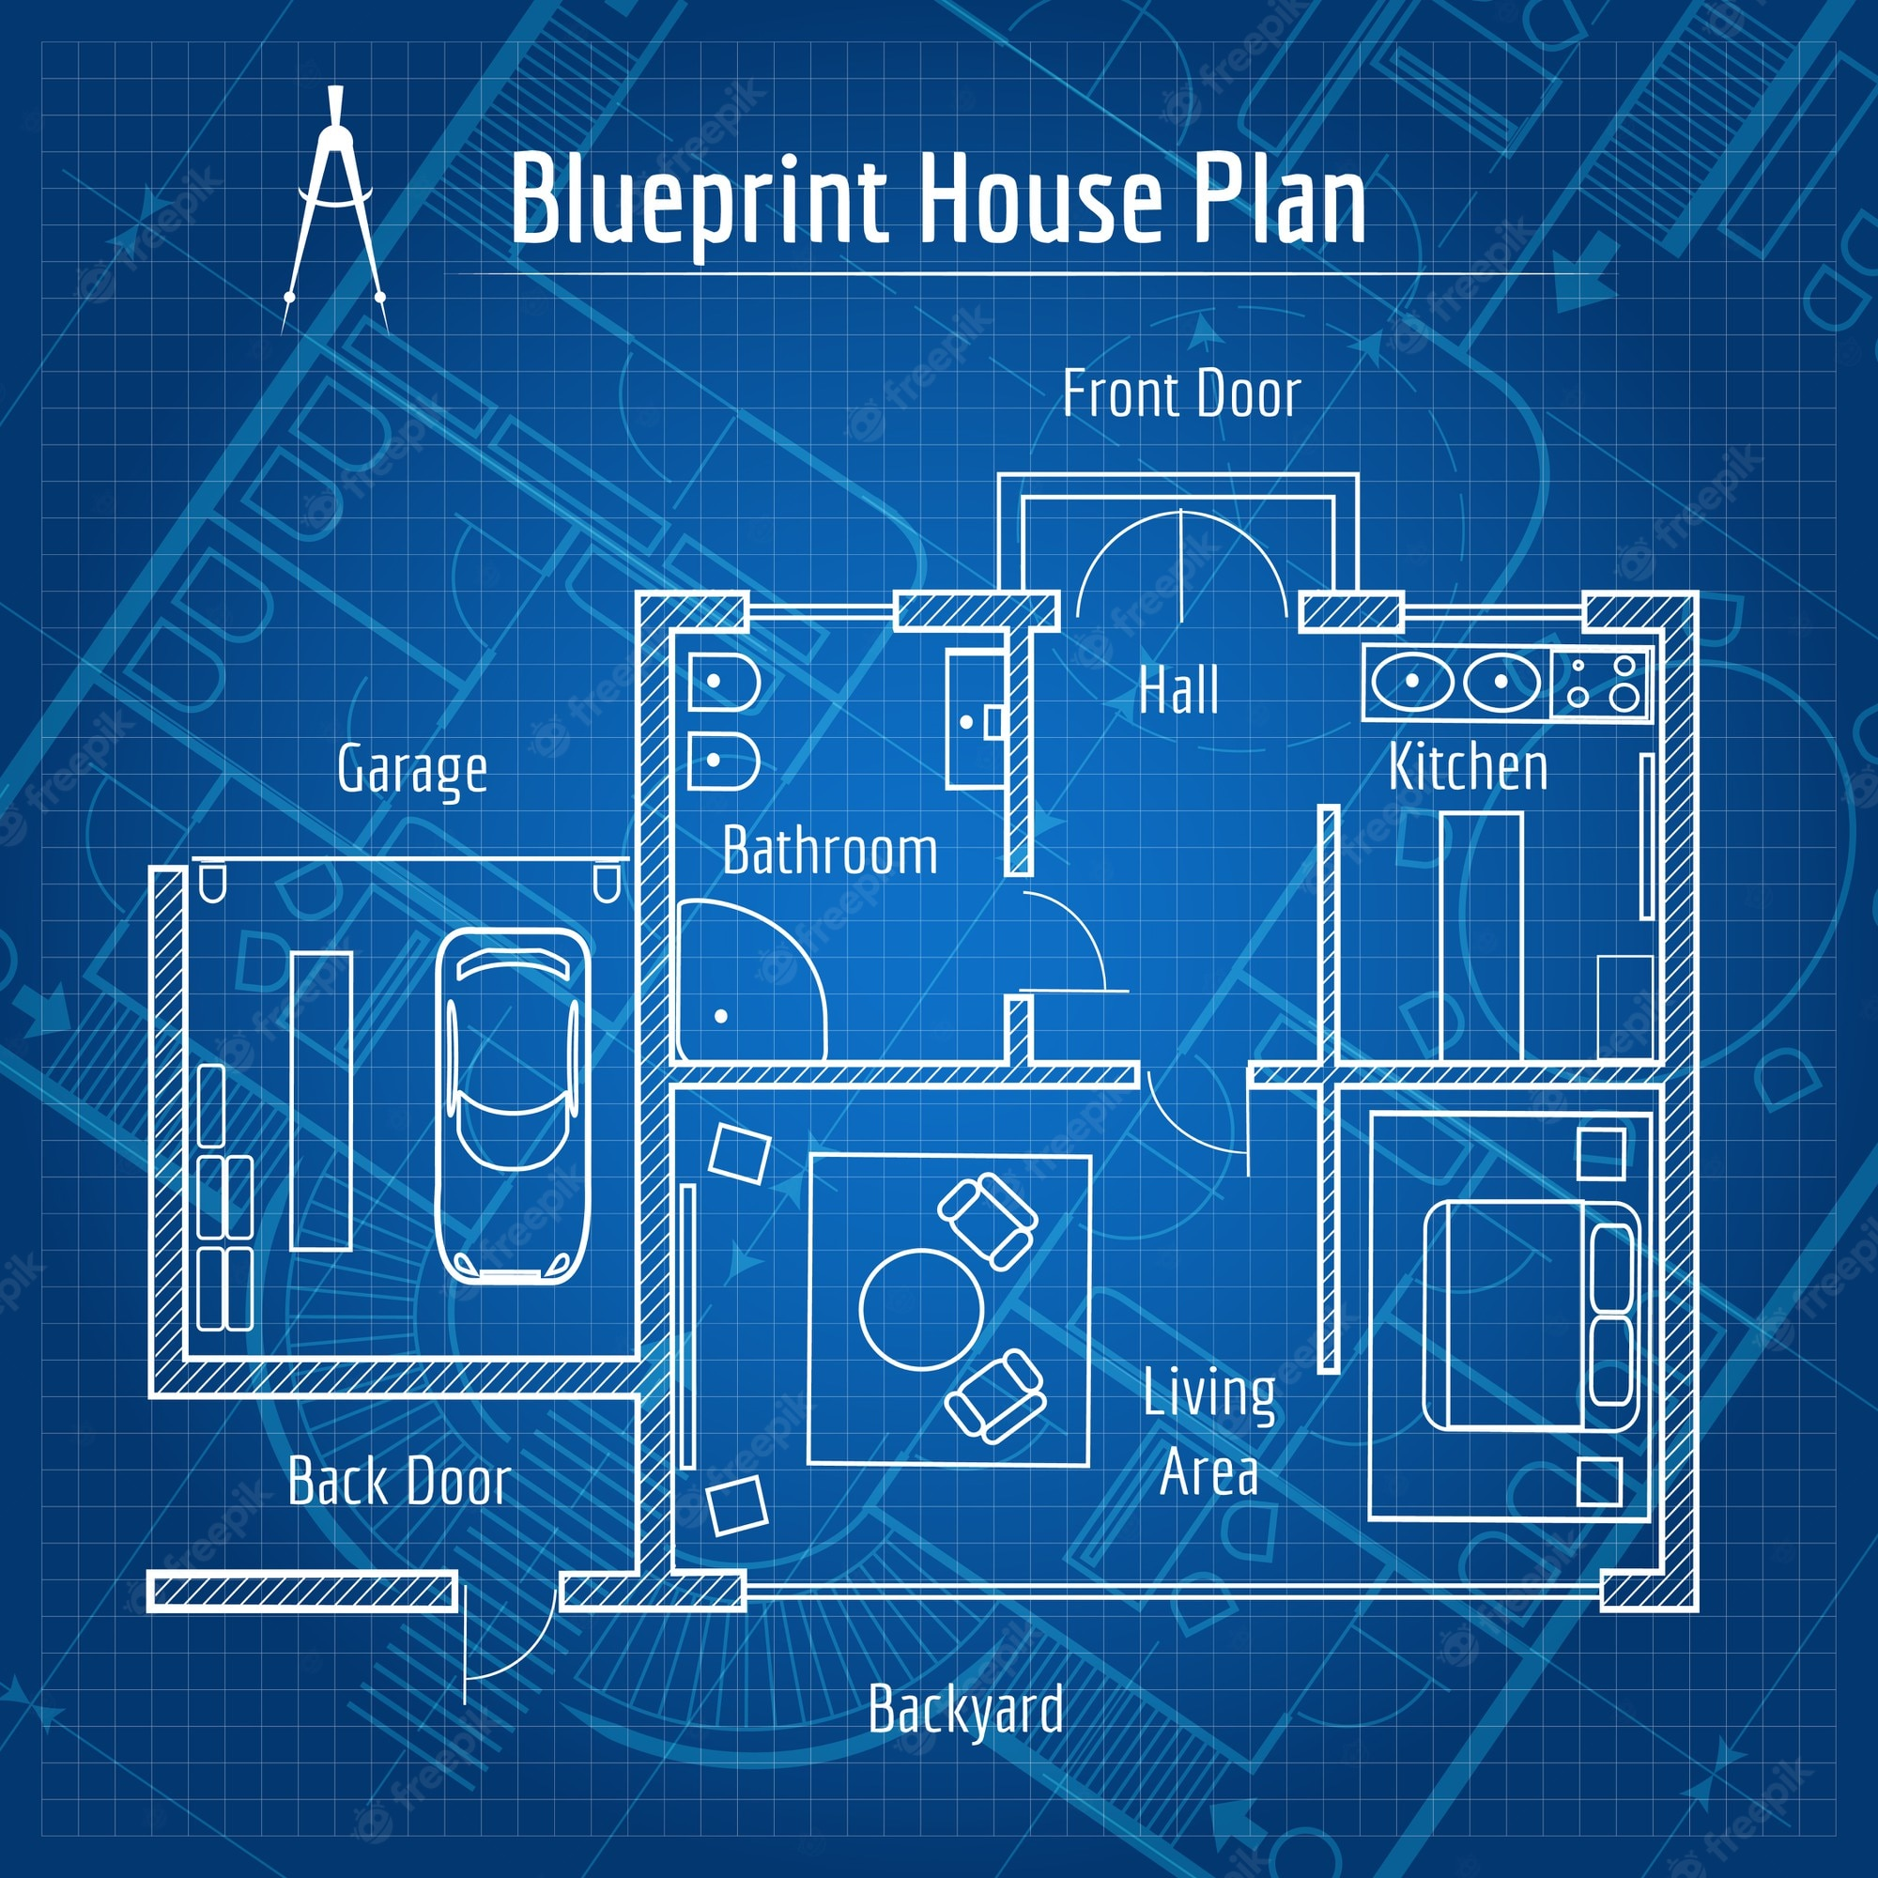
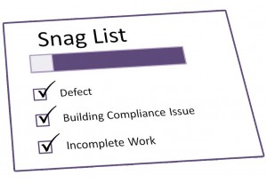
ADDIE Model
To Design, Develop, and Evaluate Quality Blended Learning

Slide 5
ADDIE Model
The ADDIE model is used by instructional designers and training developers. It is composed of five phases:
Analysis,
Design,
Development,
Implementation, and
Evaluation
To Design, Develop, and Evaluate Quality Blended Learning

Slide 6
ADDIE Model
This represents a dynamic, flexible model for building effective training and performance support tools.
This model attempts to save time by catching problems while they are still easy to fix.
To Design, Develop, and Evaluate Quality Blended Learning

Slide 7
ADDIE Model
In the Analysis stage we want to find out:
Who are the learners or audience? (Audience analysis)
What is the goal or intended outcome? (Goal analysis)
To Design, Develop, and Evaluate Quality Blended Learning

Slide 8
ADDIE Model
In the Design stage we are exploring:
The content of the course (Subject matter analysis)
The steps of instruction (Lesson planning-writing objectives)
The type of media or presentation mode (Media selection)
To Design, Develop, and Evaluate Quality Blended Learning

Slide 9
ADDIE Model
In the Development stage we are:
Generating lesson plans (this is different from the lesson planning done in the Design phase) and lesson materials.
Completing all media and materials for instruction, as well as completing all of the supporting documents.
The end-result is a course or workshop ready for delivery.
To Design, Develop, and Evaluate Quality Blended Learning

Slide 10
ADDIE Model
In the Implementation stage we are:
Delivering of the instruction.
Aiming for effective and efficient delivery of instruction.
Promoting students’ understanding of materials and objectives, as well as ensuring a transfer of knowledge.
To Design, Develop, and Evaluate Quality Blended Learning

Slide 11
ADDIE Model
In the Evaluation stage we are:
Undertaking two related evaluations:
Formative Evaluation
Summative Evaluation
To Design, Develop, and Evaluate Quality Blended Learning

Slide 12
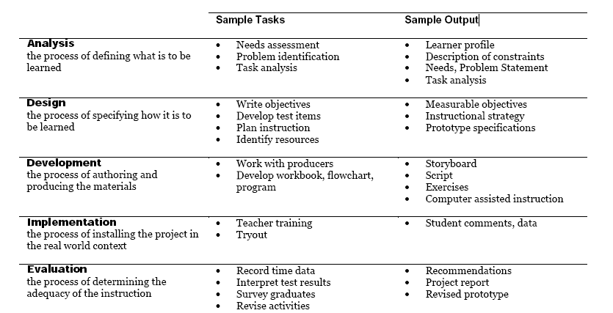

Slide 13
Instructional Design
We have created an instructional design model especially for blended learning, and it is as follows:
To Design, Develop, and Evaluate Quality Blended Learning

Slide 14
Discover
Define
Develop
Deliver
Decide
BL-5D
To Design, Develop, and Evaluate Quality Blended Learning

Slide 15
Discover (Analysis) Phase
What new blended activities are you thinking of doing?
How will this benefit/impact the students?
Will the students need to learn any new skills?
Will you need to learn any new skills?
Will there be a change in the balance of classroom/computer activity?
To Design, Develop, and Evaluate Quality Blended Learning

Slide 16
Define (Design) Phase – 1 of 2
Will this new approach mean that some of the learning outcomes might be addressed in new ways?
Will this impact how the module is assessed (New Assessments or Exams?)?
What new eLearning techniques will you consider (e.g. videos, audios, quizzes, interactive documents, games, interactive presentations, searching activities, forums, Mind Maps, peer evaluation)?
To Design, Develop, and Evaluate Quality Blended Learning

Slide 17
Define (Design) Phase – 2 of 2
What new classroom techniques will you consider (e.g. peer evaluation, debates, role playing, problem solving, case studies, reflection activities, active learning techniques)?
Will the addition of technology be:
>>> Substitution (a direct substitute, with no functional change)
>>> Augmentation (a direct substitute, with some functional change)
>>> Modification (significant task redesign)
>>> Redefinition (the creation of new tasks previously impossible)
To Design, Develop, and Evaluate Quality Blended Learning

Slide 18
Develop (Development) Phase – 1 of 2
How might this impact how you teach the students?
How might it impact how you communicate with the students?
What technology skills might you have to learn (e.g. video editing, audio editing, game design, interactivity design, accessibility design, quiz development, digital badges, assessment tools, blogs, wikis, simulations, social media tools, forums)?
To Design, Develop, and Evaluate Quality Blended Learning

Slide 19
Develop (Development) Phase – 2 of 2
What new teaching approaches might you try out?
How will you deliver this content, e.g. in a VLE, on a website, on a USB, in the classroom?
How will you evaluate the changes?
To Design, Develop, and Evaluate Quality Blended Learning

Slide 20
Deliver (Implement) Phase – 1 of 2
Consider these questions BEFORE the lesson:
What are the key points of the lesson?
How was this lesson taught previously?
What changes are you planning to make?
Consider these questions AFTER the lesson:
What went well?
What went badly?
What surprised me?
To Design, Develop, and Evaluate Quality Blended Learning

Slide 21
Decide (Evaluation) Phase
What was it like before the changes?
What was it like during the changes?
What is it like after the changes?
What were the key issues raised?
What are the key conclusions?
What will be done differently the next time?
To Design, Develop, and Evaluate Quality Blended Learning

