Slide 1
Blended Learning International Train the Train (BLITT)
Piloting the Six Activities
Damian Gordon
Lecturer in Computer Science
To Design, Develop, and Evaluate Quality Blended Learning

Slide 2
Quality Blended Learning
We’ll remember that
the workbook has six
kinds of Activities:
To Design, Develop, and Evaluate Quality Blended Learning

Slide 3
Quality Blended Learning
Presentations
Podcasts
Videos
Documents
Games
Searching
To Design, Develop, and Evaluate Quality Blended Learning

Slide 4
Quality Blended Learning
You can do these (or get your students):
Presentations, and Prezi (and PPT morph)
Podcasts, and soundscapes
Videos, and subtitles (interactive and accessible)
Documents (interactive and accessible)
Games, and gamification
Searching, and WebQuests
To Design, Develop, and Evaluate Quality Blended Learning

Slide 5
Quality Blended Learning
In Chapter 2 we present
simple piloting activities
for each of these:
To Design, Develop, and Evaluate Quality Blended Learning

Slide 6
Presentations
A simple way of making presentations more interesting is to add audio to them.
So the important thing to do is to write a simple script first to know exactly what you are going to say.
Adding audio in Powerpoint is easy, you do it like this:
Insert > Media > Audio > Record Media
To Design, Develop, and Evaluate Quality Blended Learning

Slide 7
Podcasts
We know students always have their phones with them, so let’s try to leverage that.
So the important thing to do is to write a simple script first to know exactly what you are going to say.
You can use your phone or laptop to record this podcast, or try something like Audacity (https://www.audacityteam.org/)
To Design, Develop, and Evaluate Quality Blended Learning

Slide 8
Videos
Creating short videos are easy to do with your phone.
So the important thing to do is to write a simple script first to know exactly what you are going to say, the average rate of speak is about 75-100 words a minute in videos.
Imagine there’s a student right behind the camera, and speak to them. Tape the script behind the camera.
Try something like Bandicam (https://www.bandicam.com/)
To Design, Develop, and Evaluate Quality Blended Learning

Slide 9
Documents
Consider creating a Glossary for one of your classes.
After each lesson take a note 4 or 5 key terms that are really important for that topic.
Write a one sentence definition for each of the terms.
At the end of the semester you should have 50-60 definitions and it’ll be a great revision tool for the exams.
http://www.damiantgordon.com/BLITT/Bridge/Week2/Glossary-for-UDL.pdf
To Design, Develop, and Evaluate Quality Blended Learning

Slide 10
Games
Some simple games that focus on terminology about the topic you are teaching include crosswords and quizzes.
For the crossword activity, go online and locate a free crossword generator, for example, the following:
https://crosswordhobbyist.com
http://www.eclipsecrossword.com
For the quiz activity, go online and locate a free quiz generator, for example, the following:
https://hotpot.uvic.ca/wintutor6/tutorial.htm
https://www.quiz-maker.com
https://quizlet.com/en-gb
To Design, Develop, and Evaluate Quality Blended Learning

Slide 11
Searching
Develop a series of questions for the learners to teach them how to use a search engine, for example:
What is Dihydrogen Monoxide? (It is water.)
Find out how many miles we are away for Bohola, Mayo, Ireland.( Depends on where you are.)
What is a European storm petrel? (It is a seabird.)
What is the deepest part of the ocean? (It is the Challenger Deep in the Mariana Trench.)
How high is the highest mountain on Earth? (Mount Everest, 8848m.)
Look for the phrase “Evaluation Criteria” in three different search engines, are the first 10 pages returned the same in all three engines? (Very unlikely.)
What was the first search engine online? (The Archie search engine.)
Find the meaning of word “requisition”. (A thorough search)
Find a web page that contains the exact phrase: learning outcome. (enter “learning outcome” in your favourite search engine.)
Find a web page that contains the word “learning” but NOT the word “teaching”. (Search for “learning – [minus] teaching”)
To Design, Develop, and Evaluate Quality Blended Learning

Slide 13
Blended Learning International Train the Train (BLITT)
Blended Learning Methodology
Damian Gordon
Lecturer in Computer Science
To Design, Develop, and Evaluate Quality Blended Learning

Slide 14
Instructional Design
Instructional Design is a way for teachers to create educational content that maximises the effectiveness, efficiency and appeal of instruction and other learning experiences.
There are many models to help do this, the most common one is called ADDIE.
To Design, Develop, and Evaluate Quality Blended Learning

Slide 15
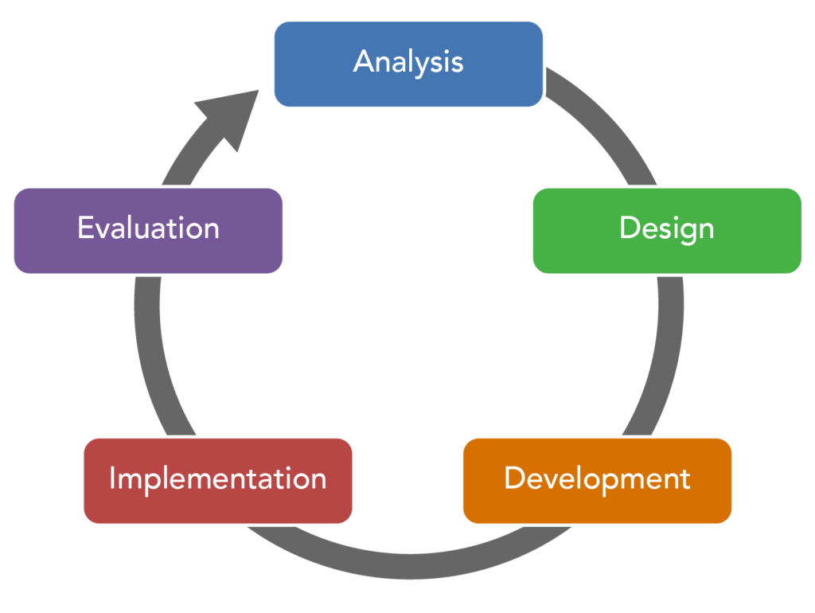
ADDIE Model
To Design, Develop, and Evaluate Quality Blended Learning

Slide 16
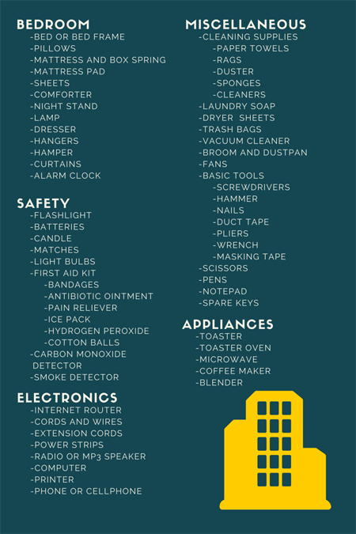
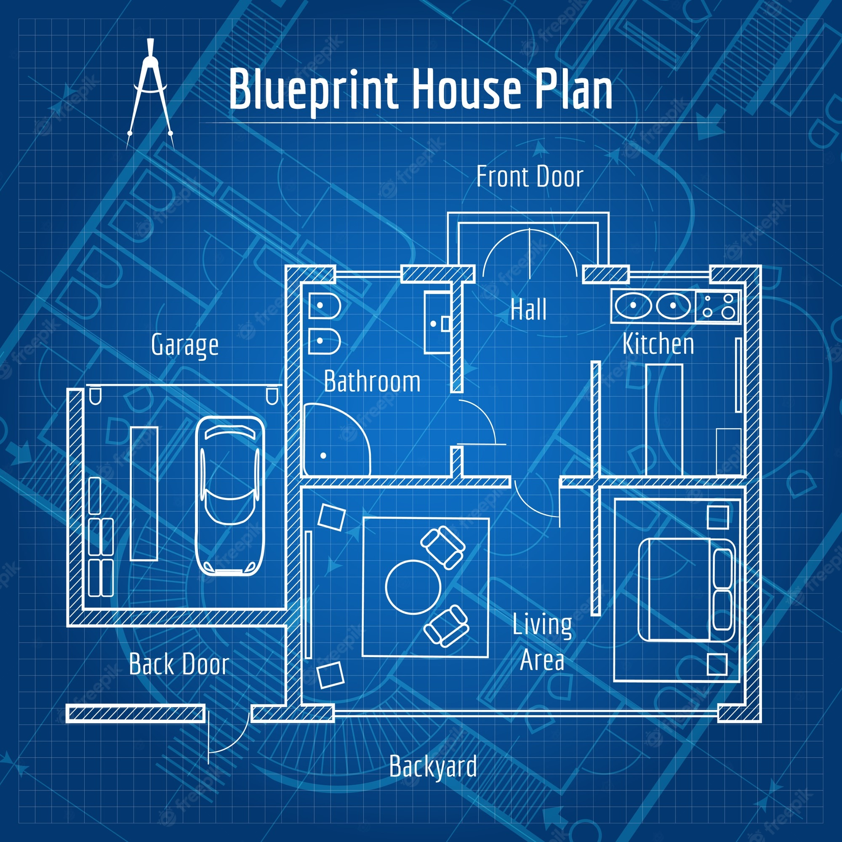
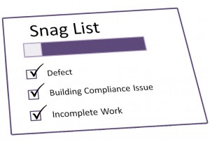
ADDIE Model
To Design, Develop, and Evaluate Quality Blended Learning

Slide 17
ADDIE Model
The ADDIE model is used by instructional designers and training developers. It is composed of five phases:
Analysis,
Design,
Development,
Implementation, and
Evaluation
To Design, Develop, and Evaluate Quality Blended Learning

Slide 18
ADDIE Model
This represents a dynamic, flexible model for building effective training and performance support tools.
This model attempts to save time by catching problems while they are still easy to fix.
To Design, Develop, and Evaluate Quality Blended Learning

Slide 19
ADDIE Model
In the Analysis stage we want to find out:
Who are the learners or audience? (Audience analysis)
What is the goal or intended outcome? (Goal analysis)
To Design, Develop, and Evaluate Quality Blended Learning

Slide 20
ADDIE Model
In the Design stage we are exploring:
The content of the course (Subject matter analysis)
The steps of instruction (Lesson planning-writing objectives)
The type of media or presentation mode (Media selection)
To Design, Develop, and Evaluate Quality Blended Learning

Slide 21
ADDIE Model
In the Development stage we are:
Generating lesson plans (this is different from the lesson planning done in the Design phase) and lesson materials.
Completing all media and materials for instruction, as well as completing all of the supporting documents.
The end-result is a course or workshop ready for delivery.
To Design, Develop, and Evaluate Quality Blended Learning

Slide 22
ADDIE Model
In the Implementation stage we are:
Delivering of the instruction.
Aiming for effective and efficient delivery of instruction.
Promoting students’ understanding of materials and objectives, as well as ensuring a transfer of knowledge.
To Design, Develop, and Evaluate Quality Blended Learning

Slide 23
ADDIE Model
In the Evaluation stage we are:
Undertaking two related evaluations:
Formative Evaluation
Summative Evaluation
To Design, Develop, and Evaluate Quality Blended Learning

Slide 24
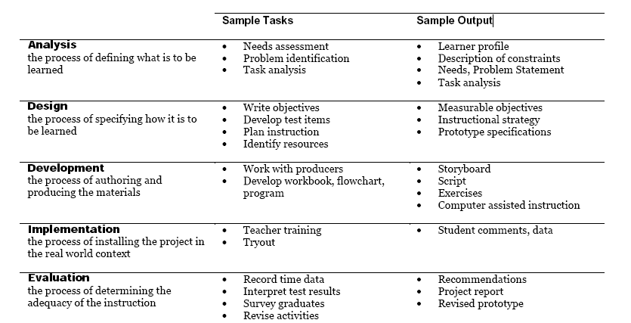

Slide 25
Instructional Design
We have created an instructional design model especially for blended learning, and it is as follows:
To Design, Develop, and Evaluate Quality Blended Learning

Slide 26
Discover
Define
Develop
Deliver
Decide
BL-5D
To Design, Develop, and Evaluate Quality Blended Learning

Slide 27
Discover (Analysis) Phase
What new blended activities are you thinking of doing?
How will this benefit/impact the students?
Will the students need to learn any new skills?
Will you need to learn any new skills?
Will there be a change in the balance of classroom/computer activity?
To Design, Develop, and Evaluate Quality Blended Learning

Slide 28
Define (Design) Phase – 1 of 2
Will this new approach mean that some of the learning outcomes might be addressed in new ways?
Will this impact how the module is assessed (New Assessments or Exams?)?
What new eLearning techniques will you consider (e.g. videos, audios, quizzes, interactive documents, games, interactive presentations, searching activities, forums, Mind Maps, peer evaluation)?
To Design, Develop, and Evaluate Quality Blended Learning

Slide 29
Define (Design) Phase – 2 of 2
What new classroom techniques will you consider (e.g. peer evaluation, debates, role playing, problem solving, case studies, reflection activities, active learning techniques)?
Will the addition of technology be:
>>> Substitution (a direct substitute, with no functional change)
>>> Augmentation (a direct substitute, with some functional change)
>>> Modification (significant task redesign)
>>> Redefinition (the creation of new tasks previously impossible)
To Design, Develop, and Evaluate Quality Blended Learning

Slide 30
Develop (Development) Phase – 1 of 2
How might this impact how you teach the students?
How might it impact how you communicate with the students?
What technology skills might you have to learn (e.g. video editing, audio editing, game design, interactivity design, accessibility design, quiz development, digital badges, assessment tools, blogs, wikis, simulations, social media tools, forums)?
To Design, Develop, and Evaluate Quality Blended Learning

Slide 31
Develop (Development) Phase – 2 of 2
What new teaching approaches might you try out?
How will you deliver this content, e.g. in a VLE, on a website, on a USB, in the classroom?
How will you evaluate the changes?
To Design, Develop, and Evaluate Quality Blended Learning

Slide 32
Deliver (Implement) Phase – 1 of 2
Consider these questions BEFORE the lesson:
What are the key points of the lesson?
How was this lesson taught previously?
What changes are you planning to make?
Consider these questions AFTER the lesson:
What went well?
What went badly?
What surprised me?
To Design, Develop, and Evaluate Quality Blended Learning

Slide 33
Decide (Evaluation) Phase
What was it like before the changes?
What was it like during the changes?
What is it like after the changes?
What were the key issues raised?
What are the key conclusions?
What will be done differently the next time?
To Design, Develop, and Evaluate Quality Blended Learning

Slide 35
Blended Learning International Train the Train (BLITT)
Writing Learning Outcomes
Damian Gordon
To Design, Develop, and Evaluate Quality Blended Learning

Slide 36
Learning Outcomes
We know what these are:
To Design, Develop, and Evaluate Quality Blended Learning

Slide 37
Learning Outcomes
On successful completion of this module the learner will be able to:
1. Demonstrate a clear understanding of the principles of blended learning, and how they relate to a variety of technology-related situations.
2. Critically assess and evaluate existing blended learning case studies.
3. Select and evaluate the use of different technological solutions for a specific blended context.
4. Compare and contrast traditional teaching approaches to blended approaches.
To Design, Develop, and Evaluate Quality Blended Learning

Slide 38
Learning Outcomes
How to write Learning outcomes:
We typically write 3-7 learning outcomes
We begin with a verb (one of Bloom’s)
Limit the length of each learning outcome to about 400 characters
Exclude special characters (e.g., accents, umlats, ampersands, etc.)
Exclude special formatting (e.g., dashes, numbering, etc.)
To Design, Develop, and Evaluate Quality Blended Learning

Slide 39
Benjamin S. Bloom
Born: Feb 21, 1913
Died: Sept 13, 1999
Born in Lansford, Pennsylvania.
Educational psychologist
Editor of “Taxonomy of Educational Objectives, Handbook 1: Cognitive Domain” (1956)

Slide 40
Bloom’s Taxonomy
In 1956 Bloom helped developed a taxonomy of cognitive objectives in “Taxonomy of Educational Objectives, Handbook 1”
As a means of expressing qualitatively different kinds of thinking
To Design, Develop, and Evaluate Quality Blended Learning

Slide 41
Bloom’s Taxonomy
It’s been adapted for classroom use as a planning tool and is one of the most universally applied models
Provides a way of organizing thinking skills into six levels, from basic to the more complex levels of thinking
To Design, Develop, and Evaluate Quality Blended Learning

Slide 42
Bloom’s Taxonomy
Evaluation
Synthesis
Analysis
Application
Comprehension
Knowledge
Higher-order thinking
To Design, Develop, and Evaluate Quality Blended Learning

Slide 43
Bloom’s Taxonomy
Evaluation: compare and discriminate between ideas, assess value of theories, presentations make choices based on reasoned argument, verify value of evidence, recognize subjectivity
To Design, Develop, and Evaluate Quality Blended Learning

Slide 44
Bloom’s Taxonomy
Synthesis: use old ideas to create new ones, generalize from given facts, relate knowledge from several areas, predict, draw conclusions
To Design, Develop, and Evaluate Quality Blended Learning

Slide 45
Bloom’s Taxonomy
Analysis: seeing patterns, organization of parts, recognition of hidden meanings, identification of components
To Design, Develop, and Evaluate Quality Blended Learning

Slide 46
Bloom’s Taxonomy
Application: use information use methods, concepts, theories in new situations, solve problems using required skills or knowledge
To Design, Develop, and Evaluate Quality Blended Learning

Slide 47
Bloom’s Taxonomy
Comprehension: understanding information, grasp meaning, translate knowledge into new context
To Design, Develop, and Evaluate Quality Blended Learning

Slide 48
Bloom’s Taxonomy
Knowledge: observation and recall of information, knowledge of dates, events, places knowledge of major ideas
To Design, Develop, and Evaluate Quality Blended Learning

Slide 49
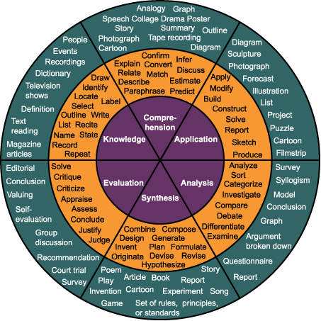
Bloom’s Taxonomy
To Design, Develop, and Evaluate Quality Blended Learning

Slide 50
Bloom’s Taxonomy
Evaluation: appraise, argue, assess, attach, choose, compare, defend estimate, judge, predict, rate, score, select, support, value
To Design, Develop, and Evaluate Quality Blended Learning

Slide 51
Bloom’s Taxonomy
Synthesis: arrange, assemble, collect, compose, construct, create, design, develop, formulate, manage, organize, plan, prepare
To Design, Develop, and Evaluate Quality Blended Learning

Slide 52
Bloom’s Taxonomy
Analysis: analyze, appraise, calculate, categorize, compare, contrast, criticize, differentiate, discriminate, distinguish, examine
To Design, Develop, and Evaluate Quality Blended Learning

Slide 53
Bloom’s Taxonomy
Application: apply, choose, demonstrate, dramatize, employ, illustrate, interpret, operate, practice, schedule, sketch, solve, use
To Design, Develop, and Evaluate Quality Blended Learning

Slide 54
Bloom’s Taxonomy
Comprehension: classify, describe, discuss, explain, express, identify, indicate, locate, recognize, report, restate, review
To Design, Develop, and Evaluate Quality Blended Learning

Slide 55
Bloom’s Taxonomy
Knowledge: arrange, define, duplicate, label, list, memorize, name, order, recognize, relate, recall, repeat, reproduce, state
To Design, Develop, and Evaluate Quality Blended Learning

