Slide 1
CPD in Applied Blended Learning Technologies
Universal Design for Learning
Damian Gordon
Lecturer in Computer Science
To Design, Develop, and Evaluate Quality Blended Learning

Slide 2
UDL
The Center for Applied Special Technology (CAST) in Boston created UDL. Two of its members, Anne Meyer and David Rose, developed the principles of UDL in the late 1990s as a framework to improve and optimize teaching and learning for all people based on scientific insights into how humans learn.
To Design, Develop, and Evaluate Quality Blended Learning

Slide 3
UDL
What is a “system view”?
To Design, Develop, and Evaluate Quality Blended Learning

Slide 4
UDL
What is a “system view”?
The system is a box …
To Design, Develop, and Evaluate Quality Blended Learning

Slide 5
UDL
What is a “system view”?
The system is a box …
System
To Design, Develop, and Evaluate Quality Blended Learning

Slide 6
UDL
What is a “system view”?
The system has inputs…
System
Inputs
To Design, Develop, and Evaluate Quality Blended Learning

Slide 7
UDL
What is a “system view”?
The system has outputs…
System
Outputs
Inputs
To Design, Develop, and Evaluate Quality Blended Learning

Slide 8
UDL
What is a “system view”?
And has a number of interacting process. That convert inputs to outputs
Process 1
Process 4
Outputs
Inputs
Process 2
Process 5
Process 3
To Design, Develop, and Evaluate Quality Blended Learning

Slide 9
UDL
How does this work for a person?
To Design, Develop, and Evaluate Quality Blended Learning

Slide 10
UDL
Exactly the same way…
To Design, Develop, and Evaluate Quality Blended Learning

Slide 11
UDL
Exactly the same way…
Inputs
To Design, Develop, and Evaluate Quality Blended Learning

Slide 12
UDL
Exactly the same way…
Inputs
Perception
Sight
Hearing
Taste
Smell
Touch
To Design, Develop, and Evaluate Quality Blended Learning

Slide 13
UDL
Exactly the same way…
Inputs
Perception
Outputs
Sight
Hearing
Taste
Smell
Touch
To Design, Develop, and Evaluate Quality Blended Learning

Slide 14
UDL
Dexterity
Locomotion
Reach
Exactly the same way…
Inputs
Perception
Outputs
Actions
Sight
Hearing
Taste
Smell
Touch
To Design, Develop, and Evaluate Quality Blended Learning

Slide 15
UDL
Dexterity
Locomotion
Reach
Exactly the same way…
Interacting Processes
Inputs
Perception
Outputs
Actions
Sight
Hearing
Taste
Smell
Touch
To Design, Develop, and Evaluate Quality Blended Learning

Slide 16
UDL
Dexterity
Locomotion
Reach
Exactly the same way…
Interacting Processes
Cognition
Attention
Memory
Language
Inputs
Perception
Outputs
Actions
Sight
Hearing
Taste
Smell
Touch
To Design, Develop, and Evaluate Quality Blended Learning

Slide 17
UDL
Dexterity
Locomotion
Reach
Exactly the same way…
Interacting Processes
Cognition
Attention
Memory
Language
Inputs
Perception
Outputs
Actions
The WHAT of learning:
REPRESENTATION
Sight
Hearing
Taste
Smell
Touch
To Design, Develop, and Evaluate Quality Blended Learning

Slide 18
UDL
Dexterity
Locomotion
Reach
Exactly the same way…
Interacting Processes
Cognition
Attention
Memory
Language
Inputs
Perception
Outputs
Actions
The WHAT of learning:
REPRESENTATION
The WHY of learning:
ENGAGEMENT
Sight
Hearing
Taste
Smell
Touch
To Design, Develop, and Evaluate Quality Blended Learning

Slide 19
UDL
Dexterity
Locomotion
Reach
Exactly the same way…
Interacting Processes
Cognition
Attention
Memory
Language
Inputs
Perception
Outputs
Actions
The WHAT of learning:
REPRESENTATION
The WHY of learning:
ENGAGEMENT
The HOW of learning:
EXPRESSION
Sight
Hearing
Taste
Smell
Touch
To Design, Develop, and Evaluate Quality Blended Learning

Slide 20
UDL
The UDL Guidelines can be used by educators, curriculum developers, researchers, parents, and anyone else who wants to implement the UDL framework in a learning environment.
To Design, Develop, and Evaluate Quality Blended Learning

Slide 21
UDL
These guidelines offer a set of concrete suggestions that can be applied to any discipline or domain to ensure that all learners can access and participate in meaningful, challenging learning opportunities.
To Design, Develop, and Evaluate Quality Blended Learning

Slide 22
UDL
The full guidelines are here:
https://udlguidelines.cast.org/?utm_source=castsite&lutm_medium=web&utm_campaign=none&utm_content=aboutudl#
To Design, Develop, and Evaluate Quality Blended Learning

Slide 23
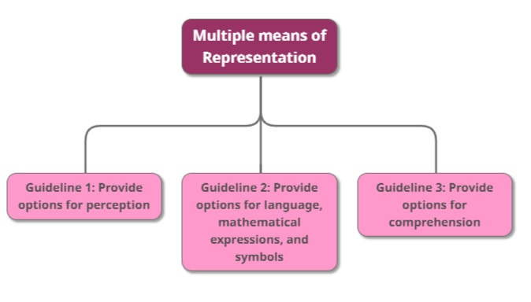
UDL
The
“WHAT”
To Design, Develop, and Evaluate Quality Blended Learning

Slide 24
UDL
Multiple means of Representation
Guideline 1: Provide options for perception
Guideline 2: Provide options for language, mathematical expressions, and symbols
Guideline 3: Provide options for comprehension
To Design, Develop, and Evaluate Quality Blended Learning

Slide 25
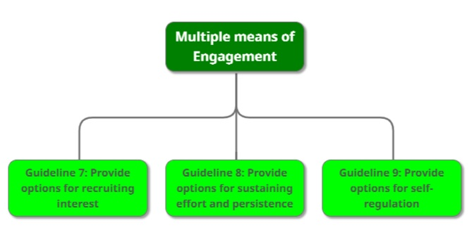
UDL
The
“WHY”
To Design, Develop, and Evaluate Quality Blended Learning

Slide 26
UDL
Multiple means of Engagement
Guideline 7: Provide options for recruiting interest
Guideline 8: Provide options for sustaining effort and persistence
Guideline 9: Provide options for self-regulation
To Design, Develop, and Evaluate Quality Blended Learning

Slide 27
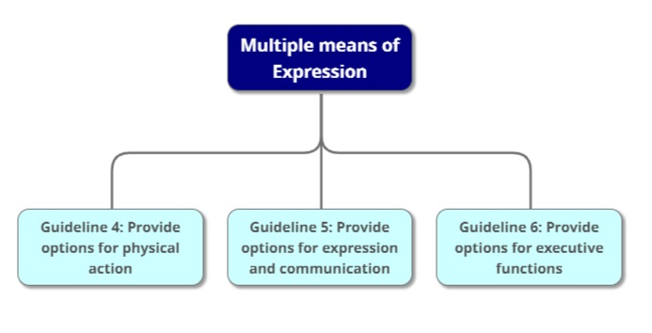
UDL
The
“HOW”
To Design, Develop, and Evaluate Quality Blended Learning

Slide 28
UDL
Multiple means of Expression
Guideline 4: Provide options for physical action
Guideline 5: Provide options for expression and communication
Guideline 6: Provide options for executive functions
To Design, Develop, and Evaluate Quality Blended Learning

Slide 29
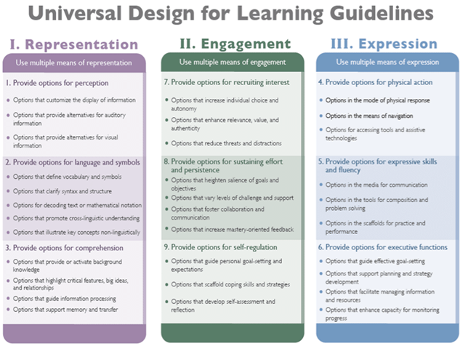

Slide 30
UDL
Multiple means of Representation
Guideline 1: Provide options for perception
Checkpoint 1.1 – Offer ways of customizing the display of information
Checkpoint 1.2 - Offer alternatives for auditory information
Checkpoint 1.3 - Offer alternatives for visual information
To Design, Develop, and Evaluate Quality Blended Learning

Slide 31
UDL
Multiple means of Representation
e.g. change the font size, type, and colour. Also change the background
e.g. change the speed of a video or an audio file
e.g. create captions, and allow text-to-speech. Consider tactile interfaces
e.g. follow accessibility standards (DAISY, NIMAS, etc.)
To Design, Develop, and Evaluate Quality Blended Learning

Slide 32
UDL
Multiple means of Representation
Guideline 2: Provide options for language, mathematical expressions, and symbols
Checkpoint 2.1 - Clarify vocabulary and symbols
Checkpoint 2.2 - Clarify syntax and structure
Checkpoint 2.3 - Support decoding of text, mathematical notation, and symbols
Checkpoint 2.4 - Promote understanding across languages
Checkpoint 2.5 - Illustrate through multiple media
To Design, Develop, and Evaluate Quality Blended Learning

Slide 33
UDL
Multiple means of Representation
e.g. pre-teach vocabulary and symbols, so that it connects to the students
e.g. make explicit links between parts of the teaching content
e.g. provide access to alternative representations of mathematical notations.
e.g. provide links to online translation tools and multilingual glossaries.
To Design, Develop, and Evaluate Quality Blended Learning

Slide 34
UDL
Multiple means of Representation
Guideline 3: Provide options for comprehension
Checkpoint 3.1 - Activate or supply background knowledge
Checkpoint 3.2 - Highlight patterns, critical features, big ideas, and relationships
Checkpoint 3.3 - Guide information processing, visualization, and manipulation
Checkpoint 3.4 - Maximize transfer and generalization
To Design, Develop, and Evaluate Quality Blended Learning

Slide 35
UDL
Multiple means of Representation
e.g. link topics to student’s previous knowledge and cross-curricular topics
e.g. to emphasize critical content, use multiple examples, and non-examples
e.g. “chunk” information into smaller elements, and memory mnemonics and tools
e.g. provide a visual organiser to show topic sequence, but give students choice of “entry-point”
To Design, Develop, and Evaluate Quality Blended Learning

Slide 36
UDL
Multiple means of Engagement
Guideline 7: Provide options for recruiting interest
Checkpoint 7.1 - Optimize individual choice and autonomy
Checkpoint 7.2 - Optimize relevance, value, and authenticity
Checkpoint 7.3 - Minimize threats and distractions
To Design, Develop, and Evaluate Quality Blended Learning

Slide 37
UDL
Multiple means of Engagement
e.g. provide students with choice in terms of challenge, rewards, timing of sub-tasks.
e.g. create activities that are personalized, relevant (culturally and socially), and ability appropriate.
e.g. create activities that foster problem solving, and encourage the use of imagination.
e.g. create a supportive and accepting classroom environment.
To Design, Develop, and Evaluate Quality Blended Learning

Slide 38
UDL
Multiple means of Engagement
Guideline 8: Provide options for sustaining effort and persistence
Checkpoint 8.1 - Heighten salience of goals and objectives
Checkpoint 8.2 - Vary demands and resources to optimize challenge
Checkpoint 8.3 - Foster collaboration and community
Checkpoint 8.4 - Increase mastery-oriented feedback
To Design, Develop, and Evaluate Quality Blended Learning

Slide 39
UDL
Multiple means of Engagement
e.g. encourage students to define and focus on goals; and explore what excellence means.
e.g. focus less on external evaluation, and focus on effort and improvement in meeting standards.
e.g. use peer-review and peer-tutoring. Create rubrics and guides for groupwork.
e.g. provide feedback that is frequent, timely, and relevant. Also that emphasises effort and improvement.
To Design, Develop, and Evaluate Quality Blended Learning

Slide 40
UDL
Multiple means of Engagement
Guideline 9: Provide options for self-regulation
Checkpoint 9.1 - Promote expectations and beliefs that optimize motivation
Checkpoint 9.2 - Facilitate personal coping skills and strategies
Checkpoint 9.3 - Develop self-assessment and reflection
To Design, Develop, and Evaluate Quality Blended Learning

Slide 41
UDL
Multiple means of Engagement
e.g. create guides and checksheets to reduce frustration, and to keep on-task in spite of distractions.
e.g. use real life examples or simulations to demonstrate coping skills.
e.g. assist students in overcoming specific topics that they have phobias about.
e.g. assist the students in identifying their personal goals, and their own strengths and weaknesses.
To Design, Develop, and Evaluate Quality Blended Learning

Slide 42
UDL
Multiple means of Expression
Guideline 4: Provide options for physical action
Checkpoint 4.1 - Vary the methods for response and navigation
Checkpoint 4.2 - Optimize access to tools and assistive technologies
To Design, Develop, and Evaluate Quality Blended Learning

Slide 43
UDL
Multiple means of Expression
e.g. provide alternative ways of accessing content, in terms of rate, timing, and motor action.
e.g. provide alternative keystrokes for mouse actions, and access to alternative keyboards
e.g. only use software that works with a range of assistive technologies.
e.g. explore the use of switch and scanning access for your content.
To Design, Develop, and Evaluate Quality Blended Learning

Slide 44
UDL
Multiple means of Expression
Guideline 5: Provide options for expression and communication
Checkpoint 5.1 - Use multiple media for communication
Checkpoint 5.2 - Use multiple tools for construction and composition
Checkpoint 5.3 - Build fluencies with graduated levels of support for practice and performance
To Design, Develop, and Evaluate Quality Blended Learning

Slide 45
UDL
Multiple means of Expression
e.g. consider using text, speech, drawing, film, music, dance, visual art, sculpture.
e.g. use social media, interactive web tools, simulations, chats, animations.
e.g. provide sample sentences, and sentence starters. Use concept mapping tools.
e.g. provide multiple model solutions to real problems, and differentiated feedback.
To Design, Develop, and Evaluate Quality Blended Learning

Slide 46
UDL
Multiple means of Expression
Guideline 6: Provide options for executive functions
Checkpoint 6.1 - Guide appropriate goal-setting
Checkpoint 6.2 - Support planning and strategy development
Checkpoint 6.3 - Facilitate managing information and resources
Checkpoint 6.4 - Enhance capacity for monitoring progress
To Design, Develop, and Evaluate Quality Blended Learning

Slide 47
UDL
Multiple means of Expression
e.g. create guides and checksheets to identify milestones, and to help estimate effort.
e.g. create guides and checksheets to embed points to reflect at, and point to show your work.
e.g. create guides and checksheets for notetaking, and categorizing.
e.g. create guides and checksheets for self-assessment, and sample rubrics.
To Design, Develop, and Evaluate Quality Blended Learning

