Slide 1
Introduction to Creative Coding
Damian Gordon

Slide 2
Overview
Creative coding is using code, algorithms and Maths in a creative and fun way to make art.

Slide 3
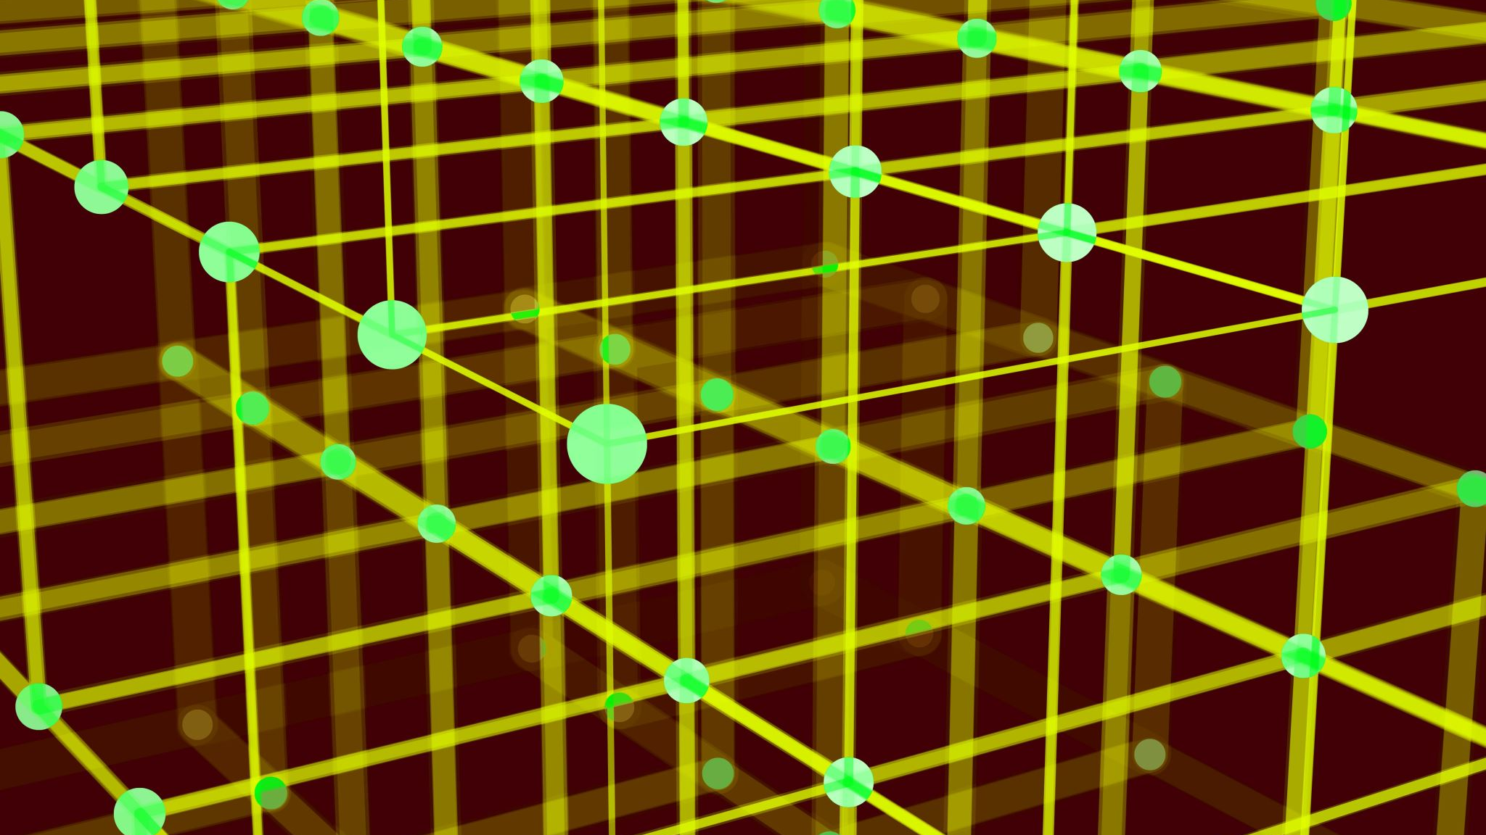
The Basics

Slide 4
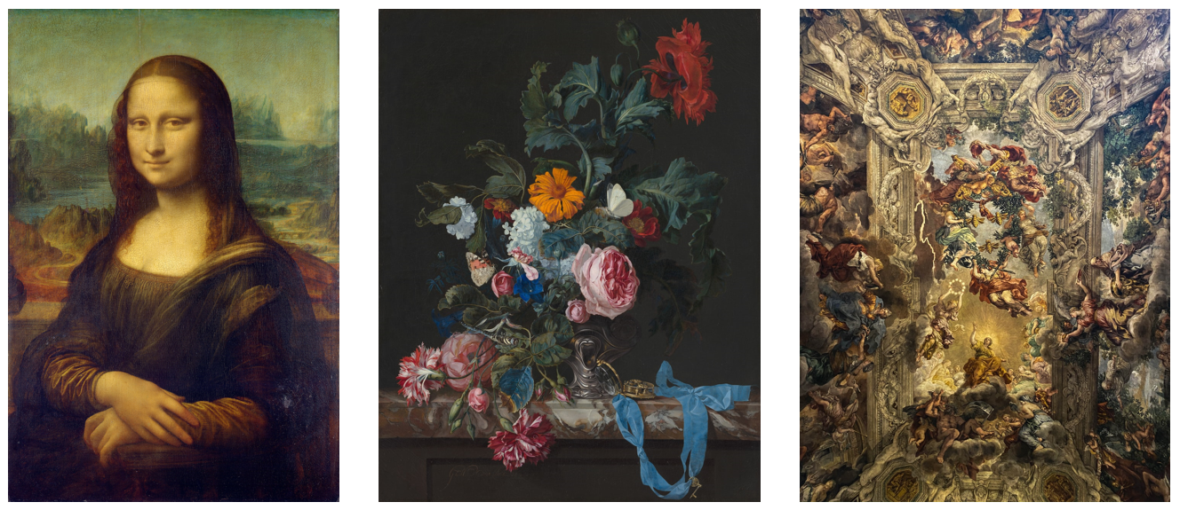
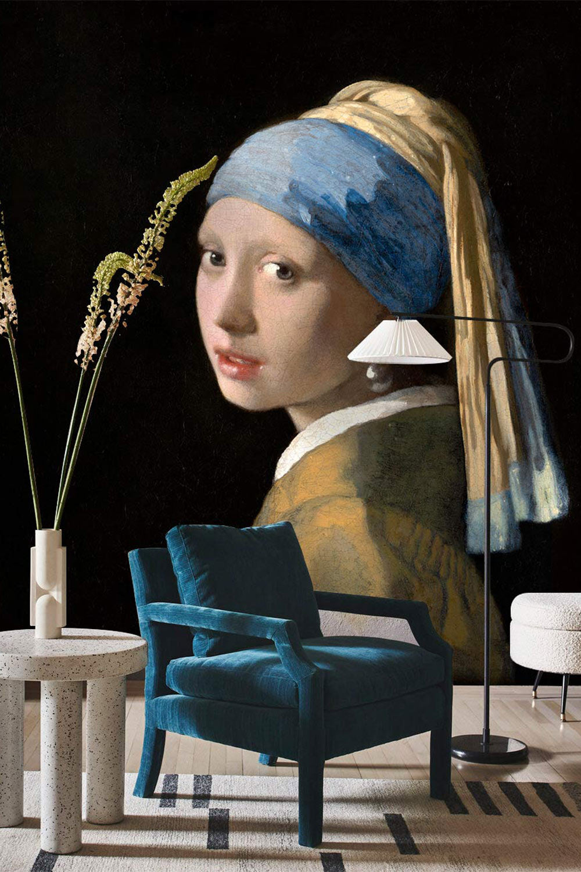
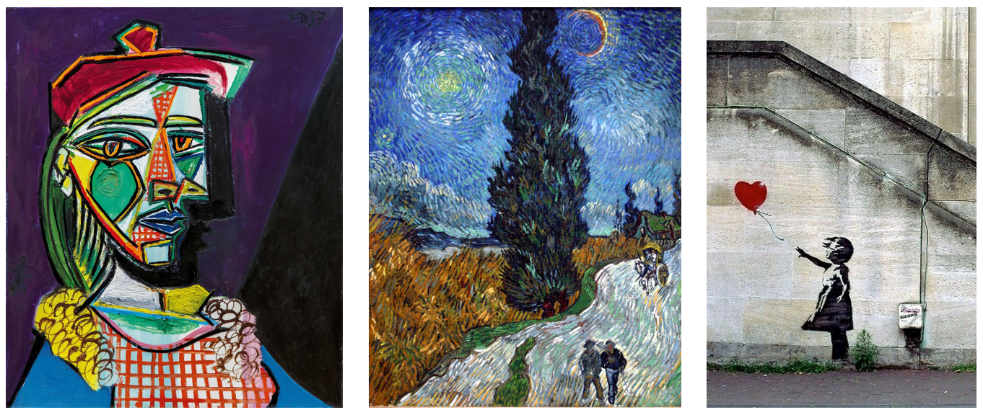
What is Art?

Slide 5
What is Art?
Art is a form of human expression that communicates ideas, emotions, and experiences through various creative mediums such as painting, music, literature, dance, film, and digital media. It is both deeply personal and culturally significant, reflecting the values, struggles, and aspirations of individuals and societies.

Slide 6
What is Art?
At its core, art involves creativity, intentionality, and interpretation. Some define it as anything that evokes an emotional or intellectual response, while others see it as a skillful or aesthetic endeavor.
Art can be representational (depicting the real world), abstract (focusing on form and emotion), or conceptual (prioritizing ideas over physical execution).

Slide 7
1st Art - Architecture
2nd Art - Sculpture
3rd Art - Painting and Drawing
4th Art - Music
5th Art - Literature and Poetry
6th Art - Dance, Mime, theatre, opera & circus
7th Art - Cinema
8th Art - Radio, TV, and photography
9th Art - Comics
10th Art - Video games and digital Art
The 10 Arts

Slide 8
What is Creative Coding?

Slide 9
Creative Coding
Key areas: Generative art, data visualization, interactive media, algorithmic design, digital storytelling, algorithmic creativity and emergent behavior
Differences from traditional coding: Emphasizing experimentation, aesthetics, and exploration rather than efficiency or optimization.

Slide 10
Tools and Programming Languages
Python with Turtle / Pygame / Generative Libraries (for drawing, AI-based art, or music).
p5.js (JavaScript-based, beginner-friendly for visuals and interaction).
Processing (Java-based, widely used in creative coding).
TouchDesigner, Max/MSP, OpenFrameworks (for more advanced projects).

Slide 11
Example Applications
Generative posters and abstract art.
Interactive data visualizations.
Music visualization and sound-reactive visuals.
Algorithmic poetry and text generation.
Game-like simulations and interactive storytelling.

Slide 12
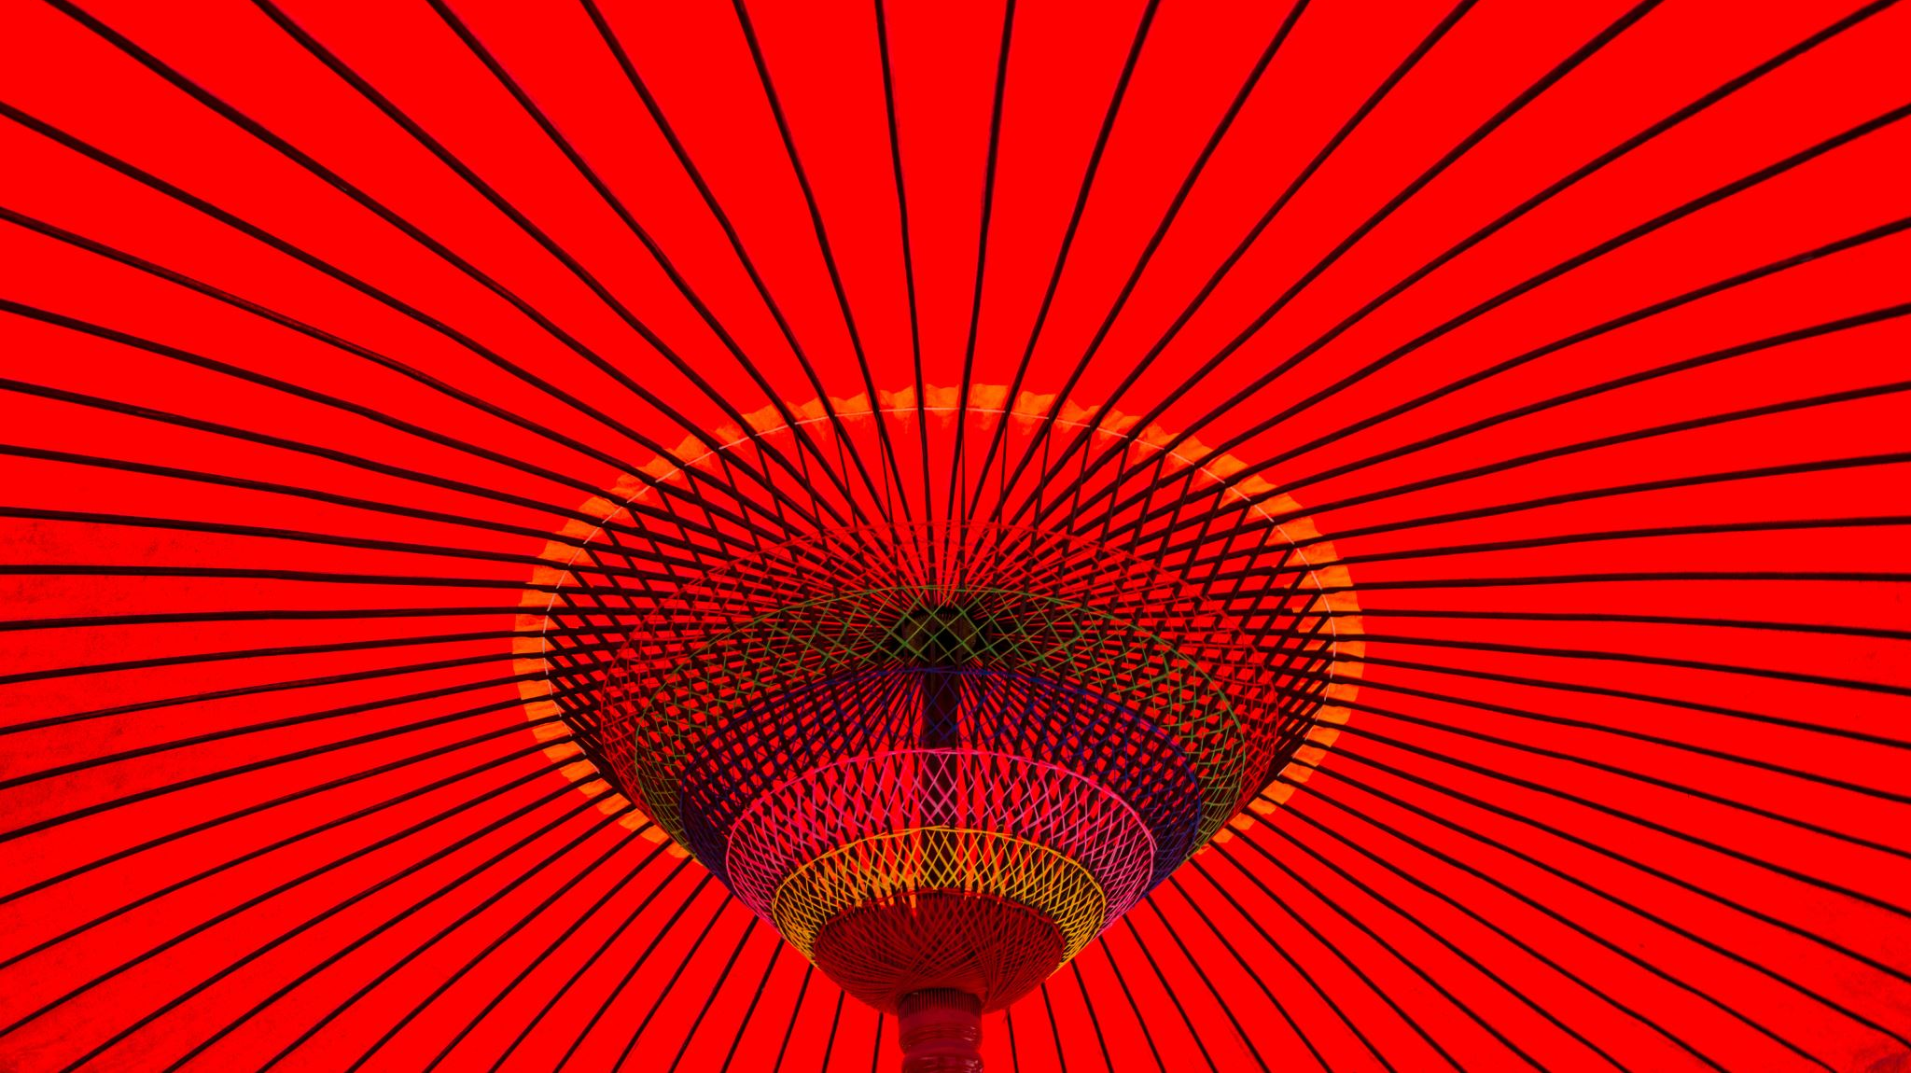
Images

Slide 13
Contents
Drawing functions – co-ordinates, line, ellipse, point, rect, triangle, RGB & HSB colors, animation, setup & draw functions, using the mouse.
Variables & operations, moving objects around the screen, drawing patterns using variables & operations
Trigonometry & the unit circle, drawing spirals

Slide 14
Contents
Conditions & Boolean operations. Inside & outside of boxes and circles
Drawing with loops. Patterns in shapes and colors
Arrays, min, max, average, iteration and graphing data
Loading CSV files, using an ArrayList

Slide 15
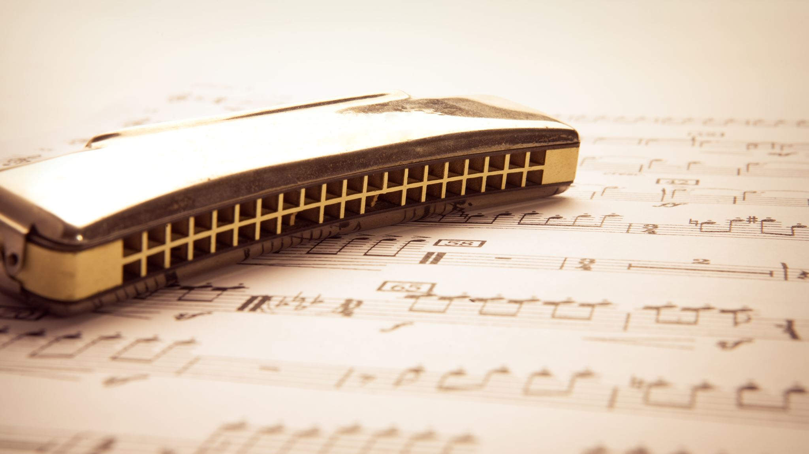
Audio

Slide 16
Contents
Audio, time domain, frequency domain, average amplitude. Mapping audio to colors and shapes.

Slide 17
Video

Slide 18
Contents
Particle Systems – Classes, snow, fireworks
Cellular automata. The Game of Life

Slide 19
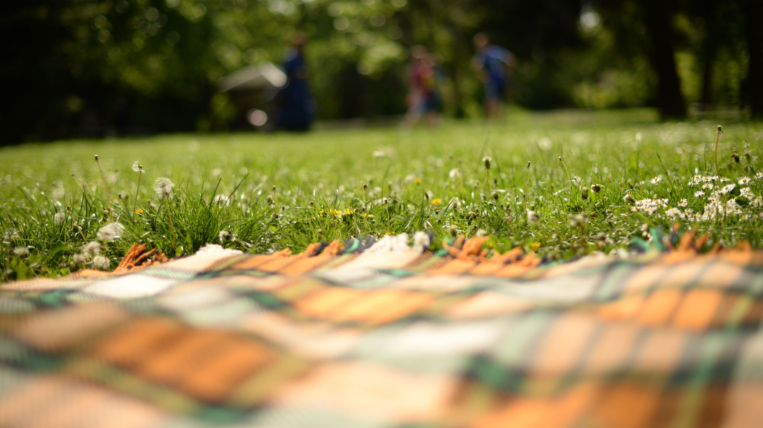
Aesthetics

Slide 20
Aesthetics
Aesthetics is concerned with the nature of beauty, art, and taste.
It explores how people perceive, experience, and evaluate visual, auditory, and conceptual elements in the world around them.
Aesthetics is not just about what is "beautiful" but also about how things evoke emotions, meanings, and cultural significance.

Slide 21
Aesthetics
a
b
c
Let’s look at the Golden Ratio:
It is also called phi or Φ, and arises when a line is divided into two parts such that the ratio of the whole line to the longer segment is the same as the ratio of the longer segment to the shorter segment.

Slide 22
Aesthetics
a
b
c

Slide 23
Aesthetics
c

Slide 24
Aesthetics
c
a

Slide 25
Aesthetics
c
a
b

Slide 26
Aesthetics
c
a
a
b

Slide 27
Aesthetics
c
a
So, the ratio:
C/A = A/B
a
b

Slide 28
Aesthetics
a
b
c
And the Golden Ratio is:
1.6180339887…
For simplicity let’s call it:
1.618

Slide 29
Aesthetics
So, the ratios:
C/A = A/B
c
a
b

Slide 30
Aesthetics
So, the ratios:
1.618/1 = 1/0.618
1.618
1
0.618

Slide 31
Aesthetics

Slide 32
Aesthetics
If we make this a square…

Slide 33
Aesthetics
If we make this a square…
And make this a rectangle

Slide 34
Aesthetics
This rectangle
has the
Golden Ratio

Slide 35
Aesthetics
And if we take
a square
out of this

Slide 36
Aesthetics
We get another
Golden
Ratio

Slide 37
Aesthetics

Slide 38
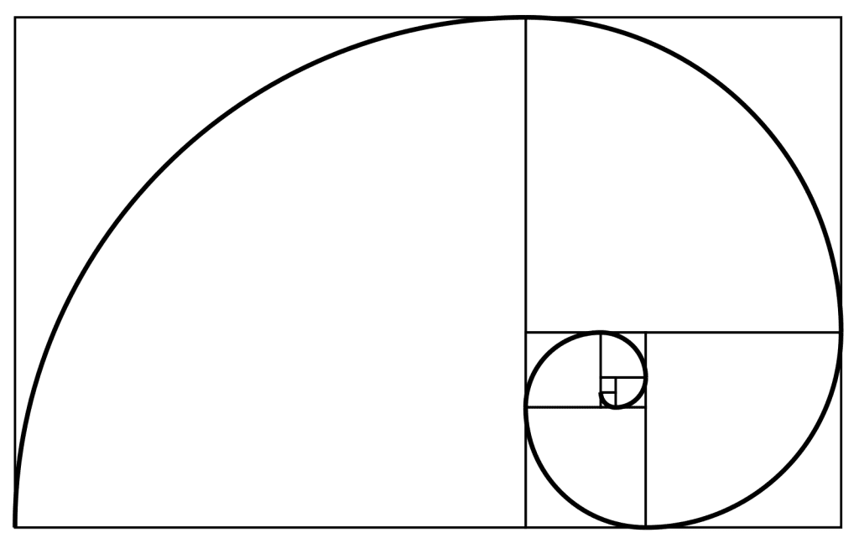
Aesthetics

Slide 39
Aesthetics
The Golden Spiral

Slide 40
Aesthetics
The Golden Ratio is also called phi or Φ, and represents an aesthetically pleasing proportion.
The Golden Ratio is everywhere >>>>>>>>

Slide 41
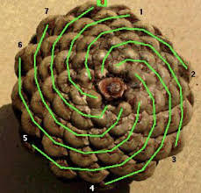
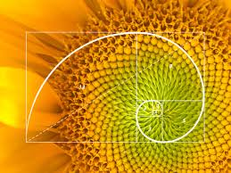
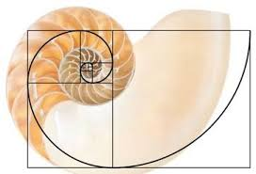
Nature: sunflower spirals, pinecones, nautilus shells

Slide 42
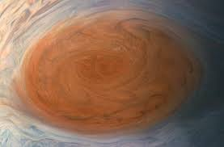
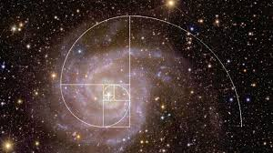
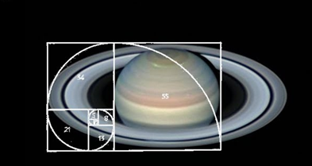
Cosmically: spiral galaxies, Jupiter’s Great Red Spot, Saturn’s Rings

Slide 43
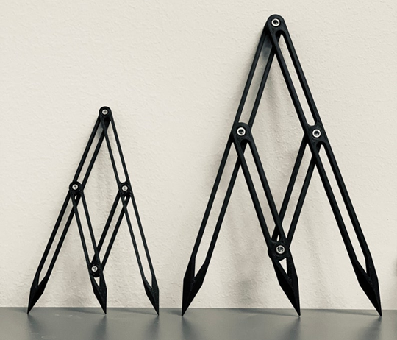
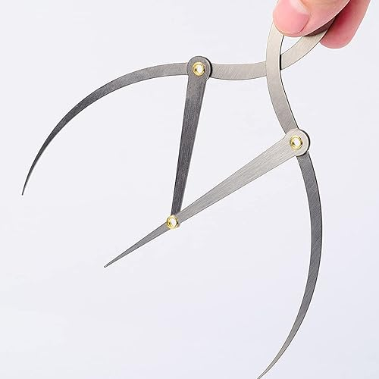
Aesthetics
Artists and Architectures are well aware of the Golden Ratio for hundreds of years, and have developed tools to help them:

Slide 44
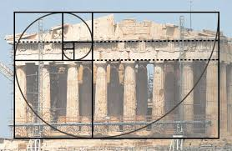
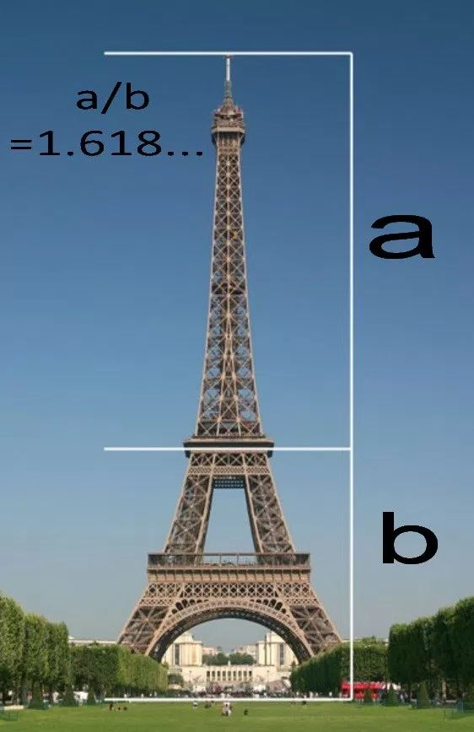
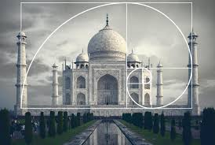

Slide 45
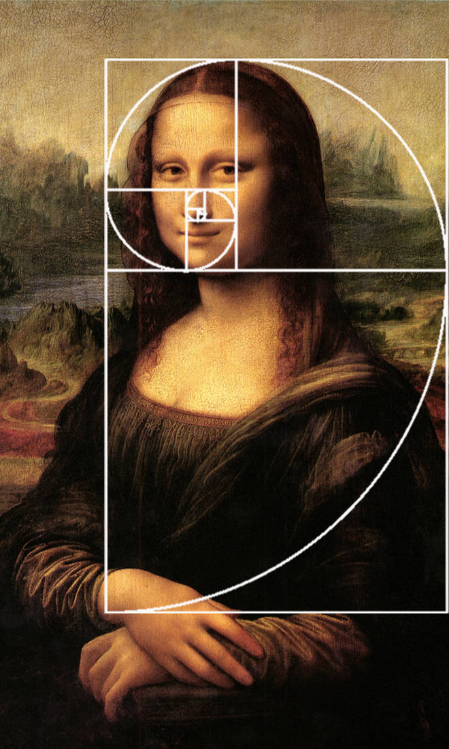
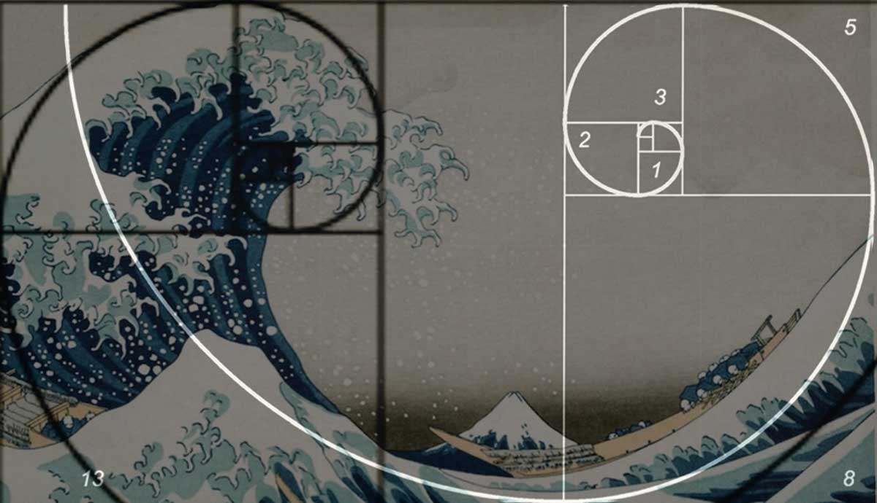
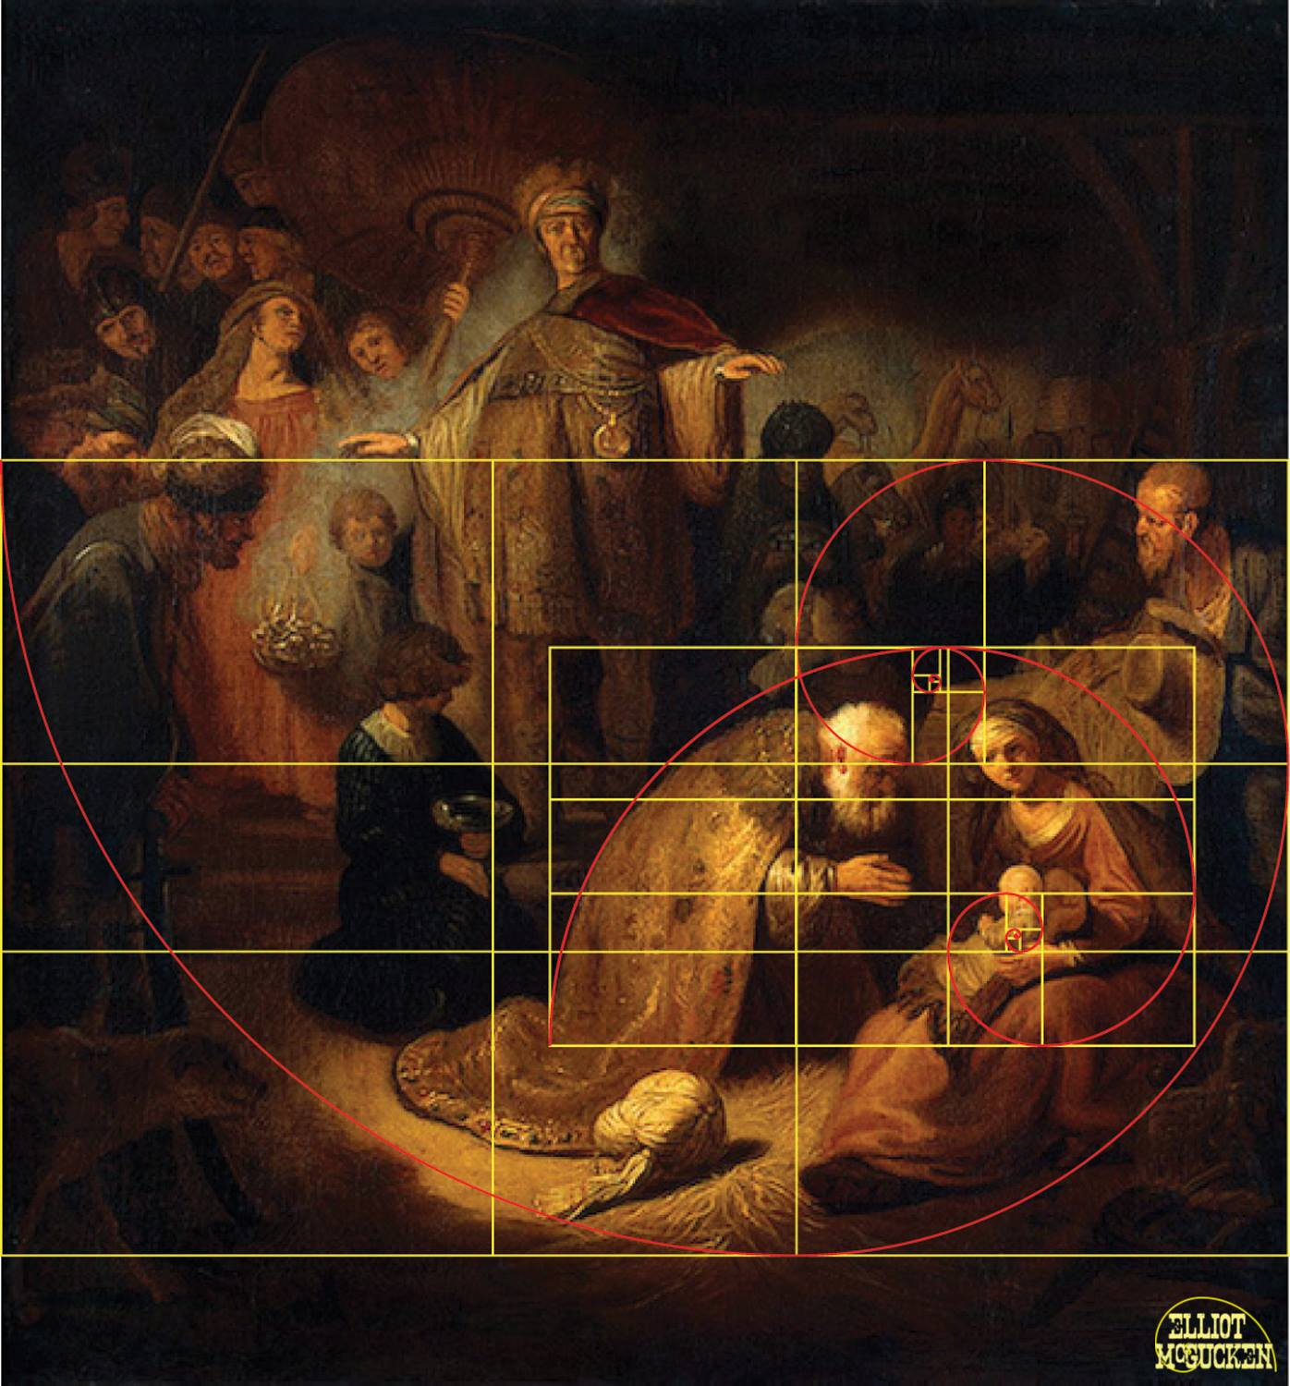
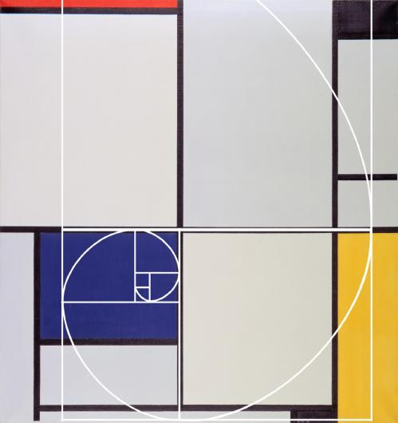

Slide 46
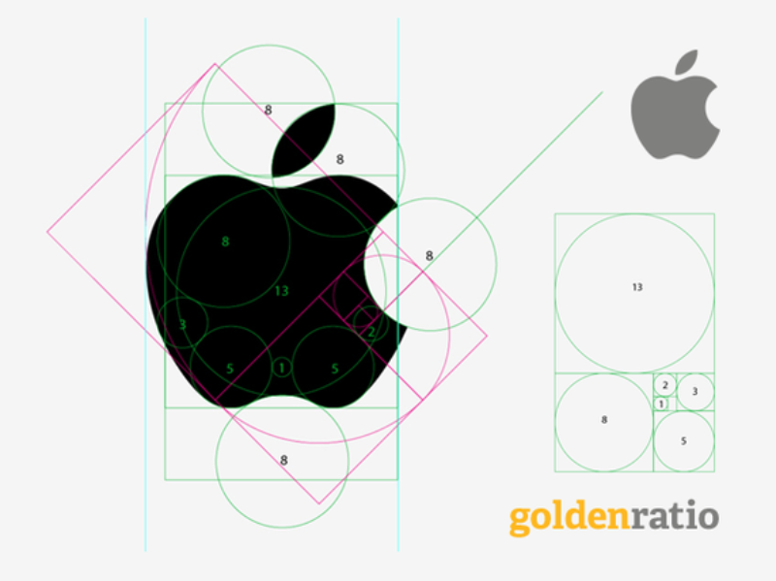
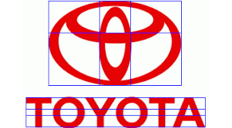
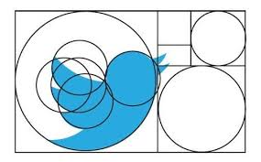
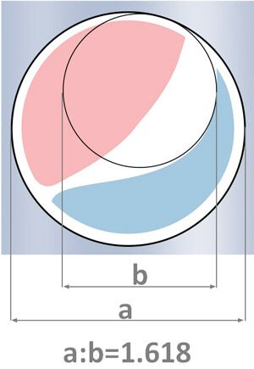

Slide 47
Fibonacci Sequence
The Fibonacci numbers are a series of numbers where the next number in the sequence is the sum of the previous two. It is closely related to the Golden Spiral.
The sequence starts with 1, 1,
And then it’s 2
Then 3
Then 5
Then 8
Then 13

Slide 48
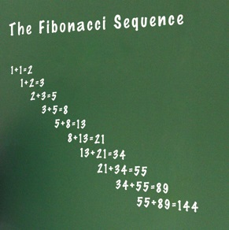
Fibonacci Sequence
1, 1, 2, 3, 5, 8, 13, 21,
34, 55, 89, 144, 233,
377, 610, 987, 1597,
2584, 4181, 6765, 10946,
17711, 28657, 46368,
75025, 121393, 196418,
317811, 514229, 832040,
1346269, 2178309…

Slide 49
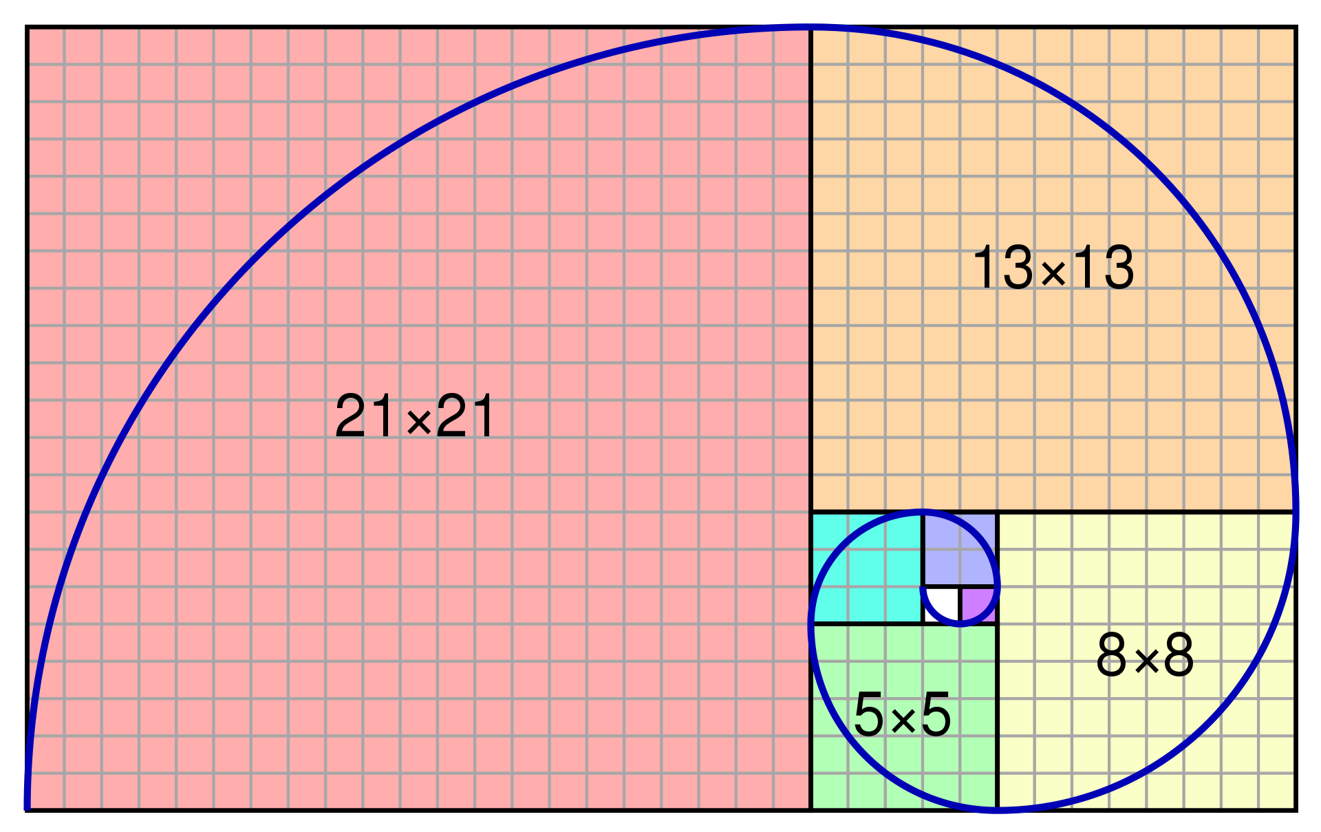
Fibonacci Sequence
As the Fibonacci sequence grows, if you divide pairs of numbers in the sequence (the larger by the smaller), you will get an approximate value of the golden ratio, which is roughly 1.618.

Slide 50
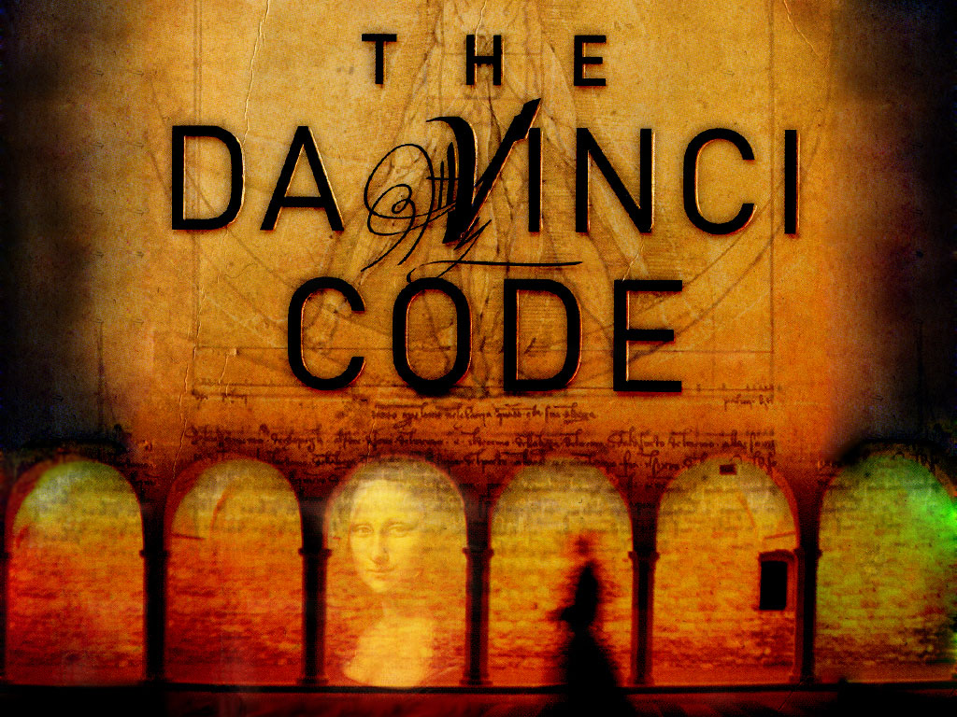

Slide 51
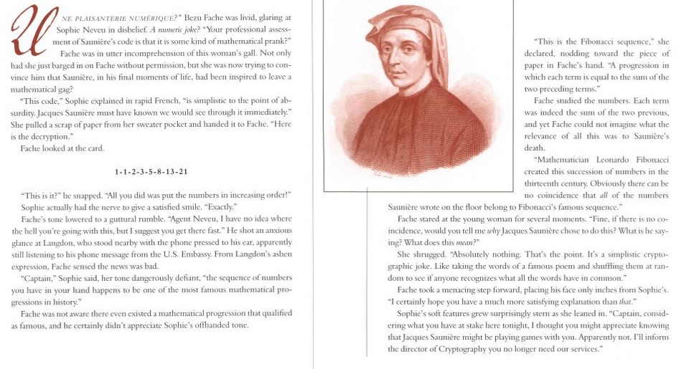
Fibonacci Numbers

Slide 52
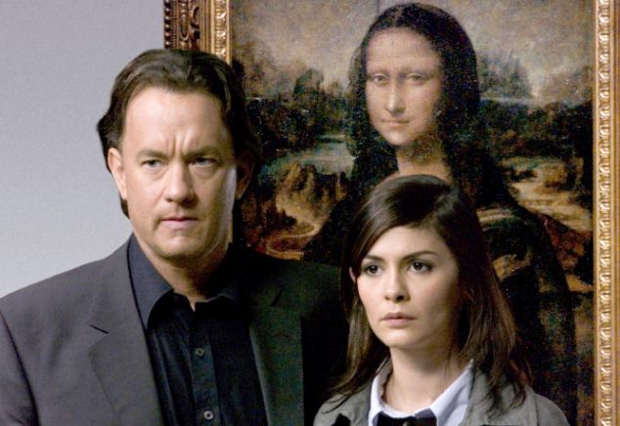
Fibonacci Sequence
As seen in the Da Vinci Code:

Slide 53
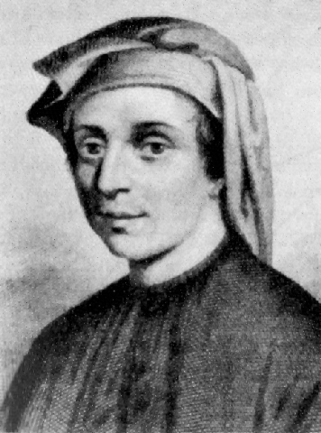
Leonardo Bonacci (aka Fibonacci)
Born 1170.
Born in Pisa, Italy
Died 1250.
An Italian mathematician, considered to be "the most talented Western mathematician of the Middle Ages".
Introduced the sequence of Fibonacci numbers which he used as an example in Liber Abaci.

Slide 54
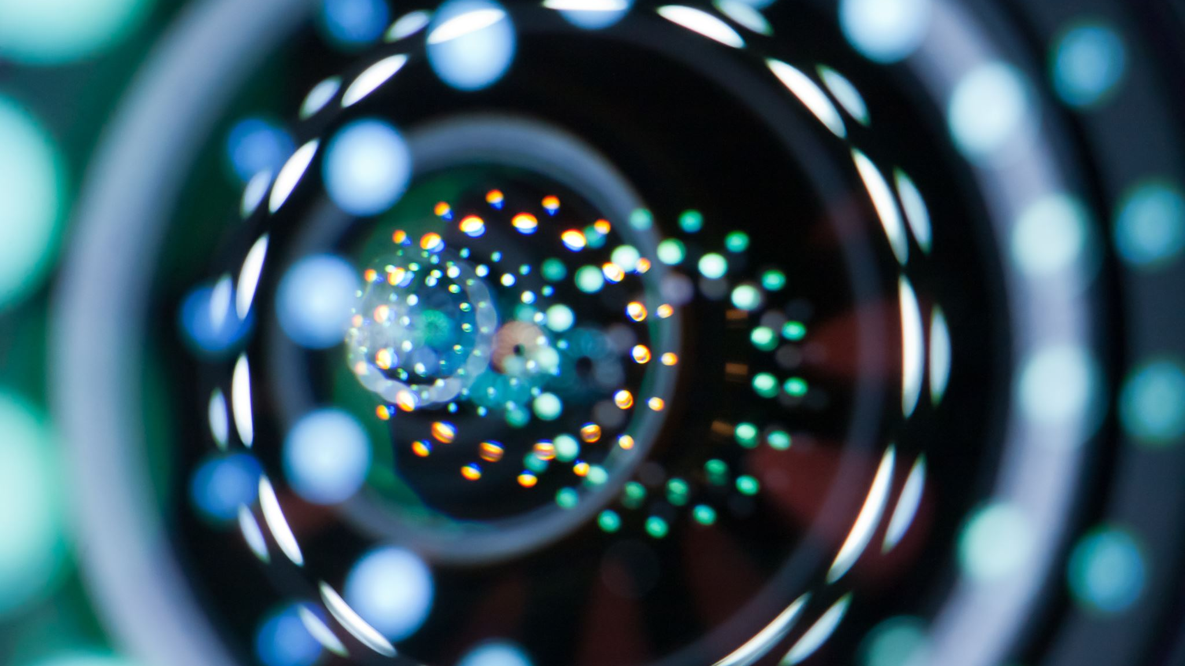
Let’s look at some code…

Slide 55
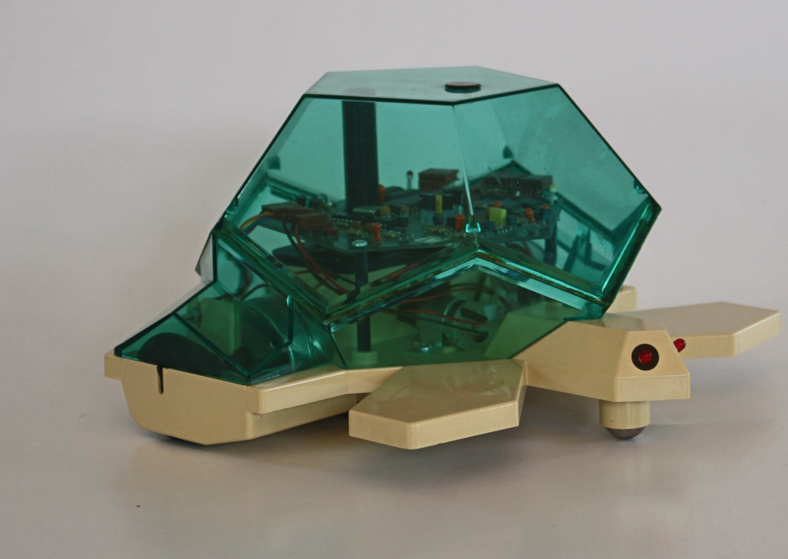
Python Code
Python has a number of ways of drawing things on the screen.
One approach is to use a drawing library called “turtle”. Which is named after a robot shaped like a turtle with a pen connected.

Slide 56
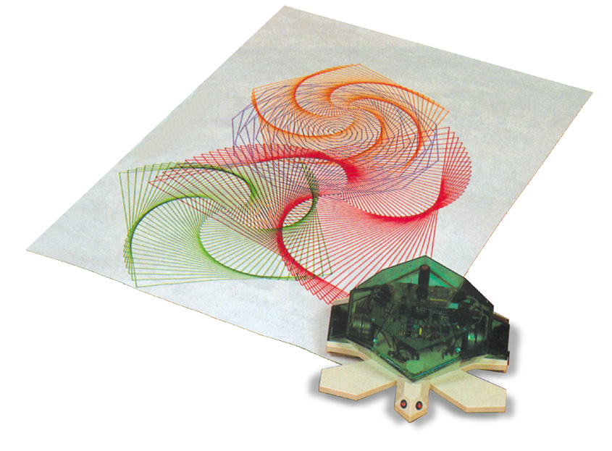

Slide 57
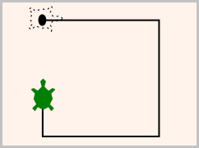
Python Code
So, we can write code to direct the turtle to move forward and do turns, and this will allow us to draw shapes.

Slide 58
Python Code
To make Turtle work in Python we need to do the following:
import turtle
t1 = turtle.Turtle()

Slide 59
Python Code
The following functions are available in turtle:
METHOD | PARAMETER | DESCRIPTION
forward( ) | distance | Moves the turtle forward by distance
backward( ) | distance | Moves the turtle backward by distance
right( ) | angle | Turns the turtle clockwise by angle
left( ) | angle | Turns the turtle anticlockwise by angle

Slide 60
Python Code
The following functions are available in turtle:
METHOD | PARAMETER | DESCRIPTION
color( ) | colourname | Changes the color of the turtle’s pen to colourname
penup( ) up( ) | None | Picks up the turtle’s Pen
pendown( ) down( ) | None | Puts down the turtle’s Pen

Slide 61
Python Code
The following functions are available in turtle:
METHOD | PARAMETER | DESCRIPTION
fillcolor( ) | colourname | Changes the color that the turtle will use to fill a shape
begin_fill( ) | None | Remember the starting point for a filled shape
end_fill( ) | None | Close the shape and fill with the current fill color

Slide 62
Python Code
The following functions are available in turtle:
METHOD | PARAMETER | DESCRIPTION
goto( ) | x, y | Move the turtle to position x,y
heading( ) | None | Returns the current heading
position( ) | None | Returns the current position

Slide 63
Python Code
The following functions are available in turtle:
METHOD | PARAMETER | DESCRIPTION
shape( ) | shapename | Should be ‘arrow’, ‘classic’, ‘turtle’ or ‘circle’
dot( ) | None | Leave a dot at the current position
stamp( ) | None | Leaves a turtle shape at the current location

Slide 64
#PROGRAM DrawRectangle
import turtle # Set up the turtle t = turtle.Turtle() t.pensize(3) t.color("gold") # Set the color to gold # Draw a rectangle t.forward(162) # Move forward by 162 units t.right(90) # Turn right by 90 degrees t.forward(100) # Move forward by 100 units t.right(90) # Turn right by 90 degrees t.forward(162) # Move forward by 162 units t.right(90) # Turn right by 90 degrees t.forward(100) # Move forward by 100 units t.right(90) # Turn right by 90 degrees
` # Close the window when clicked turtle.done()
#END.

Slide 65
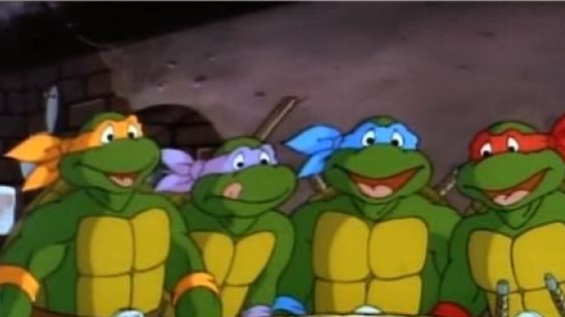
COWABUNGA

