Slide 1
Recursion
Damian Gordon

Slide 2
1st Art - Architecture
2nd Art - Sculpture
3rd Art - Painting and Drawing
4th Art - Music
5th Art - Literature and Poetry
6th Art - Dance, Mime, theatre, opera & circus
7th Art - Cinema
8th Art - Radio, TV, and photography
9th Art - Comics
10th Art - Video games and digital Art
The 10 Arts

Slide 3
Recursion: Overview
Recursion is where we embed an entity inside itself, like the image here:

Slide 4
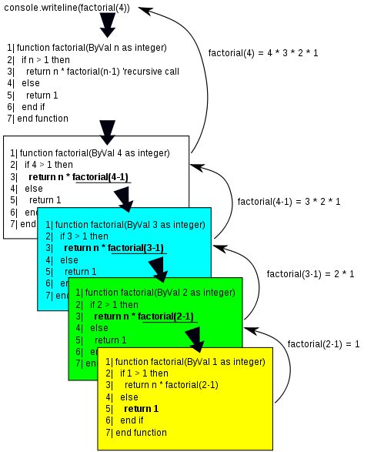
Recursion: Overview
Recursion in computers can be defined as a technique in programming where a function (method) calls itself to solve a problem.

Slide 5
Recursion: Overview
There are usually 2 components to the function:
Base Case: A condition that stops the recursion to prevent infinite loops.
Recursive Case: The function calls itself with a modified parameter to approach the base case.

Slide 6
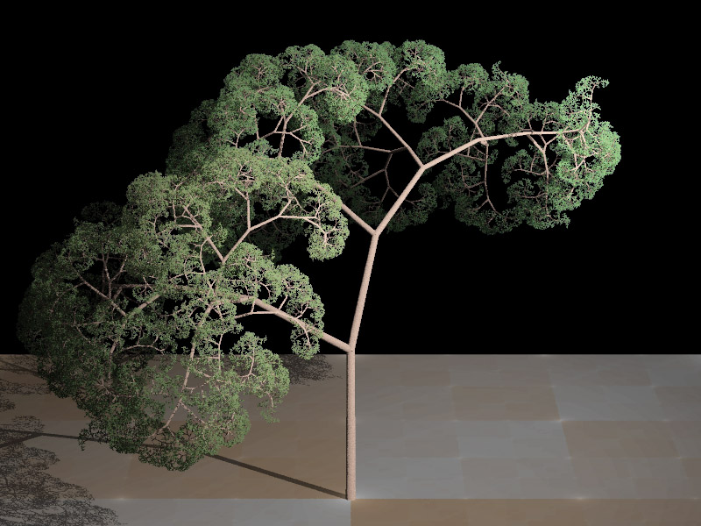
Trees have
fractal
properties,
and can be
created using
Recursion.

Slide 7
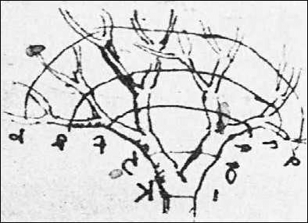
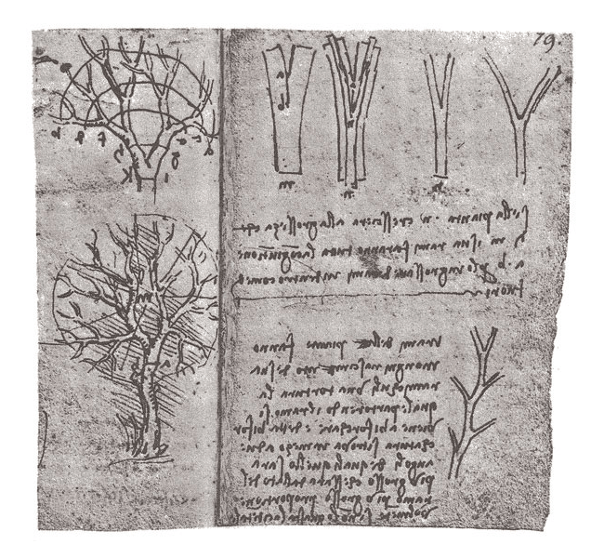
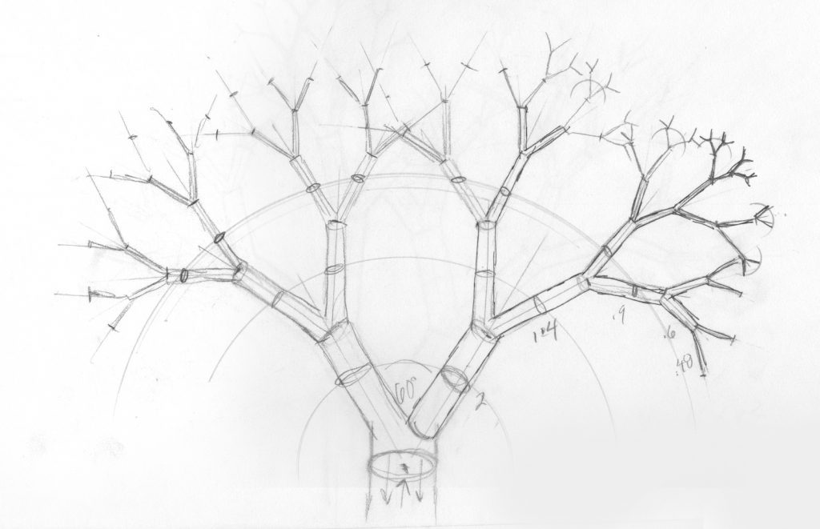
Notes:
https://tumamocsketchbook.com/2021/07/drawing-a-tree-like-leonardo.html

Slide 8
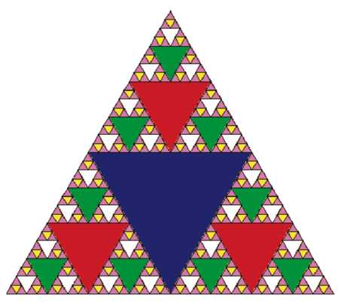
Sierpinski
Triangle

Slide 9
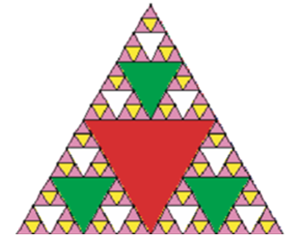
Sierpinski
Triangle

Slide 10
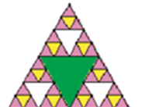
Sierpinski
Triangle

Slide 11
Recursion: Overview
MODULE Recursive(N):
IF (N <= 0)
THEN RETURN 1;
ELSE RETURN N ? Recursive(N-1);
ENDIF;
END.

Slide 12
Recursion: Factorial
Recursion is a feature of modularisation, when a module can call itself to complete a solution.
Let’s remember factorial:
7! = 7 * 6 * 5 * 4 * 3 * 2 * 1

Slide 13
Recursion: Factorial
Recursion is a feature of modularisation, when a module can call itself to complete a solution.
Let’s remember factorial:
7! = 7 * 6 * 5 * 4 * 3 * 2 * 1
and
6! = 6 * 5 * 4 * 3 * 2 * 1

Slide 14
Recursion: Factorial
So
7! = 7 * (6 * 5 * 4 * 3 * 2 * 1)

Slide 15
Recursion: Factorial
So
7! = 7 * (6 * 5 * 4 * 3 * 2 * 1)
is
7! = 7 * 6!

Slide 16
Recursion: Factorial
So
7! = 7 * (6 * 5 * 4 * 3 * 2 * 1)
is
7! = 7 * 6!
and
9! = 9 * 8 * 7 * 6 * 5 * 4 * 3 * 2 * 1
9!= 9 * (8 * 7 * 6 * 5 * 4 * 3 * 2 * 1)
9! = 9 * 8!

Slide 17
Recursion: Factorial
Or, in general:

Slide 18
Recursion: Factorial
Or, in general:
N! = N * (N-1)!

Slide 19
Recursion: Factorial
Or, in general:
N! = N * (N-1)!
or
Factorial(N) = N * Factorial(N-1)

Slide 20
Recursion: Factorial
We can do Factorial iteratively:

Slide 21
Recursion: Factorial
PROGRAM Factorial:
READ Value;
Total <- 1;
WHILE (Value != 0)
DO Total <- Value * Total;
Value <- Value - 1;
ENDWHILE;
PRINT Total;
END.

Slide 22
Recursion: Factorial
Now this is how we implement the following:
Factorial(N) = N * Factorial(N-1)

Slide 23
Recursion: Factorial
MODULE Fact(N):
IF (N <= 0)
THEN RETURN 1;
ELSE RETURN N * Fact(N-1);
ENDIF;
END.
PROGRAM Factorial:
Get Value;
PRINT Fact(Value);
END.

Slide 24
Recursion: Factorial
MODULE Fact(N):
IF (N <= 0)
THEN RETURN 1;
ELSE RETURN N * Fact(N-1);
ENDIF;
END.
PROGRAM Factorial:
Get Value;
PRINT Fact(Value);
END.

Slide 25
Recursion: Factorial
#include <stdio.h>
// Calculate factorial
long long factorial(int n) {
if (n == 0) // Base case
return 1;
else
return n * factorial(n - 1);
}

Slide 26
Recursion: Factorial
int main() {
int num;
printf("Enter a number: ");
scanf("%d", &num);
if (num < 0)
printf(“Only positive numbers.\n");
else
printf("Factorial is %d\n", factorial(num));
return 0;
}

Slide 27
Recursion: Factorial
def factorial(n):
if n == 0: # Base case
# then
return 1
else:
return n * factorial(n - 1) # Recursive case
# EndIf;
# END factorial.

Slide 28
Recursion: Factorial
# MAIN Program
num = int(input("Enter a number: "))
if num < 0:
# then
print(“Only positive numbers, please.")
else:
print(f"Factorial of {num} is {factorial(num)}")
# EndIf;
# END.

Slide 29
Recursion: Factorial
So if N is 5

Slide 30
Recursion: Factorial
So if N is 5
MODULE Fact(5) returns
5 * Fact(4)

Slide 31
Recursion: Factorial
So if N is 5
MODULE Fact(5) returns
5 * Fact(4)
5 * 4 * Fact(3)

Slide 32
Recursion: Factorial
So if N is 5
MODULE Fact(5) returns
5 * Fact(4)
5 * 4 * Fact(3)
5 * 4 * 3 * Fact(2)

Slide 33
Recursion: Factorial
So if N is 5
MODULE Fact(5) returns
5 * Fact(4)
5 * 4 * Fact(3)
5 * 4 * 3 * Fact(2)
5 * 4 * 3 * 2 * Fact(1)

Slide 34
Recursion: Factorial
So if N is 5
MODULE Fact(5) returns
5 * Fact(4)
5 * 4 * Fact(3)
5 * 4 * 3 * Fact(2)
5 * 4 * 3 * 2 * Fact(1)
5 * 4 * 3 * 2 * 1 * Fact(0)

Slide 35
Recursion: Factorial
So if N is 5
MODULE Fact(5) returns
5 * Fact(4)
5 * 4 * Fact(3)
5 * 4 * 3 * Fact(2)
5 * 4 * 3 * 2 * Fact(1)
5 * 4 * 3 * 2 * 1 * Fact(0)
5 * 4 * 3 * 2 * 1 * 1

Slide 36
Recursion: Factorial
So if N is 5
MODULE Fact(5) returns
5 * Fact(4)
5 * 4 * Fact(3)
5 * 4 * 3 * Fact(2)
5 * 4 * 3 * 2 * Fact(1)
5 * 4 * 3 * 2 * 1 * Fact(0)
5 * 4 * 3 * 2 * 1 * 1
120

Slide 37
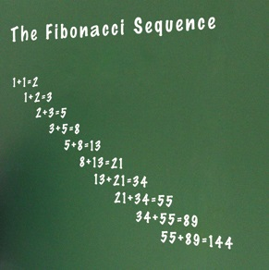
Recursion: Fibonacci
The Fibonacci numbers are numbers where the next number in the sequence is the sum of the previous two.
The sequence starts with 1, 1,
And then it’s 2
Then 3
Then 5
Then 8
Then 13

Slide 38
Recursion: Fibonacci
We can do Fibonacci iteratively:

Slide 39
Recursion: Fibonacci
PROGRAM FibonacciNumbers:
READ A;
FirstNum <- 1;
SecondNum <- 1;
WHILE (A != 2)
DO Total <- SecondNum + FirstNum;
FirstNum <- SecondNum;
SecondNum <- Total;
A <- A – 1;
ENDWHILE;
PRINT Total;
END.

Slide 40
Recursion: Fibonacci
Now let’s look at the recursive version:

Slide 41
Recursion: Fibonacci
MODULE RecurFib(N):
IF N == 1 OR N == 2:
THEN RETURN 1;
ELSE RETURN RecurFib(N-1) + RecurFib(N-2);
ENDIF;
END.
PROGRAM FibonacciNumbers:
READ A;
PRINT RecurFib(A);
END.

Slide 42
Recursion: Decimal to Binary Conversion
How do we convert decimal numbers to binary?

Slide 43
Recursion: Decimal to Binary Conversion
How do we convert decimal numbers to binary?
Let’s try the number 23…

Slide 44
Recursion: Decimal to Binary Conversion
How do we convert decimal numbers to binary?
Let’s try the number 23…
23 / 2

Slide 45
Recursion: Decimal to Binary Conversion
How do we convert decimal numbers to binary?
Let’s try the number 23…
23 / 2 = 11 and remainder is 1

Slide 46
Recursion: Decimal to Binary Conversion
How do we convert decimal numbers to binary?
Let’s try the number 23…
23 / 2 = 11 and remainder is 1
11/2 = 5 and remainder is 1

Slide 47
Recursion: Decimal to Binary Conversion
How do we convert decimal numbers to binary?
Let’s try the number 23…
23 / 2 = 11 and remainder is 1
11/2 = 5 and remainder is 1
5/2 = 2 and remainder is 1

Slide 48
Recursion: Decimal to Binary Conversion
How do we convert decimal numbers to binary?
Let’s try the number 23…
23 / 2 = 11 and remainder is 1
11/2 = 5 and remainder is 1
5/2 = 2 and remainder is 1
2/2 = 1 and remainder is 0

Slide 49
Recursion: Decimal to Binary Conversion
How do we convert decimal numbers to binary?
Let’s try the number 23…
23 / 2 = 11 and remainder is 1
11/2 = 5 and remainder is 1
5/2 = 2 and remainder is 1
2/2 = 1 and remainder is 0
1/2 = 0 and remainder is 1

Slide 50
Recursion: Decimal to Binary Conversion
How do we convert decimal numbers to binary?
Let’s try the number 23…
23 / 2 = 11 and remainder is 1
11/2 = 5 and remainder is 1
5/2 = 2 and remainder is 1
2/2 = 1 and remainder is 0
1/2 = 0 and remainder is 1
>> So DEC 23 is BIN 10111

Slide 51
Recursion: Decimal to Binary Conversion
MODULE DecToBin(N):
IF N == 0
THEN RETURN ‘0’;
ELSE RETURN DecToBin(N DIV 2) + String(N MOD 2);
ENDIF;
END.
PROGRAM DecimalToBinary:
READ A;
PRINT DecToBin(A);
END.

Slide 52
GEB

Slide 53
Kurt Gödel
Born: April 28, 1906
Born in Brno, Czech Republic
Died: January 14, 1978
One of the greatest logicians, mathematicians, and philosophers of all time
His Incompleteness Theorem has profound implications for computer science and life

Slide 54
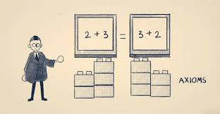
Gödel's Incompleteness Theorem

Slide 55
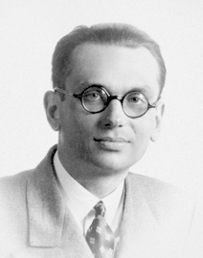
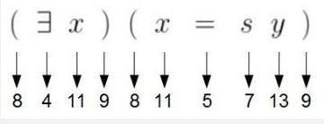
Gödel's Incompleteness Theorem
Step 1. Gödel Numbering
Gödel developed a way to assign unique numbers (Gödel numbers) to mathematical statements and proofs. This turned mathematical logic into a mechanical, recursive system, where statements could refer to other statements numerically.

Slide 56
Gödel's Incompleteness Theorem
Step 2. Self-Reference & The Liar Paradox
Using this numbering, Gödel constructed a statement that essentially says:
"This statement is unprovable within this system."
This is a recursive self-reference, similar to paradoxes like "This sentence is false." It loops back on itself in a way that can’t be resolved inside the system—just like how some recursive functions never reach a base case.

Slide 57
Gödel's Incompleteness Theorem
Step 3. Recursion in Proof Theory
Many logical proofs use induction and recursion, which are fundamental to formal systems. Gödel’s proof technique involved constructing statements recursively—each step building upon the previous in a structured, self-referential way.

Slide 58
Gödel's Incompleteness Theorem
Step 4. Gödel and Computer Science
His ideas influenced recursively enumerable sets and Turing machines, which define computability in terms of recursion. Alan Turing later showed that certain problems (like the halting problem) are undecidable—mirroring Gödel’s idea that some truths in mathematics are unprovable.

Slide 59
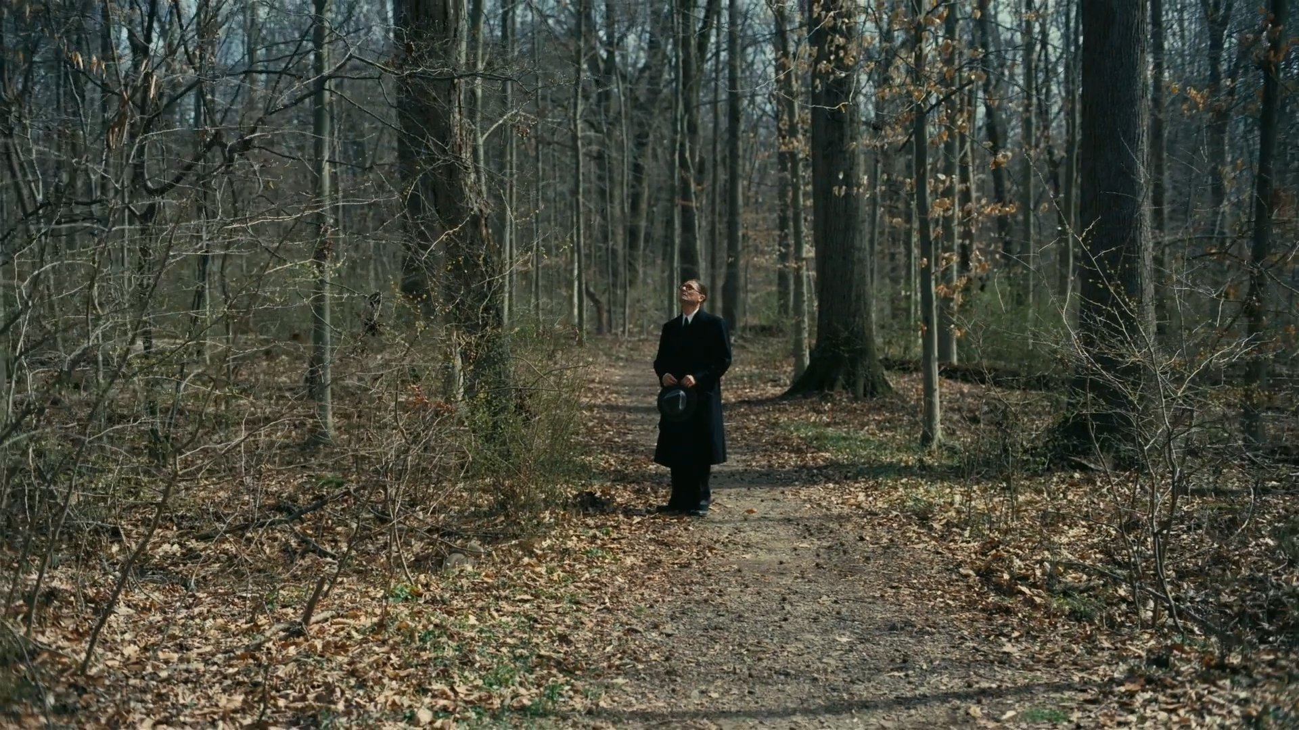
“Trees are the most inspiring structures”
James Urbaniak as Kurt Gödel

Slide 60
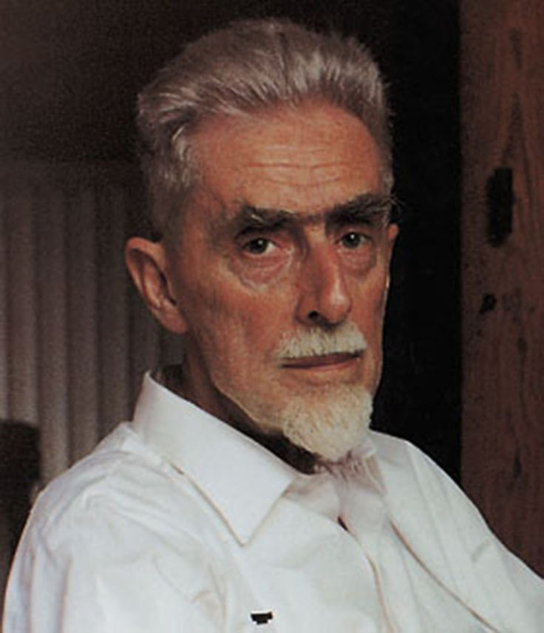
M. C. Escher
Born: 17 June 1898
Born in Leeuwarden, Netherlands
Died: 27 March 1972
A Master Dutch graphic artist who made woodcuts, lithographs, and mezzotints
His work features mathematical objects and operations including reflection, symmetry, and tessellations

Slide 61
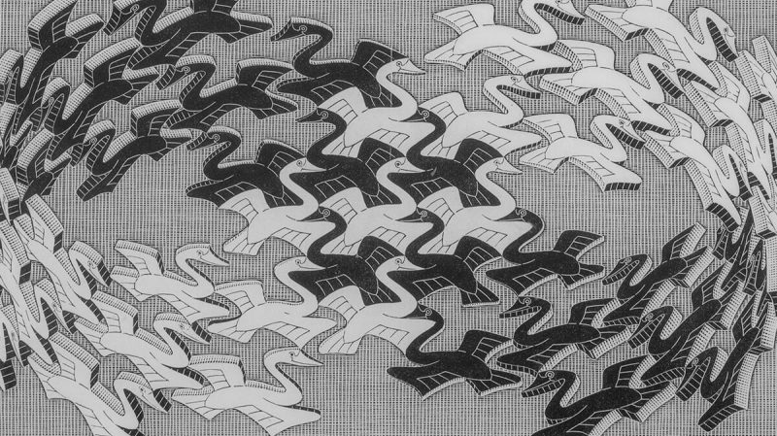
Notes:
Swan, 1956.

Slide 62
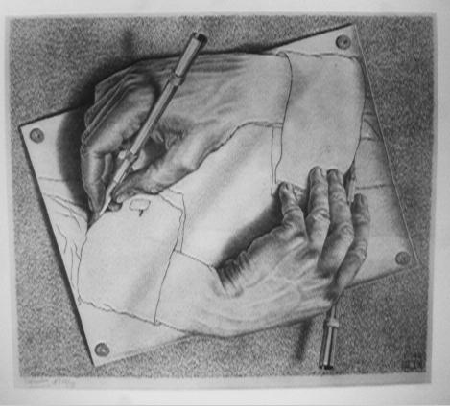
Notes:
Drawing Hands, 1948.

Slide 63
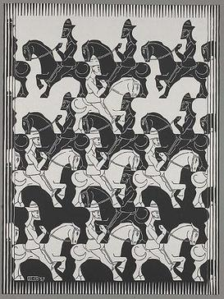
Notes:
Regular Division of the Plane, 1936.

Slide 64
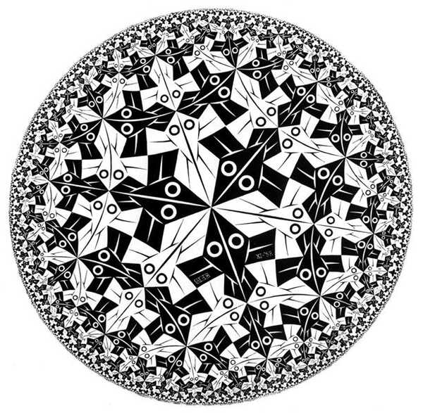
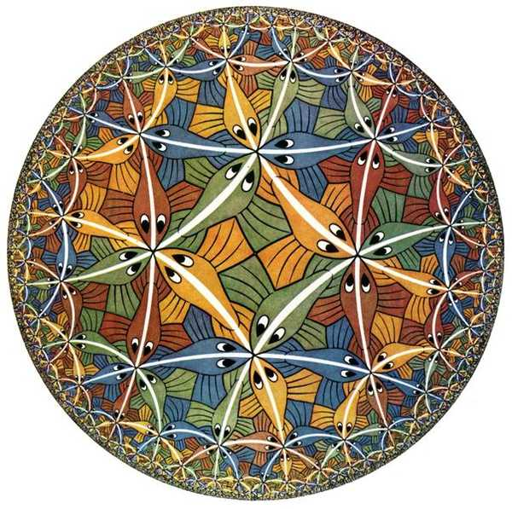

Slide 65
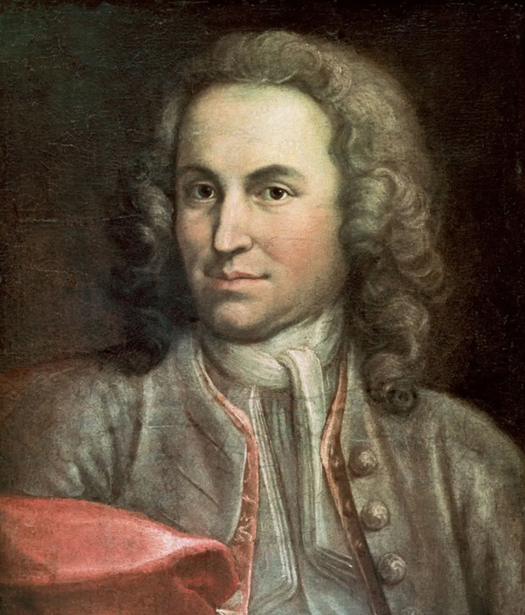
J. S. Bach
Born: 31 March 1685
Born in Eisenach, Germany
Died: 28 July 1750
He is known for his work across a variety of instruments and forms, including orchestral, cello, violin, piano, organ works and choral works
He is considered one of the greatest composers in the history of Western music

Slide 66
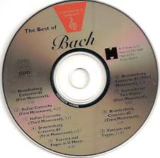
J. S. Bach
Brandenburg Concertos
Cello suites and sonatas
Partitas for solo violin
Goldberg Variations
The Well-Tempered Clavier
The Schübler Chorales
St Matthew Passion
The Mass in B minor
The Toccata and Fugue in D minor

Slide 67
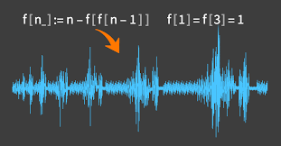

Slide 68
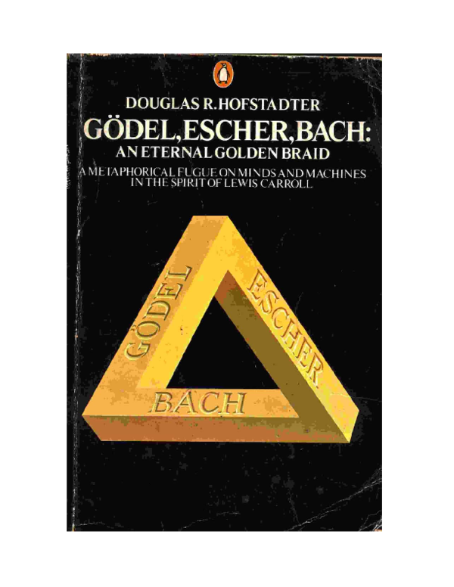
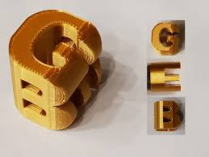

Slide 69
Linked Lists

Slide 70
Linked Lists
Imagine we wanted to have an array where we can dynamically add elements into it, and take them away.
We can do this with a linked list.

Slide 71
Linked Lists
A linked list is made up of nodes.

Slide 72
Linked Lists
A linked list is made up of nodes.
Each node has two parts to it:

Slide 73
Linked Lists
A linked list is made up of nodes.
Each node has two parts to it:
Value
Pointer

Slide 74
Linked Lists
For example

Slide 75
Linked Lists
For example
23

Slide 76
Linked Lists
For example
23
62

Slide 77
Linked Lists
For example
23
62
37

Slide 78
Linked Lists
For example
23
62
37
31

Slide 79
Linked Lists
For example
23
62
37
31
NULL

Slide 80
Linked Lists
For example
23
62
37
31
NULL
Start
of List
End
of List

Slide 81
Linked Lists
To add a value in:
23
62
37
31
NULL

Slide 82
Linked Lists
To add a value in:
23
62
37
31
NULL
26

Slide 83
Linked Lists
To add a value in:
23
62
37
31
NULL
26

Slide 84
Linked Lists
To add a value in:
23
62
37
31
NULL
26

Slide 85
Linked Lists
To add a value in:
23
62
26
37
31
NULL

Slide 86
Linked Lists
To delete a value:
23
62
26
37
31
NULL

Slide 87
Linked Lists
To delete a value:
23
62
26
37
31
NULL

Slide 88
Linked Lists
To delete a value:
23
62
37
31
NULL

Slide 89
Linked Lists
So a Linked List is a series of Nodes
And a Node has two parts
Value
Pointer
A Linked List has a pointer to the start of the list called Head.

Slide 90
Linked Lists
Pointer
Value
23
62
26
37
31
NULL
HEAD

Slide 91
Recursion: Linked Lists
A linked list is made up of nodes.
Each node has two parts to it:
The pointer points to another node of the same type (recursively)
Value
Pointer

Slide 92
RecursiveCount()

Slide 93
23
62
26
37
31
NULL

Slide 94
23
62
26
37
31
NULL
1
+
REST OF LIST

Slide 95
23
62
26
37
31
NULL
1
+
REST OF LIST
1
+
REST OF LIST

Slide 96
23
62
26
37
31
NULL
1
+
REST OF LIST
1
+
REST OF LIST
1
+
REST OF LIST

Slide 97
23
62
26
37
31
NULL
1
+
REST OF LIST
1
+
REST OF LIST
1
+
REST OF LIST
1
+
REST OF LIST

Slide 98
23
62
26
37
31
NULL
1
+
REST OF LIST
1
+
REST OF LIST
1
+
REST OF LIST
1
+
1

Slide 99
Linked Lists: Recursive Count
MODULE RecursiveCount(Current):
IF (Current == NULL)
THEN RETURN 0;
ELSE RETURN 1 + RecursiveCount(Current.pointer)
ENDIF;
END.

Slide 100
RecursivePrint()

Slide 101
Linked Lists: Recursive Print
MODULE RecursivePrint(Current):
IF (Current == NULL)
THEN RETURN 0;
ELSE PRINT Current.value;
RecursivePrint(Current.pointer);
ENDIF;
END.

Slide 102
FindANode()

Slide 103
Linked Lists: Find a node
MODULE FindANode(Current, N):
IF (Current.pointer == NULL)
THEN RETURN NULL;
ELSE IF (Current.value == N)
THEN PRINT N “was found”;
ELSE RETURN FindANode(Current.pointer, N)
ENDIF;
ENDIF;
END.

Slide 104
InsertANode()

Slide 105
Linked Lists: Insert a node
MODULE InsertANode(Current, Pos, N):
IF (Current.pointer == NULL)
THEN RETURN NULL;
ELSE IF (Current.value == Pos)
THEN Nnode <- NEW Node(N, NULL);
Nnode.pointer <- Current.pointer;
Current.pointer <- Nnode;
ELSE RETURN InsertANode(Current.pointer, Pos, N);
ENDIF;
ENDIF;
END.

Slide 106
DeleteANode()

Slide 107
Linked Lists: Delete a node
MODULE DeleteANode(Current, N):
IF (Current.pointer != NULL)
THEN IF (Current.value == N)
THEN Current <- Current.pointer;
ELSE Current.pointer <- DeleteANode(Current.pointer, N);
ENDIF;
ENDIF;
END.

