Slide 1
Interactivity
Damian Gordon

Slide 2
1st Art - Architecture
2nd Art - Sculpture
3rd Art - Painting and Drawing
4th Art - Music
5th Art - Literature and Poetry
6th Art - Dance, Mime, theatre, opera & circus
7th Art - Cinema
8th Art - Radio, TV, and photography
9th Art - Comics
10th Art - Video games and digital Art
The 10 Arts

Slide 3
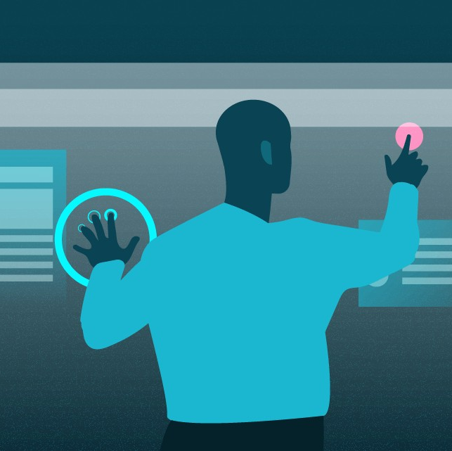
Interactivity: Overview
Interactivity is where we get the user involved in the art, and potentially allow them to change the art.

Slide 4
Interactivity: Overview
Interactivity means that the users are part of the artistic process and are fully engaged in the art.

Slide 5
Interactivity
In the olden days (“in days of yore”), the viewer had to use their minds to make the art interactive:

Slide 6
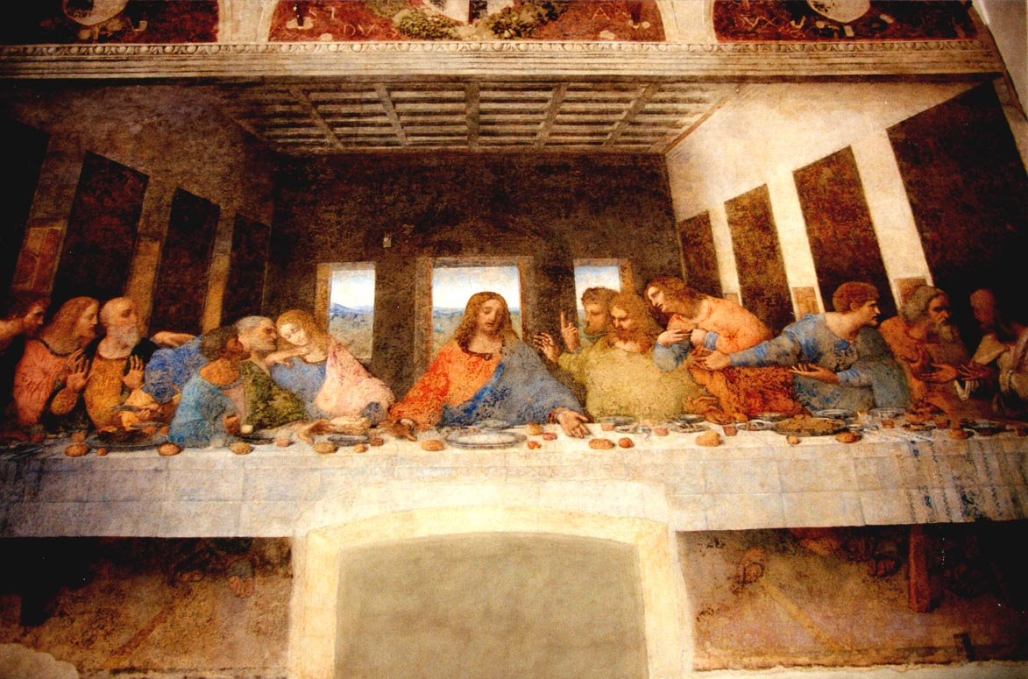

Slide 7
They would experience it visually

Slide 8
And imagine what the sounds and smells would have been

Slide 9
And think about what the food have tasted like ?

Slide 10
...and had other reflections and questions

Slide 11
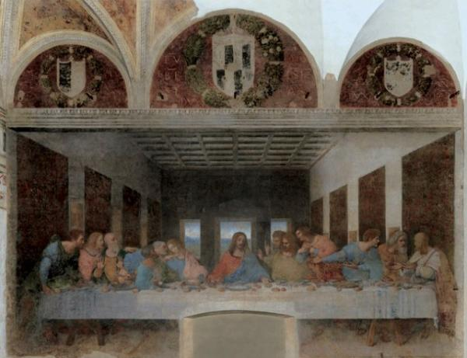

Slide 12
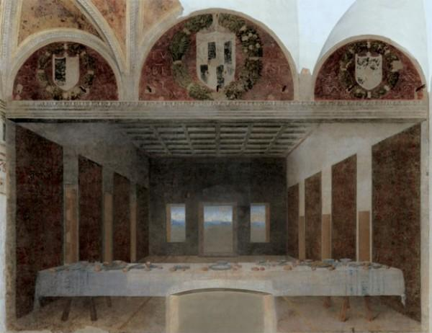

Slide 13
Interactivity
Nowadays (“in days of modernity”), we have the technology to make art interactive in new and exciting ways. Let’s look at the 10 Arts again:

Slide 14
1st Art - Architecture
2nd Art - Sculpture
3rd Art - Painting and Drawing
4th Art - Music
5th Art - Literature and Poetry
6th Art - Dance, Mime, theatre, opera & circus
7th Art - Cinema
8th Art - Radio, TV, and photography
9th Art - Comics
10th Art - Video games and digital Art
The 10 Arts

Slide 15
1. Architecture
Interactive architecture, like responsive buildings that change shape, color, or function based on how people move through them.
e.g., the Media Facade at the Ars Electronica Center in Austria, which reacts to visitors.

Slide 16
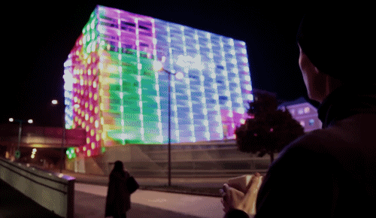

Slide 17
2. Sculpture
Kinetic sculptures or installations that move or change based on touch, wind, or sensors.
e.g., Cloud Gate ("The Bean") in Chicago, where people’s reflections become part of the artwork.

Slide 18
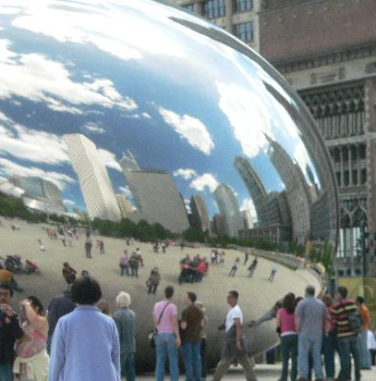

Slide 19
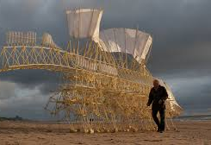
Strandbeests
Theo Jansen is engaged in creating new forms of life: the so called strandbeests. Skeletons made from yellow plastic tube (Dutch electricity pipe) are able to walk and get their energy from the wind. They have evolved since their inception in 1990 and have been divided into 12 periods of evolution.
https://www.strandbeest.com/

Slide 20
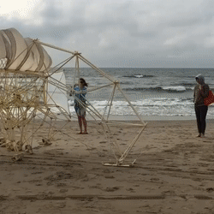
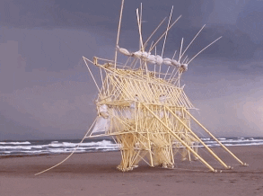
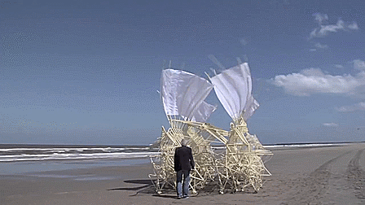
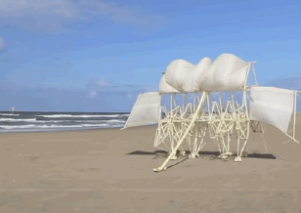

Slide 21
3. Painting and Drawing
Some digital paintings or projection art allow viewers to change colors, patterns, or elements by touching a screen or using motion sensors
e.g., teamLab Borderless in Tokyo, where walls and floors react to visitors' presence.

Slide 22
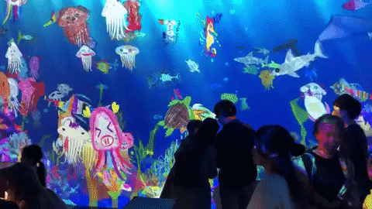

Slide 23
4. Music
Generative music that shifts based on audience input, such as Brian Eno's ambient music apps or AI-driven compositions that change based on external data like weather or audience movement.

Slide 24
4. Music
https://www.generativemusic.com/

Slide 25
5. Literature and Poetry
Choose-your-own-adventure books, hypertext fiction, and AI-generated storytelling where the reader makes choices that alter the plot

Slide 26
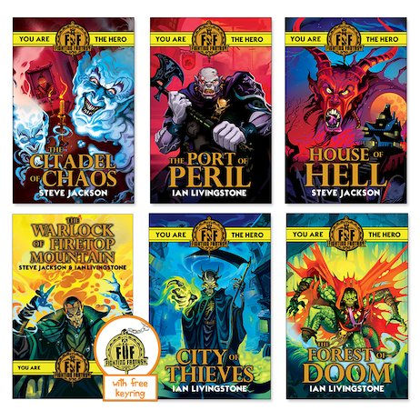
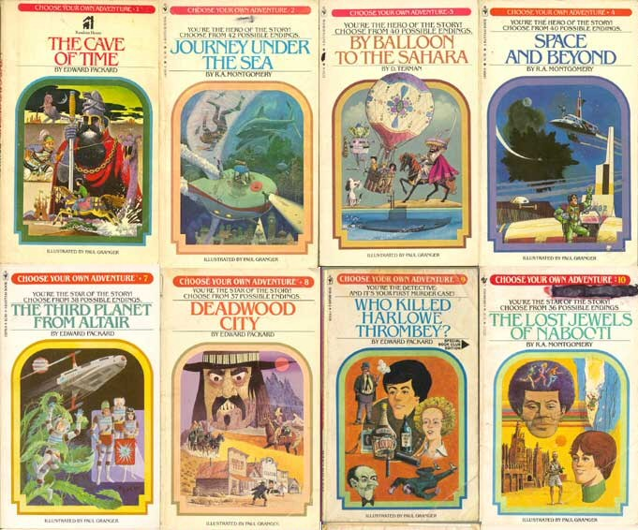
5. Literature and Poetry

Slide 27
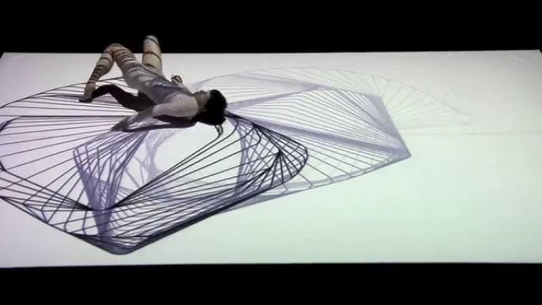
6. Dance, Mime, theatre, opera & circus
Dance - Interactive dance performances where audience members influence choreography, such as Chunky Move’s dance performances using motion capture to alter visuals in real-time.
https://www.youtube.com/watch?v=2AautwIOON8

Slide 28
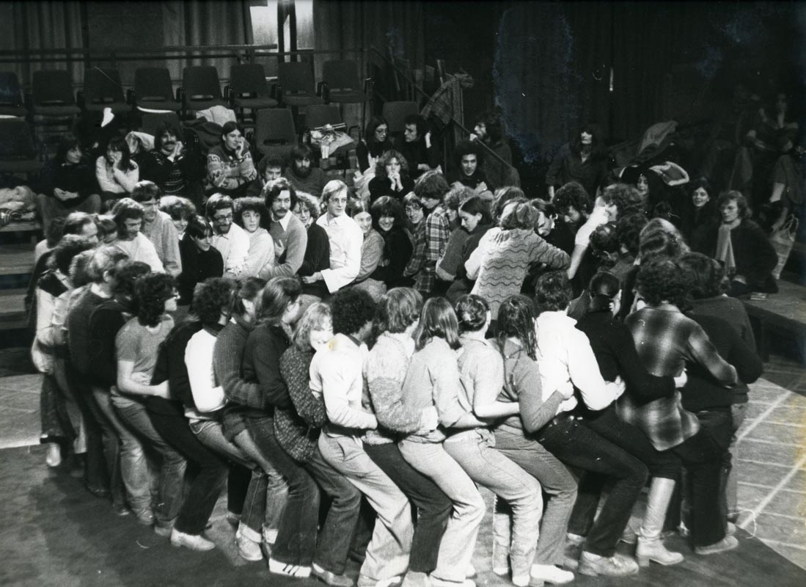
6. Dance, Mime, theatre, opera & circus
Theatre – Immersive and interactive theatre like Sleep No More (where the audience moves freely and chooses which parts of the story to follow) or Augusto Boal’s Theatre of the Oppressed, where spectators become "spect-actors" and change the narrative.

Slide 29
7. Cinema
Interactive films or virtual reality experiences where viewers make decisions that change the story (e.g., Black Mirror: Bandersnatch or VR films like Wolves in the Walls).

Slide 30
8. Radio, TV, and photography
Photography – Augmented reality (AR) photography where users can manipulate elements in real-time or AI-generated portraits that evolve based on viewer input (e.g., Dronestagram, where people contribute geotagged drone images).

Slide 31
9. Comics
Webcomics or digital comics that allow readers to change the sequence of panels, choose different narrative paths, or even contribute to the story (e.g., Homestuck, which incorporated reader suggestions into its plot).

Slide 32
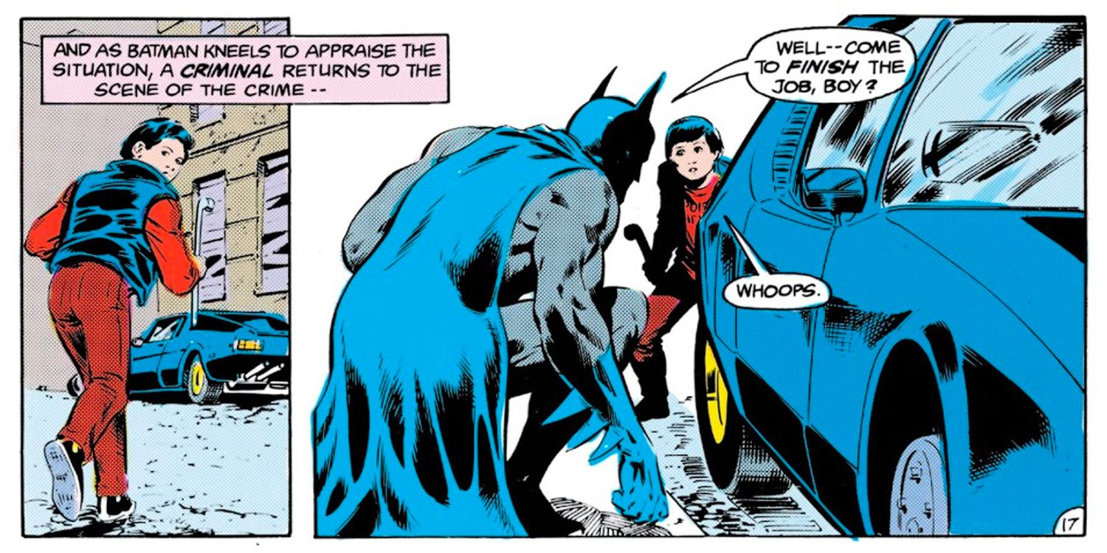
Robin – Jason Todd

Slide 33
9. Comics
"A Death in the Family" is a 1988 storyline in Batman. Serialized in Batman issues #426–429 from August to November 1988.
Readers were warned that Jason could die of his injuries in the story, but that they could "prevent it with a telephone call".

Slide 34
9. Comics
Two 900 numbers were given:
1-(900) 720–2660, to let Robin live,
1-(900) 720–2666, to cause him to die.
The numbers were activated for 35 hours in the United States and Canada from 9:00 a.m. Eastern Standard Time on September 15, 1988.

Slide 35
9. Comics
The poll received 10,614 votes and 5,343 voted for Jason's death over 5,271 for his survival—a margin of just 72 votes.

Slide 36
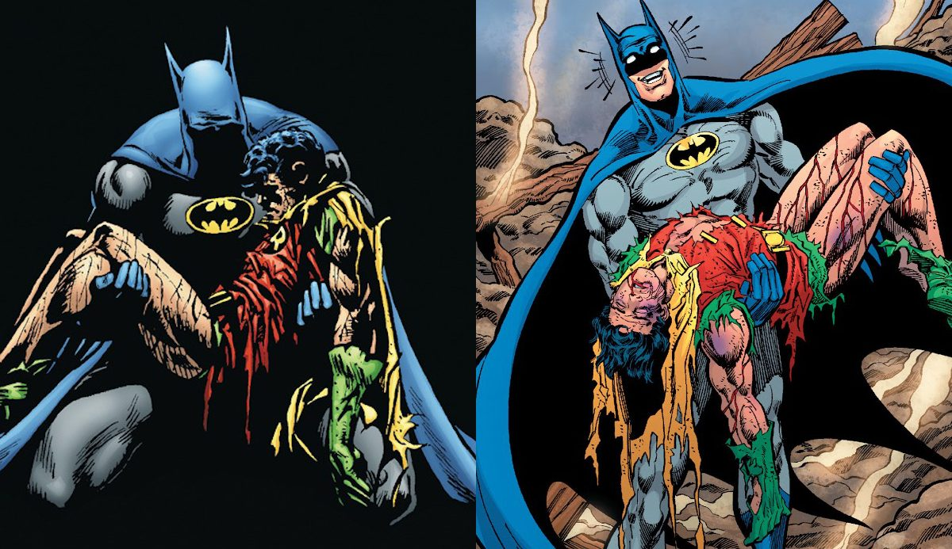
9. Comics

Slide 37
10. Video games and digital Art
Video games and digital art often incorporate audience interaction in ways that directly influence the experience.
e.g. Minecraft – The world is entirely shaped by the player, from structures to landscapes, making each experience unique.

Slide 38
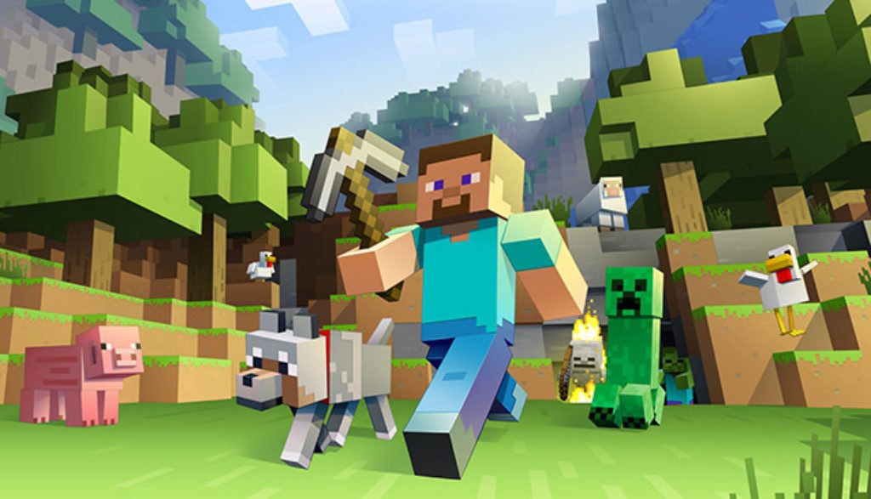

Slide 39
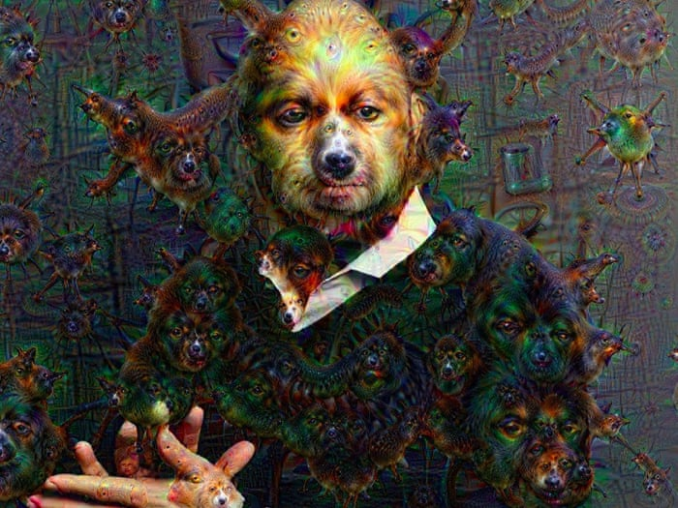
10. Video games and digital Art
Digital Art:
Google DeepDream – Users provide input images, and AI generates surreal dream-like visuals.

Slide 40
Interactive Code

Slide 41
Interactive Code in C: Spacebar
#include <stdio.h>
#include <conio.h>
int main() {
printf("Press Spacebar...\n");
while (1) {
char ch = getch(); // Get key if (ch == ' ‘){
printf("Spacebar pressed!\n");
}
}
}

Slide 42
Interactive Code in C: Mouse click
#include <stdio.h>
#include <windows.h>
int main() {
printf("Click the mouse...\n"); while (1) {
if (GetAsyncKeyState(VK_LBUTTON)) {
printf("Mouse clicked! \n");
}
}
}

Slide 43
Interactive Code in Python: Spacebar
import keyboard
print("Press the spacebar...")
while True:
if keyboard.is_pressed("space"):
print("Spacebar pressed!")
# EndIf;
# EndWhile;
# END.

Slide 44
Interactive Code in Python: Mouse click
import mouse
print("Click the mouse...")
while True:
if mouse.is_pressed("left"):
print("Mouse clicked! ")
# EndIf;
# EndWhile;
# END.

Slide 45
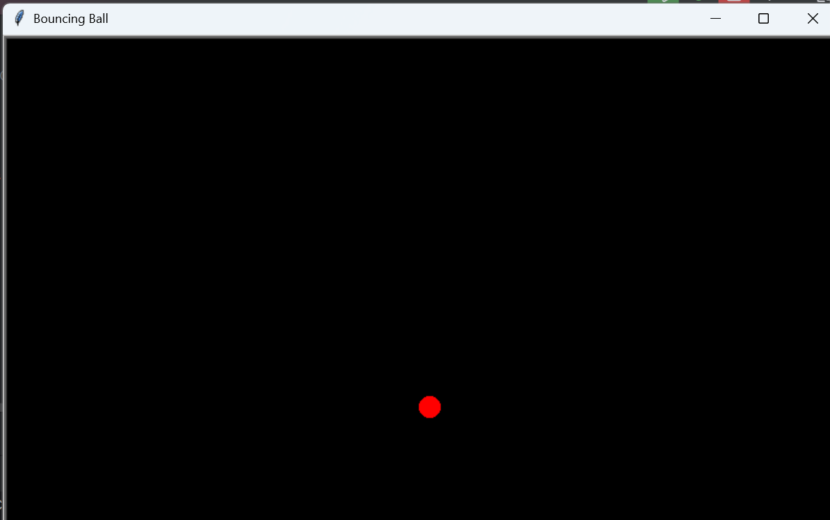

Slide 46
import turtle
import random
# Set up the screen
screen = turtle.Screen()
screen.title("Bouncing Ball")
screen.bgcolor("black")
screen.setup(width=800, height=600)
screen.tracer(0)

Slide 47
# Create the ball
ball = turtle.Turtle()
ball.shape("circle")
ball.color("red")
ball.penup()
ball.speed(0)

Slide 48
# Initial ball movement speed
ball.dx = random.choice([-3, 3])
ball.dy = random.choice([-3, 3])

Slide 49
# Function to change direction and color
def change_direction():
global ball
ball.dx, ball.dy = -ball.dy, ball.dx # 90 deg
ball.color(random.choice(["red", "blue", "green"]))

Slide 50
# Ball movement function
def move_ball():
global ball
x, y = ball.xcor(), ball.ycor()
# Move the ball
ball.setx(x + ball.dx)
ball.sety(y + ball.dy)
# Bounce off walls
if x + ball.dx > 390 or x + ball.dx < -390:
ball.dx *= -1
if y + ball.dy > 290 or y + ball.dy < -290:
ball.dy *= -1
screen.update()
screen.ontimer(move_ball, 10)

Slide 51
# Bind space bar to change direction and color
screen.listen()
screen.onkey(change_direction, "space")
# Start the movement
move_ball()
# Keep the window open
screen.mainloop()

Slide 53
import turtle
# Set up the screen
screen = turtle.Screen()
screen.title("Pong Game")
screen.bgcolor("black")
screen.setup(width=800, height=600)
screen.tracer(0)

Slide 54
# Left paddle
left_paddle = turtle.Turtle()
left_paddle.shape("square")
left_paddle.color("white")
left_paddle.shapesize(stretch_wid=6, stretch_len=1)
left_paddle.penup()
left_paddle.goto(-350, 0)

Slide 55
# Right paddle
right_paddle = turtle.Turtle()
right_paddle.shape("square")
right_paddle.color("white")
right_paddle.shapesize(stretch_wid=6, stretch_len=1)
right_paddle.penup()
right_paddle.goto(350, 0)

Slide 56
# Ball
ball = turtle.Turtle()
ball.shape("circle")
ball.color("white")
ball.penup()
ball.dx = 2
ball.dy = 2

Slide 57
# Move paddles
def left_paddle_up():
if left_paddle.ycor() < 250:
left_paddle.sety(left_paddle.ycor() + 20)
def left_paddle_down():
if left_paddle.ycor() > -240:
left_paddle.sety(left_paddle.ycor() - 20)
def right_paddle_up():
if right_paddle.ycor() < 250:
right_paddle.sety(right_paddle.ycor() + 20)
def right_paddle_down():
if right_paddle.ycor() > -240:
right_paddle.sety(right_paddle.ycor() - 20)

Slide 58
# Keyboard bindings
screen.listen()
screen.onkeypress(left_paddle_up, "w")
screen.onkeypress(left_paddle_down, "s")
screen.onkeypress(right_paddle_up, "Up")
screen.onkeypress(right_paddle_down, "Down")

Slide 59
# Ball movement function
def move_ball():
global ball
ball.setx(ball.xcor() + ball.dx)
ball.sety(ball.ycor() + ball.dy)
# Bounce off top and bottom walls
if ball.ycor() > 290 or ball.ycor() < -290:
ball.dy *= -1

Slide 60
# Bounce off paddles
if (ball.xcor() > 340 and ball.xcor() < 350) and
(ball.ycor() < right_paddle.ycor() + 50 and
ball.ycor() > right_paddle.ycor() - 50):
ball.dx *= -1
if (ball.xcor() < -340 and ball.xcor() > -350) and
(ball.ycor() < left_paddle.ycor() + 50 and
ball.ycor() > left_paddle.ycor() - 50):
ball.dx *= -1
# Reset ball if it goes out of bounds
if ball.xcor() > 390 or ball.xcor() < -390:
ball.goto(0, 0)
ball.dx *= -1

Slide 61
# Start game
move_ball()
screen.mainloop()

Slide 62
# Start game
move_ball()
screen.mainloop()

