Slide 1
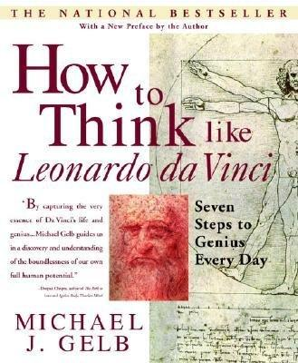

Slide 2
Seven Principles
Curiosità
Dimonstrazione
Sensazione
Sfumato
Arte/Scienza
Corporalita
Connessione

Slide 3
1. Curiosità
An insatiably curious approach to life and unrelenting quest for continuous learning.

Slide 4
2. Dimonstrazione
A commitment to test knowledge through experience, persistence, and willingness to learn from mistakes.

Slide 5
3. Sensazione
A continual refinement of the senses, especially sight, as enlivened experience.

Slide 6
4. Sfumato
literally “Going up in Smoke”
A willingness to embrace ambiguity, paradox, and uncertainty.

Slide 7
5. Arte/Scienza
A development of the balance between science and art, logic and imagination. “Whole brain” thinking.

Slide 8
6. Corporalita
The cultivation of grace, ambidexterity, fitness, and poise.

Slide 9
7. Connessione
The recognition of and appreciation for the interconnectedness of all things and phenomena, system thinking.

Slide 10
1. Curiosità

Slide 11
Curiosità
An insatiably curious approach to life and unrelenting quest for continuous learning.

Slide 12
Curiosità: Checklist
I keep a notebook to record questions and ideas
I take time for reflection
I am always learning something new
I seek alternatives when facing an important decisions
I love to read
My friends describe me as open-minded
When I hear a new word I look it up
I am learning a new language
I love learning

Slide 13
Curiosità
Leonardo keep notebooks with him all the time, and wrote at least 12,000 pages;
Jokes and fables
Thoughts of scholars he admired
Personal financial records
Letters
Reflections on domestic problems
Philosophical musings
Plans for inventions
Ideas on anatomy, geology, flight, water, and painting

Slide 14
Curiosità
You too can keep a notebook;
Keep it with you everywhere
Record
your questions
Observations
Insights
Jokes
Dreams
Musings
Be free-flowing, non-judgemental, unfinished
Add newspaper articles and internet materials

Slide 15
Curiosità
A Hundred Questions
Make a list of 100 questions that are important to you
Any kind of question you like
“How can I save more money?”, “How can I have more fun?”, “What is the meaning of life?” “How can I best serve my destiny?”
Do it all in one sitting
Don’t worry about spelling and grammar, or repeating the same question in different words
When finished, read the list, and highlight the themes that emerge
Are most questions about Work? Fun? Money? Life?

Slide 16
Curiosità
Top Ten Questions
Review the questions and select the top ten

Slide 17
Curiosità
Ten Power Questions
When am I most naturally myself? What people, and activities allow me to feel like myself?
What one thing could I stop doing, start doing, or do differently, starting today, that would improve the quality of my life?
What is my greatest talent?
How can I get paid for what I love?
Who are my most inspiring role models?
How can I best be of service to others?
What is my deepest heart’s desire?
How am I perceived by my best friend, my worst enemy, my boss, my friends, my family, etc.?
What are the blessings of my life?
What legacy would I like to leave?

Slide 18
Curiosità
Ten questions about a topic
Pick a topic that interests you, or Leonardo
Flight
Flowing water
The human body
Reflected light
Knots
Think of ten questions

Slide 19
Curiosità
E.g., how does a bird fly?
Why does it have two wings?
Why does it have feathers?
How does it “take off”?
How does it slow down?
How does it accelerate?
How high can it fly?
When does it sleep?
How good is its eyesight?
What does it eat?
What does it drink?

Slide 20
Curiosità
Stream of Consciousness Exercise
Pick a question from your notebook
Find a quiet spot, spend ten minutes writing answers to the question
Keep the pen moving, don’t lift it up to correct spellings and grammar
Just write continuously
Don’t worry about writing nonsense
Highlight words, phrases and themes

Slide 21
Curiosità
Stream of Consciousness Exercise
Pick a question
Write down 10 questions about it

Slide 22
Curiosità
Realise your Ideal Hobby
How will I benefit from this pursuit?
What are my goals?
What resources will I need?
Where can I find a good teacher?
How much time will I devote to it?
What obstacles must I overcome?
How can I make money from my hobby?

Slide 23
Curiosità
Learn a new language
Be willing to make mistakes
Repeat words over and over
Do an “immersion course”
Find movies, songs, etc. with subtitles - use the web
Learn phrases about topics that interest you
Put translation Post-It notes on household objects
Pretend to be a native, adopt the expression and gestures of a native
Have fun!

Slide 24
Curiosità
Build a Lexicon
Codex Trivulzianus is full of them, define words, new vocabulary, foreign terms, neogolisms.
Arduous – difficult, painful
Alpine – of the region of the Alps
Archimandrite – a leader of a group
A large vocabulary is a powerful ally

Slide 25
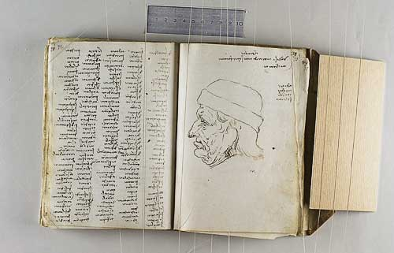
Codex Trivulzianus
This notebook originally contained 62 sheets, but today only 55 remain.
It documents Leonardo's attempts to improve his modest literary education, through long lists of learned words copied from authoritative lexical and grammatical sources. The manuscript also contains studies of military and religious architecture.

Slide 26
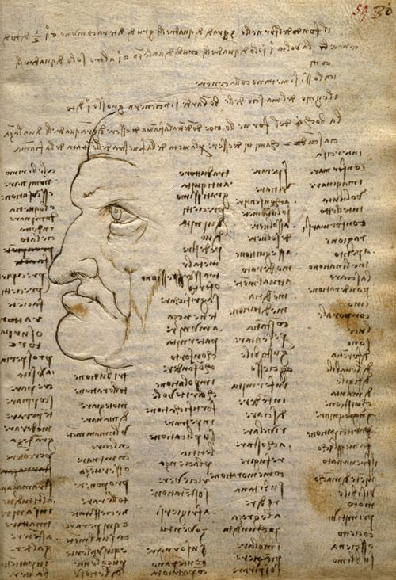
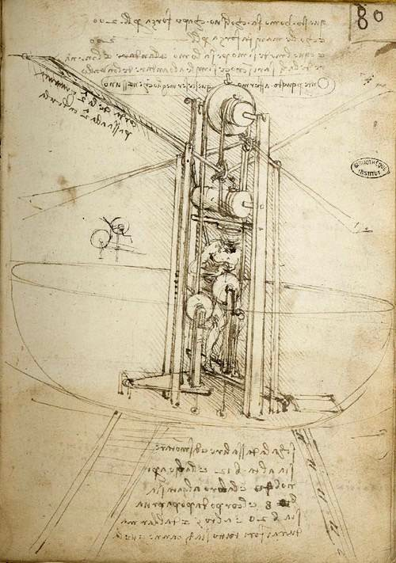

Slide 27
2. Dimonstrazione

Slide 28
Dimonstrazione
A commitment to test knowledge through experience, persistence, and willingness to learn from mistakes.

Slide 29
Dimonstrazione: Checklist
I am willing to acknowledge my mistakes
I learn from my mistakes
I question “conventional wisdom”
I am influenced by celebrity endorsements
I can articulate my fundamental beliefs
I can change my beliefs based on experience
I persevere in the face of obstacles
I view adversity as an opportunity for growth
I am sometimes susceptible to superstition

Slide 30
Dimonstrazione
Examine your experience
Think of 5-7 experiences in your life that have been very influential
Write a sentence about what you learned from each of those experiences
Which is the single most influential?
How has this coloured you attitudes?
Can you rethink conclusions drawn from this experience?

Slide 31
Dimonstrazione
We have a range of beliefs
Human nature
Ethics
Politics
Ethnic groups
Scientific truth
Religion
Medicine
Life
Art
Marriage
History

Slide 32
Dimonstrazione
How would they be different if you;
Lived in a different country
Came from another religious background
Were twenty years older
Were twenty years younger
Were a member of the opposite gender

Slide 33
Dimonstrazione
Fight commercial tricks;
Get a magazine
Look at the advertisements
What tactics are being used in the ads?
Relationship-related
Coolness
Hero fantasies
Repetition
Endorsements

Slide 34
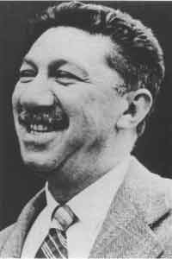
Abraham Maslow
Born April 1, 1908
Died June 8, 1970
Born in Brooklyn, New York
An American psychologist who was best known for creating Maslow's hierarchy of needs

Slide 35
Maslow’s Hierarchy of Needs

Slide 36
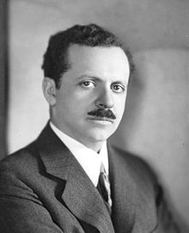
Edward Bernays
Born November 22, 1891
Died in March 9, 1995
Born in Vienna, Austria-Hungary
A pioneer in the field of public relations and propaganda, referred to as "the father of public relations".

Slide 37
Dimonstrazione
List the three best ads you have seen
What makes them so good?
Consider purchases you have undertaken in the last year that were influenced by ads
Try a “stream of consciousness exercise on the topic “The role of advertising in the formation of my values and self-image”

Slide 38
Dimonstrazione
Identify Anti-role models
Look for three people who regularly make mistakes that you think are obvious
What can you learn from their mistakes?
They may do positive things also
What can you learn there?

Slide 39
Dimonstrazione
Explore attitudes to mistakes
What did you learn from school about making mistakes?
What did your parents teach you about making mistakes?
What is the biggest mistake you have ever made?
What mistakes do you repeat?
What role does fear of making mistakes play in your life, your work, at home?
Are you more likely to make mistakes of commission, or omission?

Slide 40
Get Over a Fear of Failure
Author Warren Berger outlines six questions to ask yourself to kill those fears
What would you attempt to do if you knew you could not fail?
What if I fail—how will I recover?
What if I do nothing?
What if I succeed?
What's truly worth doing, whether you fail or succeed?
In this failure, what went right?

Slide 41
3. Sensazione

Slide 42
Sensazione
A continual refinement of the senses, especially sight, as enlivened experience.

Slide 43
Sensazione
Da Vinci’s motto:
“Saper vedere” = knowing how to see

Slide 44
Sensazione
What is the most beautiful thing that you have ever seen?
The sweetest sound that you have ever heard?
The most tender touch?
Imagine a delicious taste
And a wonderful aroma

Slide 45
Sensazione: Visual
Find out the exact time of sunset/sunrise
Find a quite spot outdoors
Relax, enjoy it,
Note down details in your notebook

Slide 47
Sensazione: Visual
Study the lives of your favourite artists
Make a list of your top ten painters
Set a period of time (a month, 6 weeks, etc.) to study their life and their work
Hang reproductions in your house
Write about them in your notebook

Slide 48
Sensazione: Visual
Visualization
Visualization is a technique that Leonardo used a great deal in his work, and is now used by top athletes and business executives.
It is simply a matter of imagining (practicing) a performance before you do it, to allow your brain to match the imagination.

Slide 49
Sensazione: Visual
Visualization
Practice visualization
In the morning upon waking
At night as you are about to sleep
When travelling as a passenger
Whenever you are relaxed

Slide 50
Sensazione: Visual
Visualization using Art
Find a quiet place and study a particular work of art.

Slide 51
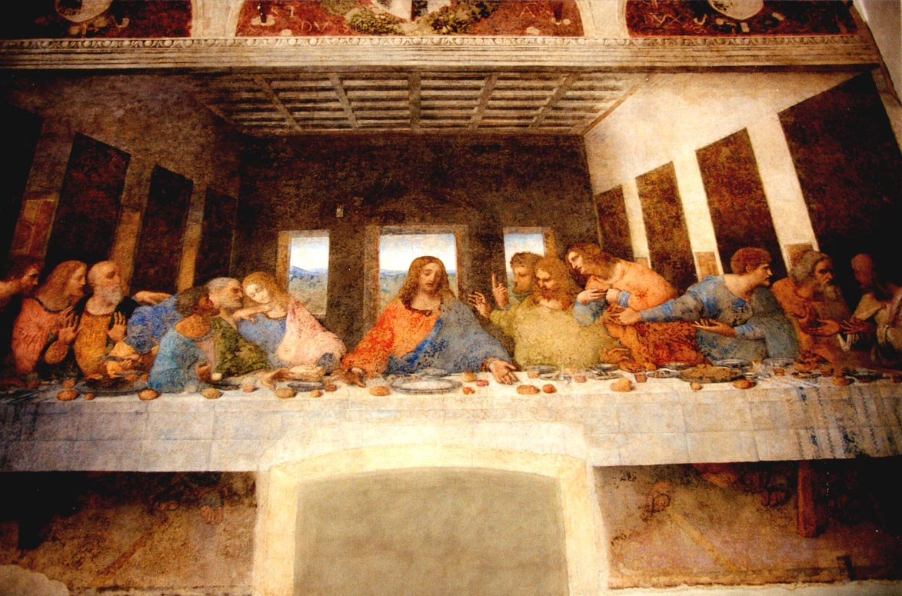

Slide 52
Experience it visually

Slide 53
imagine what the sounds and smells would have been

Slide 54
What would the food have tasted like ?

Slide 55
...and your own questions

Slide 56
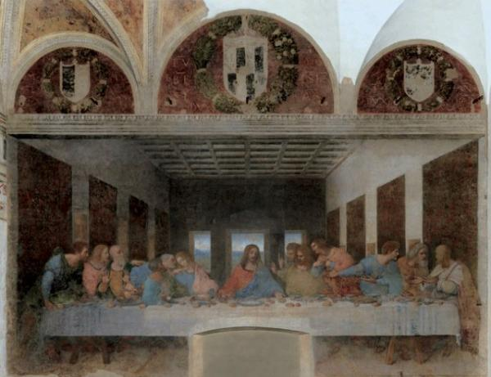

Slide 57
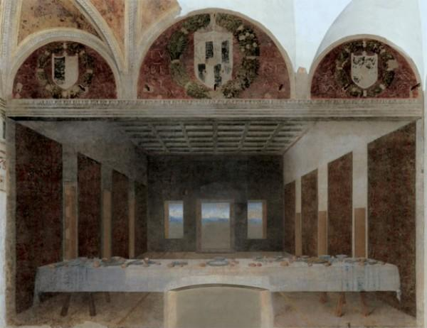

Slide 58
Sensazione: Visual
Draw
Draw
Draw
Draw
Draw
Draw
Draw

Slide 59
Sensazione: Visual
Learn how to draw
Identify approaches
Get good pencils and paper
Take lessons or get a book
Doodle
Scribble
Etc.

Slide 60
Sensazione: Listening
Listen for silences
In conversation
In background noise
In music
When do the silences occur?
How to they sound?

Slide 61
Sensazione: Listening
Listen to music
Listen to music you love
Listen to different styles of music
Listen to patterns in music

Slide 62
Sensazione: Listening
Study the lives of your favourite musicians
Make a list of your top ten musicians
Set a period of time (a month, 6 weeks) to study their life and their work
Listen to the work – major and minor
Write about them in your notebook

Slide 63
Sensazione: Smell
Focus on smell for a day
Observe all the typical smells you encounter on a day-to-day basis.
Discuss them in your notebook

Slide 64
Sensazione: Smell
Locate a range of objects that create a range of smells;
Old tee shirts
A rose
Seaweed
Wood
Orange
Soil
Cigars
Etc.
Note down your reaction to each of them in your notebook

Slide 65
Sensazione: Smell
Make your own perfume;
Go to a fragrance shop
Locate smells that you like
Mix them together
Is the result better or worse ??
Discuss in your notebook

Slide 66
Sensazione: Taste
Compare different tastes
Different honeys
Different chocolates
Different grapes
Different ice creams
Note differences in your notebook

Slide 67
Sensazione: Touch
Blindfold touch
Rubber ball
Silk
Ceramic
Velcro
Leaf
Bowl of ice
Velvet
Describe in terms of textures, weight, temperature, and other sensations.

Slide 68
Sensazione: Synesthesia
Draw music
Make sounds of colour
Imagine if Mozart were a painter or Michelango a composer
who would they be most like?
What sort of art would they create?

Slide 69
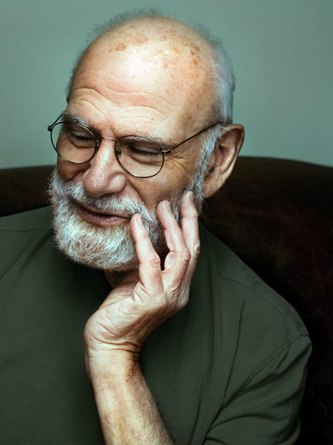
Oliver Sacks
Born 9 July 1933
Born in London, England
A British-American neurologist, psychologist, writer, and chemist who is Professor of Neurology at New York University School of Medicine.

Slide 71
Sensazione: Maestro’s Room
Create your own studio
Find a room, put a sign on the door
Get good lighting – UV-radiation full-spectrum, sun lamps
Install a good stereo system
Hang art on the walls, add plants
Comfortable furniture – hammock, bean bags
Feng Shui it up!
Air – (de)humidifer, heater/fan, aromas.

Slide 72
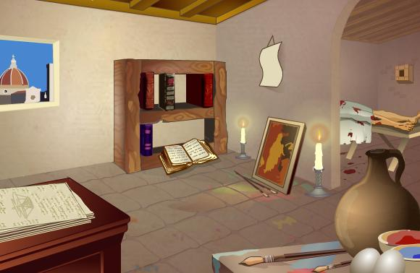
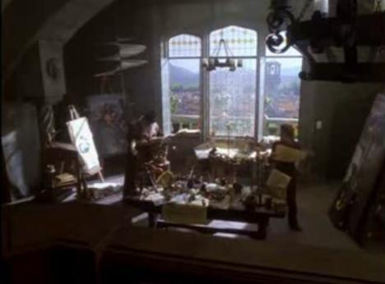
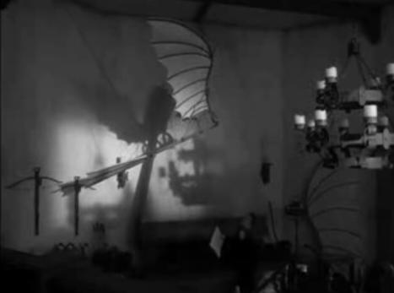
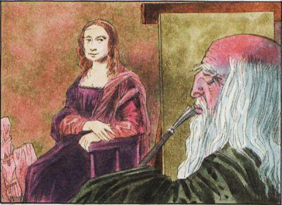

Slide 73
4. Sfumato

Slide 74
Sfumato
literally “Going up in Smoke”
A willingness to embrace ambiguity, paradox, and uncertainty.

Slide 75
Sfumato: Self Assessment
I am comfortable with ambiguity
I am attuned to my intuitions
I thrive on change
I see humour in life
I seem to “jump to conclusions”
I enjoy riddles, puzzles and puns
I usually know when I am feeling anxious
I delight in paradox
I think conflict can help creativity

Slide 76
Sfumato
Are there paradoxes at the heart of any of the questions you have listed for yourself?
What music do you think best expresses ambiguity?
Draw some abstract art in your notebook

Slide 77
Sfumato
List three situations in your life (past or present) where ambiguity reigns
Waiting to hear about a college place
Considering leaving your job
Considering proposing to your partner
Describe the feelings you have in these situations, how did it feel? If it had a shape, colour or taste what would it be?

Slide 78
Sfumato
Count the number of times in a day you use absolute terms such as “totally”, “always”, “certainly”, “must”, “never”, and “absolutely”
Consider how you close conversations, do you typically end conversations with either a statement or question?

Slide 79
Sfumato
Meditate on the Mona Lisa
It is so familiar that it is rarely seen
Focus on the Mona Lisa for a while, allow time for your analytical mind to be hushed and experience the painting

Slide 80
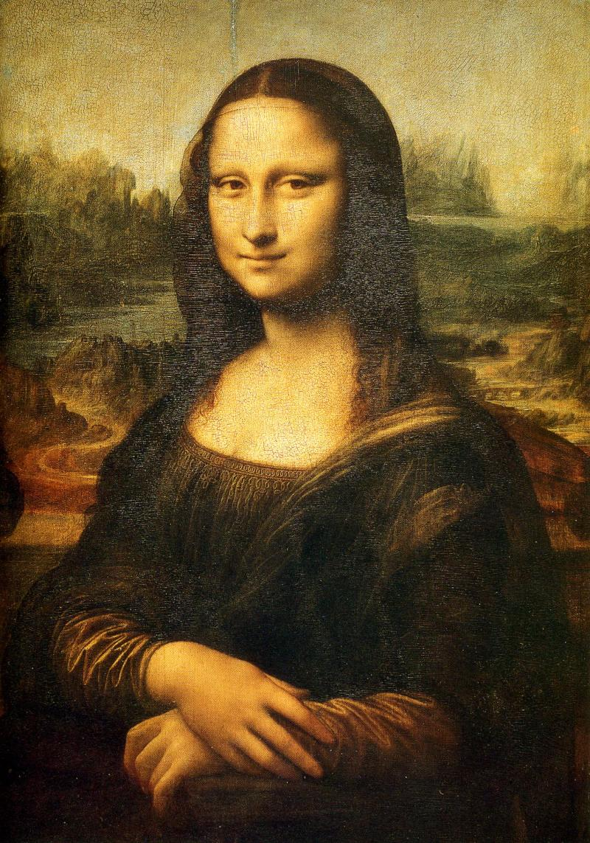

Slide 81
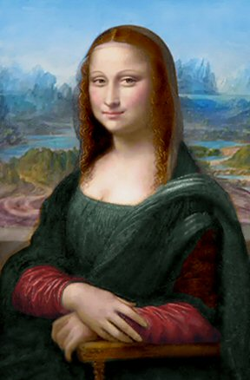

Slide 83
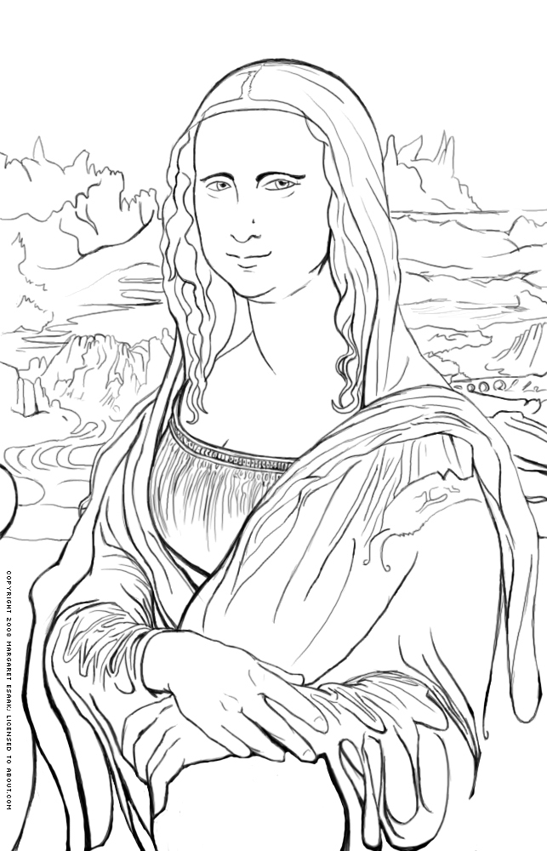

Slide 85
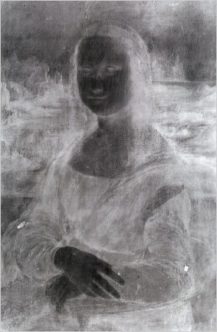

Slide 87
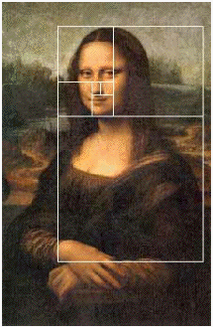

Slide 89
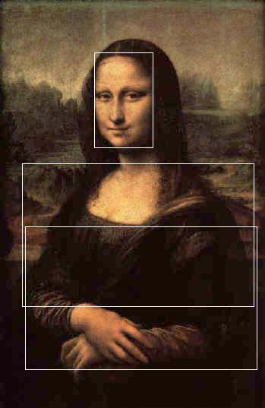

Slide 91
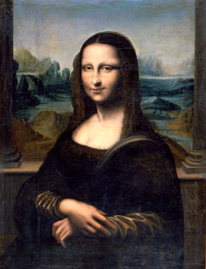

Slide 93
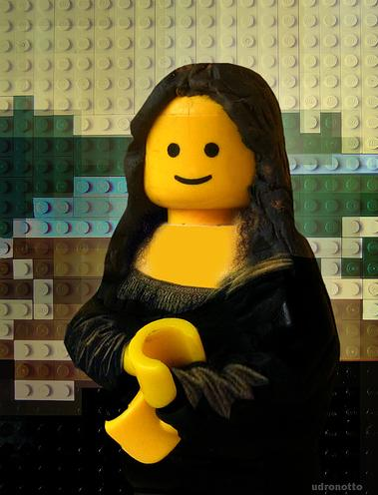

Slide 95
Sfumato
When do you have your best ideas?
Resting in bed
Walking in the outdoors
Listening to music
While driving
In the bath/shower
How many people say “at work” ?

Slide 96
5. Arte/Scienza

Slide 97
Arte/Scienza
A development of the balance between science and art, logic and imagination. “Whole brain” thinking.

Slide 98
Arte/Scienza: Self Assessment
I like details
I am almost always on time
I am skilled at mathematics
I rely on logic
I am organised
I like lists
I am highly imaginative
I am good at brainstorming
I often say or do the unexpected
I love to doodle
I rely on intuition
I often lose track of time

Slide 99
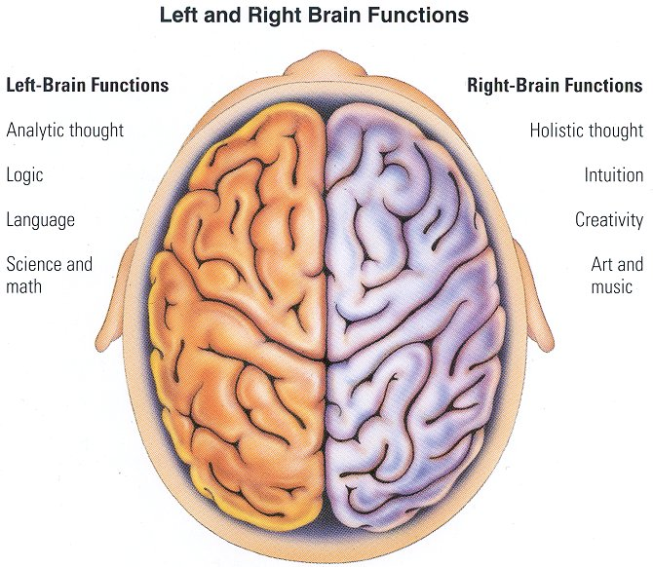
Arte/Scienza

Slide 100
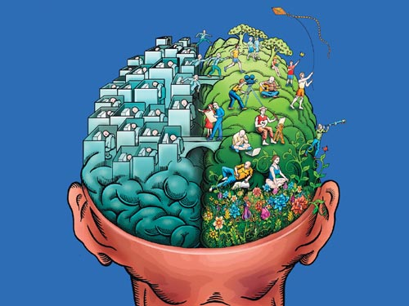
Arte/Scienza

Slide 101
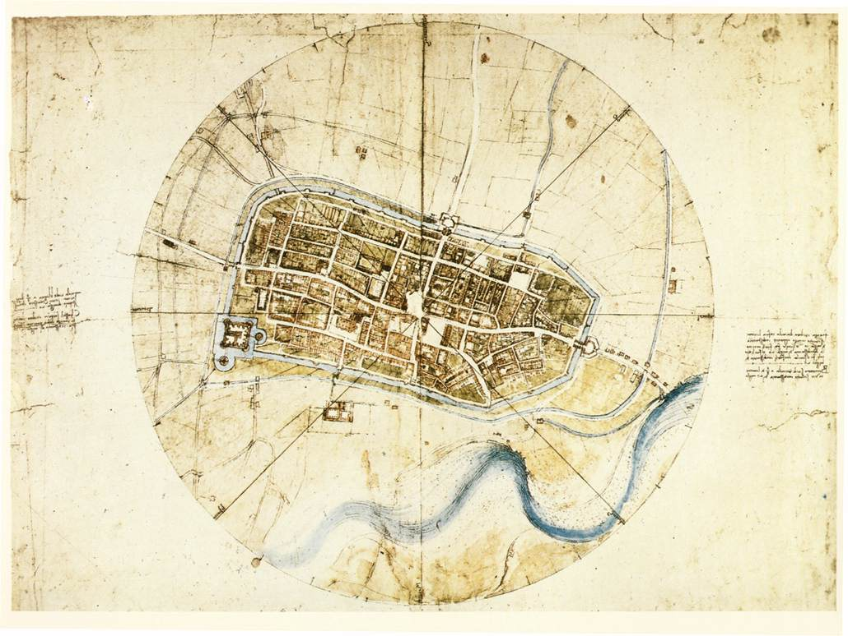

Slide 102
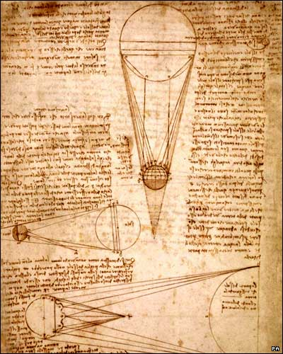
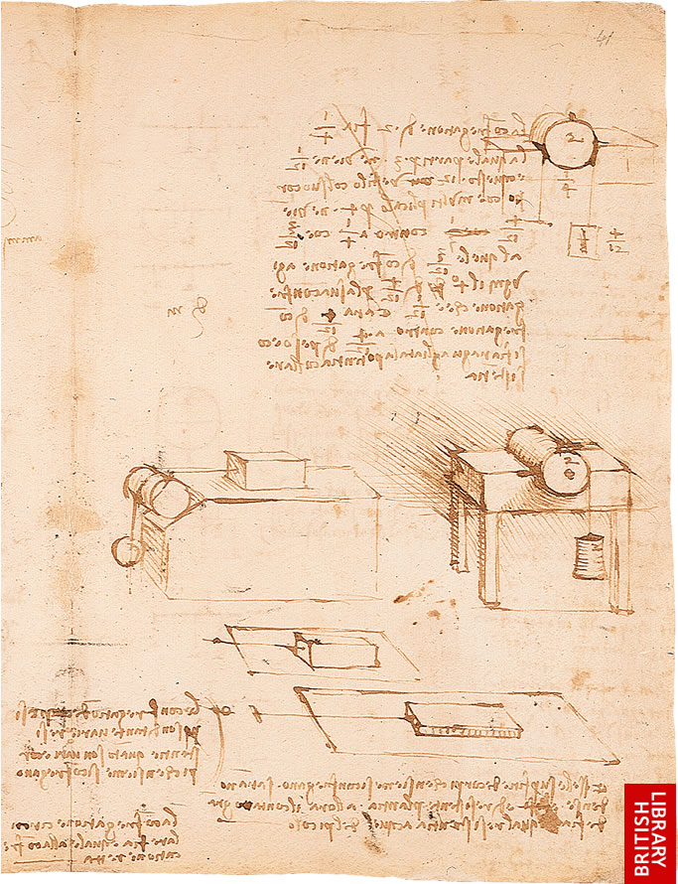
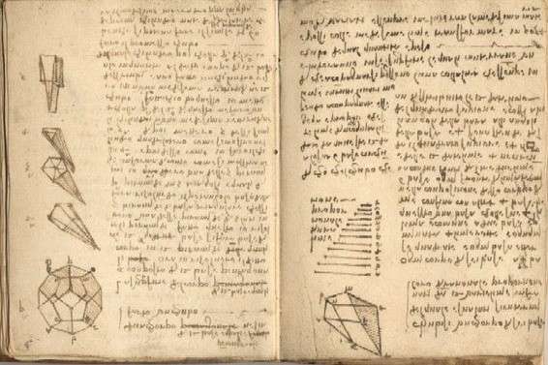
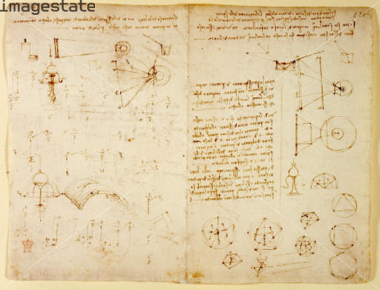
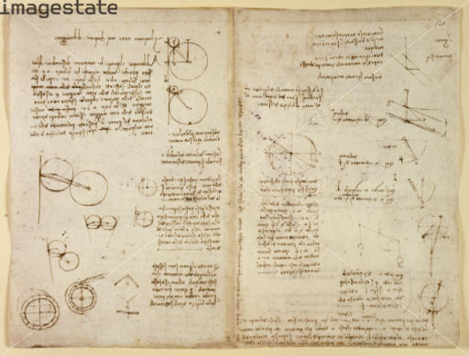

Slide 103
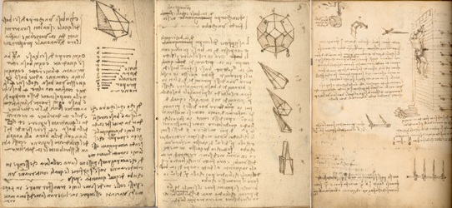

Slide 105
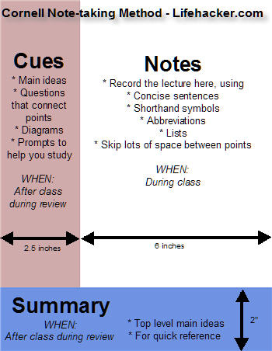
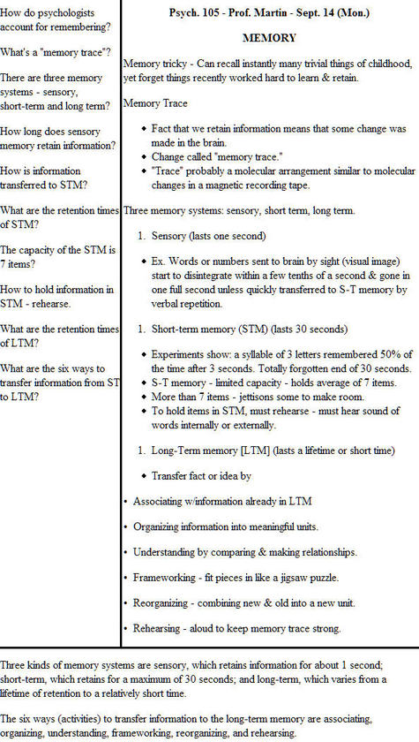

Slide 108
Arte/Scienza

Slide 109
Arte/Scienza

Slide 110
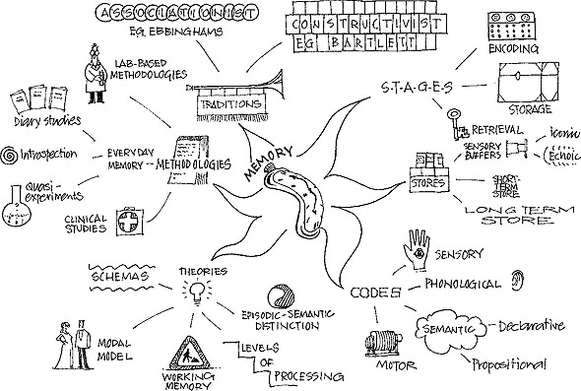
Arte/Scienza

Slide 111
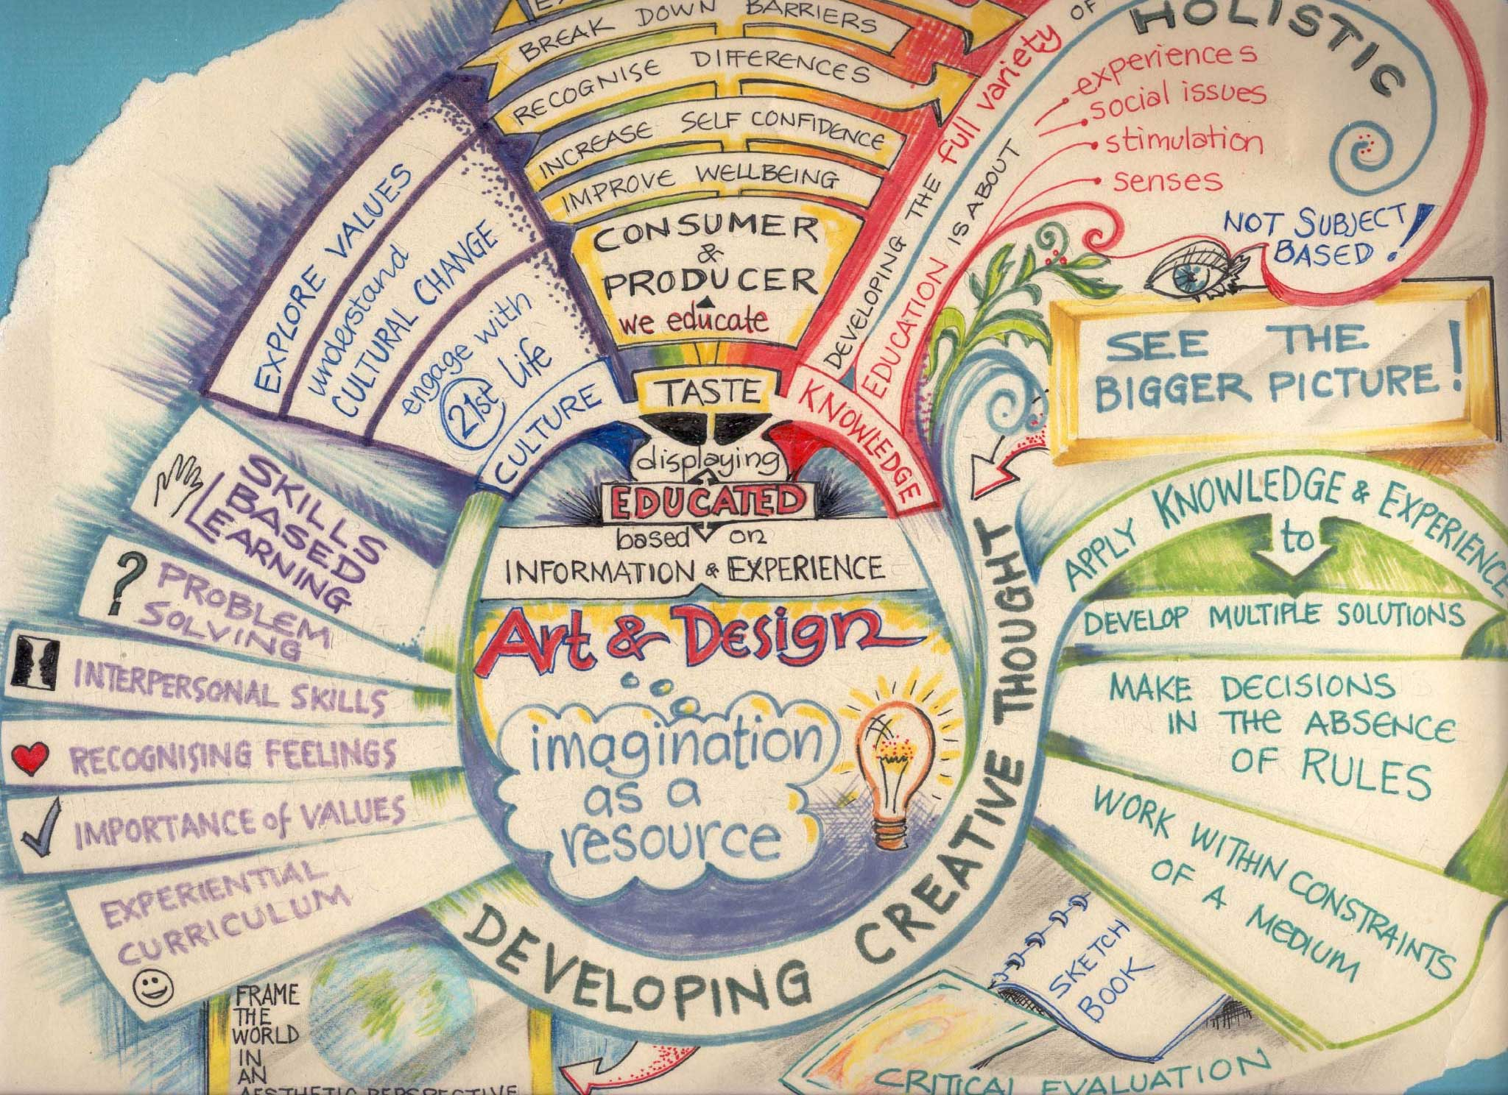
Arte/Scienza

Slide 112
Arte/Scienza
Make a mindmap about your job

Slide 113
6. Corporalita

Slide 114
Corporalita
The cultivation of grace, ambidexterity, fitness, and poise.

Slide 115
Corporalita: Self Assessment
I am aerobically fit
I am getting stronger
My flexibility is improving
I know when I am tense
I am knowledgeable about diet
Friends describe me as graceful
I am aware of the way my attitude can affect my physical state
I love to move

Slide 116
Corporalita
Aerobic exercise
Do something you enjoy
Walking, running, dancing, swimming
Strength training
Find a coach
Flexibility exercise
Stretching exercises

Slide 117
Corporalita
Study anatomy
Read a book on anatomy
Take a walk and see how
Your head sits on your neck
How your arms hang from your shoulders
How your hips bend and swing

Slide 118
Corporalita
The Alexander Technique
a technique of body reeducation and coordination, accomplished through physical and psychological principles. The technique focuses on the self-perception of movement and has applications in alleviating back pain, promoting rehabilitation after accidents, improving breathing, playing musical instruments or singing.

Slide 119
Corporalita
Cultivate Ambidexterity
Cross your arms and legs in the opposite to the normal way you do it
Use your non-dominant hand to turn on lights, brush your teeth, etc. record the feeling
Try writing with your non-dominant hand
Try drawing with both hands simultaneously
Experiment with mirror writing

Slide 120
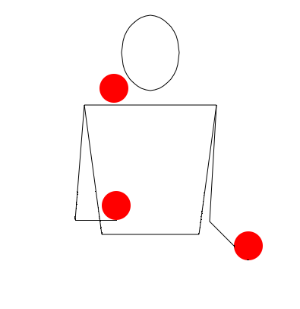
Corporalita
Cultivate Ambidexterity
Learn to juggle

Slide 121
7. Connessione

Slide 122
Connessione
The recognition of and appreciation for the interconnectedness of all things and phenomena, system thinking.

Slide 123
Connessione: Self Assessment
I am ecologically aware
I enjoy similes, metaphors and analogues
I make connections that others don’t see
When I travel, I am struck by people’s similarities than their differences
I seek a holistic approach to diet, health, and healing
I see things as patterns, systems, and networks
My life goals are clearly formulated
I feel a sense of connectedness with nature

Slide 124
Connessione
What does wholeness mean to you?
What does disconnection mean to you?
What different parts make up your character?
Does you experience conflicts between your different parts?
E.g. Does your head, heart and body ever disagree

Slide 125
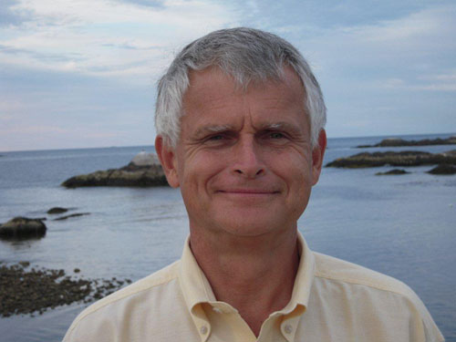
Connessione
Outside Lies Magic
by John R. Stilgoe

Slide 126
Connessione
Outside Lies Magic
What lies along the highway, just out of sight? How about behind that building? Or under the street? Most of us muse idly about such things as we take our walks or drive our cars, but only a few go further and explore the secret histories of the places where we live.

Slide 127
Connessione
Origin-all Thinking
PESTLE
POLITICAL
ECONOMIC SOCIAL
TECHNOLOGY
LEGAL
ENVIRONMENT

Slide 128
Connessione
Origin-all Thinking
Think about the origins of your mobile phone
What are the technical, social, economics forces that led to it’s creation?
Political, economic, social, technical, legal, environmental
What about your wallet?
A book
Your clothes

Slide 129
Connessione
Origin-all Thinking
Nice example found online;
“I developed a talent for understanding 'things'. Let me use an example: I look at a 'C' cell battery. I plug in my education and 'talent' and 'see' it's nature - the zinc, the chemical excitement enclosed, the utilitarian design, the appreciation of social structures arriving upon a uniform shape, the marketing use of the bunny, the need for advanced power sources, the triumph of the human mind coupled with opposable thumbs!”
http://moonstonebooks.proboards67.com/index.cgi?board=buckaroo&action=display&thread=228&page=1

Slide 130
SMART Objectives
Objectives must be
SMART
SPECIFIC
MEASURABLE
AGREED
REALISTIC
TIME BASED
Notes:
SMART Objectives – very common in industry and are used extensively for appraisals and form a simple test of whether the objective is truly a good objective.

Slide 131
SPECIFIC
Make the objective specific
Break large tasks down into smaller tasks
[X] Write your thesis
[√] Write Results chapter of your thesis
[√] Write section 1 of Results chapter of your thesis
Breaking large tasks into smaller ones makes it easier to assess progress
Notes:
Specific – this ties back to the project management module where work breakdown structures where used to split large tasks into much smaller tasks. The aim of doing this allows the objective to be specific. The classic final year PhD student objective is write my PhD. The question of where to start is a difficult one and therefore splitting the task up can make the objective more specific and also achievable within a sensible time frame can help with motivation. Think of other examples of specific objectives. On the previous slide the aim make myself more employable is not at all specific – what is meant by employable !

Slide 132
MEASURABLE
How do you know when you have completed the work
[X] Make more contacts in the my field of research
[√] Make 3 contacts using e-mail
[X] Publish a number of papers from my thesis
[√] Write a paper after my project is over
Make sure they are evidenced based – you should have a deliverable attached to the objective
Notes:
Measurable – You need to know when you have finished the objective / completed the task. There is two elements therefore to writing measurable objectives. They should not include words like more – when do you know when you have made more contacts. Is it one or is it a million. The second element relates to actually having something which you can provide as evidence. Therefore deliverables attached to the objective is good (e.g. Short reports) as these can help you prove that you have achieved the objective (this will be important when you start work!).

Slide 133
AGREED
Get the agreement of the stakeholders in the project
Especially your supervisor!
[X] I think I will finish this set of experiments by the end of March
[X] My supervisor thinks I will finish these experiments by the end of January
[√] We agreed that my objective will be to finish the experiments by the end of February
Notes:
Agreed – In the project management sessions we talked about stakeholders and involving them in the project. Setting your objectives and agreeing them with your supervisor is important. This might take some negotiation but it worth doing this as everybody will be committed to the plan.
Note that if you ever set objectives for someone else make sure you discuss them with them as setting unachievable objectives for someone can prove a source of conflict.

Slide 134
REALISTIC
Will you achieve the objective?
Unrealistic objectives can be very de-motivating
Challenging objectives which are realistic can be motivating
[X] Publish 10 papers from my thesis
[√] Publish a paper from my thesis
Notes:
Realistic Objectives – It is important that the objectives you set are realistic. All too often people will set very unrealistic objectives and the end result is that the project is not delivered on time, resentment develops within the project stakeholders etc. Furthermore if you are being assessed against the objectives which are set, if they are unrealistic you may not achieve any of them! It is however important to set your self challenging objectives which you could achieve if you apply yourself – these are often referred to as stretch targets and are used to motivate staff.

Slide 135
TIME BASED
Set timescales on your objectives
Deadlines and Milestones
Review progress against these deadlines
[X] Finish writing my literature review
[√] Finish the first draft of my literature review by the 1st of December
Notes:
Time Bound – It is important that there is an element of time linked to the objective. Again if the objective is open ended when do you when you have achieved the objective. Therefore set yourself deadlines and review yourself against them – don’t let the deadlines slip as the progress of the project overall could be in jeopardy. These can also be a useful time management tool as often people will work on something when little value is being added (80% of the value is provided by 20% of the effort) and a dealine can be used to force you to move on to the next objective.

Slide 136
TIME SCALES
Set objectives at multiple timescales
This week I will read 4 papers on modelling
This month I will prepare a short report on modelling
In the next 2 months I will review the three principle modelling techniques and write the literature review of these techniques for my thesis
Notes:
Time scales - It is useful to set objectives at multiple levels – one week, one month, 6 months – 1 year. This will let you focus on the big picture as well as on the short-term tasks. A useful technique which can be used to improve your time management is to set weekly SMART objectives to help organise your time. The objectives at a number of timescales can be linked back to the WBS discussed in the project management session – the bottom level tasks may be weekly objectives whilst the higher level tasks are longer term.

Slide 137
Connessione
Timeline of your life
Create a time line of your life
Highlight the key events
Either personally or globally

Slide 138
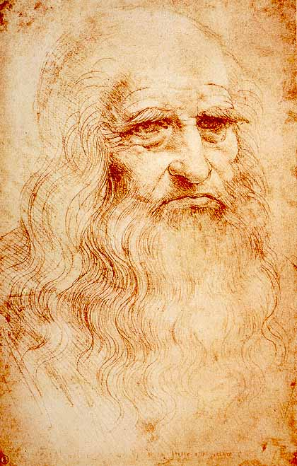
Seven Principles
Curiosità
Dimonstrazione
Sensazione
Sfumato
Arte/Scienza
Corporalita
Connessione

