Slide 1
Fostering Innovation Thinking
Damian Gordon

Slide 2
What is INNOVATION?

Slide 3
What is INNOVATION?

Slide 4
What is INNOVATION?

Slide 5
What is INNOVATION?
IDEA

Slide 6
What is INNOVATION?
INVENTION
IDEA

Slide 7
What is INNOVATION?
PRODUCT (Tech, Brand, Package)
INVENTION
IDEA

Slide 8
What is INNOVATION?
BUSINESS (legal, accounting)
PRODUCT (Tech, Brand, Package)
INVENTION
IDEA

Slide 9
What is INNOVATION?
MARKET (brand awareness, selling it)
BUSINESS (legal, accounting)
PRODUCT (Tech, Brand, Package)
INVENTION
IDEA

Slide 10
What is INNOVATION?
SUSTAINABLE BUSINESS
MARKET (brand awareness, selling it)
BUSINESS (legal, accounting)
PRODUCT (Tech, Brand, Package)
INVENTION
IDEA

Slide 12
How do
people
learn?

Slide 15
Environment

Slide 16
Sensory
Cognitive
Environment

Slide 17
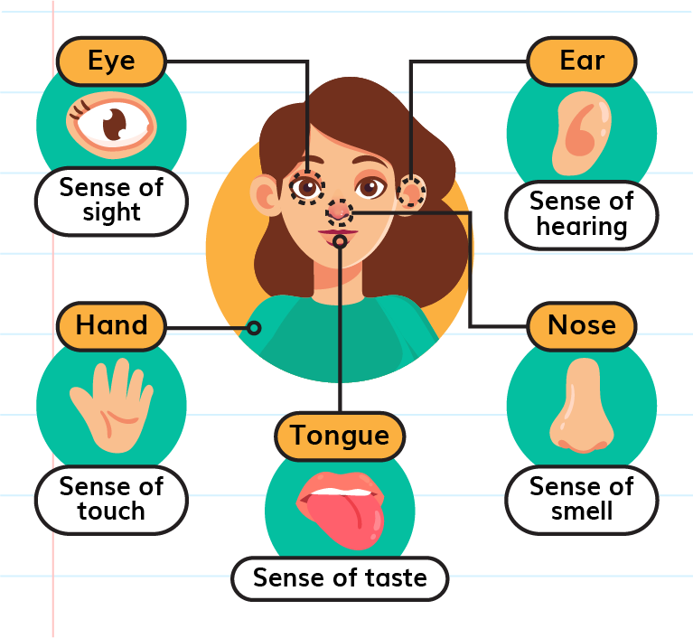
Sensory

Slide 18
Sensory
VARK Model

Slide 19
VISUAL
Diagrams
Videos
Infographic
Charts
Worksheets
Colour Coding
Virtual Reality

Slide 20
VISUAL
Diagrams
Videos
Infographic
Charts
Worksheets
Colour Coding
Virtual Reality
AUDITORY
Podcasts
Group chat
Singing
Reading Aloud
Mnemonics
Presentations
Speech tools

Slide 21
VISUAL
Diagrams
Videos
Infographic
Charts
Worksheets
Colour Coding
Virtual Reality
AUDITORY
Podcasts
Group chat
Singing
Reading Aloud
Mnemonics
Presentations
Speech tools
READ/WRITE
Text
Symbols
Note-taking
Reading
Glossary/Lists
Redrafting
Online forums

Slide 22
VISUAL
Diagrams
Videos
Infographic
Charts
Worksheets
Colour Coding
Virtual Reality
AUDITORY
Podcasts
Group chat
Singing
Reading Aloud
Mnemonics
Presentations
Speech tools
READ/WRITE
Text
Symbols
Note-taking
Reading
Glossary/Lists
Redrafting
Online forums
KINESTHETIC
All-senses
Hands-on
Case Studies
Labs
Field trips
Lego
Simulations

Slide 23
Sensory
Cognitive
Environment

Slide 24
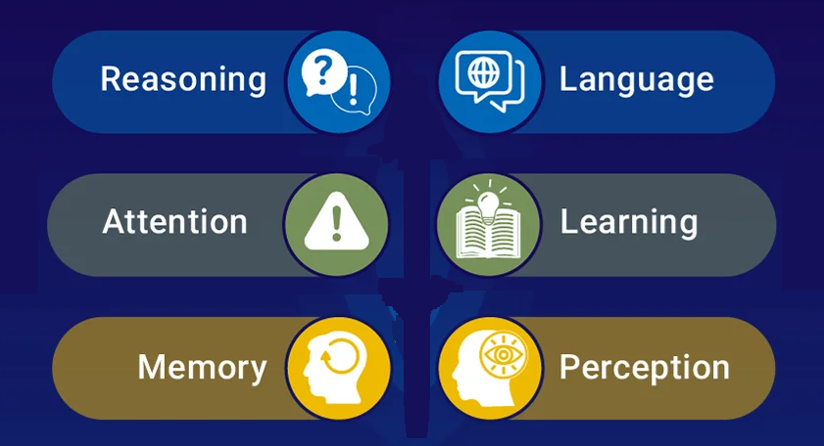
Cognitive

Slide 25
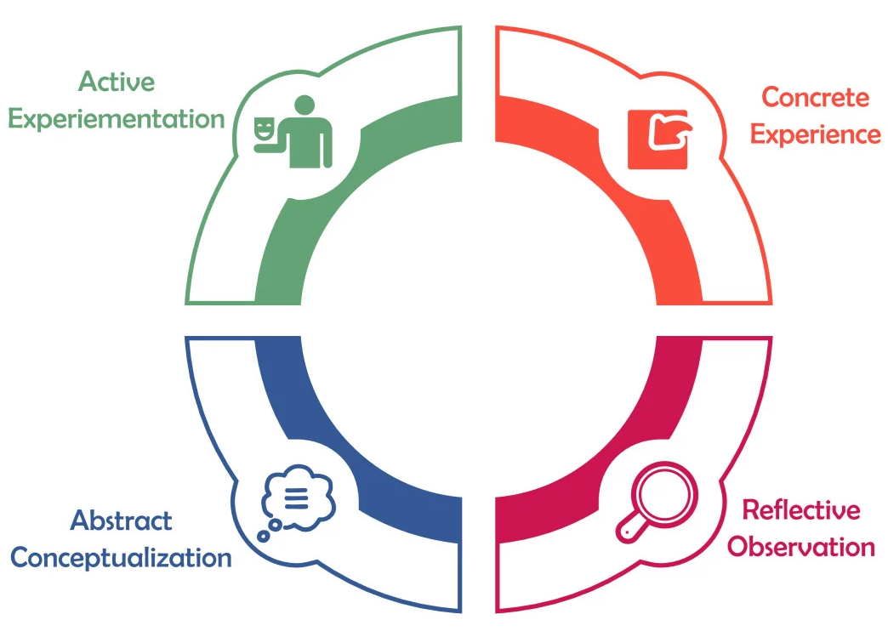
Cognitive
Kolb Model

Slide 26
Cognitive
Creative
Constructive
Practical
Pragmatic
Intrapersonal
Interpersonal
Abstract
Analytical
Kolb Model

Slide 27
ABSTRACT / ANALYTICAL
Logic Games
Fallacies
Programming
Workbooks
Strategy Games
Scientific Exp.
Venn Diagram

Slide 28
ABSTRACT / ANALYTICAL
Logic Games
Fallacies
Programming
Workbooks
Strategy Games
Scientific Exp.
Venn Diagram
PRACTICAL / PRAGMATIC
Examples
Case Studies
Real-world
Simulations
Debates
Worksheets
NoteTaking

Slide 29
ABSTRACT / ANALYTICAL
Logic Games
Fallacies
Programming
Workbooks
Strategy Games
Scientific Exp.
Venn Diagram
PRACTICAL / PRAGMATIC
Examples
Case Studies
Real-world
Simulations
Debates
Worksheets
NoteTaking
CREATIVE / CONSTRUCTIVE
Imagination
Roleplaying
Storytelling
Simulations
Show-and-Tell
Rapid Puzzles
Art projects

Slide 30
ABSTRACT / ANALYTICAL
Logic Games
Fallacies
Programming
Workbooks
Strategy Games
Scientific Exp.
Venn Diagram
PRACTICAL / PRAGMATIC
Examples
Case Studies
Real-world
Simulations
Debates
Worksheets
NoteTaking
CREATIVE / CONSTRUCTIVE
Imagination
Roleplaying
Storytelling
Simulations
Show-and-Tell
Rapid Puzzles
Art projects
INTRAPERSONAL/ INTERPERSONAL
Journaling
Ethical debates
Service-Learning
Mentorship
Peer-Learning
Discussion
Reflection

Slide 31
Sensory/Cognitive
Creative
Constructive
Practical
Pragmatic
Intrapersonal
Interpersonal
Abstract
Analytical
VARK Model
Kolb Model

Slide 32
Critical Thinking
Doing a PMI

Slide 33
Open Innovation
Open innovation is a paradigm that assumes that firms can and should use external ideas as well as internal ideas, and internal and external paths to market, as the firms look to advance their technology”.
The boundaries between a firm and its environment have become more permeable; innovations can easily transfer inward and outward.

Slide 34
Fostering Innovation Thinking
Damian Gordon

Slide 35
Teaching Approaches
Gagné’s Nine Events of Instruction
Reigeluth’s Elaboration Theory
Component Display Theory
Active Learning Approaches
Learning by teaching
Action learning
Failing Forward
Service-learning
Jigsaw
Gallery Walk
Role-Playing
Peer Learning
Peer Assessment
Blended Learning
Flipped Classroom
Cooperative Learning

Slide 36
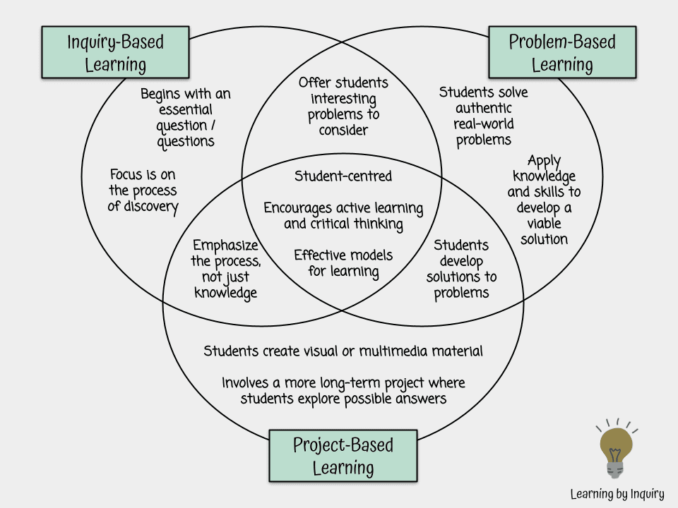
PRACTICAL PROJECTS

Slide 37
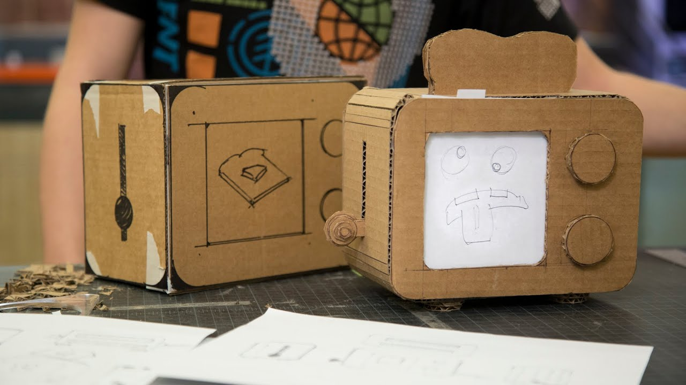
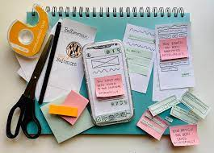
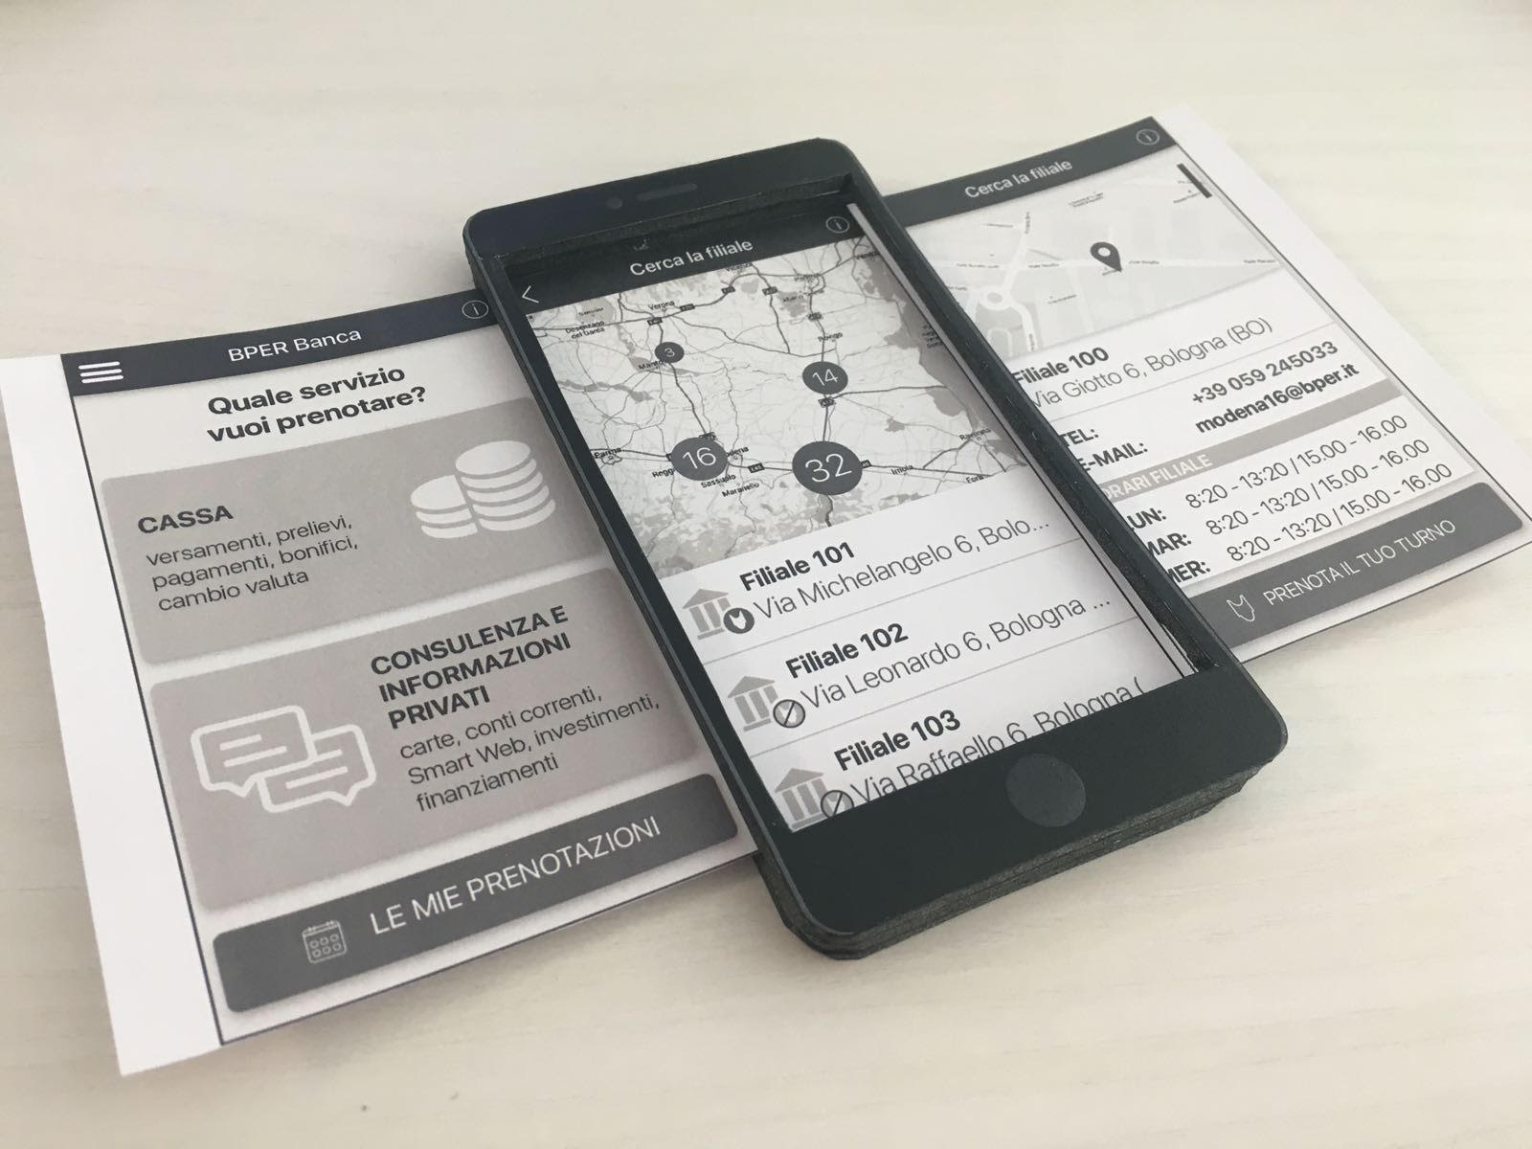
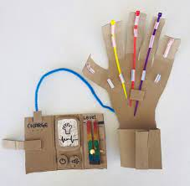
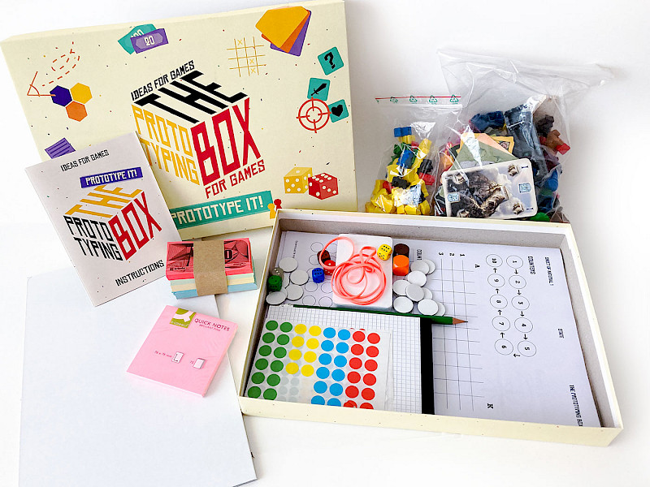
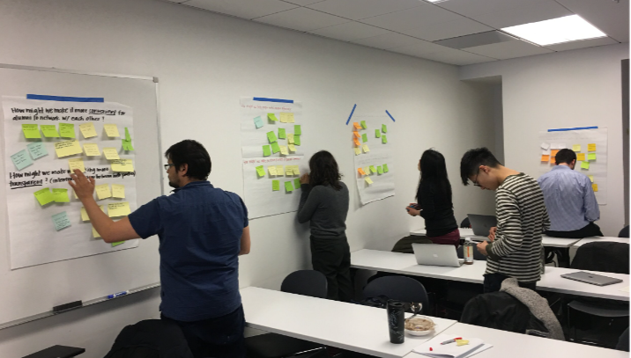
INNOVATIVE LEARNING ENVIRONMENT

Slide 38
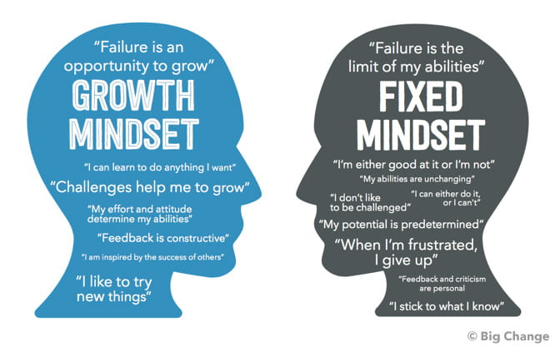
GROWTH MINDSET
Persevere
Be Yourself! ...
Work through problems.
Don't miss a chance! ...
Have courage. ...
Do your best! ...
Keep learners in mind. ...
Apply Yourself.

Slide 39
Mistakes (Embrace failure)
Explore attitudes to mistakes
What did you learn from school about making mistakes?
What did your parents teach you about making mistakes?
What is the biggest mistake you have ever made?
What mistakes do you repeat?
What role does fear of making mistakes play in your life, your work, at home?
Are you more likely to make mistakes of commission, or omission?

Slide 40
Promote Collaboration

Slide 41
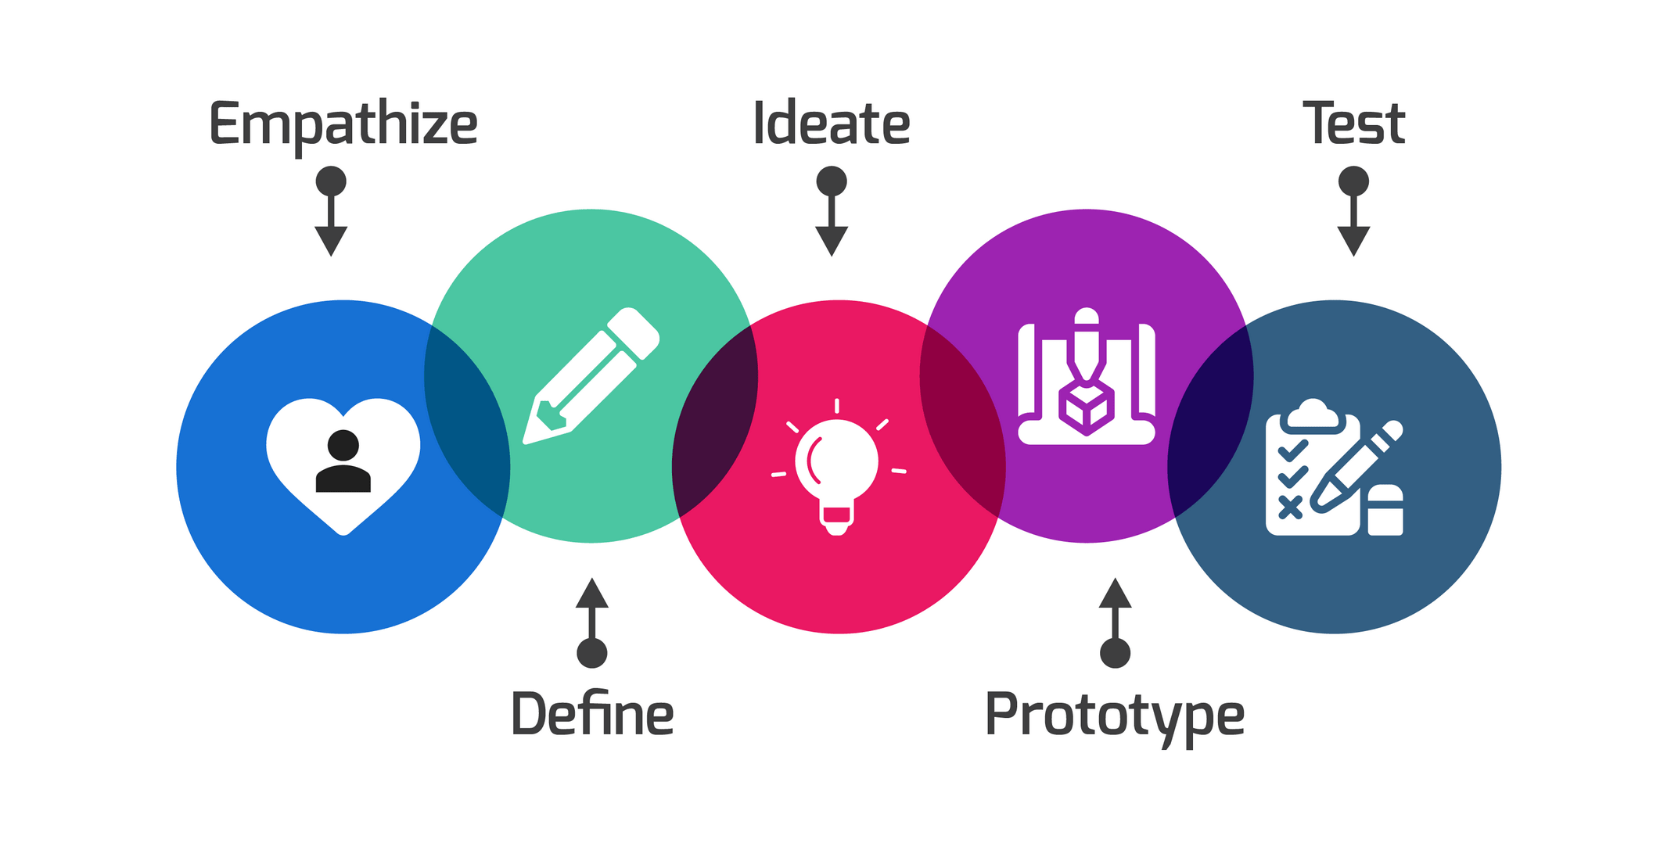
DESIGN THINKING

Slide 42
PROMOTE CREATIVITY AND CRITICAL THINKING

Slide 43
ChatGPT
www.damiantgordon.com/ChatGPT

