Slide 1
Dt-228 Computer Science
Operating systems I
Bryan McDevitt
Matthew Dwyer
Patrick O’Connor
Andrew McGowan
Oghenetega Orugun

Slide 2
Dt-228 Computer Science
Operating systems I
Bryan McDevitt
Matthew Dwyer
Patrick O’Connor
Andrew McGowan
Oghenetega Orugun

Slide 3
What is
the

Slide 4
Contents
1
Tesla
2
Abstergo
3
Testing
4
Uranprojekt
5
Die Glocke
1
6
Early Animus
7
Generations
8
References
3

Slide 5
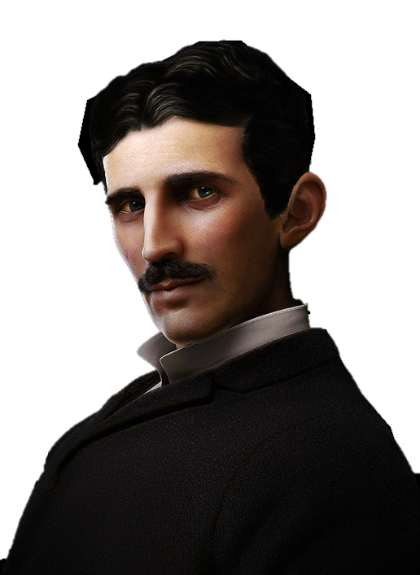
Nikola Tesla
Born 10th of July 1856 in Smilijan in the Austrian Empire (now modern day Croatia).
Parents were Milutin and Duka Tesla.
In 1847 he fled to Tomingai, to avoid being drafted to the army.
Spent much of his time exploring the wilderness and surrounding mountains.
That’s where he found the apple of Eden..
4

Slide 6
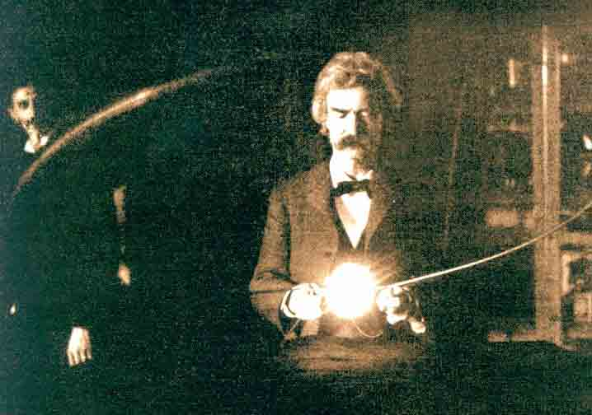
Nikola Tesla
In 1908 he worked for Assassins helping them in recovering one of the staves of eden and destroying a Templar facility in Tunguska.
Designed the Die Glocke in the 1930’s which later on was developed by Abstergo and became known as the animus.
Officially, Tesla died in New York in 1943, however it was rumoured he was still alive working for the Nazi General and Templar, Gero Kramer.
5

Slide 7
\Abstergo
Formed in 1937 by Templars.
Multinational corporate conglomerate and primary front for the Templar Order..
Responsible for the majority of human technological development.
Home of the Animus Project.
6

Slide 8
Early Testing
Uranprojekt
First instance of the animus designed in 1930’s.
Powered by the 4th Apple of Eden, a supernatural object previously possessed by Nikola Tesla and used to develop electricity.
Project started by SS General and Templar Gero Kramer.
Used the Nazi atomic program, “Uranprojekt”, as a guise for their real invention.
The project was intended to create a machine that allowed the user to watch the memories of an individual's ancestors.
8

Slide 9
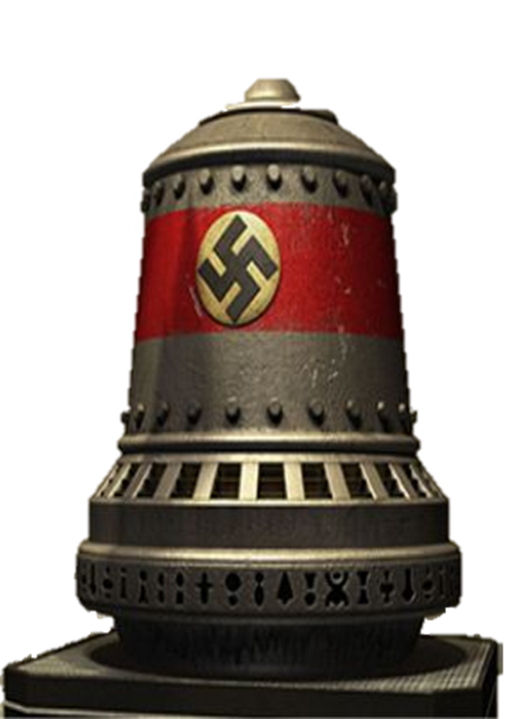
Early Testing
Die Glocke
Designed by Nikola Tesla, Die Glocke was an anti-gravity system capable of generating a wormhole.
This acted as a window to the past of the user.
Tesla was able to construct the machine by coupling his own inventions with technologies stole from the allies by the Nazis.
In 1943, the first prototype was completed.
9

Slide 10
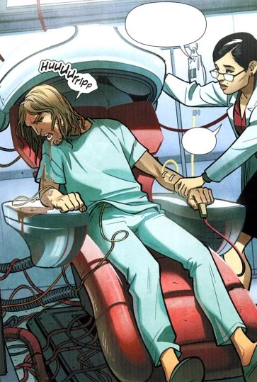
Early Failures
The proto-Animus was operational with Kramer using it on himself
Seemed to work
However, when used on allied spy Eddie Gorm, something went wrong. Due to the design of the proto-Animus, if your descendant is using it to go to your time period while you use it, your consciousness’s will be switched
This is exactly what happened to Gorm, and he woke up in his 21st century decedent's, Maxime, body.
Soon after, the Nazi regime was defeated and the technology was lost until the late 20th century
10

Slide 11
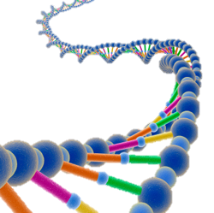
The Animus Project
Dr. Warren Vidic, leading authority on genetic memory, became overseer of the animus project early on
Early development of the Animus began in by Abstergo Industries
Initially relied on hypnosis, psychoanalysis and chemicals to unlock genetic memories.
This changed with the invention of the animus
11

Slide 12
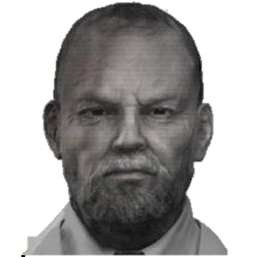
The Animus Project
Experiments began with Subject but the Animus proved too unstable, causing the subject to go into a fatal seizure.
Earliest prototype of the new animus known to exist was made in 198080.
7

Slide 13
The Animus Project
By 1983, Vidic had developed a more stable version of the Animus.
It was used to manipulate the genetic memory of Subject 4 of the Animus Project.
Since then, the machine has gone through several major cosmetic and technical alterations.
By 2000, the appearance of the Animus bore a resemblance to a chair, and required a lot of external wiring to properly function.
12

Slide 14
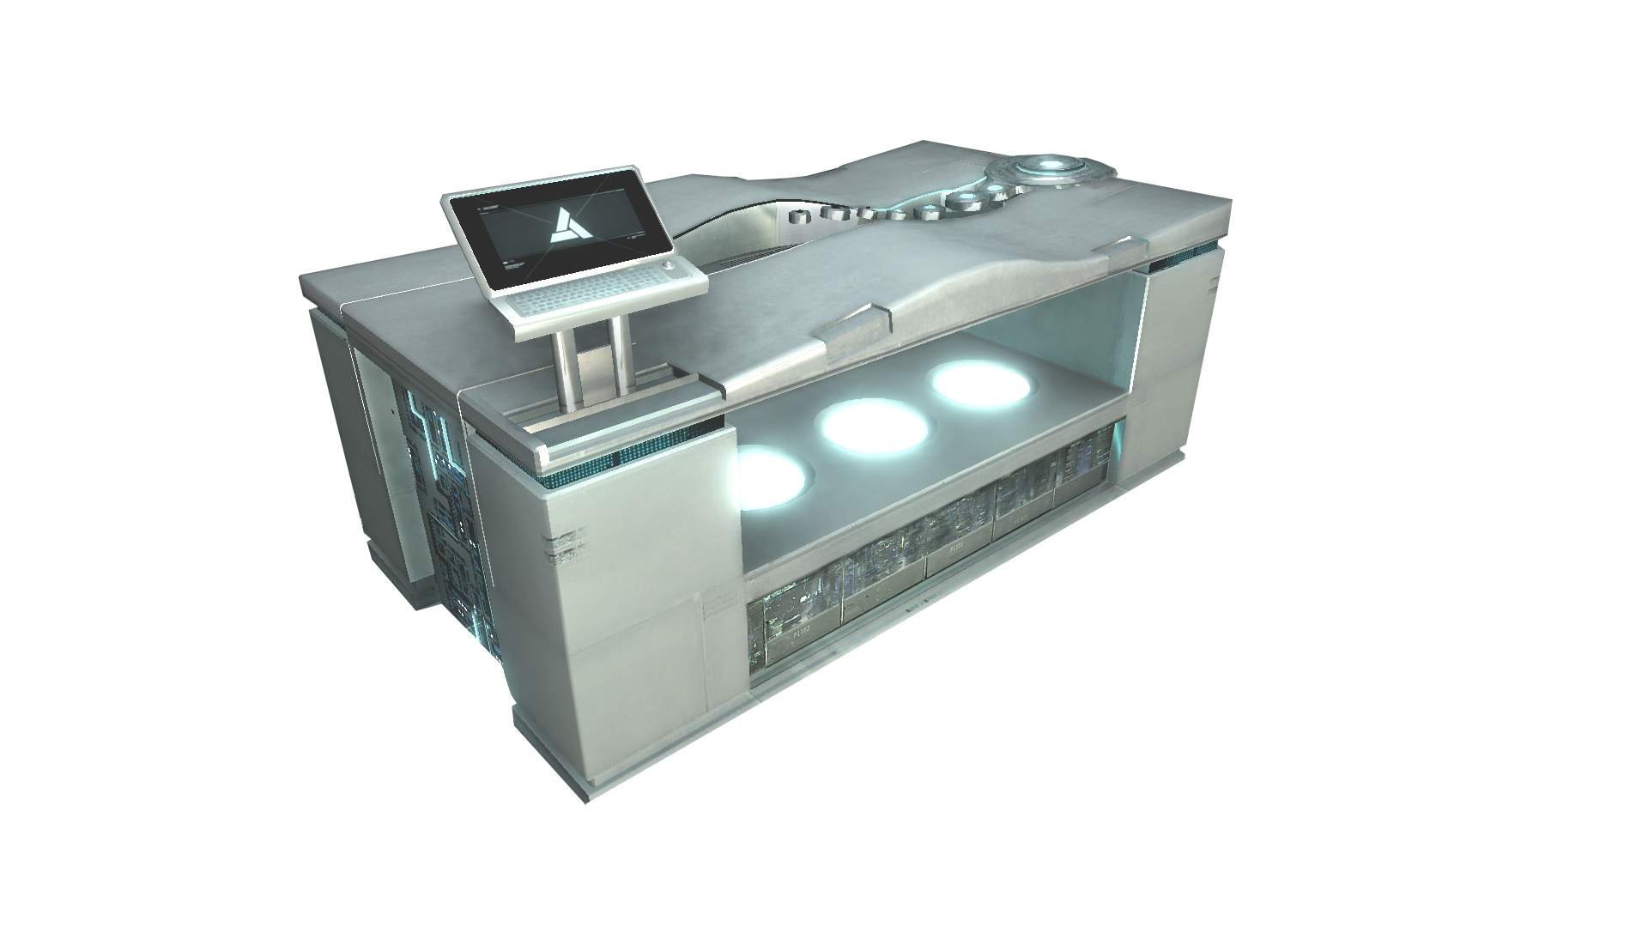
The Animus Project
Over the next 2 years, the Animus prototype was refined further.
By 2002, the new model bore a closer resemblance to a bed and had a chrome-coloured appearance.
This eventually was the model used for the Animus 1.0, the first full version of the Operating System.
13

Slide 15
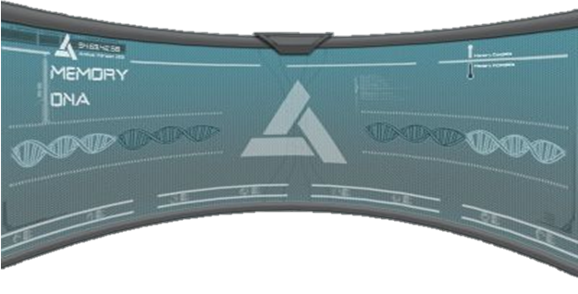
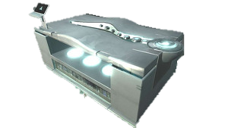
Animus 1.0
Created in 2002 . under management of Jade and Patrice Raymond.
Worked for 9 years to meet the high standards of the consumers.
First operating system to control the heads up display of the animus.
Only received minor updates until Animus OS 1.28 in 2009.
14

Slide 16
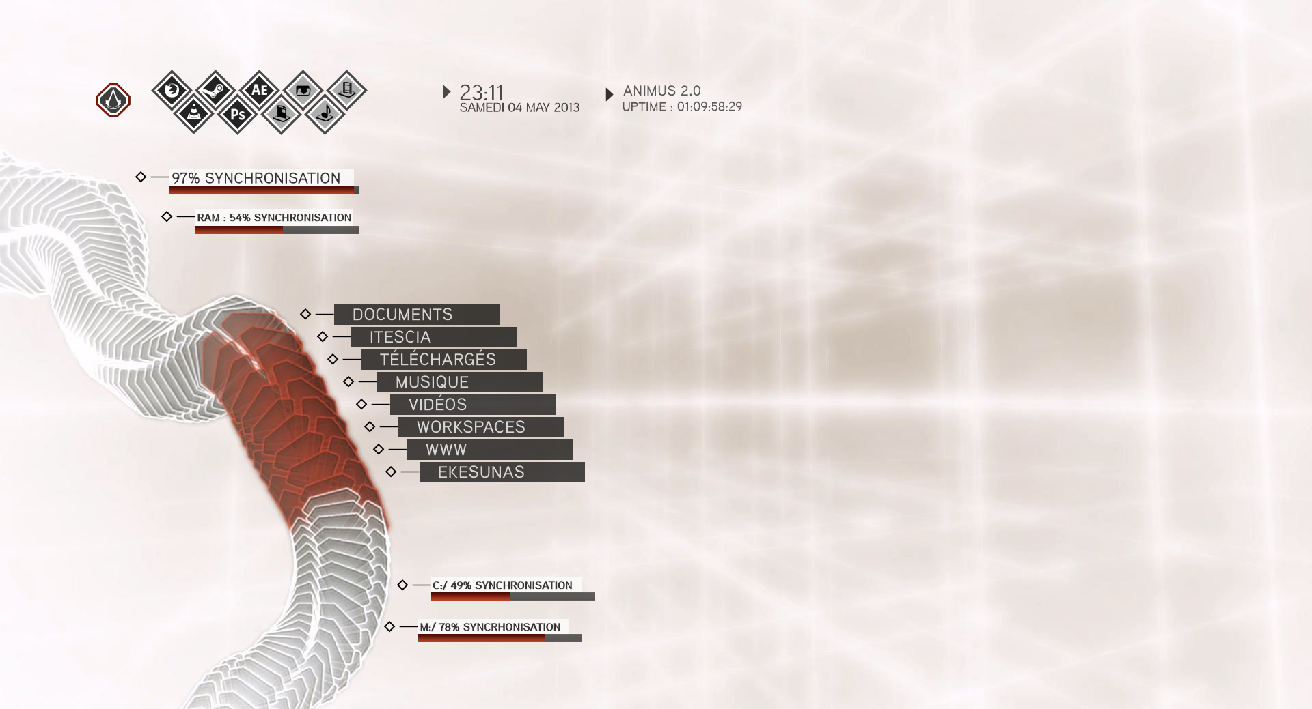
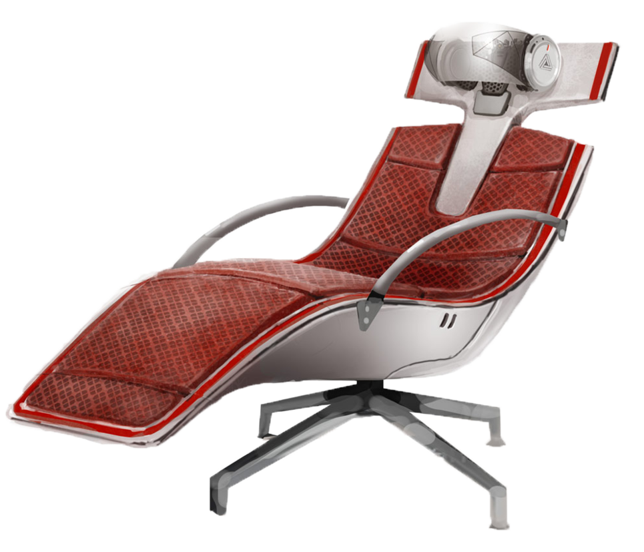
Animus 2.0
Only minor changes made to fit the updated hardware
Most changes were aesthetic to have a clearer, crisper user interface
15

Slide 17
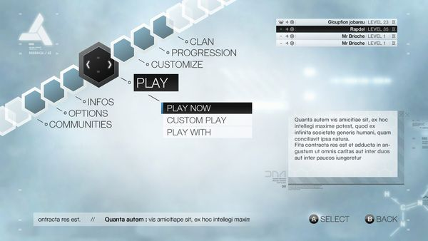
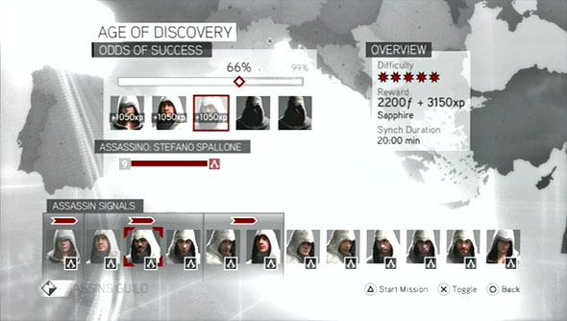
Animus 2.5 - Brotherhood
Released in 2010.
Users can now interact with others using the same OS.
New AI.
Shows important information about places, people and events during your session;
16

Slide 18
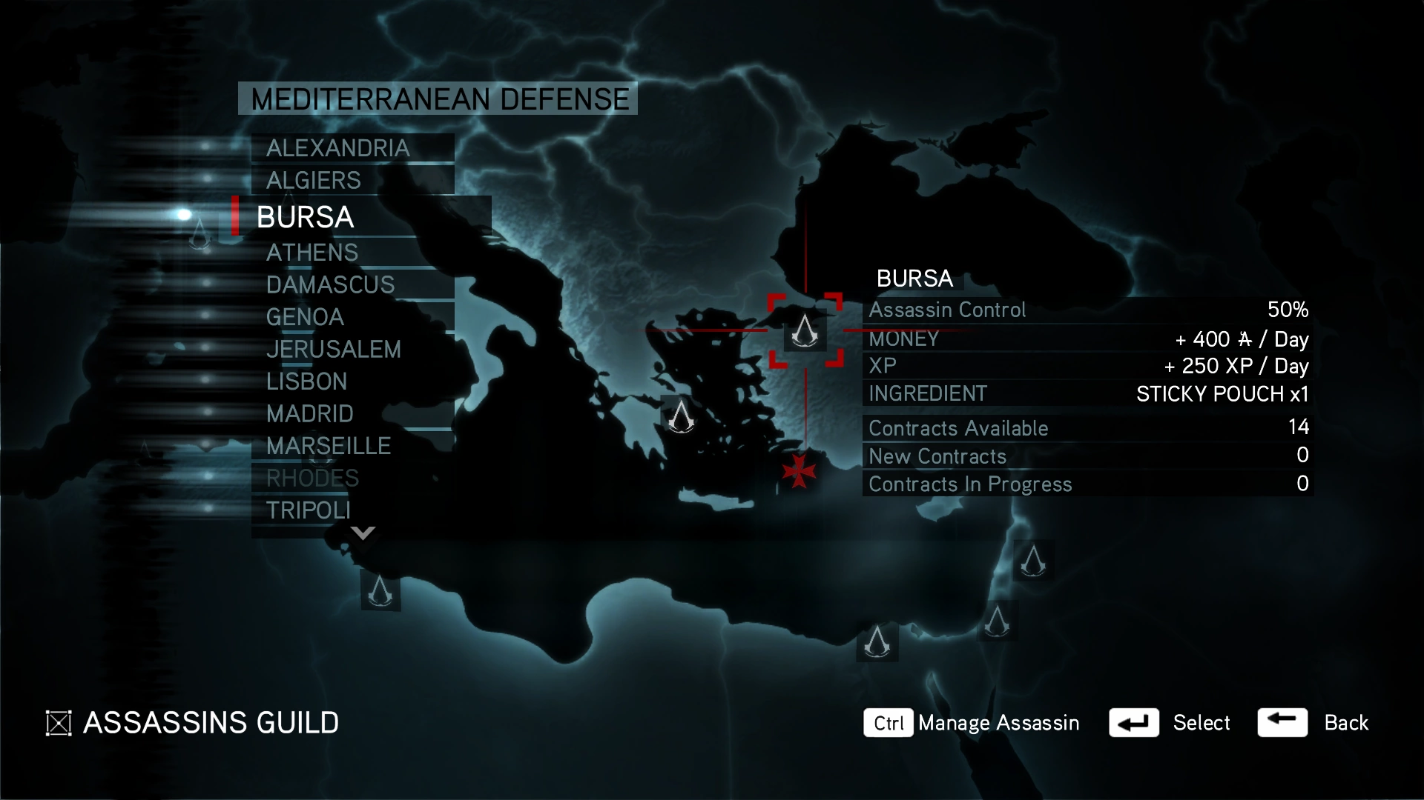
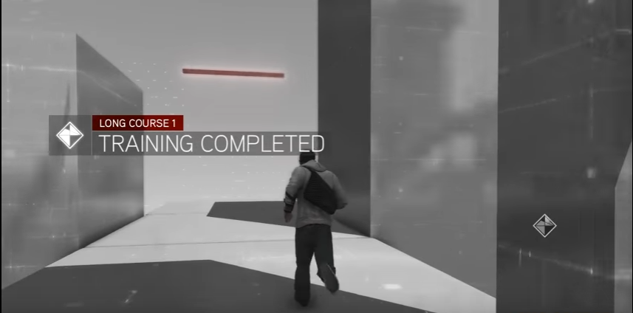
Animus 2.8.7 - Revelations
Released in 2011.
Includes a virtual training program.
AOS 3.0 announced for the last quarter of 2012.
17

Slide 19
Animus 3.0
Meant to be released 30th of October however Abstergo ran into legal issues
Included a day night cycle and seasonal changes
18

Slide 20
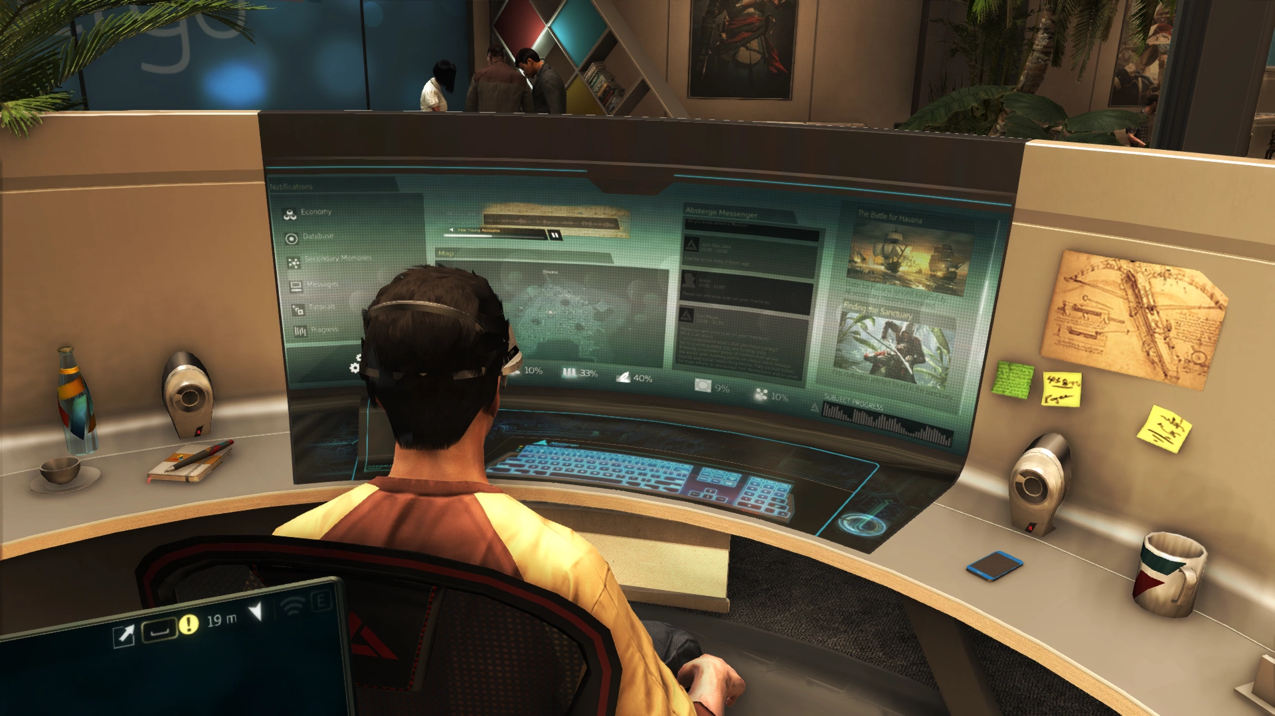
Animus Omega
In 2013, Animus technology had reached the a point where the genetic memories of an individual could be experienced by anyone.
Abstergo used this in their Animus console where the public could experience the past from their own homes.
19

Slide 21
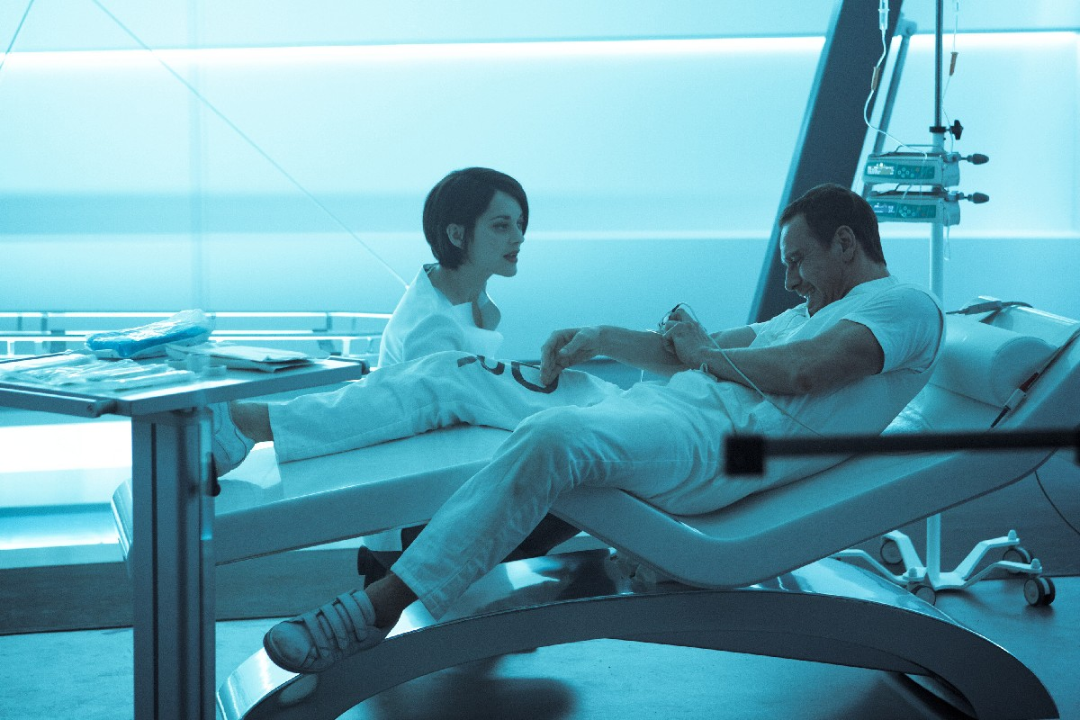
Animus 4.3
By late 2016 Abstergo had disregarded the chair design of the animus
This meant that the user could physically relive the events of their ancestors
However, it involved using a large room and required the user to be connected via spinal tap
This version of the Animus also subjected the user to headaches and nausea
20

Slide 22
References
http://joneck.deviantart.com/art/Animus-364250296?q=gallery%3Ajoneck%2F43010190&qo=1
http://wallpapercave.com/animus-wallpaper
https://www.pinterest.com/pin/398287160765771815/
https://abstergo.org/about/projects/animus/
http://assassinscreed.wikia.com/wiki/Animus
5

