Slide 1
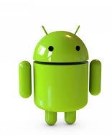
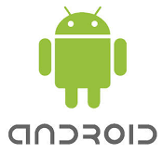
Android
By Filip Tyrala, Jack Wright, Jennifer Nolan

Slide 2
Table of Contents
Introduction
Android in the Market
Biographies
Architecture
Android Versions
Conclusion
Bibliography

Slide 3
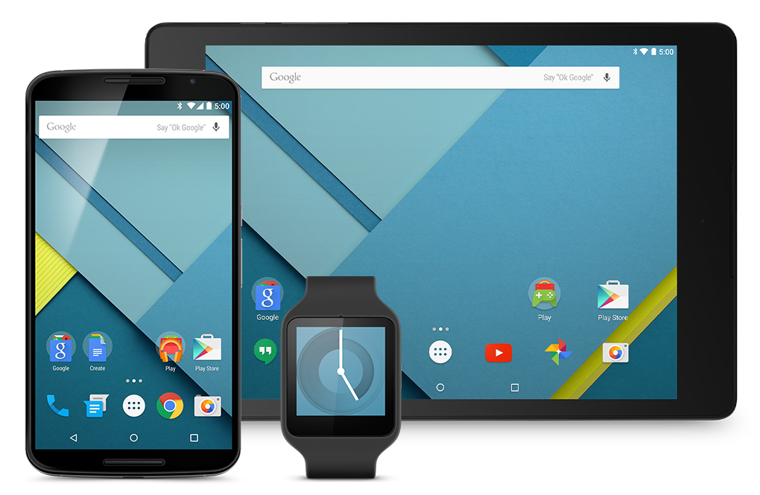
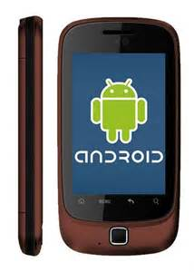
Introduction
Androids position in the market
The people behind Android’s creation
Architecture of the operating system
The different versions of android

Slide 4
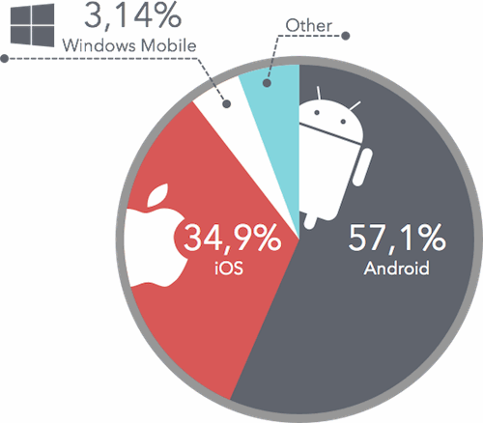
Android in the Market
Phone market is taken up mostly by
either Apple or Android

Slide 5
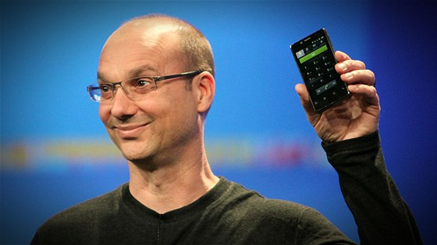
Andy Rubin
Born 1963, New York, USA
Co-Founded Android Inc. in October 2003 with Rich Miner
Rubin foresaw smart mobile devices as the future

Slide 6
Rich Miner
Born May 25, 1963, Massachusetts, USA
Also co-founded Wildfire Communications
Pioneer of voice recognition

Slide 7
Nick Sears & Chris White
Both also co-founded Android Inc.
Sears - VP of T-Mobile
White - Design and interface development lead at WebTV
Both stopped working on Android after Google Acquisition

Slide 8
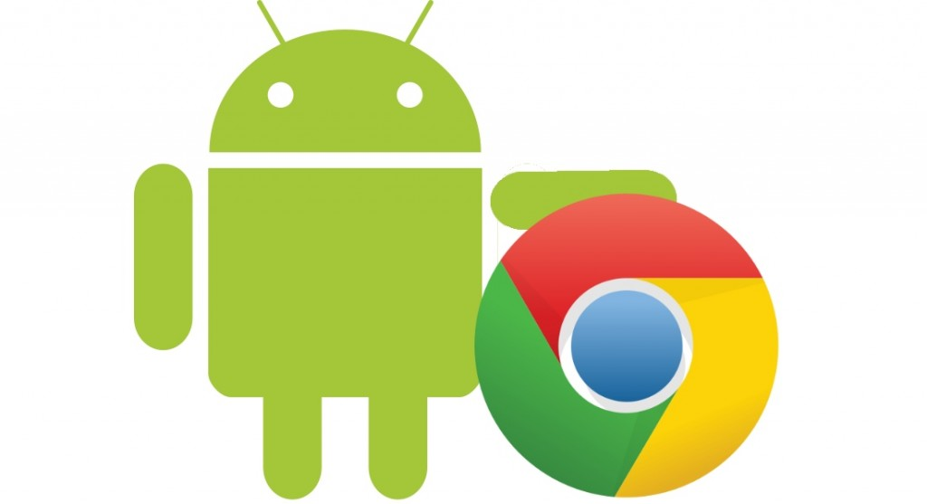
Google Acquisition
July 2005, $50 million acquisition
Original founders joined Google as a result, continued working on Android
Marketed by Google as a “flexible and upgradeable system”

Slide 9
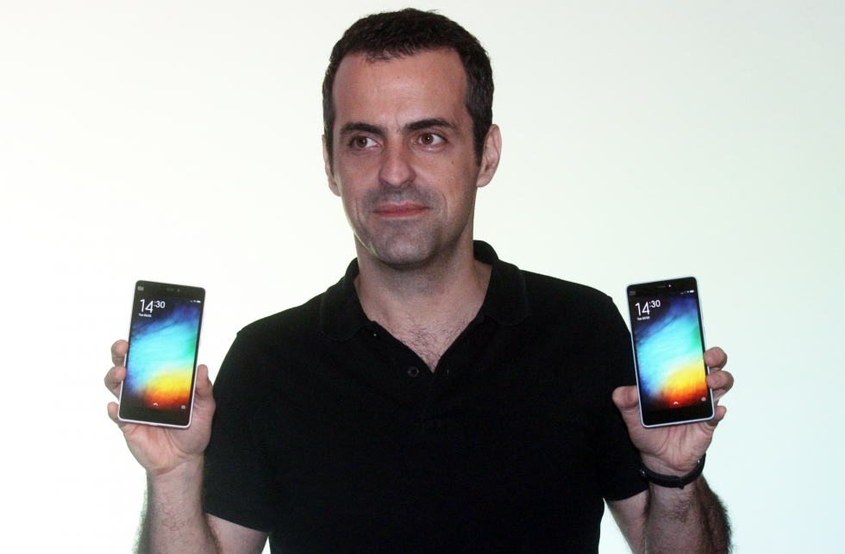
Hugo Barra
Born October 28, 1976, Brazil
Joined Google in 2008, Android team in 2010
Spokesperson and marketer of Android phones

Slide 10
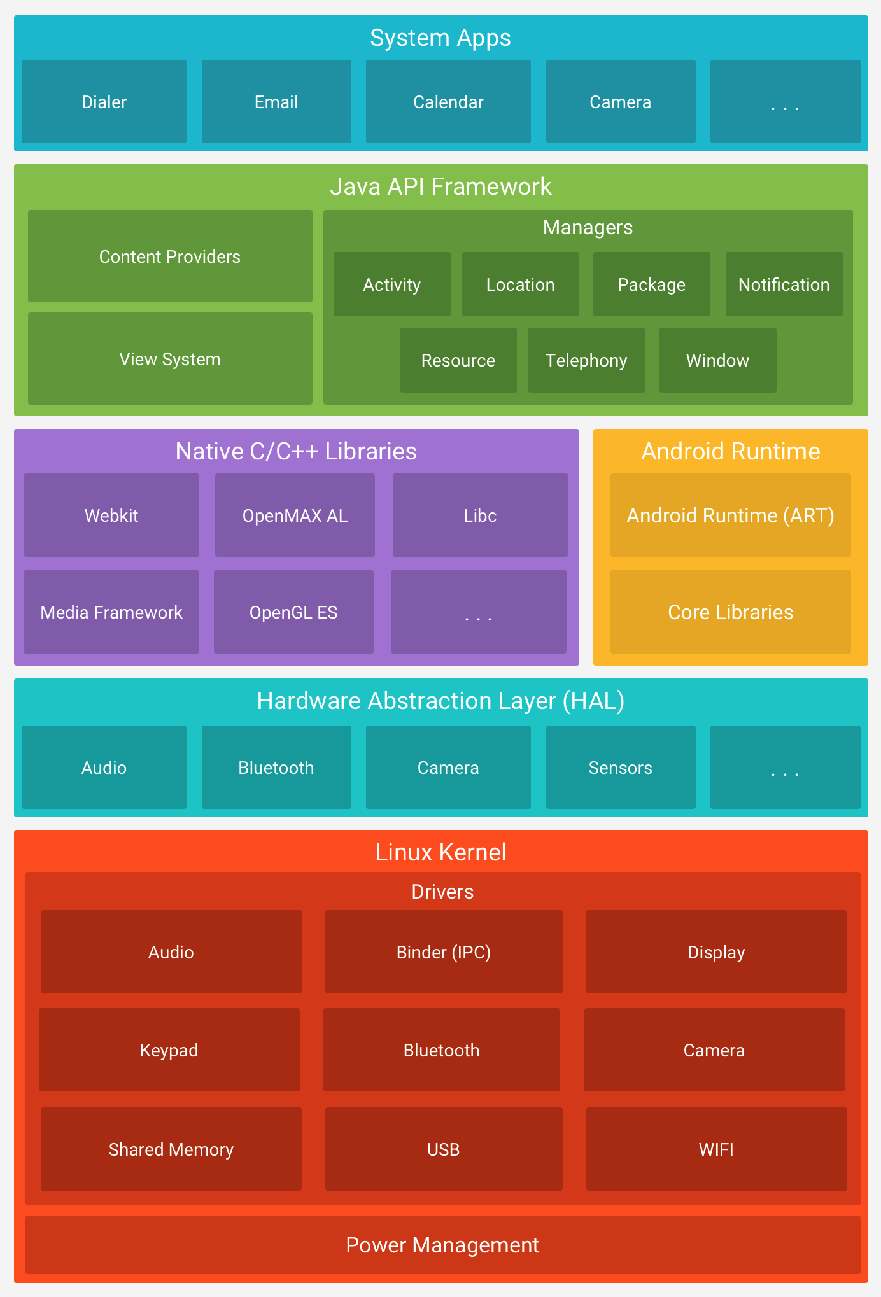
Architecture
Architecture consists of 6 main parts:
The Linux Kernel
Hardware Abstraction Layer
C/C++ Libraries
Android Runtime
Java API Framework
System Apps

Slide 11
Android Versions
There are 13 main versions
Some versions changes names even if they are one version
Named after sweets alphabetically

Slide 12
Android 1.0
First version of Android
Released: 23rd September 2008
Most important features implemented
First available on HTC Dream

Slide 13
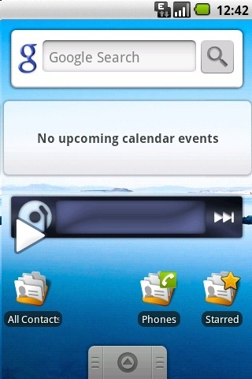
Android 1.5 Cupcake
Released: April 27th 2009
Named “Cupcake”
First version to use a name after sweets
An updated version of Android 1.0
Allowed Widgets
Auto-Rotation

Slide 14
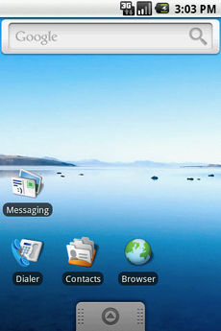
Android 1.6 Donut
Released: September 15th 2009
Named “Donut”
Gallery, Camera fully integrated
Speed Improvements

Slide 15
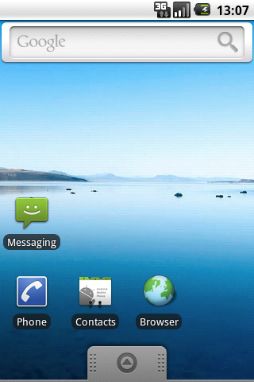
Android 2.0 Eclair
Released: October 26th 2009
Named “Eclair”
Account Syncing
Bluetooth 2.1
Refreshed UI
Live Wallpapers

Slide 16
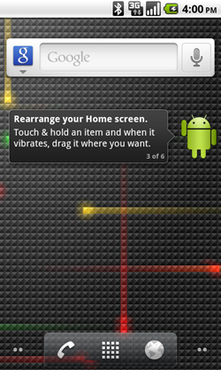
Android 2.2 Froyo
Released: 20th May 2010
Named “Froyo”
Support for docks
Numeric and Alphanumeric Passwords
Keyboard Languages
Installing Apps on SD cards
Wi-Fi Hotspot

Slide 17
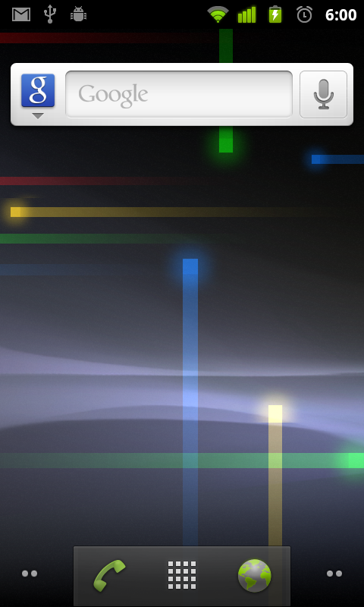
Android 2.3 Gingerbread
Released: December 6th 2010
Named “Gingerbread”
Updated UI
Support for NFC
Download Manager
Support for more sensors

Slide 18
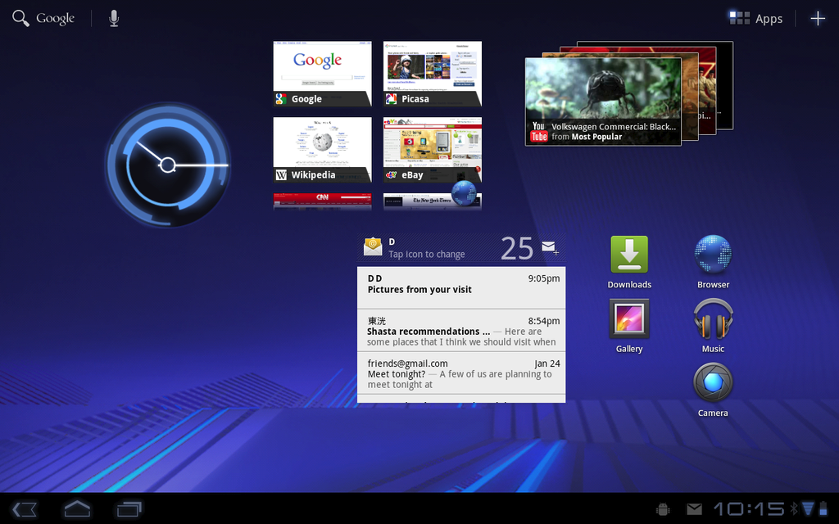
Android 3.0 Honeycomb
Released: February 22nd 2011
Named “Honeycomb”
Tablet only version
New Keyboard
Quick Access
External Keyboards

Slide 19
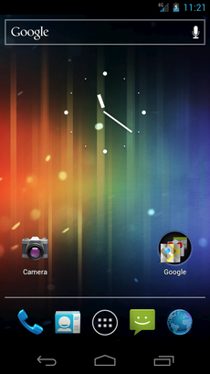
Android 4.0 Ice Cream Sandwich
Released: October 18th 2011
Named “Ice Cream Sandwich”
More user control
Data Usage control
Shut down apps from recently used
1080p recording

Slide 20
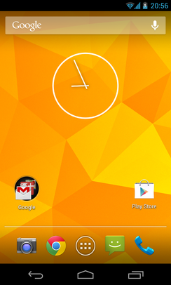
Android 4.1 Jelly Bean
Released: July 9th 2012
Named “Jelly Bean”
Smoother UI
Turn off notifications
Account Switching
4K support
Emoji Support

Slide 21
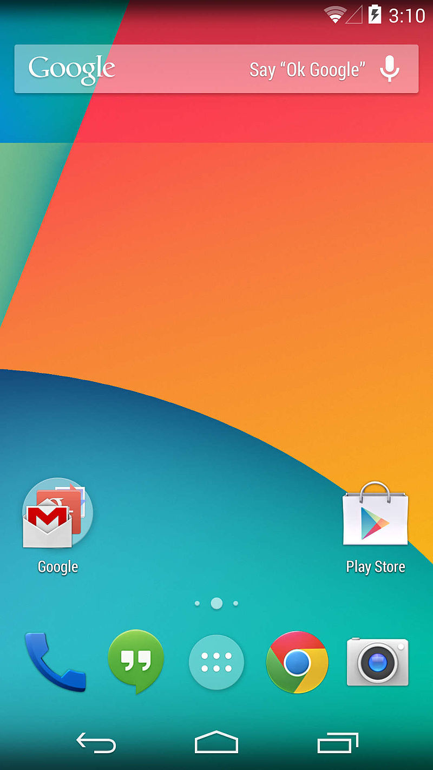
Android 4.4 Kit Kat
Released: October 31st 2013
Named “Kit Kat”
Improved voice support
Smart Dialer
GPS
Wireless Printing

Slide 22
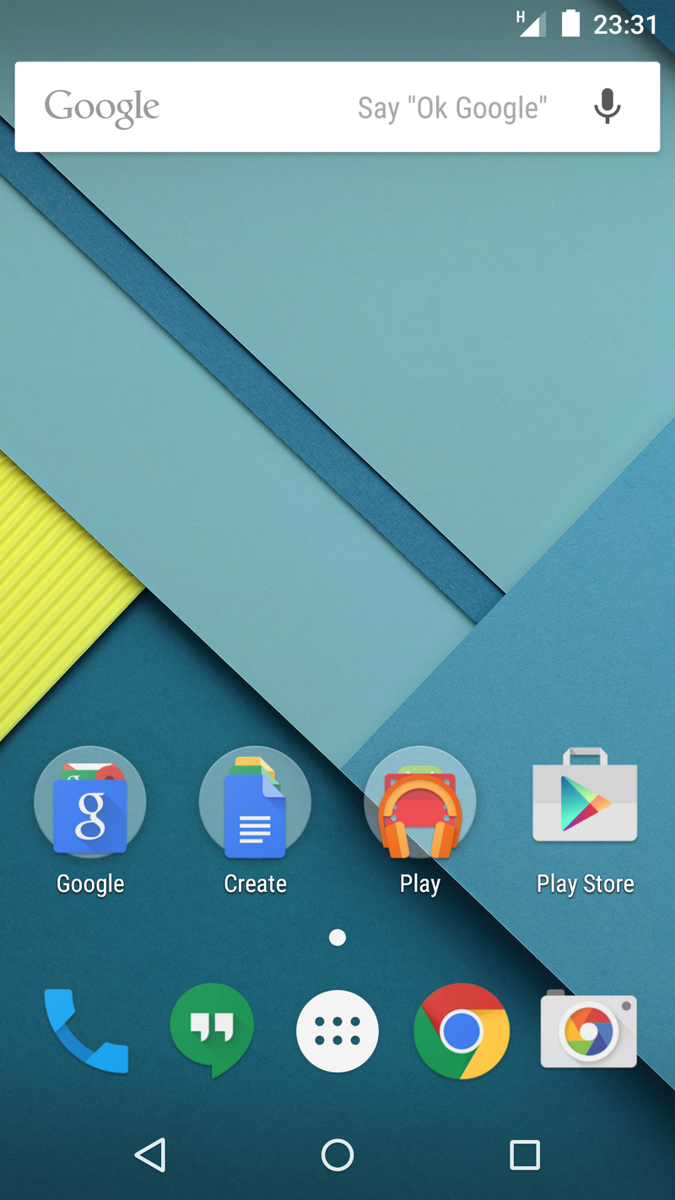
Android 5.0 Lollipop
Released: November 12th 2014
Named “Lollipop”
Multiple SIM card support
Device Protection
Control Devices via Bluetooth and Wi-Fi

Slide 23
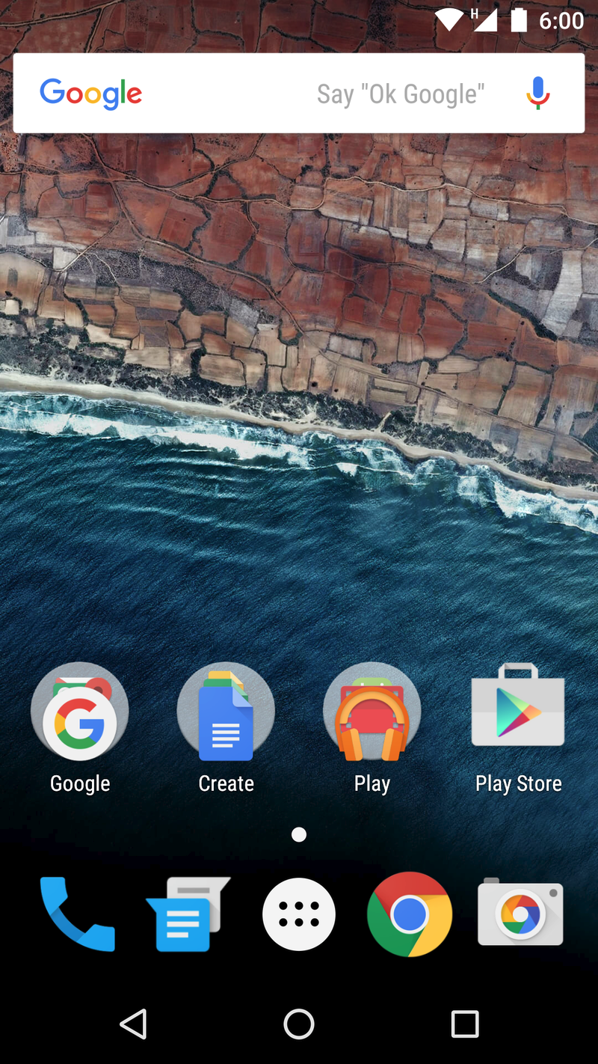
Android 6.0 Marshmallow
Released: October 5th 2015
Named “Marshmallow”
Now On Tap
Permissions
Fingerprint reader support
USB Type-C
Automatic full data backup and restore

Slide 24
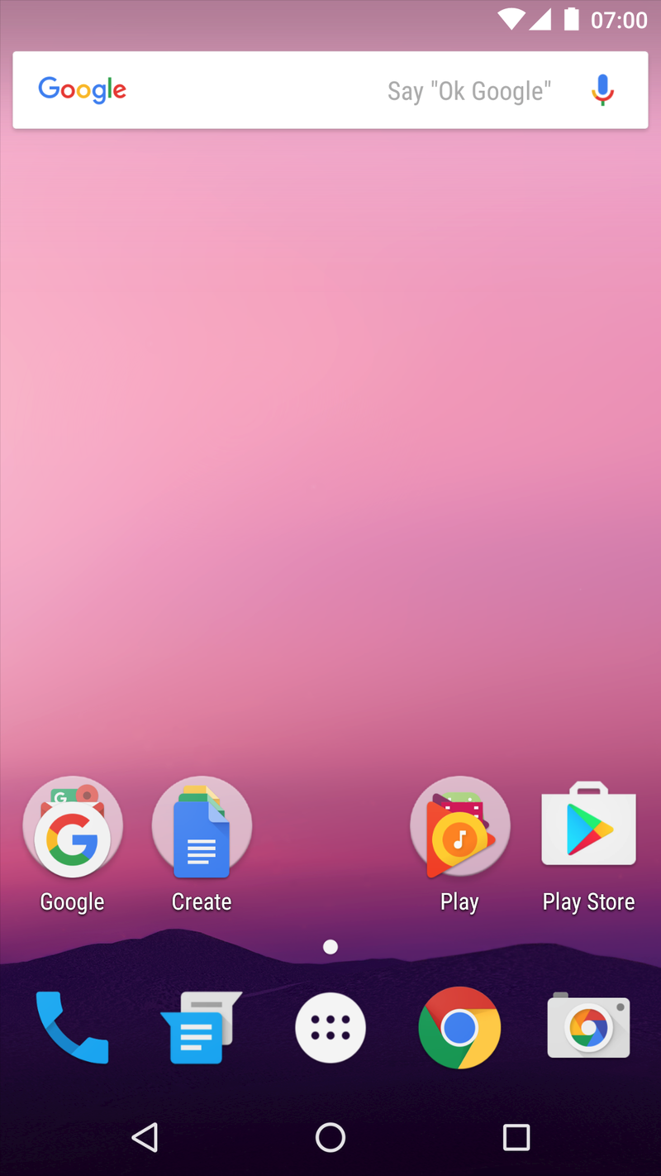
Android 7.0 Nougat
Released: August 22nd 2016
Named “Nougat”
Daydream VR interface
Multi-window support
Data saver mode
Vulcan 3D rendering API

Slide 25
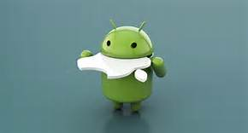
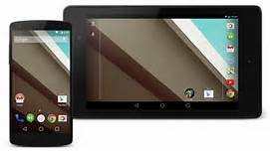
Conclusion
Android is a very commonly used operating system in phones and tablets
People who have androids use the operating system daily

Slide 26
Bibliography
Android Central. (2017). Android History. [online] Available at: http://www.androidcentral.com/android-history [Accessed 19 Mar. 2017]
En.wikipedia.org. (2017). Android (operating system). [online] Available at: https://en.wikipedia.org/wiki/Android_(operating_system)#Development [Accessed 19 Mar. 2017].
En.wikipedia.org. (2017) Android version history. [online] Available at: https://en.wikipedia.org/wiki/Android_version_history [Accessed 19 Mar. 2017]
En.wikipedia.org. (2017). Hugo Barra. [online] Available at: https://en.wikipedia.org/wiki/Hugo_Barra#Google [Accessed 19 Mar. 2017].

