Slide 1
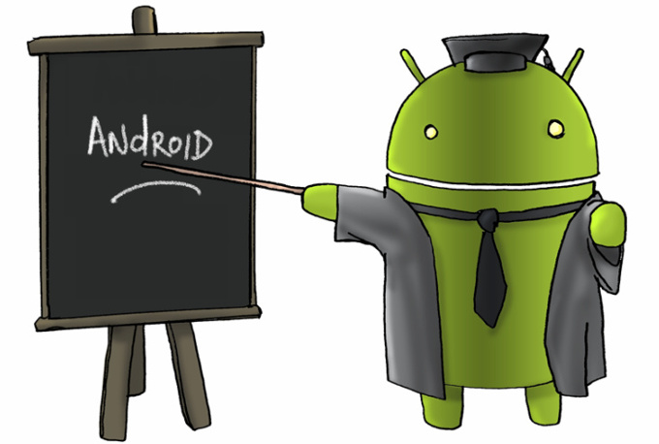
Android Operating System
Ruba Almashhuri D15125511
Faisal Algahtani D15125895
Abdulaziz Al Jabri D15125709
Florin Demian C16330621
Justin Hassan C16366366

Slide 2
Outline:
Architecture of the Android OS.
Desktop of the Android OS.
History.
Android Features.
Google Play Store.
Future of Android.
Conclusion.

Slide 3
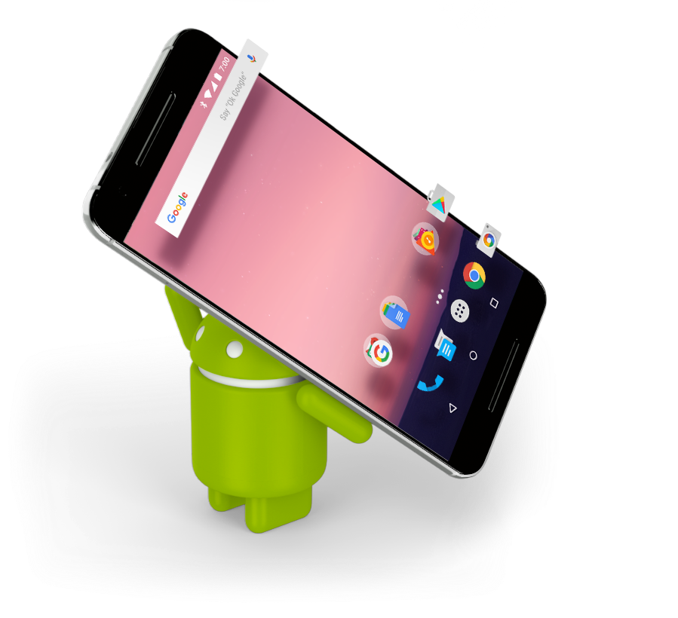
Architecture and Desktop of the Android OS
By: Ruba Almasshuri

Slide 4
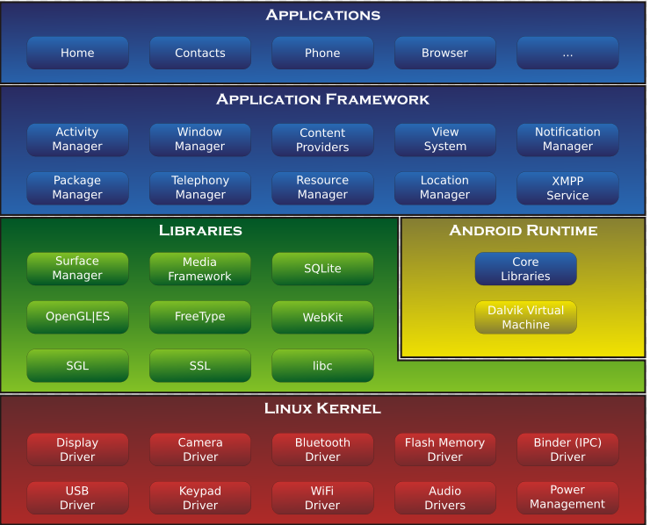
Architecture of the Android OS
It is powered by the Linux kernel based on an OpenJDK java implementation
It’s a preferred OS for smartphones because of the smaller runtime footprint, and optimization for low-frequency CPUs
The main hardware platform for Android is the ARM (ARMv7 and ARMv8-A architectures)
Notes:
On top of the Linux kernel, there are libraries, APIs written in C, the middleware and application software running on an application framework which comprises Java-compatible libraries
Other architectures include the x86 and MIPS architectures which are also officially supported for PC and later versions of Android.

Slide 5
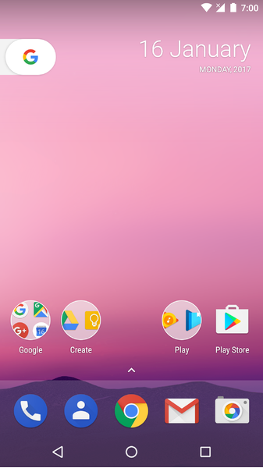
Desktop of the Android OS
The home screen that provides for primary navigation.
Most android system are designed to respond to user touch, tapping or pinching
The user home screen can be used to dock the various icons of apps
Apps are obtained from the Google Play Store which is the primary app store for android.
Notes:
The can be adjusted from portrait to landscape view with many customization preferences for end users
Shortcut icons on home screen are used for launching applications installed on an android device
Apart from Google play store, a number of third-party applications can be acquired by downloading and installing APK (Android Application Package) files
Android has an active community of designers and enthusiasts who use the Android Open Source Project to develop their own versions of the OS
However, root access can be obtained by exploiting certain security flaws to enhance capabilities or launch malicious activity.

Slide 6
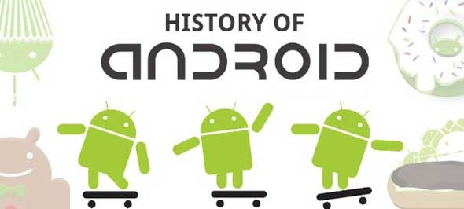
History of Android
By: Justin Hassan

Slide 7
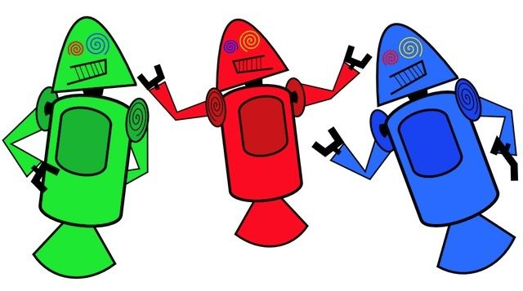
History
Android Inc. was founded by Andy Rubin, Rich Miner and Nick Sears in 2003.
Google purchased Android Inc. in august 2005 for around 50 million dollars.
Dan Morrill designs the original android mascots.
Initial hardware prototypes resemble a BlackBerry

Slide 8
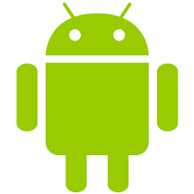
History
In 2007, google forms the open handset alliance (OHA).
Designer Irina Blok creates a new Android mascot.
In october 2008, Google make partners with HTC and T-mobile and they produce the HTC Dream (G1): the first ever Android device.

Slide 9
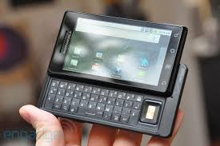
Software History
On 27 april 2009, Android 1.5 Cupcake is released.
On 29 june 2009 Samsung launches their first android.
On 15 september 2009 Android 1.6 Donut is released.
Then 41 days later on 26 october 2009 Google releases 2.0 Eclair, which debuts on the Motorola droid.

Slide 10
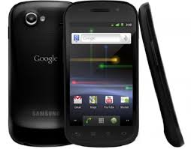
Software History
On 5 january 2010 the Nexus One is revealed, which launches as the first device with 2.1.
Feb 2010 Android marketshare surpases ios.
20 may 2010 Android Froyo 2.2 is released.
6 dec 2010 google launches Gingerbread, along with the Nexus One's successor: the samsung made google Nexus s

Slide 11
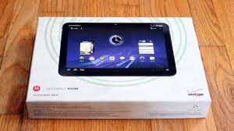
Software History
22 february 2011: Android Honeycomb 3.0 arrives for tablets, which first shipped on the Motorola Xoom.
On 15 august 2011 Google purchased Motorola mobility for 12.5 billion dollars.
18 october 2011 Ice Cream Sandwich 4.0 is released.
27 june 2012 Google launched the Nexus Q.

Slide 12
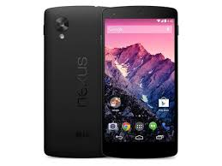
Software History
On 9 july 2012 Google releases 4.1 Jelly Bean and the first ever Nexus tablet the Nexus 7.
On 28 august 2013 Jelly Bean 4.3 debuts on an improved Nexus 7.
On 31 october 2013 Android KitKat 4.4 is released, which debuts on the Lg-made Nexus 5.
On 18 march 2014 android comes to the wrist.

Slide 13
Software History
On september 2014 Android One is released for developing markets.
On 12 november 2014 the Lollipop OTA 5.0 updates begin.
On october 2015 Android Marshmallow 6.0 is released.
On august 22 2016 Nougat 7.0 is released.

Slide 14
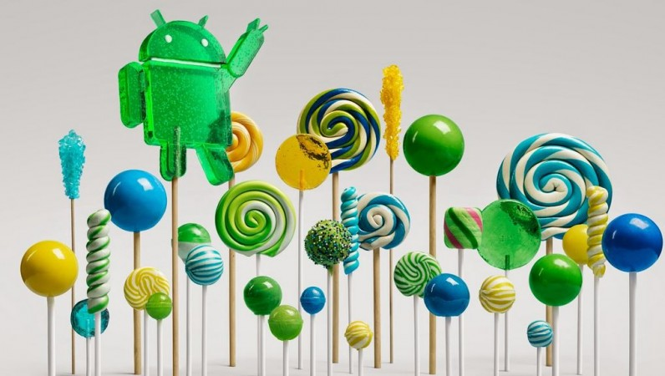
Android Features
By :Abdulaziz Al Jabri

Slide 15
Android Features
The 4 Android features:
Alternate Keyboards.
Removable Storage and Battery.
smarter caller ID
Automation

Slide 16
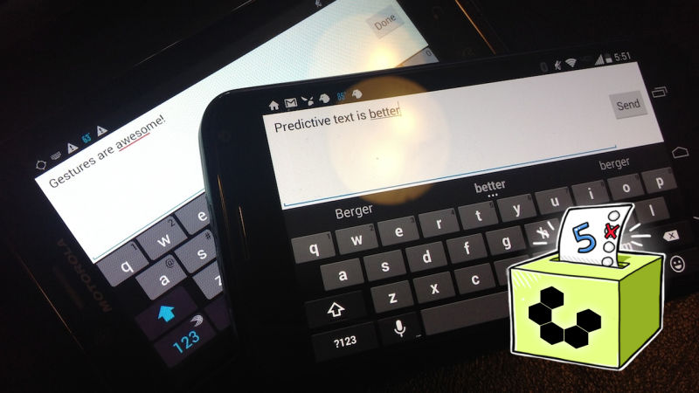
Android Features
Alternate Keyboards
One of the features in android is Alternate Keyboards, so you have a lot of different keyboards like:
Text predictors like Swifty
Creator like Swype.

Slide 17
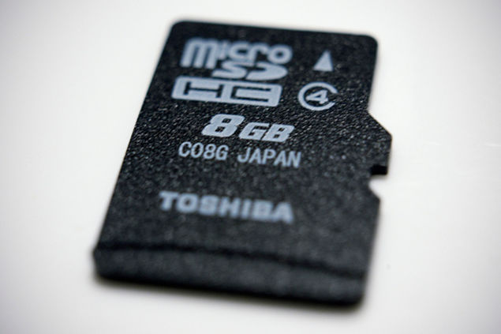
Android Features
Removable Storage and Battery
Android allows the user to change or swap the memory or the battery with new ones.

Slide 18
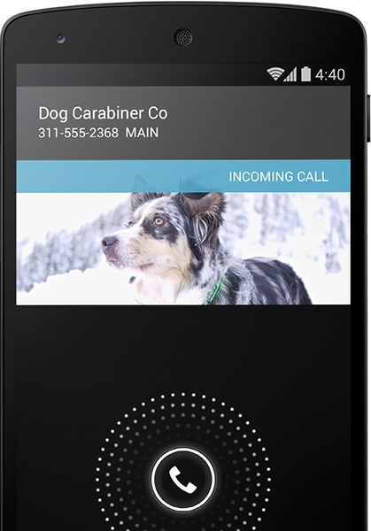
Android Features
Smarter caller ID
When the user get a call from unknown number not in your contacts, your phone will look for this numbers from businesses with a local listing on Google Maps.

Slide 19
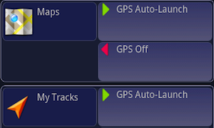
Android Features
Automation
One of the most powerful, useful Android apps around is Tasker, the automation program that lets you turn your phone into a superphone.
You can turn settings on and off for certain applications
by location
by time of day

Slide 20
Google Play Store
By: Faisal Algahtani

Slide 21
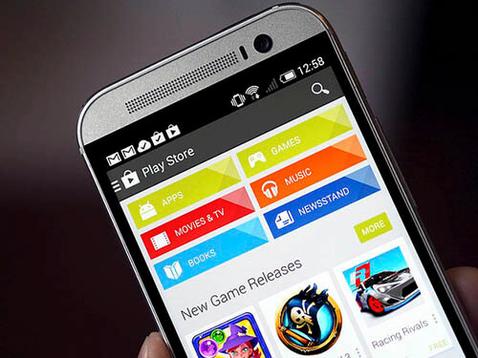
What is Google Play Store

Slide 22
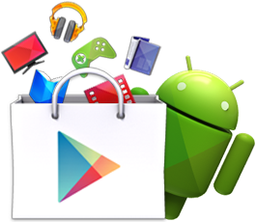
Android applications
Google Play digital media store include:
Games
music
Books and magazines
movies and television programs.

Slide 23
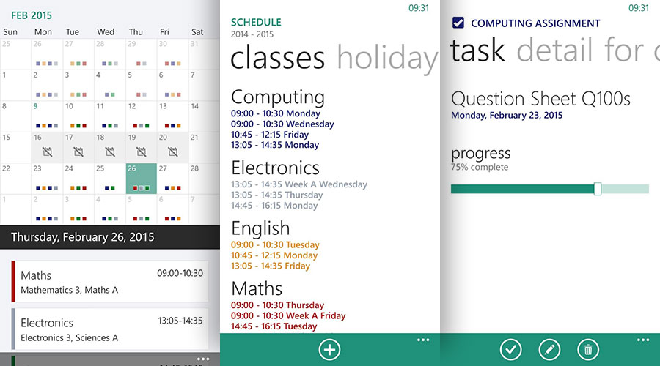
Best Android APPs for Students
My Study Life

Slide 24
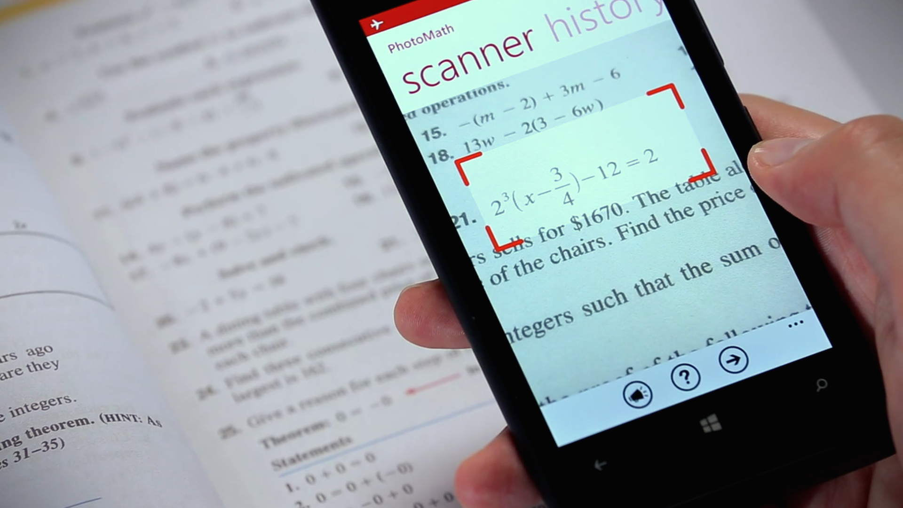
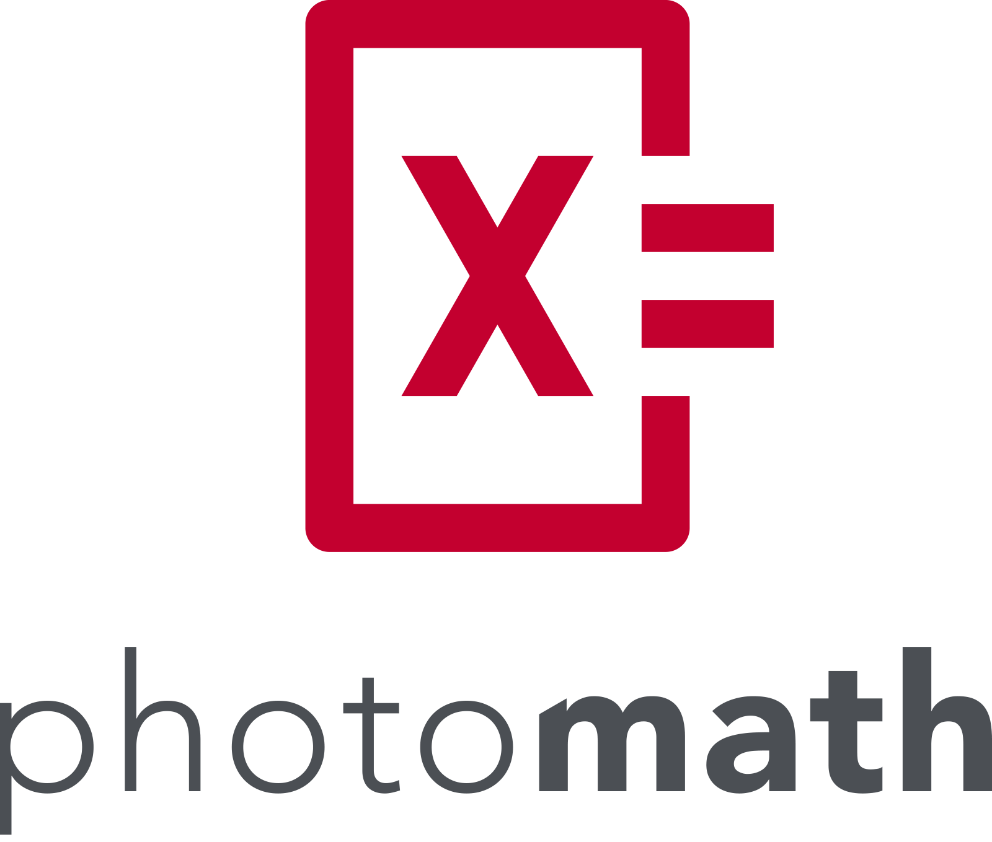
Best Android APPs for
Students

Slide 25
Future of Android
By: Florin Demian

Slide 26
Future of Android
Android should still be around in the next few years
Future personal adaptive android system
Cool future concept ideas for Android

Slide 27
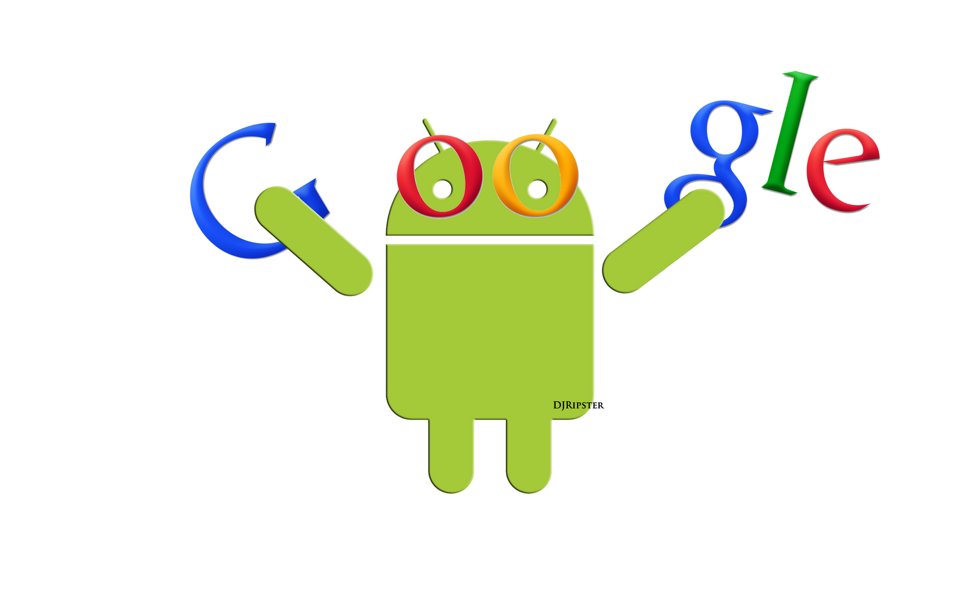
Future threats for Android
Google Fuchsia Project
Linux Kernel closing to the end of it’s lifecycle
New and innovative Operating Systems to come

Slide 28
Conclusion
Architecture of the Android OS.
Desktop of the Android OS.
History .
Android Features.
Google Play Store.
Future of Android.

Slide 29
References
Flynn, I. M., & McHoes, A. M. I. (2014). Understanding operating systems.
http://lifehacker.com/5801862/top-10-awesome-android-features- that-the-iphone-doesnt-have
https://www.android.com/versions/kit-kat-4-4
https://www.androidpit.com/google-play-services-what-is-it-and-what-is-it-for
https://www.android.com/versions/marshmallow-6-0/

