Slide 1
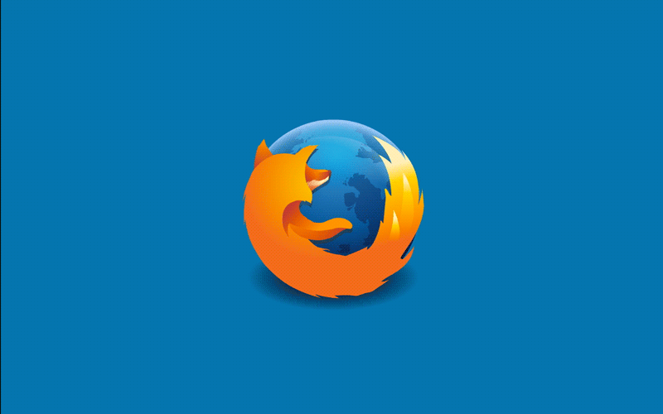
FIREFOX OS
By Adam Noone - C16448216
Paul Melinn - C16368806
Chris MacLachlan – C16373923

Slide 2
Table of Contents
What is Firefox OS ?.
Founders of Firefox OS.
Timeline.
Versions.
Firefox vs Android.
Why was Firefox OS unsuccessful?.
Firefox OS: The building blocks.
Architecture.

Slide 3
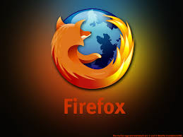
What is Firefox OS ?
Firefox OS is a discontinued open-source operating system made for smartphones, tablets and smart TVs designed by Mozilla.
It is based on the rendering engine of the Firefox web browser and on the Linux kernel.
Mozilla’s Firefox OS is an operating system based on HTML 5,every feature in the platform is a HTML5 app.
A Free Operating system aimed at lower-end ,cheap devices.

Slide 4
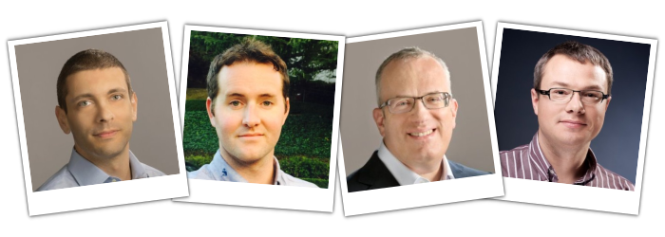
The Co-founders
Andreas Gal
Engineer
Joined Mozilla in 2008.
Chris Jones
Computer Science graduate.
Joined Mozilla in 2009.
Brendan Eich
Invented JavaScript.
Co-founded Mozilla in 1998.
Mike Shaver
Founding member of Mozilla in 1998 .

Slide 5
Timeline
2012 - Debuted at Mobile World Congress under the name Boot to Gecko.
2013 - Released on android compatible smartphones.
2014 - Firefox OS phones were offered from 14 operators in 28 countries
throughout the world.
2015 - Mozilla announced that it would stop sales of Firefox OS smartphones through carriers.
2016 - Mozilla announced that Firefox OS smartphones would be discontinued by May and that all work on Firefox OS had ceased.

Slide 6
Versions Of Firefox OS
Version 1.0 was released on February 21, 2013.
Mozilla continued releasing versions up until version 2.2.0 which was released on August 20, 2015.
They also developed a build of 2.5.0. The release of this was very underwhelming though.
After this they had more versions planned but ceased development and went open source.

Slide 7
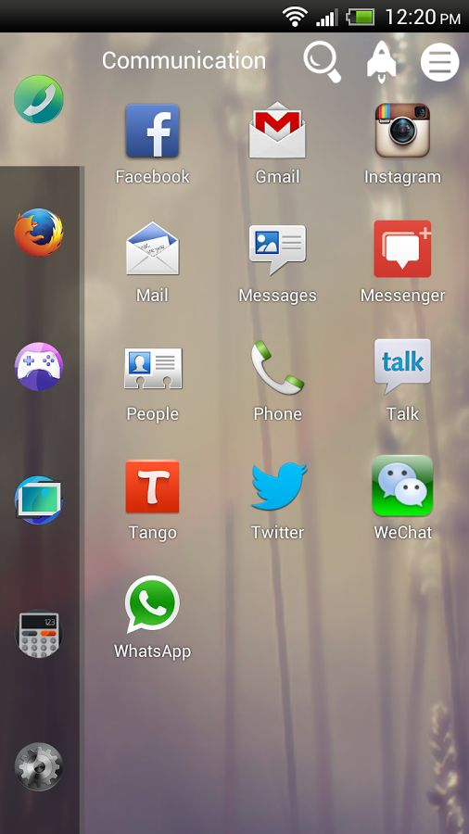
Firefox OS 1.01
In version 1.01 Firefox OS had the basic features of an android phone.
Screenshot of version 1.01 on a smartphone.

Slide 8
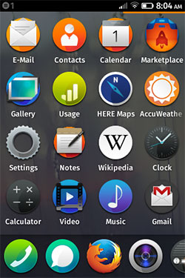
Firefox OS 1.1
Multimedia Messaging support added.
Saving media from the browser is now supported.
Attaching and sending Gallery images now supported.
Improvements to the most default apps.
Major performance improvements.
Music search to find music by artist, album or song title.
Still very basic.

Slide 9
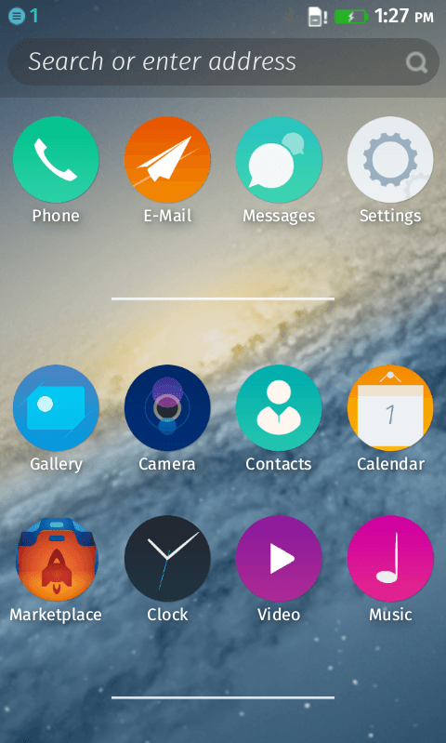
Firefox OS 2.0
NFC (Near Field Communication) support was added.
A find my device app was added.
The ability to use own files as ringtones was added.
The look was changed bigger home screen icons and just a better visual overall.

Slide 10
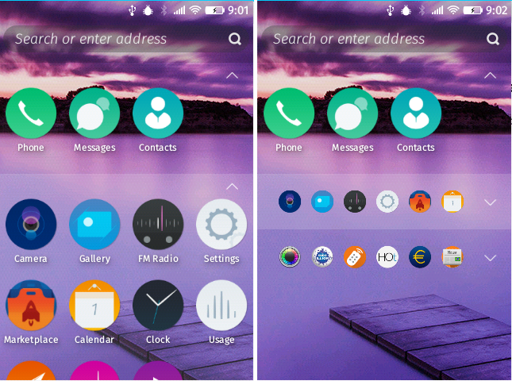
Firefox OS 2.1 and 2.2
SD card support added.
Keyboard optimized.
Text selection, copy and paste support added.
Core applications optimized .
Privacy settings added.
App grouping added to home screen.

Slide 11
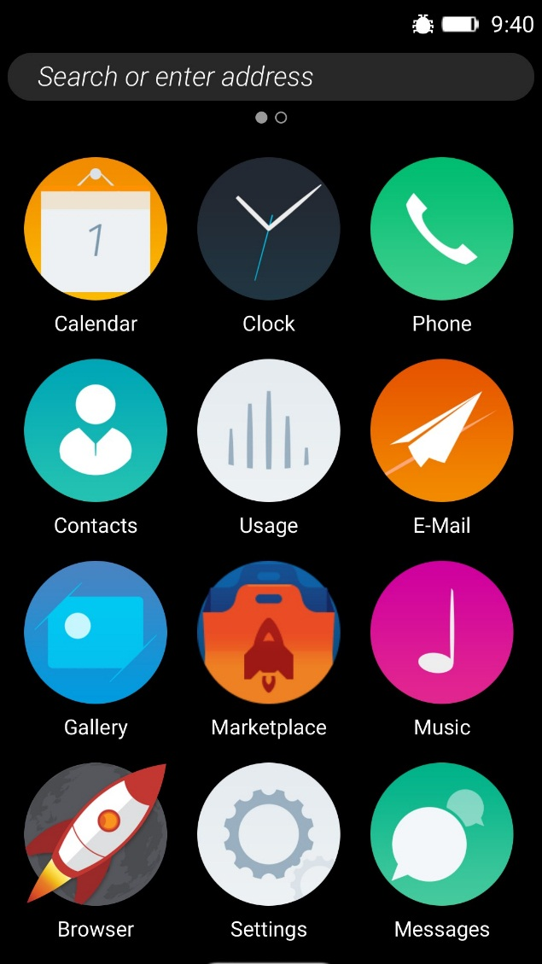
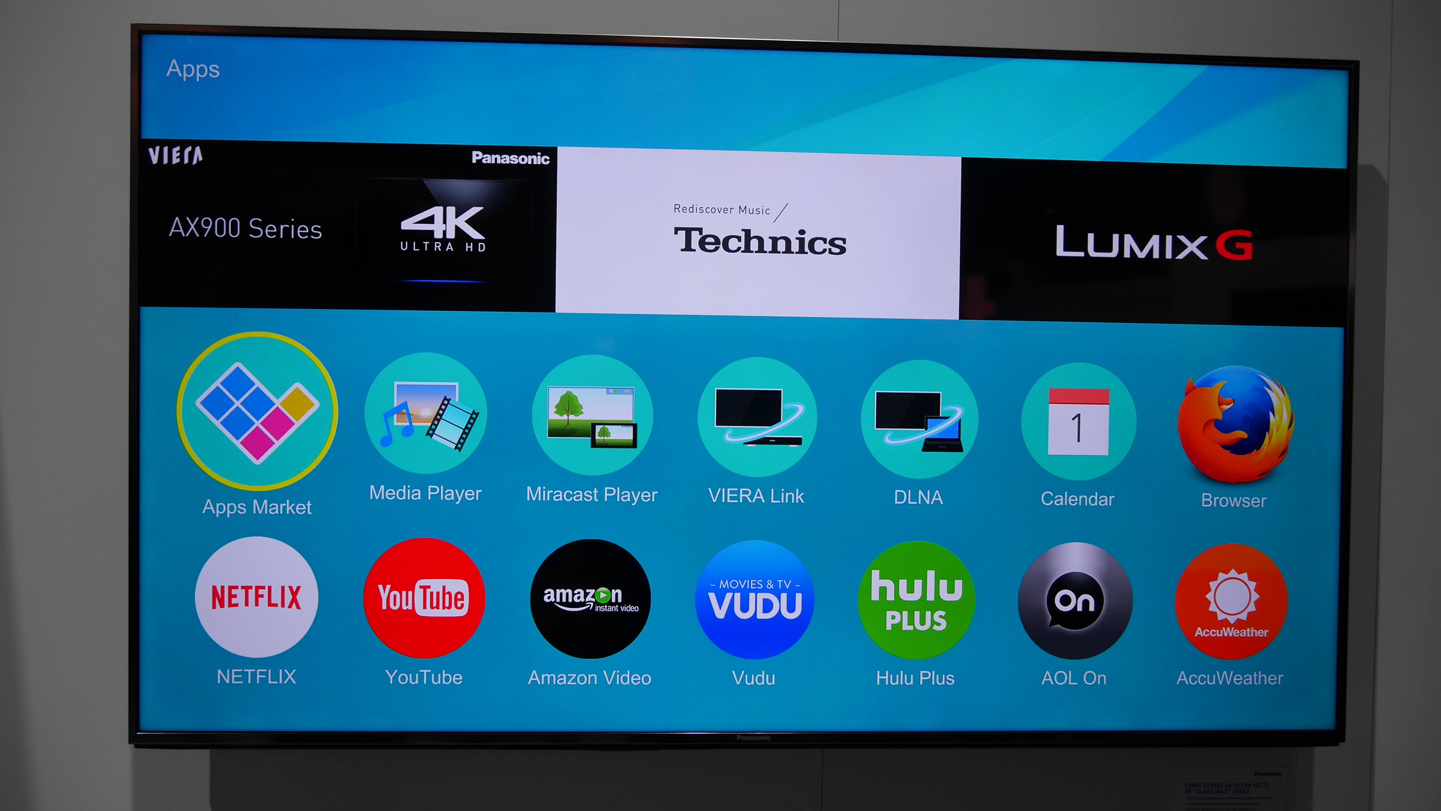
Firefox OS 2.5
Much more personalization options.
Startup time and performance optimized .
Ability to view source of core applications.
Firefox OS TV developed.

Slide 12
Mozilla Ceases Development
Mozilla ceased all commercial development of Firefox OS in 2015.
Panasonic took over Firefox OS TV.
Versions for smartphones and tablet pcs became open source.
Former Mozilla president started up Arcadine Technologies in 2015.
Acadine Technologies announced development of H5OS derivative of Firefox OS.
Due to no funding development of H5OS has also ceased.

Slide 13
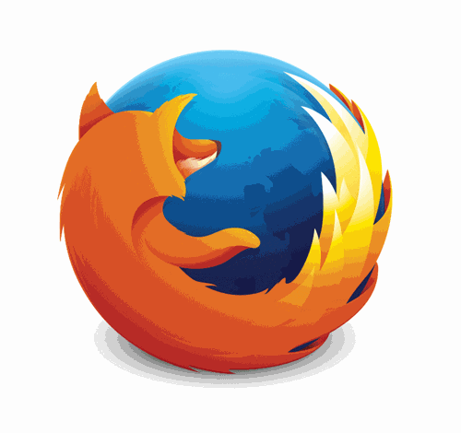
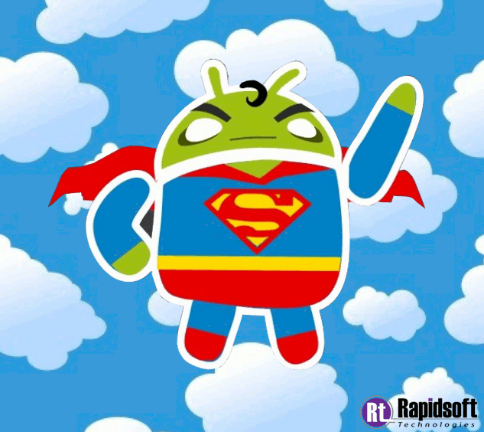
Firefox OS vs Android
Uses Gecko on top of Linux kernel.
Uses HTML, CSS, JavaScript.
Apps are essentially websites.
Features all the essentials of a smartphone.
Uses Linux kernel.
Uses Java.
Apps all have a dedicated path.
Offers a broader set of controls and development options.

Slide 14
Why was Firefox OS Unsuccessful ?

Slide 15
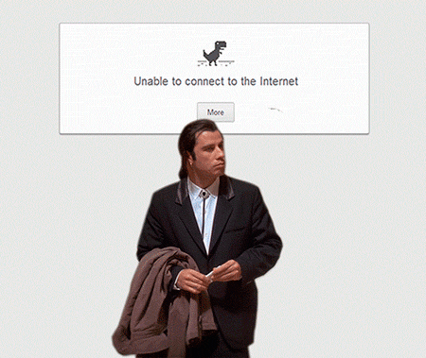
1. Could not compete with superior
operating systems such as IOS,
Android and Windows.
2. Users had to be connected to the
internet to access the majority of
their Applications.

Slide 16
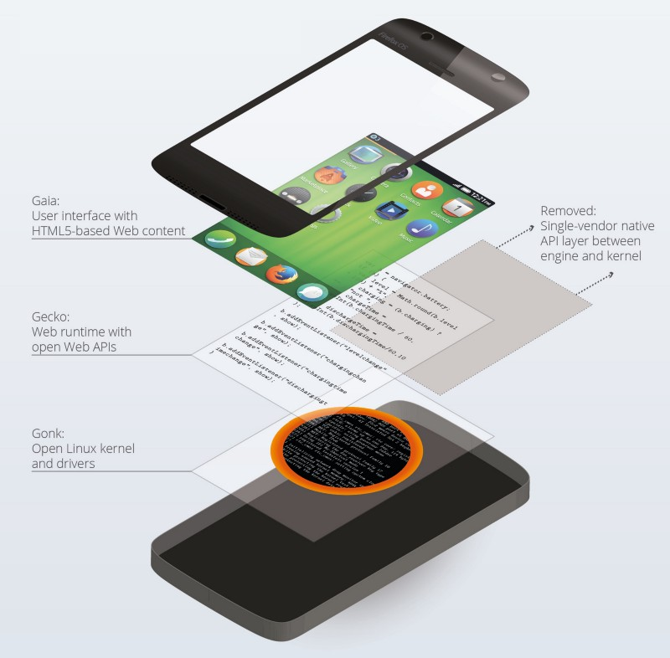
Firefox OS : The Building Blocks
Gonk - A “low-level substrate” based on the Linux kernel and Android Hardware Abstraction Layer.
Gecko - an app runtime and device APIs built on the web engine of Firefox .
Gaia - a smartphone user interface built with web technologies HTML, CSS and JavaScript.

Slide 17
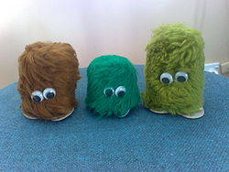
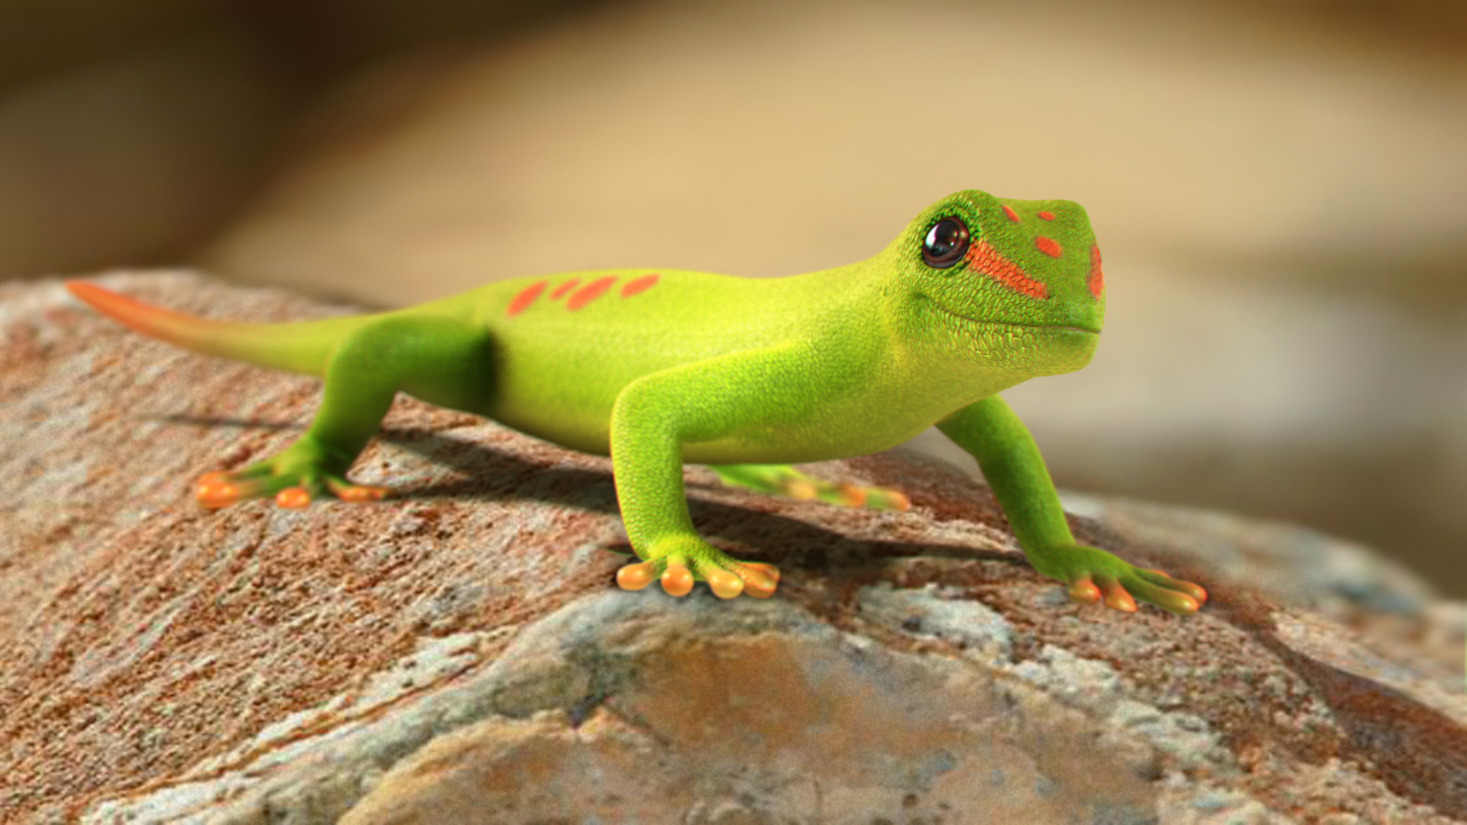
Architecture
Named project B2G (Boot to Gecko)
Gonk – the kernel
Linux based kernel.
AOSP and HAL.
Gecko – the engine
OS application runtime.
Ensures every API works.

Slide 18
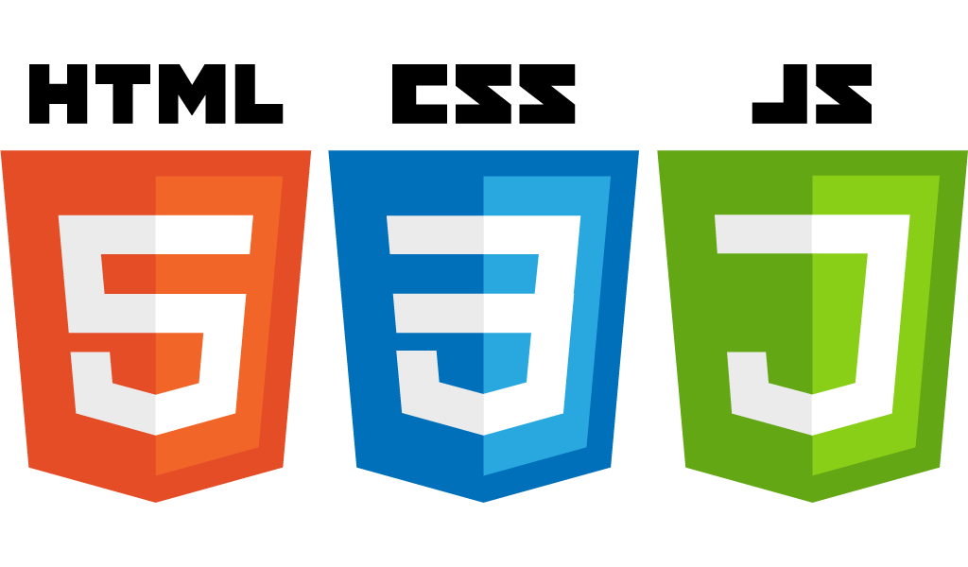
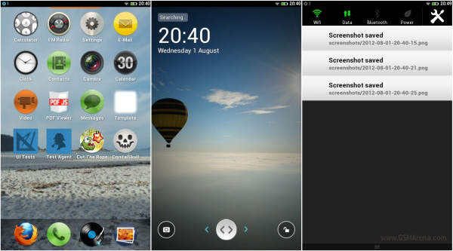
Architecture
Gaia – The user interface
Anything drawn to the screen is from the Gaia layer.
Implemented only from HTML, CSS and JavaScript.

Slide 19
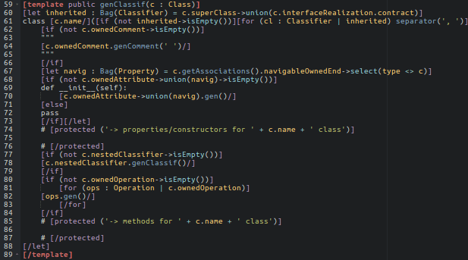
CMD
Firefox OS’s Command line uses Python.
Marionette is the automation driver.
Takes requests and executes them in Gecko.

Slide 20
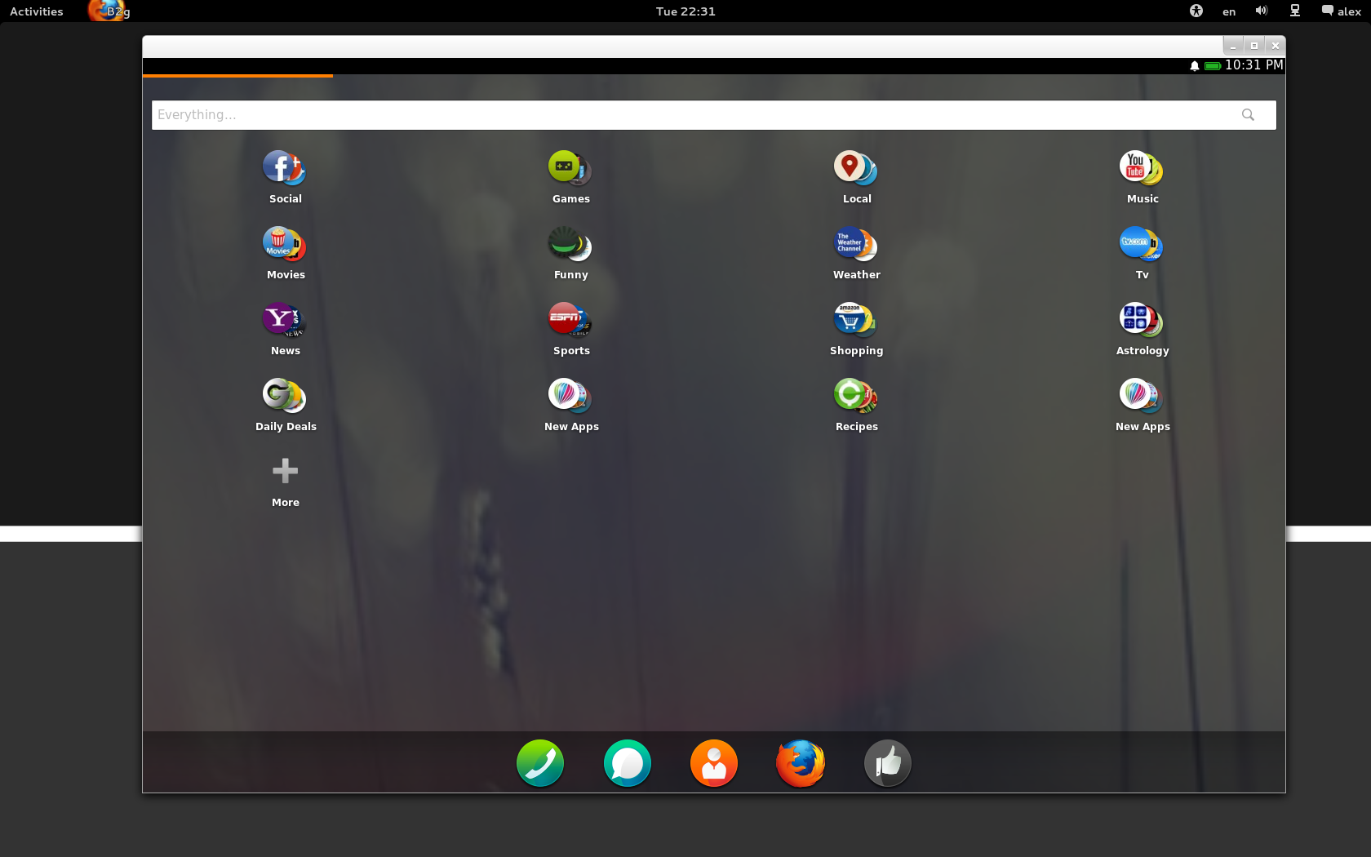
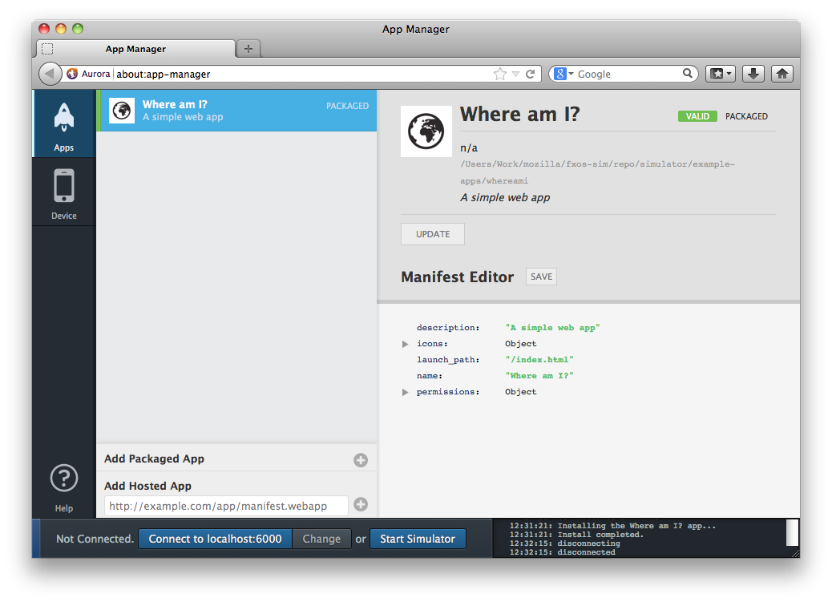
Available for Firefox desktop.
Composed of an apps panel, a device panel and toolboxes.
App Manager

Slide 21
Conclusion
Firefox couldn’t compete with popular mobile OSs on the market
It definitely had potential
Similar architecture to Android
It failed, vanished and barely made a mark in the smartphone market

Slide 22
References
https://support.mozilla.org/t5/Firefox-OS/ct-p/Firefox-OS
https://en.wikipedia.org/wiki/Firefox_OS
https://developer.mozilla.org/en-US/docs/Archive/B2G_OS
http://stackoverflow.com/firefox-os-architecture

