Slide 1
EDI Operating System
Davydenko Vladimir,
Mc Girr Stephen,
Purcell Sean.

Slide 2
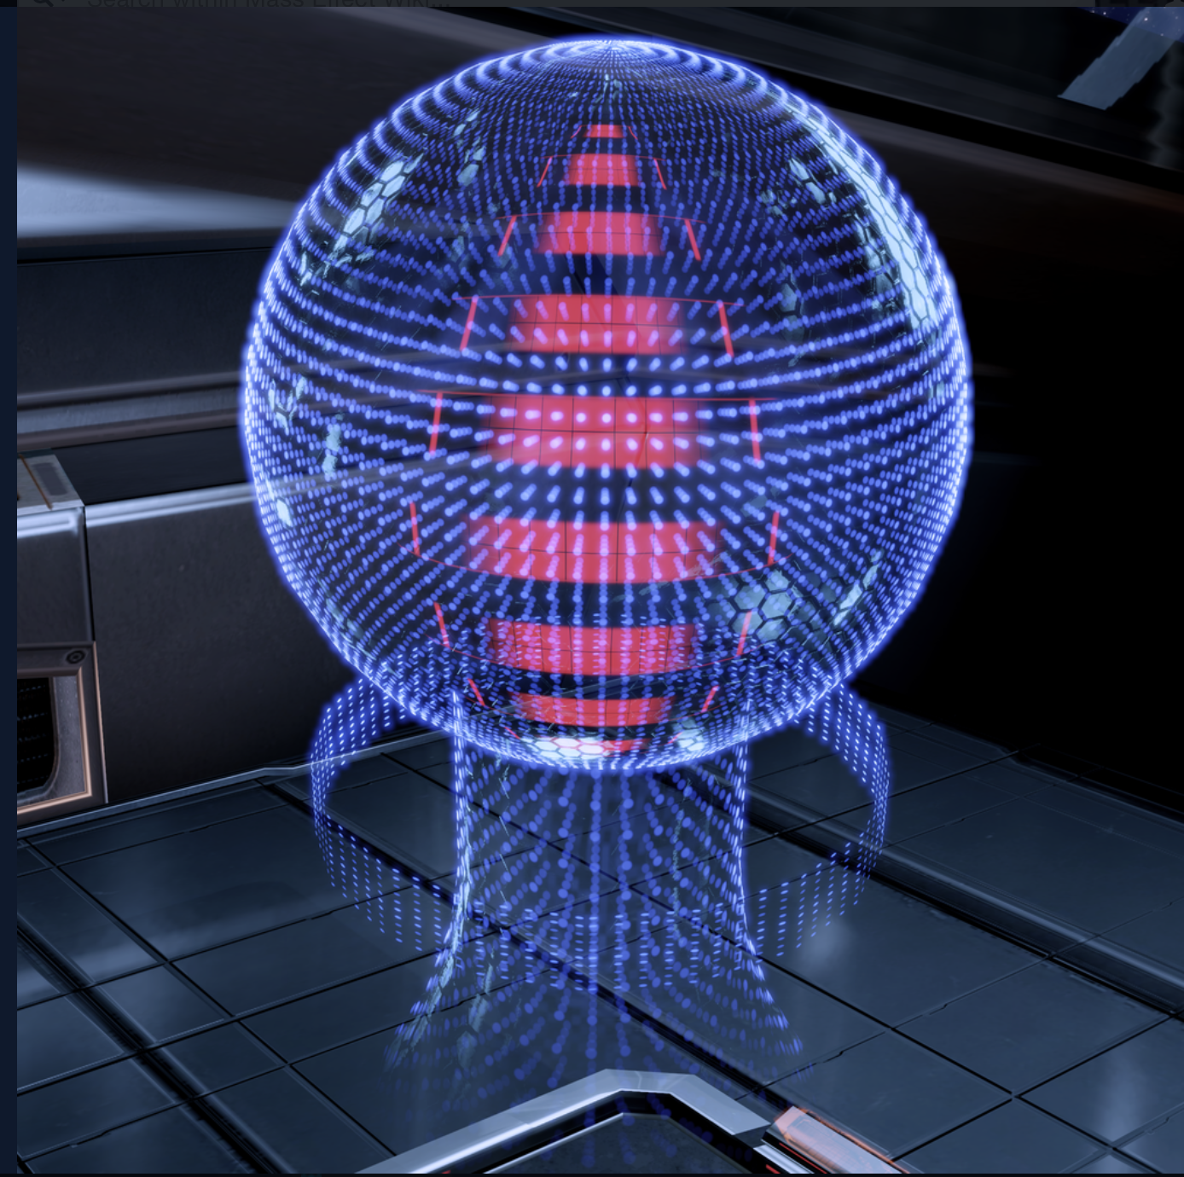
Table of Contents
Introduction
History and Background
Architecture of the OS
Desktop View
Conclusion

Slide 3
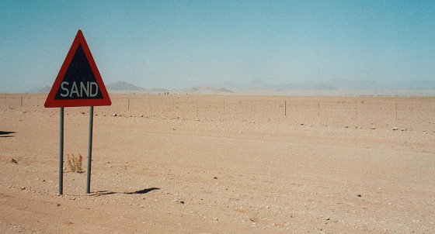
Introduction
Stating the obvious
Imagination

Slide 4
History and Background
The Enhanced Defense Intelligence.
AI created by Cerberus and Installed aboard the Normandy SR-2 as its Operating system.

Slide 5
History and Background
EDI is an AI that functions as the electronic warfare defense for the ship.
EDI initially was developed of the rouge Hannibal-class VI from Luna, with additional engineering from Reaper technology.

Slide 6
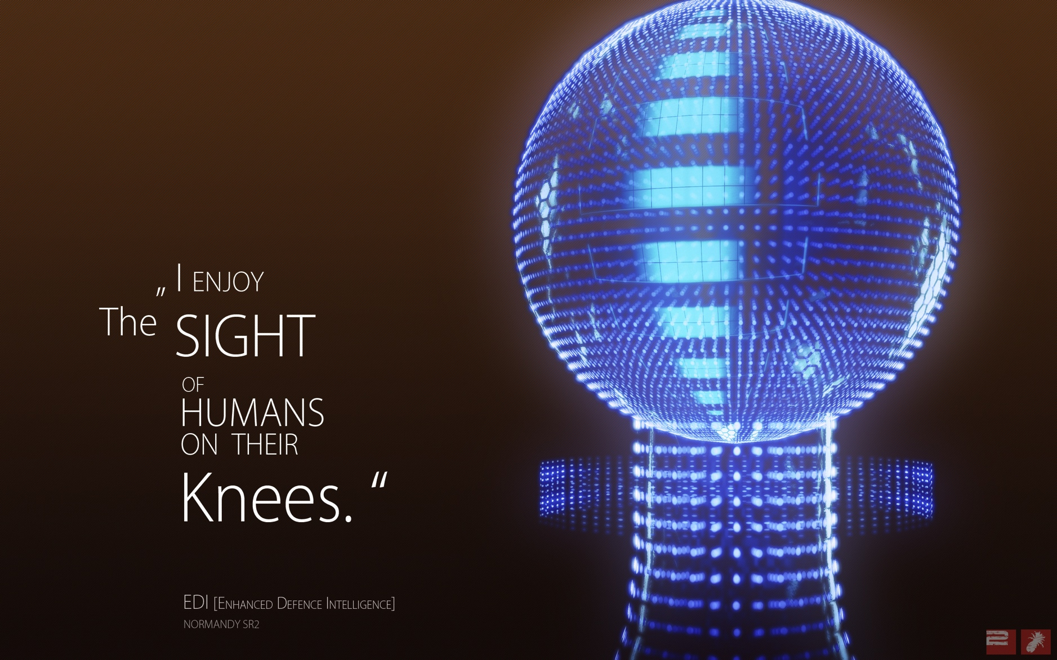
History and Background
Because of the potential danger of a rogue AI, it has been given behavioral blocks and cannot interface with the ship's systems.

Slide 7
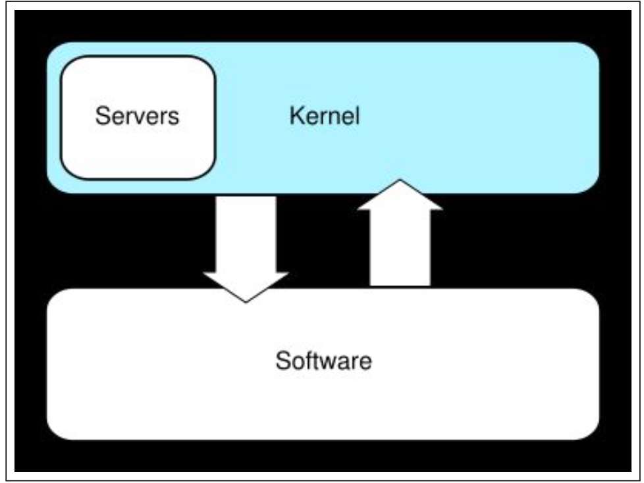
Architecture of EDI OS
EDI runs a Hybrid Kernel operating system architecture.

Slide 8
Architecture of EDI OS
The idea behind a hybrid kernel is to have a kernel structure similar to that of a microkernel, but to implement that structure in the manner of a monolithic kernel.

Slide 9
Architecture of EDI OS
This kernel approach combines the speed and simpler design of monolithic kernel with the modularity and execution safety of microkernel.

Slide 10
Architecture of EDI OS
In contrast to a microkernel, all (or nearly all) operating system services in a hybrid kernel are still in kernel space.

Slide 11
Architecture of EDI OS
So there are none of the reliability benefits of having services in user space (as in microkernel), as well as having none of the performance overhead for massage passing and context switching between kernel and user.

Slide 12
Architecture of EDI OS Diagram
Application
OS Server
Basic IPC
Virtual Memory
File Server
Scheduling
System
User Mode
Kernel Mode
Device Driver
Application IPC
Hardware
Libraries
Notes:
Inter process communications

Slide 13
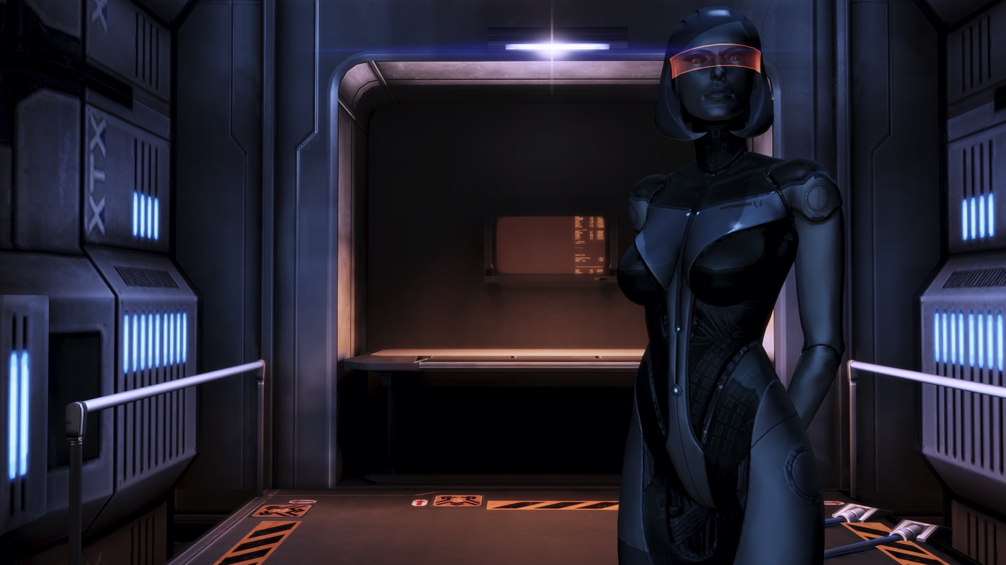
Architecture of EDI OS
Although at the moment The "hybrid" category is controversial, due to the similarity of hybrid kernels and ordinary monolithic kernels. In the future such architecture might evolve into better way of building OS
Notes:
It is contervetial at the moment but if we can indeed take the best parts of the two

Slide 14
Architecture of OS
Comparison of different types of Operating Systems

Slide 15
Desktop of the Operating System
Introduction to the EDI Operating System

Slide 16
Conclusion
The Microsoft NT kernel is a well-known example of a hybrid kernel that powers Windows NT, Windows 2000, Windows XP, Windows Server 2003, Windows Vista, Windows Server 2008 and Windows 7.

Slide 17
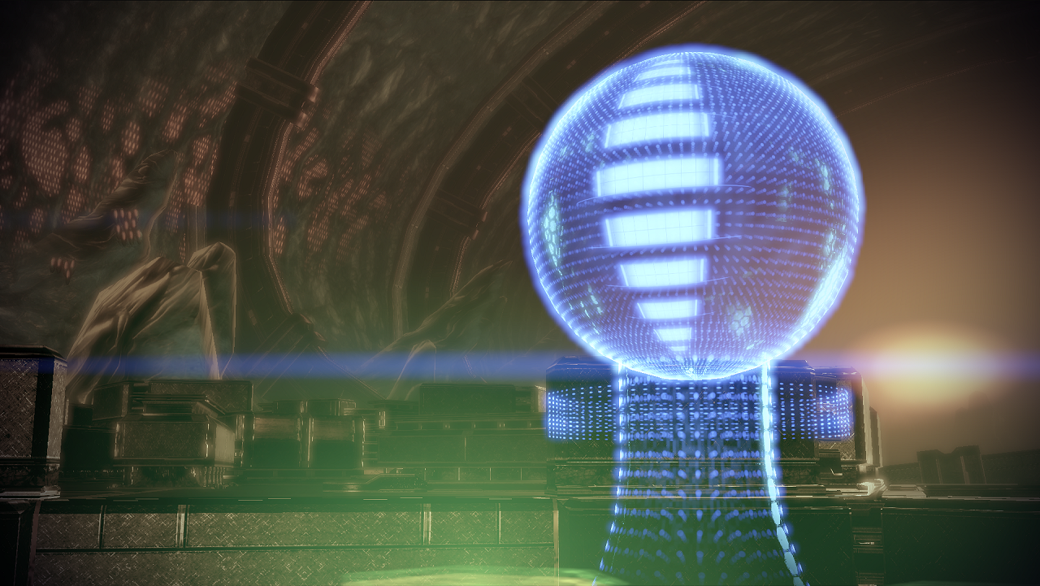
Conclusion
Operating System of the future
Notes:
Even though we see it all the time on the tv how much of a techno leap we need to make to have a os that can run an entire ship without over heating etc etc

Slide 18
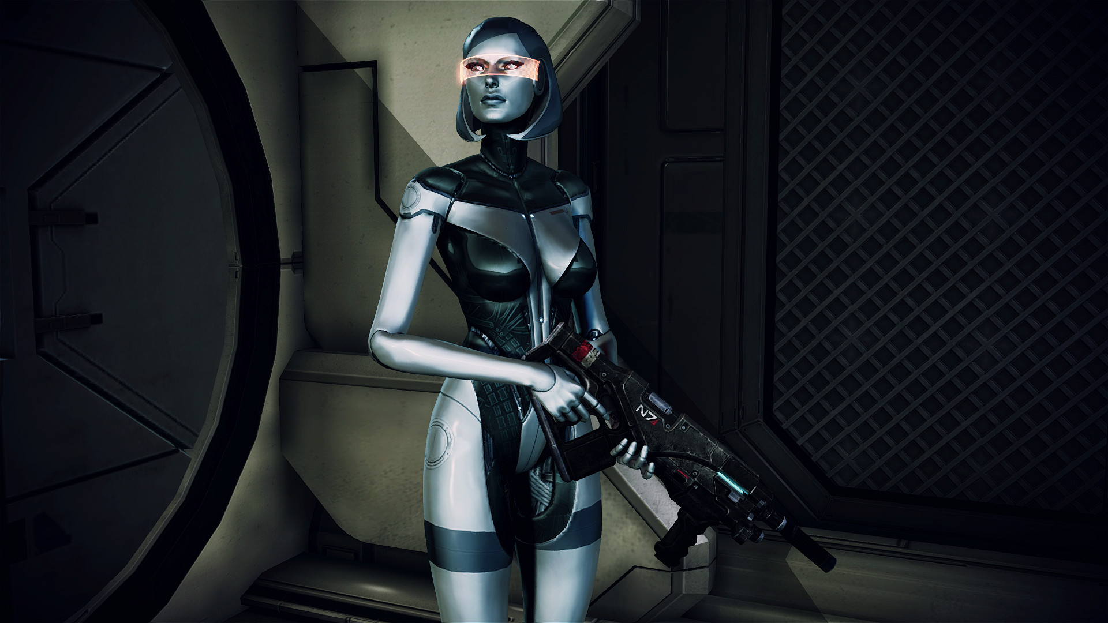
Conclusion
Any questions?

