Slide 1
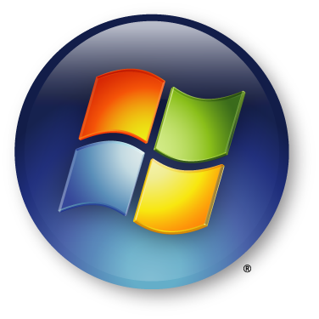
Windows OS
By Team Windows

Slide 2
Table of Contents
Introduction
Advantages & Disadvantages
Biography of Bill Gates & Windows
Architecture of Windows
The Future of Windows
Conclusion
References

Slide 3
Introduction
Team Windows
Conor Devilly
Oliver Zimmerman
Ross Murphy
Maria Kazydub
Benjamin Shanahan

Slide 4
Advantages of Windows OS
Availability
User-friendly
Backwards compatible
Vast hardware and driver support
“Plug and play”
Videogame support

Slide 5
Disadvantages of Windows OS
“Closed” source
Poor security (susceptible to viruses)
Strict License agreements
Hostile treatment for legitimate users (to combat piracy)
Poor stability
Required additional expenses (virus scanners, etc)
Resource hungry

Slide 6
William Henry “Bill” Gates III
Born October 28, 1955
Born in Washington, USA
Co-founder of Microsoft
Currently Technology Advisor for Microsoft
Industrialist, programmer, inventor, philanthropist

Slide 7
The Road to Windows
Co-founded Microsoft with Paul Allen
Programmed MITS’s(Micro Instrumentation and Telemetry Systems) BASIC microcomputer (first project)
Sourced an operating system (86-DOS/QDOS) for IBM during their partnership
Sold the OS (renamed MS-OS) to multiple other companies, growing in fame and influence
Launched Windows in 1985

Slide 8
The Philanthropy of Bill Gates
Been incredibly generous and influential in a charity sense
In 1994, Sold part of his stock and created the ‘William H. Gates Foundation’
In 2000, Bill and Melinda Gates joined 3 family foundations to create the ‘Bill & Melinda Gates Foundation’
Is the world’s wealthiest charitable foundation
Bill and Melinda are the second most generous philanthropists in America

Slide 9
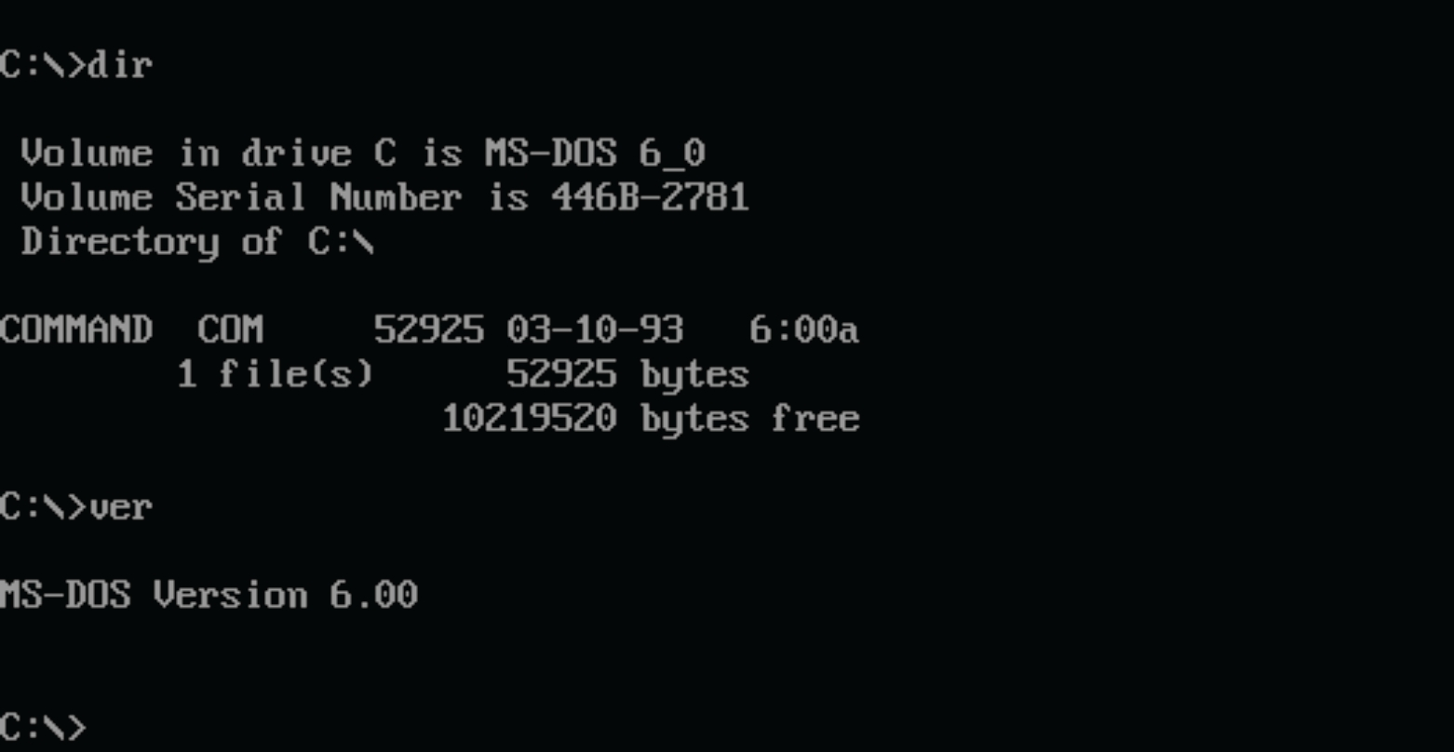
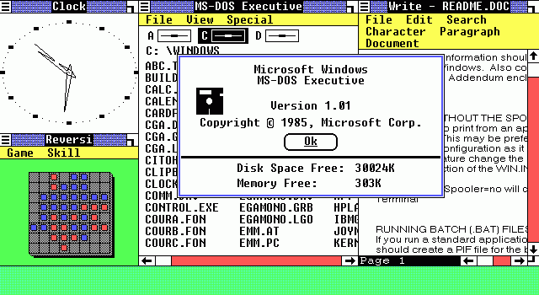
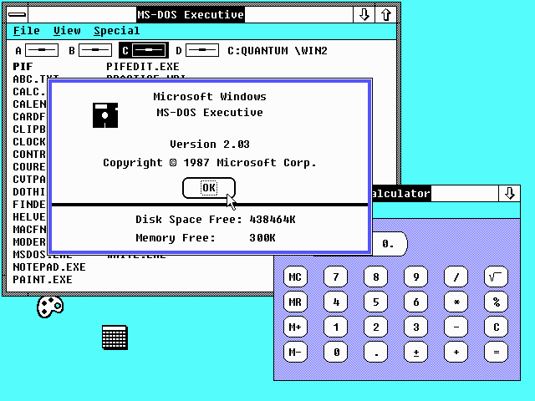
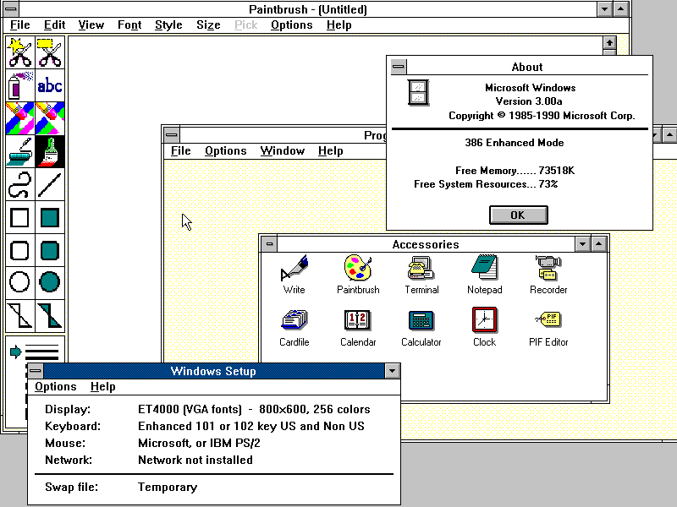
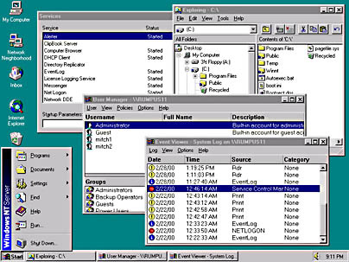
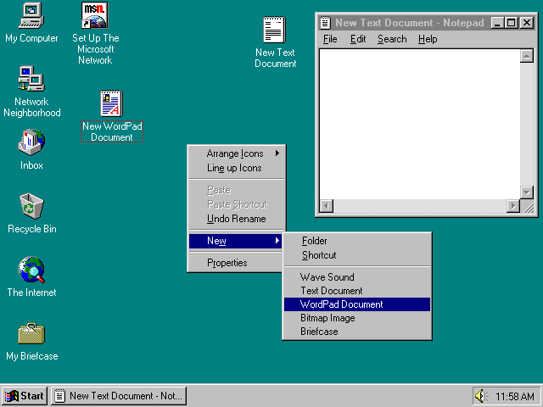
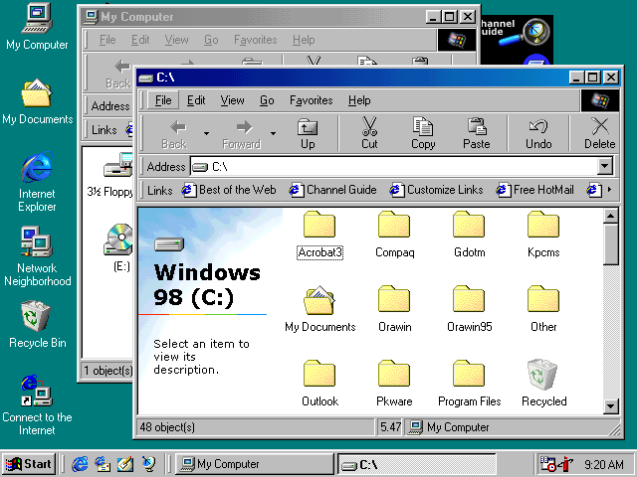
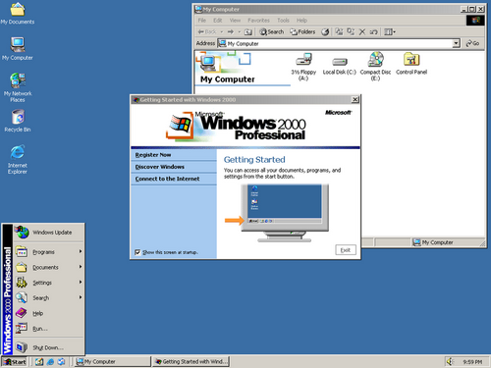
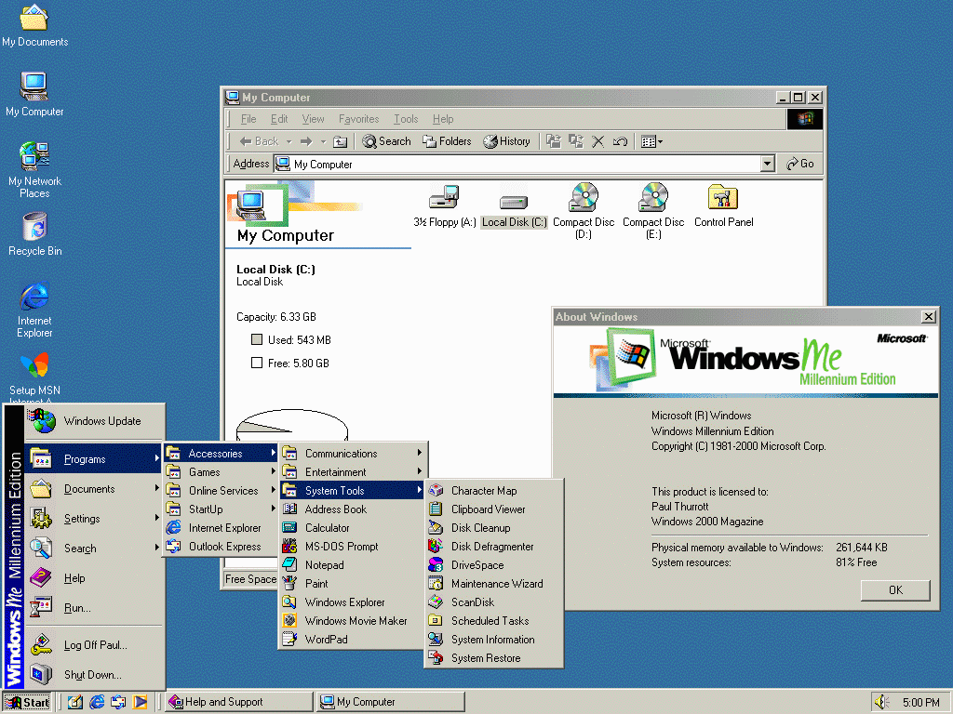
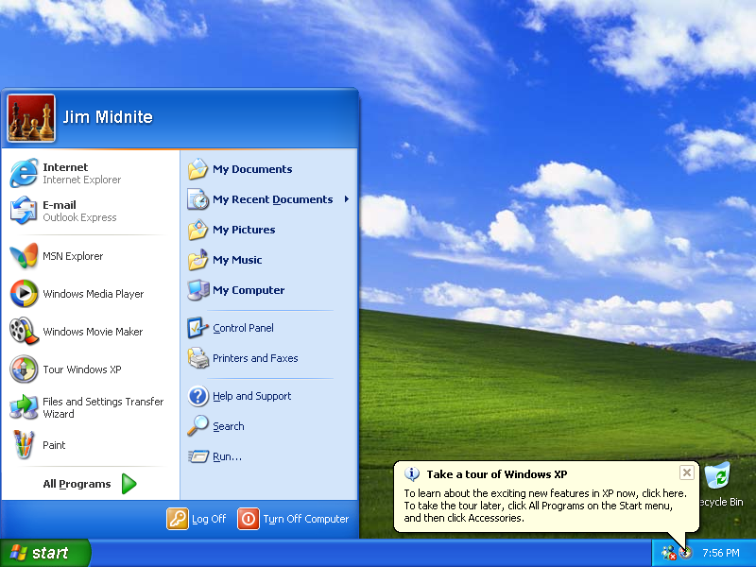
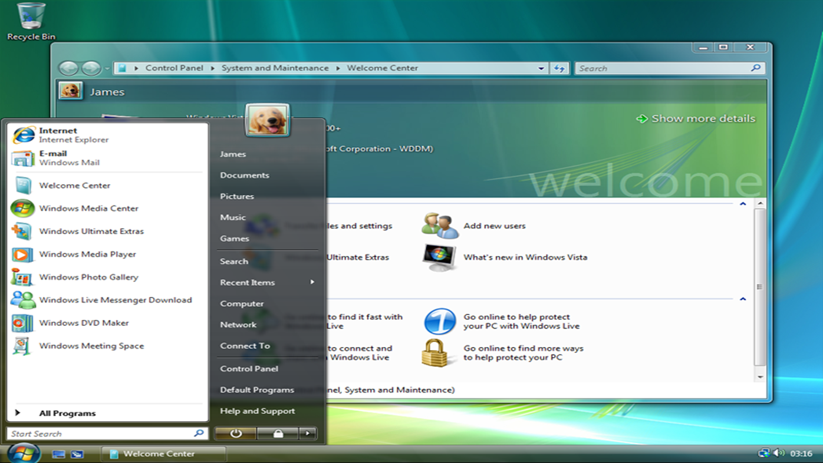
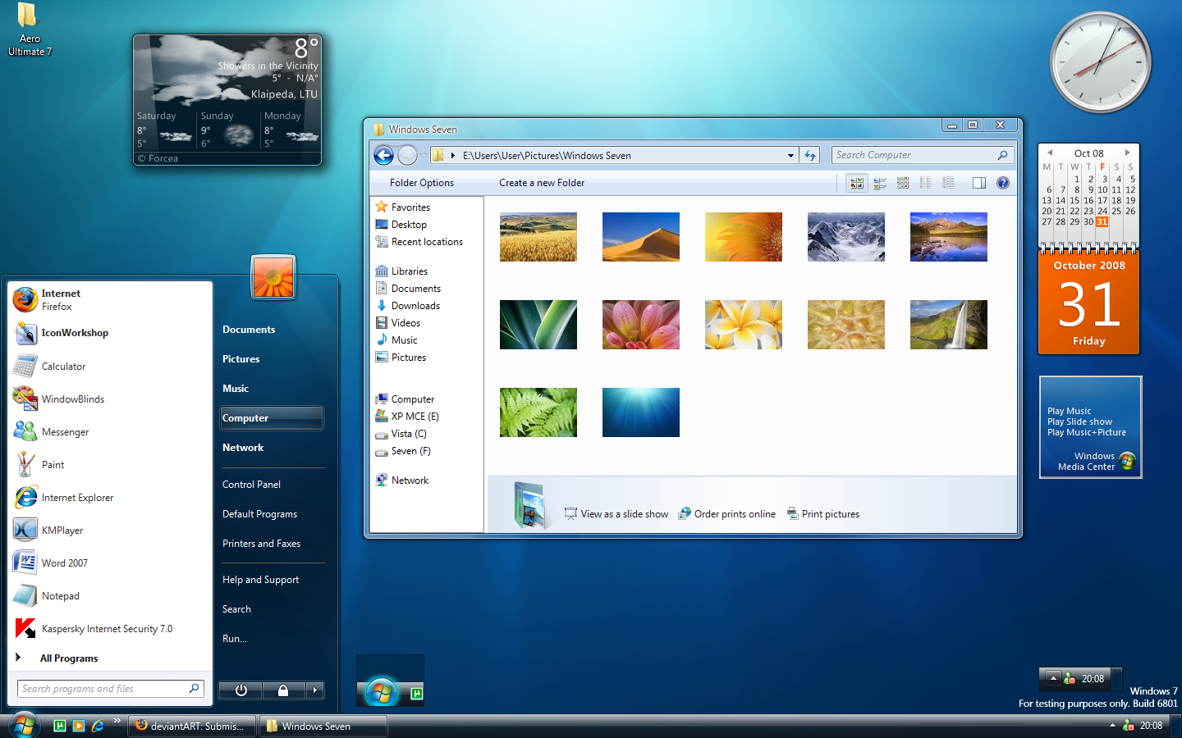

Slide 10
Windows 8 & 8.1

Slide 11
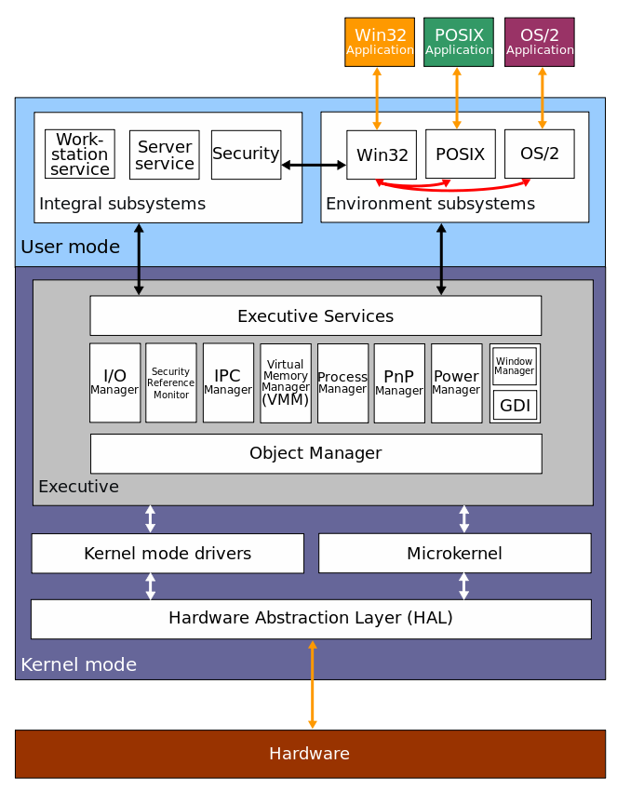

Slide 12
Windows Architecture Overview
Collections of subsystems & services
Split into User mode & Kernel mode
User mode cannot directly access hardware
Kernel mode is protected and can access hardware directly

Slide 13
User Mode
Environment Subsystems: Runs applications for different OS
Win32
POSIX (removed as of XP)
OS/2 (removed as of XP)
Integral Subsystems: Perform essential OS functions
Security Subsystems
Workstation Service
Server Service

Slide 14
Kernel Mode
Provides access to hardware and resources
Only critical system processes run here
Consists of:
Executive Services: Core OS services, I/O, memory, security
Kernel Mode Drivers: Drivers to interact with hardware
Microkernel: Performs thread & interrupt scheduling, error handling
Hardware Abstraction Layer: Hides hardware differences, makes OS portable

Slide 15
Future of Windows
Windows 10
Xbox and Windows integration
Assisted use (Microsoft Cortana)
Unified product families
Windows Spartan Web-browser

Slide 16
Windows 10 (Beta March 2015)

Slide 17
Windows 10
Codename “Threshold”, due mid 2015
Unification of different platforms
Windows PC
Windows Phone
Surface Hub
HoloLens
Addition of Cortana, an intelligent personal assistant
Improved user-interface (reinstated Start Menu, Continuum feature)

Slide 18
Windows 10
Introduction of new technologies/system components
Revised Windows App Store
Improved security (new biometric authentication framework)
DirectX 12
Improved online services and functionality (Spartan web browser).

Slide 19
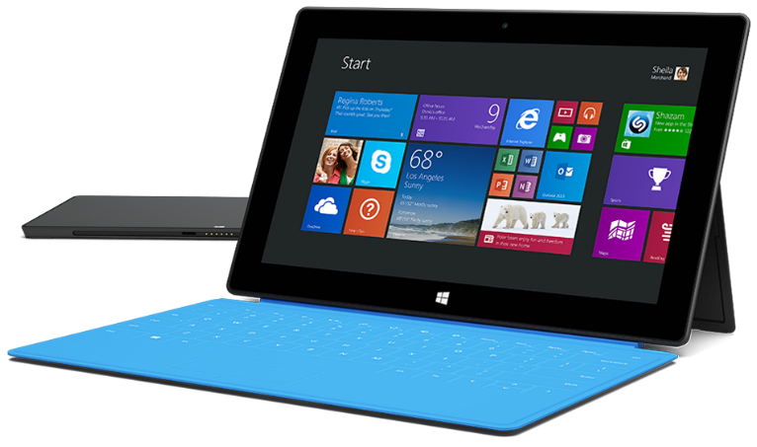
Microsoft Surface
The Surface was first released in October 2012
The Surface was designed as a hybrid of a computer and a tablet
Having the basic functions of a computer, with the portability and size of a tablet
The Surface series was followed by the Surface Pro series, both series run off Windows RT

Slide 20
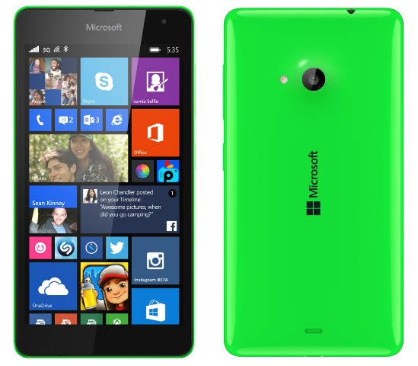
Windows Phone
In October 2010, Microsoft launched their first smart phone, the ‘Windows Phone 7’
In February 2011, it was announced Microsoft would be pairing with Nokia to produce the ‘Lumia Series’
This series of phones was suppose to become a new competitor in the Android-iOS race
All Windows phones run off a user interface evolved from Metro design language, very similar to the layout of Windows 8

Slide 21
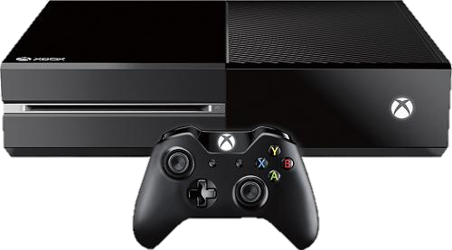
Xbox One
The Xbox One was released in November 2013
Very similar to the original, with enhanced software and hardware, graphics among other specifications
Plans for Xbox One to be able to run Windows 10 along with its other products

Slide 22
Xbox and Windows Integration
Xbox One games will be able to stream to Windows 10 devices
Linked friend lists
Cross device multiplayer
Video editing and sharing on any device
Better graphics/performance with DirectX 12

Slide 23
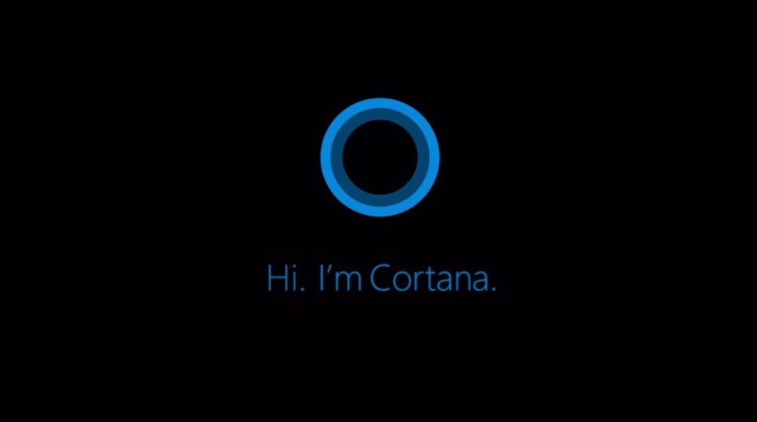
Cortana
The development of Cortana started in 2009 by the Bing research-and-development team
As of 2015, Cortana is available as a beta to all users of Windows Phone 8.1
Most versions of Cortana take the form of two nested, animated circles.

Slide 24
Conclusion

Slide 25
References
Sosinsky, B. (2008) Microsoft Windows Server 2008: Implementation and Administration
Indiana (United States): Wiley Publishing Inc. Microsoft Corporation (2000) MCSE Training Kit-Microsoft Windows 2000 Server, Washington: Microsoft Press.
http://www.computerhope.com/issues/ch000575.htm
http://www.computerhope.com/issues/ch001238.htm
https://www.hostdepartment.com/…/choose-linux-operating-sy…/
http://www.rjsystems.nl/en/3200.php
http://www.microsoft.com/…/mo…/experiences/campaign-cortana/
http://en.wikipedia.org/wiki/Windows_10#Features
http://www.xbox.com/en-IE/windows-10
http://windows.microsoft.com/en-us/windows/preview-cortana
http://halo.wikia.com/wiki/Cortana
http://www.windowsphone.com/…/w…/cortana/start-using-cortana
http://notebooks.com/…/12/a-brief-history-of-windows-mobile/
http://en.wikipedia.org/w…/Bill_%26_Melinda_Gates_Foundation
http://www.biography.com/people/bill-gates-9307520
http://en.wikipedia.org/wiki/Xbox
http://www.digitaltrends.com/gaming/the-history-of-the-xbox/http://en.wikipedia.org/wiki/Windows_Phone
http://en.wikipedia.org/wiki/Microsoft_Surface
http://www.microsoft.com/surface
http://www.gamespot.com/…/xbox-one-to-integra…/1100-6424792/

