Slide 1
Expert Systems: In Detail
Damian Gordon

Slide 2
Contents
What is an Expert System?
Definition of an Expert System
Structure of an Expert System
Reasoning in Expert Systems
Algorithms
Trees and Games
Programming Activity
History of Expert Systems

Slide 3
What is an Expert System?

Slide 4
Expert Systems
As we have mentioned previously, we can think about AI systems as being either
Rule-based Systems
Biologically-inspired Systems
And one of the most common types of Rule-based system is an Expert System.

Slide 5
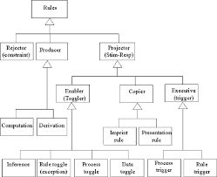
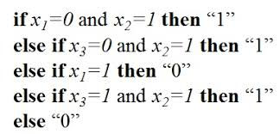
Expert Systems
Rule-based Systems
e.g. Expert Systems

Slide 6
Expert Systems
An Expert System is “a computer program designed to act as an expert in a particular area or domain of expertise. [It] typically includes a robust knowledge base composed of domain facts and heuristics, or guidelines for applying these facts.”
Janjanam, Ganesh, and Manjunatha (2021)
Notes:
Janjanam, D., Ganesh, B. and Manjunatha, L. (2021) “Design of an Expert System Architecture: An Overview”. In Journal of Physics: Conference Series (Vol. 1767, No. 1, p. 012036). IOP Publishing.

Slide 7
Expert Systems
Some Expert Systems have two components:
User Interface
Rules Engine

Slide 8
Expert Systems
Expert System
User
Interface
Rules
Engine

Slide 9
Expert Systems
Others have an additional component:
User Interface
Rules Engine
Knowledge Base

Slide 10
Expert Systems
Expert System
User
Interface
Rules
Engine
Knowledge
Base

Slide 11
Expert Systems
The Knowledge Base is like a database full of knowledge about a particular domain.
To put the knowledge into the Knowledge Base often needs a computer person (called a Knowledge Engineer) to elicit the knowledge from a domain expert, and to code it into the Knowledge Base.

Slide 12
Expert Systems
Expert System
User
Interface
Rules
Engine
Knowledge
Base
Knowledge
Engineer
Domain
Expert

Slide 13
Expert Systems
Knowledge Representation in Expert Systems
Rule-Based Systems: Production rules, for example, IF-THEN-ELSE statements, and their use in encoding expert knowledge.
Frames and Semantic Networks: Alternative ways of structuring and representing knowledge.
Ontologies and Taxonomies: These are used for knowledge organization in modern systems.

Slide 14
Expert Systems
ACTIVITY
We are going to do a knowledge elicitation activity.
These activities are a way of asking people about a topic without doing it directly.
If we ask people directly about a topic, sometimes people forget to say important stuff (the “do-say” problem).

Slide 15
Expert Systems
ACTIVITY
Take two minutes alone to decide which two of the three below cards are most related, and which is the odd one out, and then I’ll ask you to share with your group...
TEACHING
LEARNING
ASSESSMENT

Slide 16
Expert Systems
ACTIVITY
What I’m asking you about really is your views on education and the roles people have in it.
TEACHING
LEARNING
ASSESSMENT

Slide 17
How do Expert Systems reason?

Slide 18
Expert Systems
Expert systems use three ways to reason:
Forward-Chaining
Backward-Chaining
Conflict Resolution

Slide 19
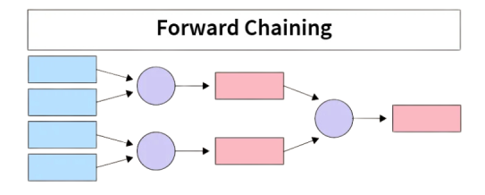
Expert Systems
FACTS
RULES
CONCS

Slide 20
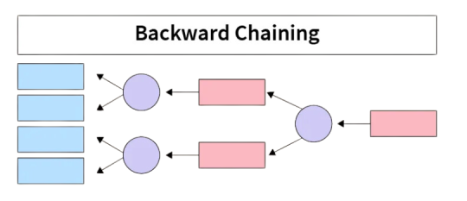
Expert Systems
GOAL
RULES
FACTS

Slide 21
Expert Systems
Conflict Resolution
?
FACTS
RULES
??????

Slide 22
Expert Systems: Forward Chaining
Forward Chaining is where reasoning starts with the facts and move forward by applying rules to derive conclusions.
Here’s an example:

Slide 23
Expert Systems: Forward Chaining
Example: Diagnosing a Cold or Flu
Given Rules:
Rule 1: If the patient has a fever and a headache, they might have the flu.
Rule 2: If the patient has a sore throat and a runny nose, they might have a cold.
Rule 3: If the patient has chills and body aches, they might have the flu.

Slide 24
Expert Systems: Forward Chaining
Facts:
The patient has a fever.
The patient has a headache.
The patient has chills.
The patient has body aches.

Slide 25
Expert Systems: Forward Chaining
Forward Chaining Process:
Start with known facts: The patient has a fever, headache, chills, and body aches.
Apply Rule 1: The patient has a fever and a headache, so the system concludes the patient might have the flu.
Apply Rule 3: The patient also has chills and body aches, which reinforces the conclusion that the patient might have the flu.
Stop: The system reaches a goal (diagnosis of flu) and stops further chaining.

Slide 26
Expert Systems: Forward Chaining
FACTS
RULES
CONCS

Slide 27
Expert Systems: Backward Chaining
Backward Chaining is a goal-driven approach, where reasoning starts from a specific goal and works backward to see if there’s enough evidence to support it.
Here’s an example:

Slide 28
Expert Systems: Backward Chaining
Example: Diagnosing a Cold or Flu
Given Rules:
Rule 1: If the patient has a fever and a headache, they might have the flu.
Rule 2: If the patient has a sore throat and a runny nose, they might have a cold.
Rule 3: If the patient has chills and body aches, they might have the flu.
Same Rules

Slide 29
Expert Systems: Backward Chaining
Goal:
The expert system needs to determine if the patient has the flu

Slide 30
Expert Systems: Backward Chaining
Backward Chaining Process:
Start with the Goal: We want to verify if the patient has the flu
2. Check Rules Related to the Goal: The system looks at rules that can conclude "the patient has the flu.“
Rule 1: Requires "fever" and "headache" to conclude "flu."
Rule 3: Requires "chills" and "body aches" to conclude "flu."

Slide 31
Expert Systems: Backward Chaining
Backward Chaining Process:
3. Gather Evidence for Each Rule:
Rule 1: Ask if the patient has a fever and a headache. If both are true, then this rule supports the flu diagnosis.
Rule 3: Ask if the patient has chills and body aches. If both are true, this rule also supports the flu diagnosis.

Slide 32
Expert Systems: Backward Chaining
Backward Chaining Process:
Make a Decision:
If either Rule 1 or Rule 3 conditions are fully satisfied, the system confirms that the patient might have the flu.
If neither rule is satisfied, the system would reject the flu hypothesis.

Slide 33
Expert Systems: Backward Chaining
GOAL
RULES
FACTS

Slide 34
Expert Systems: Conflict Resolution
Conflict Resolution is a process used to determine which rule to apply next when multiple rules are applicable at the same time.
This happens often in forward chaining, where several rules may match the current set of facts.
Conflict resolution strategies help the system prioritize and choose between competing rules.

Slide 35
Expert Systems: Conflict Resolution
Example: Diagnosing Illness with Conflicting Rules
Given Rules:
Rule 1: If the patient has a fever and a cough, they might have the flu.
Rule 2: If they has a sore throat and a runny nose, they might have a cold.
Rule 3: If they has a fever and a sore throat, they might have strep throat.
Rule 4: If they has a cough and a runny nose, they might have allergies.

Slide 36
Expert Systems: Conflict Resolution
Facts:
The patient has a fever.
The patient has a sore throat.
The patient has a cough.
The patient has a runny nose.

Slide 37
Expert Systems: Conflict Resolution
Conflict Situation:
Several rules match the current set of facts:
Rule 1: Matches fever and cough (suggesting flu).
Rule 2: Matches sore throat and runny nose (suggesting a cold).
Rule 3: Matches fever and sore throat (suggesting strep throat).
Rule 4: Matches cough and runny nose (suggesting allergies).

Slide 38
Expert Systems: Conflict Resolution
Conflict Resolution Strategies:
To decide which rule to apply, the expert system could use one of several conflict resolution strategies:
Specificity: Prioritize rules that are more specific (i.e., rules with more conditions). Here, Rules 1, 2, and 3 each have two conditions, but Rule 3 might be chosen because strep throat is often associated with both fever and sore throat.
Recency: Apply the rule that involves the most recent data. If the system received "fever" and "sore throat" last, Rule 3 would be chosen.
Priority/Rule Ordering: Give certain rules a higher priority based on expert-provided rankings. If Rule 1 is ranked highest by a medical expert, the system would apply it and diagnose the flu.

Slide 39
Expert Systems: Conflict Resolution
Conflict Resolution
?
FACTS
RULES
??????

Slide 40
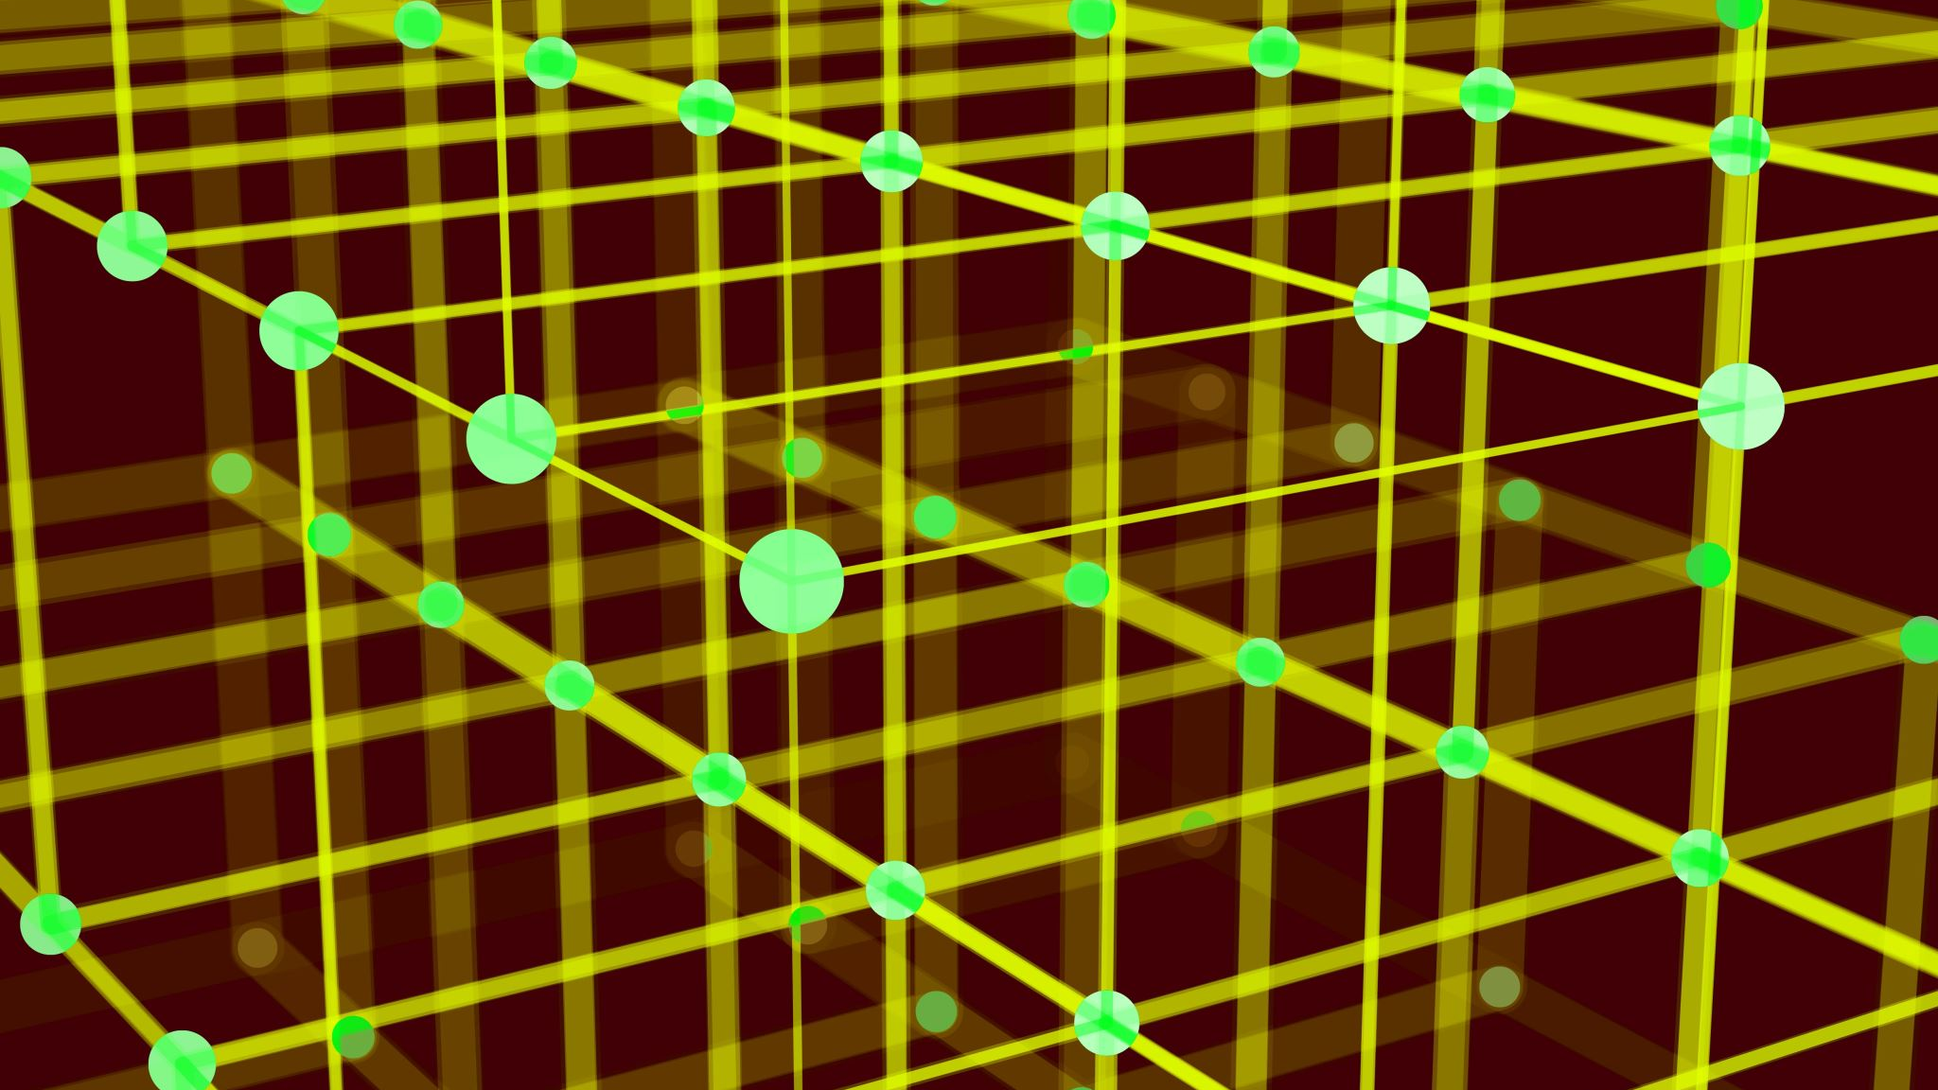
Algorithms

Slide 41
Expert Systems
As we’ve mentioned before, for Computer Scientists who look at the efficiency of different approaches, we model these computer programs as ALGORITHMS, which are not just computer programs, but any general set of step-by-step instructions (that terminates) to perform any type of task.

Slide 42
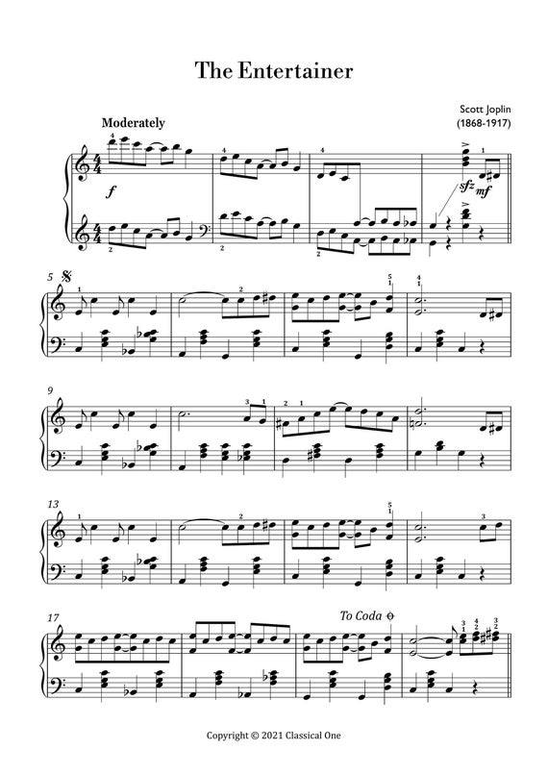
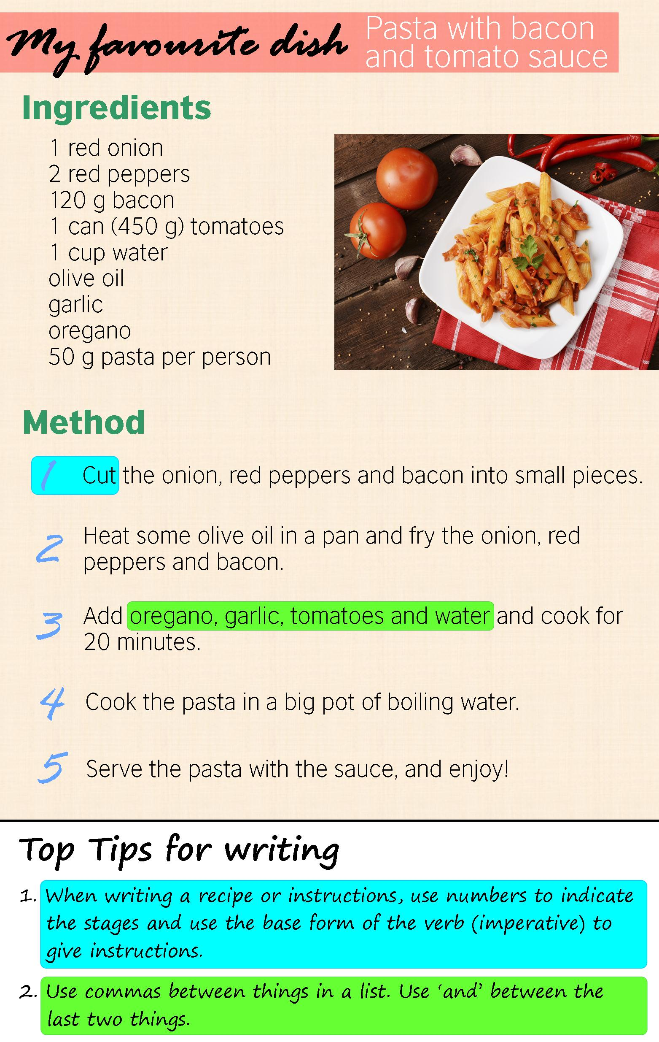
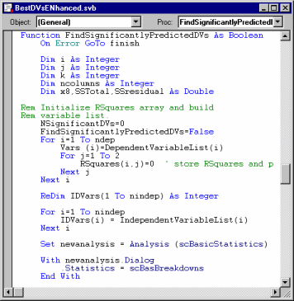
Expert Systems
Examples of Algorithms:
Musical Scores, Knitting Patterns, Recipes, Computer programs

Slide 43
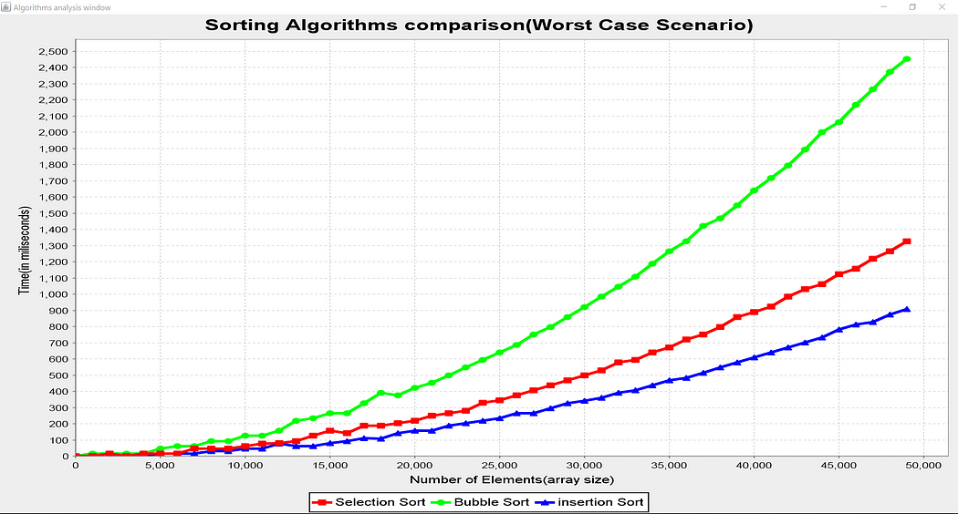
Expert Systems
And then it’s easy to compare algorithms:

Slide 44
Expert Systems
We have a special kind of data structure that looks like this:

Slide 45
Expert Systems
We have a special kind of data structure that looks like this:

Slide 46
Expert Systems
We have a special kind of data structure that looks like this:

Slide 47
Expert Systems
We have a special kind of data structure that looks like this:
We call this
a “tree”

Slide 48
Expert Systems
We have a special kind of data structure that looks like this:
The top node
is the “root”

Slide 49
Expert Systems
We have a special kind of data structure that looks like this:
The end nodes are
each a “leaf”

Slide 50
Expert Systems
We have a special kind of data structure that looks like this:
The nodes in-between
are each a “branch”

Slide 51
Root Node
Branch Node
Branch Node
Branch Node
Leaf Node
Leaf Node
Leaf Node
Leaf Node
Leaf Node

Slide 52
Expert Systems
So what has this got to do with anything?

Slide 53
Expert Systems
So what has this got to do with anything?
Let’s look at an example of a game:

Slide 54
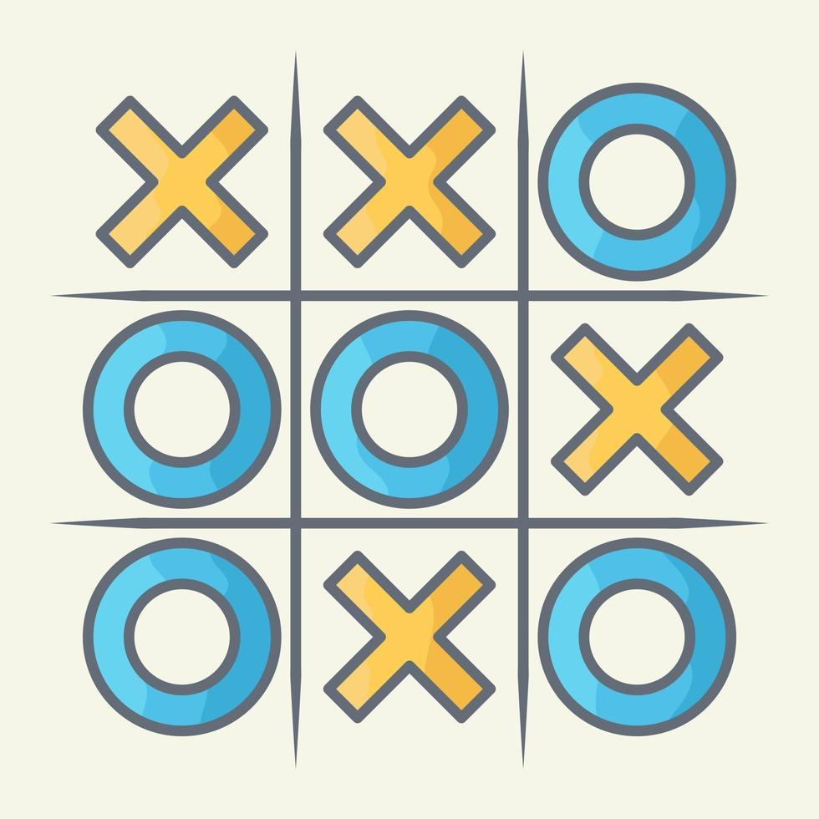
Expert Systems
Xs and Os
Tic-Tac-Toe
Noughts and Crosses

Slide 55
Expert Systems
We know we can program a computer to play this game, but how does it work?

Slide 56
Expert Systems

Slide 57
Expert Systems
We know the starting state of the game, and then all of the possible first moves:
X
 | X
 |  | X
X
 | X
 |  | X
X
 | X
 |  | X

Slide 58
Expert Systems
From here we can create a tree of all the possible moves on the board:

Slide 59
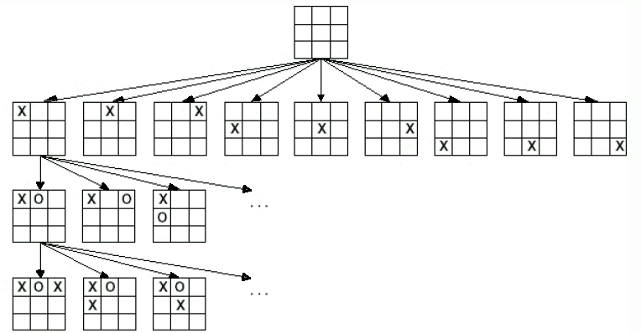
Expert Systems

Slide 60
Expert Systems
It grows into a really big tree:

Slide 61
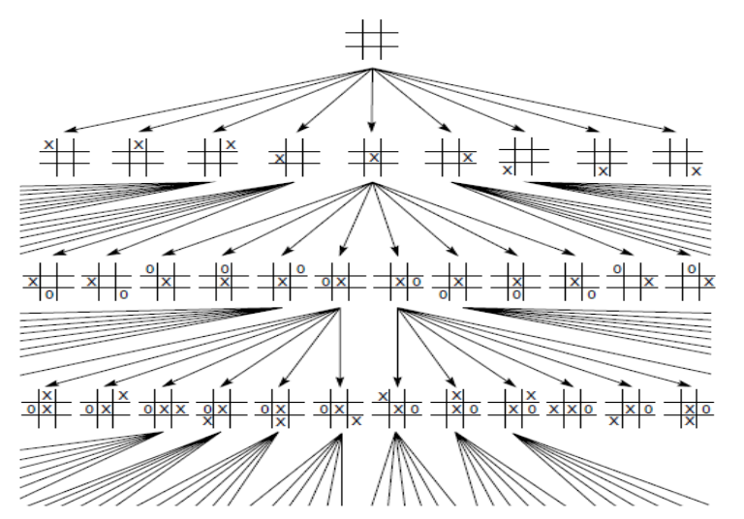

Slide 62
Expert Systems
In fact, there are 19,683 (3⁹) possible states of the game
For each state we can figure out which move will be better and which worse.

Slide 63
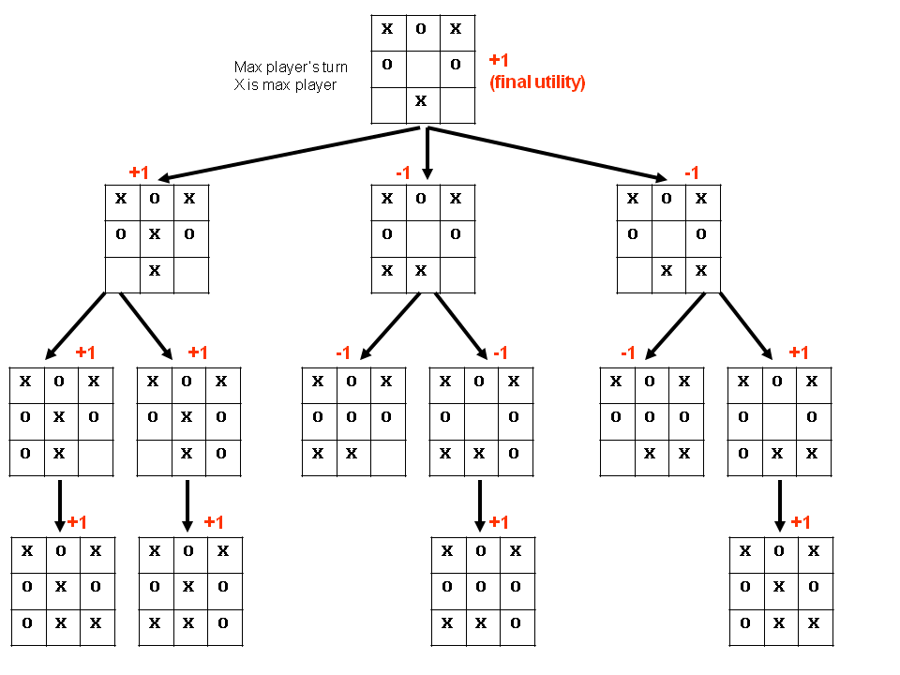

Slide 64
Expert Systems
So if we know all of the possible states of the game, and whether the next move is better or worst to win the game, we easily can create an Expert System that will have a set of IF-THEN-ELSE rules so that a human can play a computer.

Slide 65
Expert Systems
In fact, this was a really important plot point in one of the first movies about computers and AI, in 1983 called “WarGames” starring Matthew Broderick, Ally Sheedy, John Wood and Dabney Coleman.

Slide 66
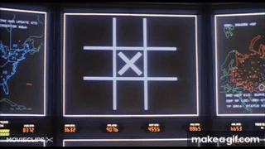
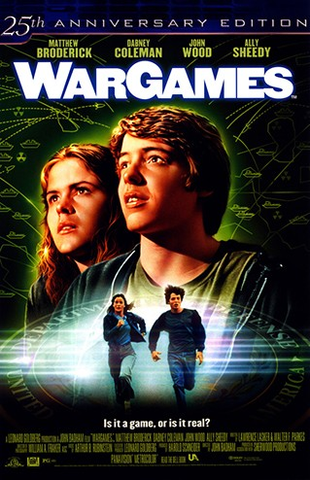
Expert Systems

Slide 67
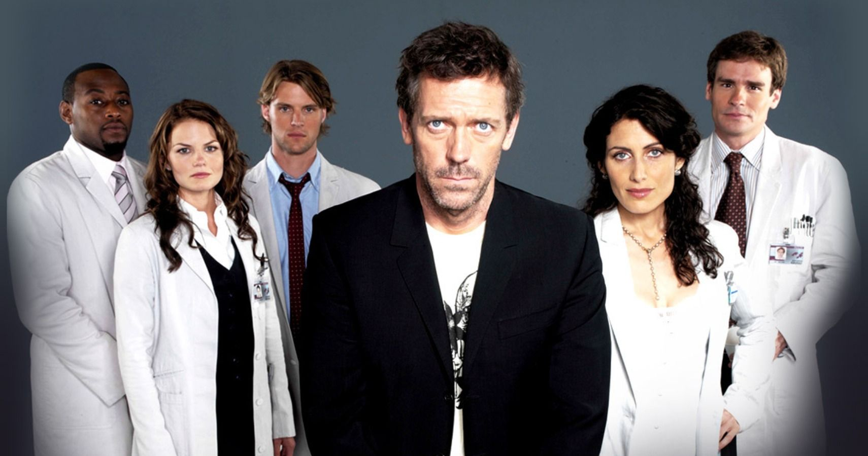
Expert Systems: House, S01E01
ACTIVITY
Look at “House MD”, Season 1, Episode 1 (on Brightspace)

Slide 68
Expert Systems: House, S01E01
ACTIVITY
As we can see, there were 3 main tests done:
An MRI
A Thiamine level measure
A CAT Scan
And there were 8 possible diagnosis.
Let’s imagine we can create a table based on the tests and the diagnosis process as follows:

Slide 69
MRI | Thiamine | CAT Scan
N | N | N | POSSIBLE DIAGNOSIS: Brain tumour FOLLOW-UP TEST: Do a Contrast MRI
N | N | Y | POSSIBLE DIAGNOSIS: Brain lesion FOLLOW-UP TEST: Inject gadolinium
N | Y | N | POSSIBLE DIAGNOSIS: Brain aneurysm FOLLOW-UP TEST: Check protein markers
N | Y | Y | POSSIBLE DIAGNOSIS: Stroke FOLLOW-UP TEST: Check SED rate
Y | N | N | POSSIBLE DIAGNOSIS: Ischemic syndrome FOLLOW-UP TEST: Give blood thinners
Y | N | Y | POSSIBLE DIAGNOSIS: Creutzfeldt–Jakob FOLLOW-UP TEST: Test with interferon
Y | Y | N | POSSIBLE DIAGNOSIS: Wernicke encephalopathy FOLLOW-UP TEST: Change diet
Y | Y | Y | POSSIBLE DIAGNOSIS: Cerebral vasculitus FOLLOW-UP TEST: Immunosuppressant drugs

Slide 70
Expert Systems: House, S01E01
TESTS
MRI
Thiamine
CAT
Tumour
Lesion
Aneurysm
Stroke
Ischemic
CJD
Wernicke
Vasculitus

Slide 71
Expert Systems: House, S01E01
TESTS
MRI
Thiamine
CAT
Tumour
Lesion
Aneurysm
Stroke
Ischemic
CJD
Wernicke
Vasculitus

Slide 72
Expert Systems: House, S01E01
TESTS
MRI
Thiamine
CAT
Tumour
Lesion
Aneurysm
Stroke
Ischemic
CJD
Wernicke
Vasculitus

Slide 73
Expert Systems: House, S01E01
TESTS
MRI
Thiamine
CAT
Tumour
Lesion
Aneurysm
Stroke
Ischemic
CJD
Wernicke
Vasculitus

Slide 74
Expert Systems: House, S01E01
TESTS
MRI
Thiamine
CAT
Tumour
Lesion
Aneurysm
Stroke
Ischemic
CJD
Wernicke
Vasculitus

Slide 75
Expert Systems: House, S01E01
TESTS
MRI
Thiamine
CAT
Tumour
Lesion
Aneurysm
Stroke
Ischemic
CJD
Wernicke
Vasculitus

Slide 76
Expert Systems: House, S01E01
ACTIVITY
How would we write that as a computer program?

Slide 77
Expert Systems: House, S01E01
/********************************************************/
/* Title: Expert system based on House S01E01 */
/* Developer: Damian Gordon */
/* Date Created: 01/11/2024 */
/********************************************************/
/* Description: This is an Expert system to do a */
/* diagnosis based on House S01E01 */
/********************************************************/
/* Modified by: Developer, Date, Description */
/* Modified by: Developer, Date, Description */
/* Modified by: Developer, Date, Description */
/* Modified by: Developer, Date, Description */
/********************************************************/

Slide 78
Expert Systems: House, S01E01
#include <stdio.h>
int main() {
/****************************************/
/* VARIABLES */
/****************************************/
/* Declare the variables to record the user answers */
char MRI_YN, Thiamine_YN, CAT_Scan_YN;

Slide 79
Expert Systems: House, S01E01
/* Check if the MRI showed anything */
printf("Was there anything on the MRI (y/n): ");
scanf("%c", &MRI_YN);
/* Check if the Thiamine Level is elevated */
printf("Is the Thiamine Level elevated (y/n): ");
scanf("%c", &Thiamine_YN);
/* Check if the CAT Scan showed anything */
printf("Was there anything on the CAT scan (y/n): ");
scanf("%c", &CAT_Scan_YN);

Slide 80
Expert Systems: House, S01E01
if ((MRI_YN == 'n') &&
(Thiamine_YN == 'n') &&
(CAT_Scan_YN == 'n')) {
printf("==================================\n");
printf("POSSIBLE DIAGNOSIS: Brain tumour.\n");
printf("FOLLOW-UP TEST: Do a Contrast MRI.\n");
}

Slide 81
Expert Systems: House, S01E01
else if ((MRI_YN == 'n') &&
(Thiamine_YN == 'n') &&
(CAT_Scan_YN == 'y')) {
printf("==================================\n");
printf("POSSIBLE DIAGNOSIS: Brain lesion.\n");
printf("FOLLOW-UP TEST: Inject gadolinium.\n");
}

Slide 82
Expert Systems: House, S01E01
else if ((MRI_YN == 'n') &&
(Thiamine_YN == 'y') &&
(CAT_Scan_YN == 'n')) {
printf("==================================\n");
printf("POSSIBLE DIAGNOSIS: Brain aneurysm.\n");
printf("FOLLOW-UP TEST: Check protein markers.\n");
}

Slide 83
Expert Systems: House, S01E01
else if ((MRI_YN == 'n') &&
(Thiamine_YN == 'y') &&
(CAT_Scan_YN == 'y')) {
printf("==================================\n");
printf("POSSIBLE DIAGNOSIS: Stroke.\n");
printf("FOLLOW-UP TEST: Check SED rate.\n");
}

Slide 84
Expert Systems: House, S01E01
else if ((MRI_YN == 'y') &&
(Thiamine_YN == 'n') &&
(CAT_Scan_YN == 'n')) {
printf("==================================\n");
printf("POSSIBLE DIAGNOSIS: Ischemic syndrome.\n");
printf("FOLLOW-UP TEST: Give blood thinners.\n");
}

Slide 85
Expert Systems: House, S01E01
else if ((MRI_YN == 'y') &&
(Thiamine_YN == 'n') &&
(CAT_Scan_YN == 'y')) {
printf("==================================\n");
printf("POSSIBLE DIAGNOSIS: Creutzfeldt–Jakob.\n");
printf("FOLLOW-UP TEST: Test with interferon.\n");
}

Slide 86
Expert Systems: House, S01E01
else if ((MRI_YN == 'y') &&
(Thiamine_YN == 'y') &&
(CAT_Scan_YN == 'n')) {
printf("==================================\n");
printf("POSSIBLE DIAGNOSIS: Wernicke encephalopathy.\n");
printf("FOLLOW-UP TEST: Change diet.\n");
}

Slide 87
Expert Systems: House, S01E01
else if ((MRI_YN == 'y') &&
(Thiamine_YN == 'y') &&
(CAT_Scan_YN == 'y')) {
printf("==================================\n");
printf("POSSIBLE DIAGNOSIS: Cerebral vasculitus.\n");
printf("FOLLOW-UP TEST: Immunosuppressant drugs.\n");
}

Slide 88
Expert Systems: House, S01E01
else {
printf("Error: Invalid input.\n");
} //Endif;
return 0;
} //End.

Slide 89
Expert Systems
Challenges in Expert Systems
Knowledge Acquisition Bottleneck: The difficulty of gathering and formalizing expert knowledge.
Maintenance and Scalability: Issues in updating and expanding the knowledge base.
Limitations: e.g. the lack of common sense, inability to adapt to new situations, and the difficulty in handling ambiguous data.

Slide 90
Timeline of Expert Systems
1960s
1970s
1981
2000s
2010s
Focus
On
Rules-
Based
Systems
Development
of
Dendral
(plants)
Development
of
MCYIN
(medical)
Development
of
APES
(legal)
Use
of
“Big Data”

Slide 91
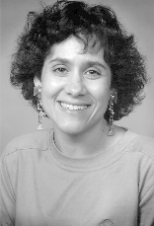
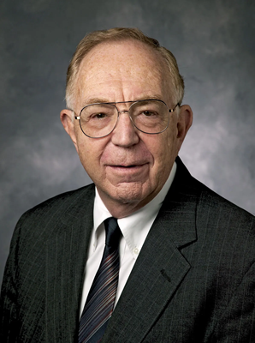
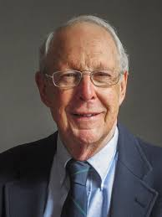
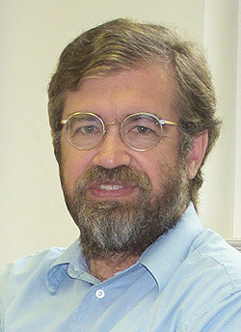
Some Famous Expert System Researchers
Edward Feigenbaum
Janet Kolodner
Carla Gomes
Bruce G. Buchanan
Randall Davis
Benjamin Kuipers

Slide 92
Some Famous Expert Systems

Slide 93
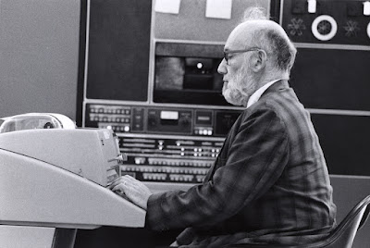
Expert Systems
Name: Dendral
Era: 1960s
Field: Chemistry
Purpose: Developed at Stanford, DENDRAL was used for identifying the structure of chemical compounds based on mass spectrometry data. It is considered one of the first successful expert systems and laid the groundwork for artificial intelligence in scientific research.

Slide 94
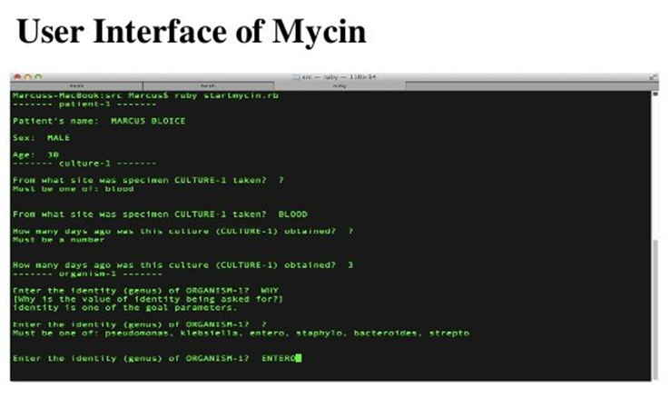
Expert Systems
Name: MYCIN
Era: 1970s
Field: Medicine
Purpose: Developed at Stanford University, MYCIN was designed to diagnose bacterial infections and recommend antibiotics. It was one of the first systems to demonstrate that expert systems could outperform human specialists in certain areas.

Slide 95
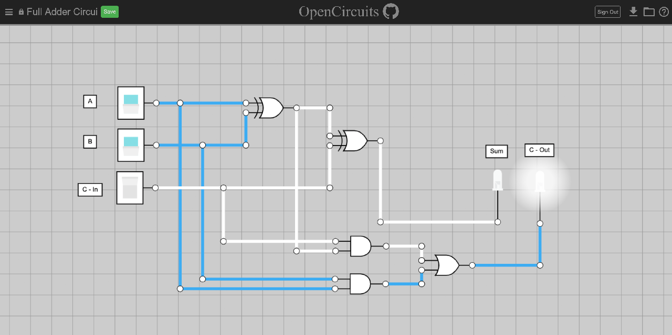
Expert Systems
Name: Sophie
Era: 1970s
Field: Physics Education
Purpose: SOPHIE was created to assist students in learning electrical circuit theory. It uses simulation to mimic a tutoring system where students can work through physics problems with guidance and explanations, helping develop understanding through hands-on problem-solving.

Slide 96
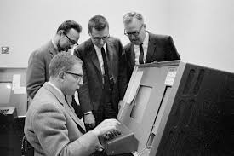
Expert Systems
Name: R1/XCON
Era: 1980s
Field: Computers
Purpose: Created by Digital Equipment Corporation (DEC), R1, also known as XCON, helped configure orders for new computer systems by suggesting component layouts based on customer specifications. This expert system saved DEC millions of dollars and demonstrated the commercial viability of expert systems.

Slide 97
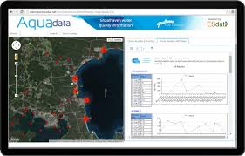
Expert Systems
Name: Aqua
Era: 1980s
Field: Water Quality Management
Purpose: AQUA assists in monitoring and managing water quality in reservoirs and rivers by analyzing data on chemical levels, temperature, and other environmental factors. It provides recommendations on actions to maintain safe water standards, such as treatment adjustments, to support ecological and human health.

Slide 98
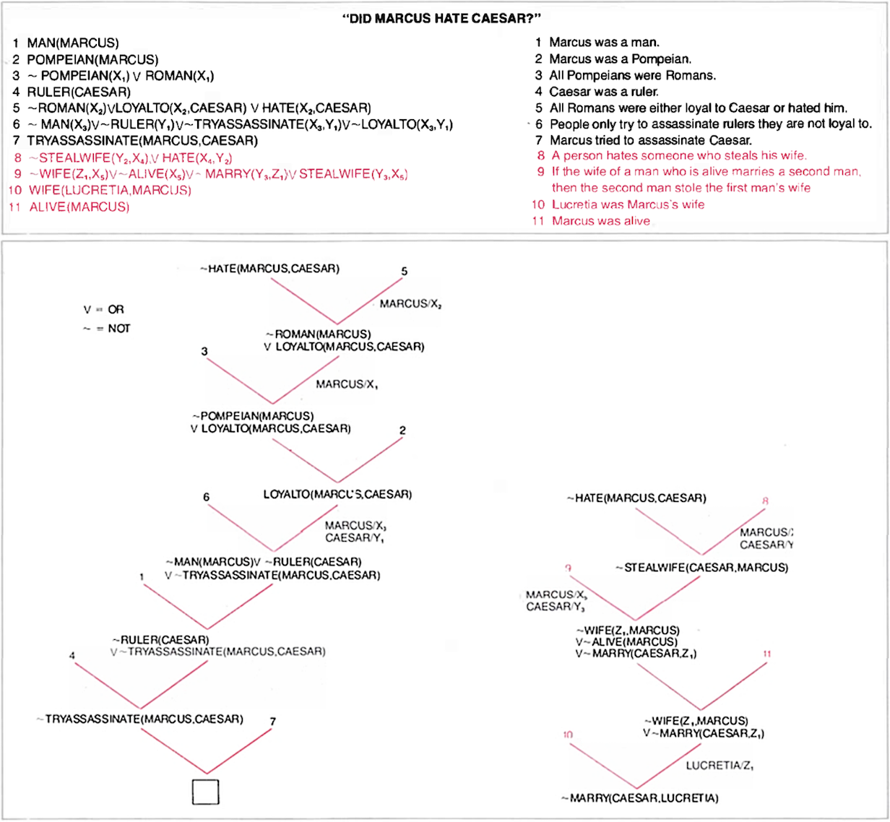
Expert Systems
Name: Cyc
Era: 1980s
Field: General Knowledge Reasoning
Purpose: CYC is an ambitious expert system that aims to capture general human knowledge in a structured, machine-readable format. Developed by Cycorp, it can reason across a vast array of topics and aims to support AI applications by providing common-sense reasoning capabilities.

Slide 99
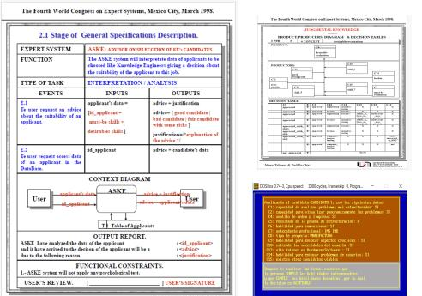
Expert Systems
Name: APES
Era: 1980s
Field: Legal
Purpose: APES is designed to assist legal professionals by automating various tasks, such as legal research, case analysis, and document drafting. A now oft-cited research paper entitled “The British Nationality Act as a Logic Program” was published in 1986 and subsequently became a hallmark for subsequent work in AI and the law.

Slide 100
Expert Systems
Name: SHYSTER
Era: 1990s
Field: Legal
Purpose: This Australian legal expert system was used to assist lawyers in statutory interpretation and case law analysis, helping them understand complex legal rules and precedents. SHYSTER could analyze legal language and suggest interpretations based on established principles.

