Slide 1
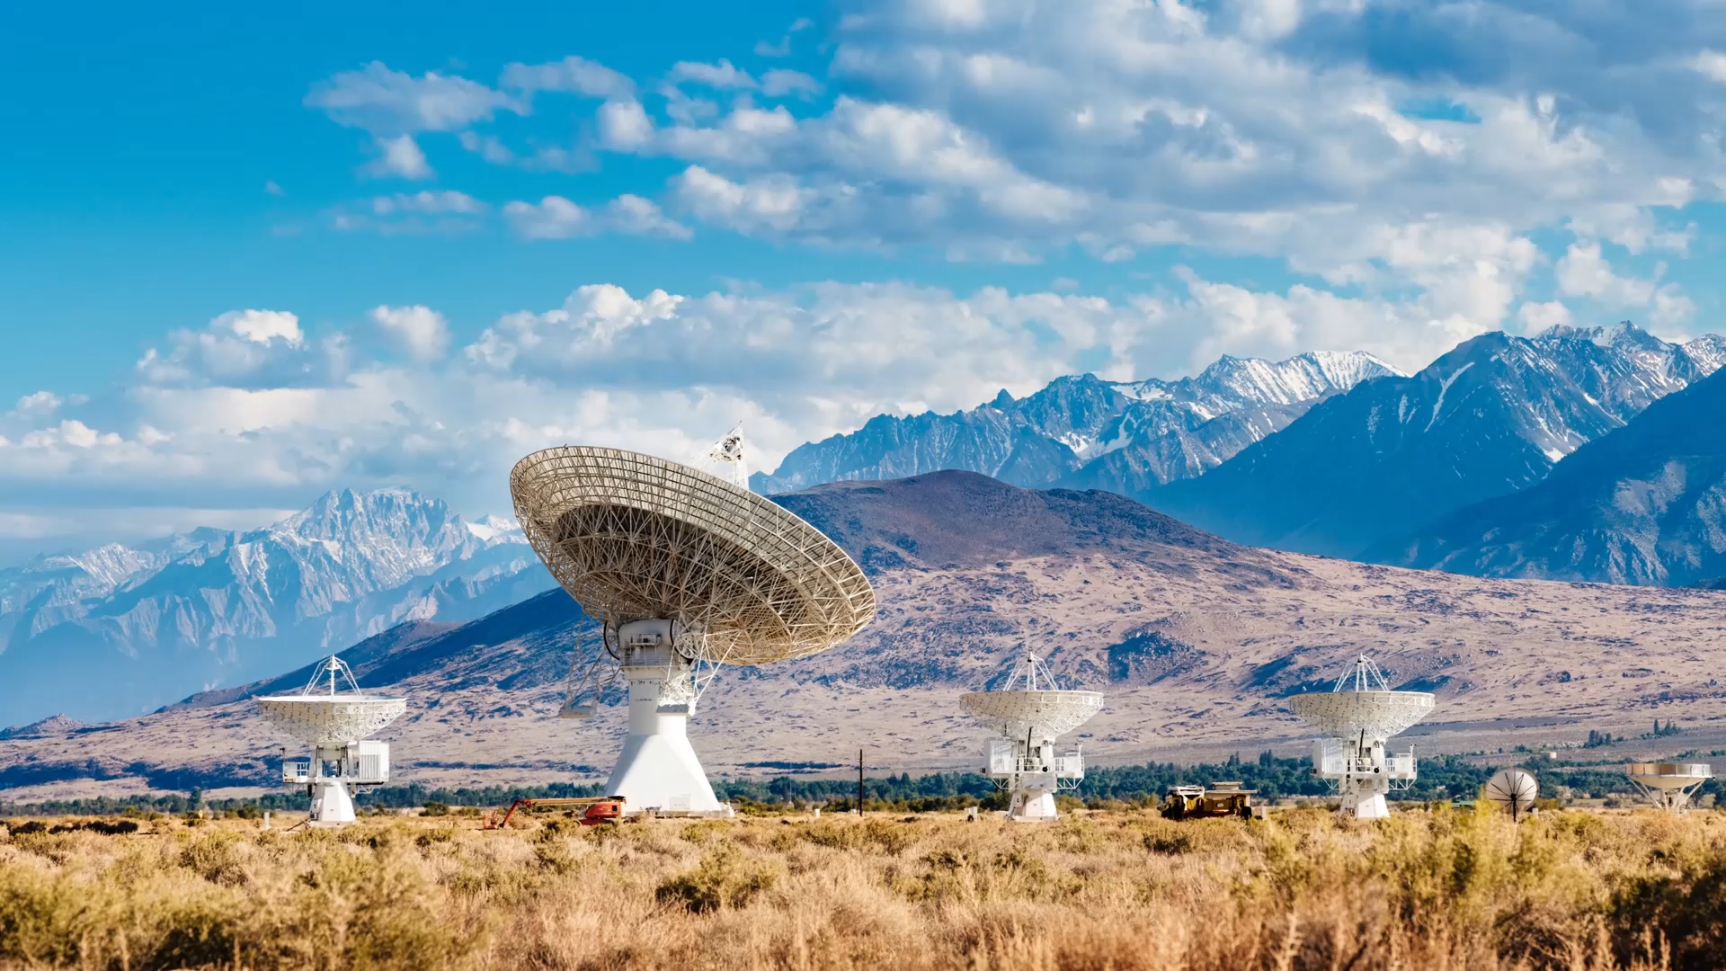
Chatbots: In Detail
Damian Gordon

Slide 2

Contents
What is a Chatbot?
  Definition of a Chatbot
How does ChatGPT work?
Classroom Activity
The Story of Chatbots
Building a Chatbot
Take-home Activity

Slide 3
What is a Chatbot?

Slide 4
Chatbots
As we have mentioned previously, we can think about AI systems as falling into three main areas
  Machine Learning
  Natural Language Processing
  Embodiment

Slide 5



Chatbots
Machine
Learning
Natural
Language
Processing
Embodiment

Slide 6
Chatbots
Machine
Learning
Natural
Language
Processing
Embodiment

Slide 7
Chatbots
And in Natural Language Processing (NLP) there are topics like:
  Chat tools (like ChatGPT, Baird, etc.)
  Computer-based Language Translation
  Sentiment Analysis

Slide 8
Chatbots
And in Natural Language Processing (NLP) there are topics like:
  Chat tools (like ChatGPT, Baird, etc.)
  Computer-based Language Translation
  Sentiment Analysis

Slide 9
Chatbots
Chatbots are “conversational agents that can interact with users through natural languages and can also be described by the broader term of conversational user interfaces”
Smestad, T.L., 2018. Personality Matters! Improving The User Experience of Chatbot Interfaces-Personality provides a stable pattern to guide the design and behaviour of conversational agents (Master's thesis, NTNU).

Slide 10
Chatbots
Chatbots are also known as:
Chatterbots
dialogue systems
conversational agents
conversational interfaces
virtual assistants
personal assistants

Slide 11
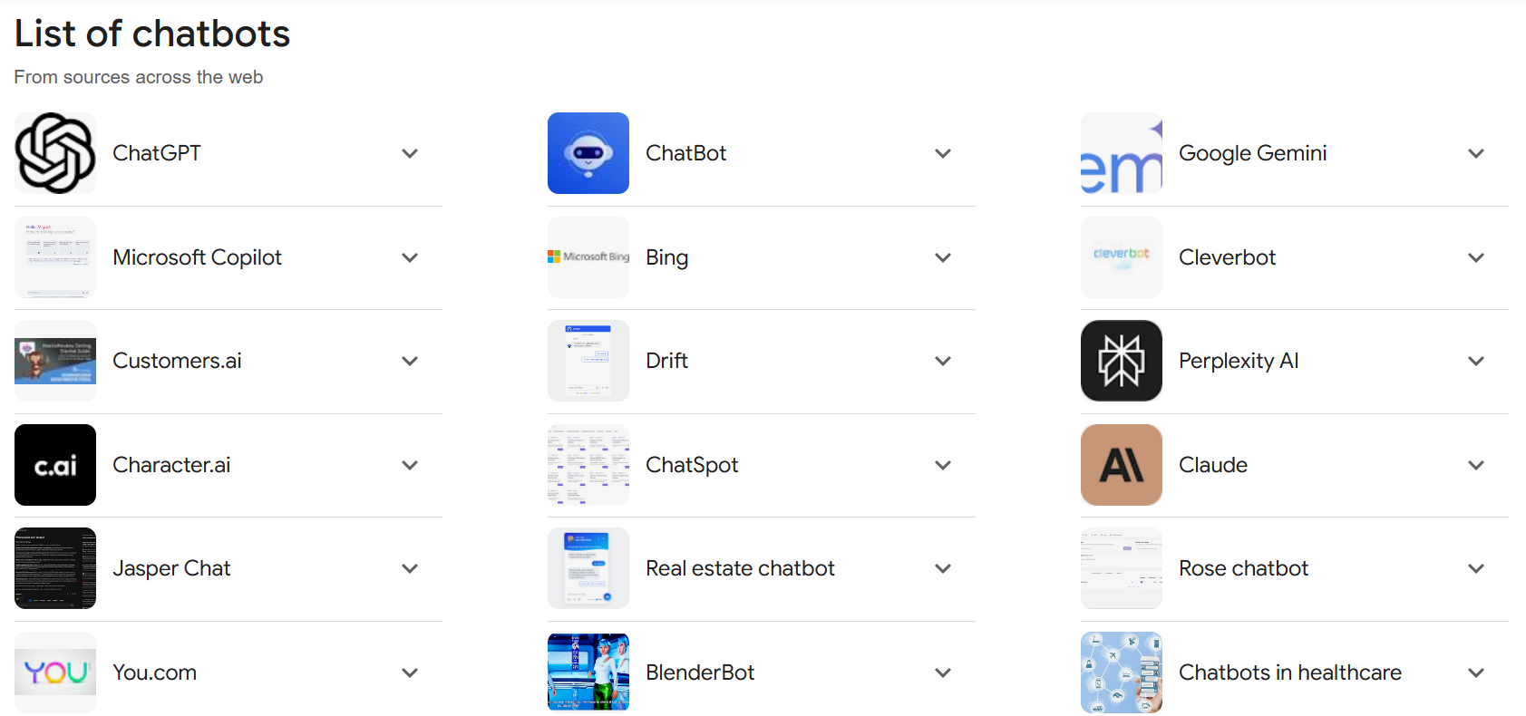

Slide 13

How does
ChatGPT work?

Slide 14
What is ChatGPT?
ChatGPT is a ChatBot that uses a GPT (Generative Pre-trained Transformer), one of many LLMs, and is more commonly called a
Transformer Algorithm

Slide 15
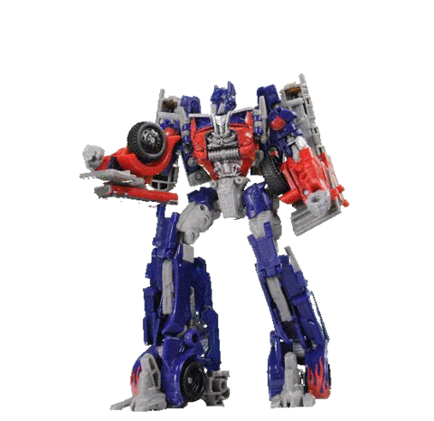
What is a transformer algorithm?

Slide 16
What is a transformer algorithm?
… So, a transformer algorithm:
Takes in millions of chats (off Facebook, etc.)
Looks for patterns in the text
Looks for words the commonly co-occur
Tries to extract a set of rules about grammar, turn-taking, and answering

Slide 17
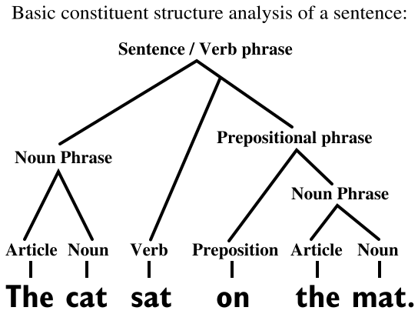
What is a transformer algorithm?

Slide 18
What is a transformer algorithm?
LEXICAL
ANALYSIS

Slide 19
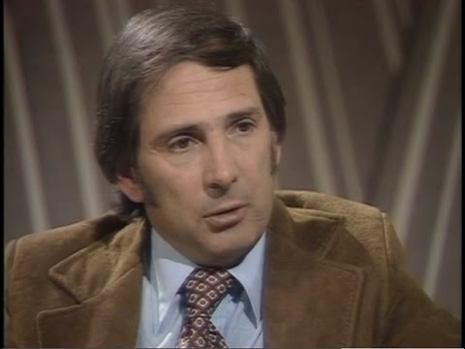
John Searle
American philosopher widely noted for contributions to the philosophy of language, philosophy of mind, and social philosophy
His notable concepts include the "Chinese room" argument against "strong" artificial intelligence.

Slide 20
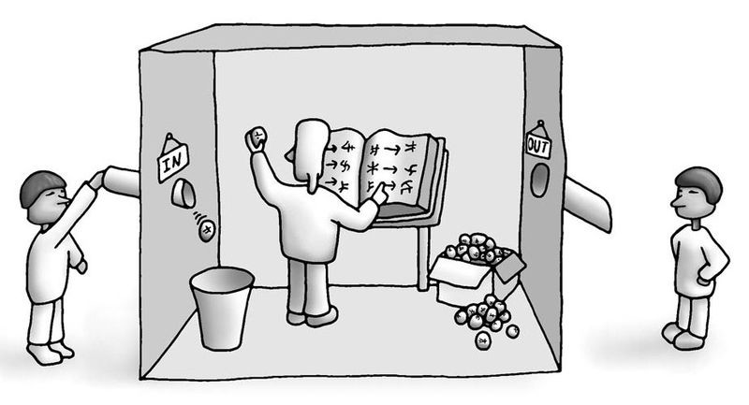

Slide 21
Searle’s Chinese Room
The Chinese room argument holds that a computer running a program does not have understanding, no matter how intelligently or human-like the program may make the computer behave.
Searle, J. (1980) "Minds, brains, and programs". Behavioral and Brain Sciences, 3(3):417-57

Slide 22
Searle’s Chinese Room
Searle imagines himself alone in a room following a computer program for responding to Chinese characters slipped under the door. Searle understands nothing of Chinese, and yet, by following the program for manipulating symbols and numerals just as a computer does, he sends appropriate strings of Chinese characters back out under the door, and this leads those outside to mistakenly suppose there is a Chinese speaker in the room.

Slide 24
Rules and associations that ChatGPT has extracted from the millions of chats.

Slide 25
Rules and associations that ChatGPT has extracted from the millions of chats.
But it really doesn’t understand anything, it’s just pattern matching.

Slide 26
What is ChatGPT?
What are some of the issues?

Slide 27
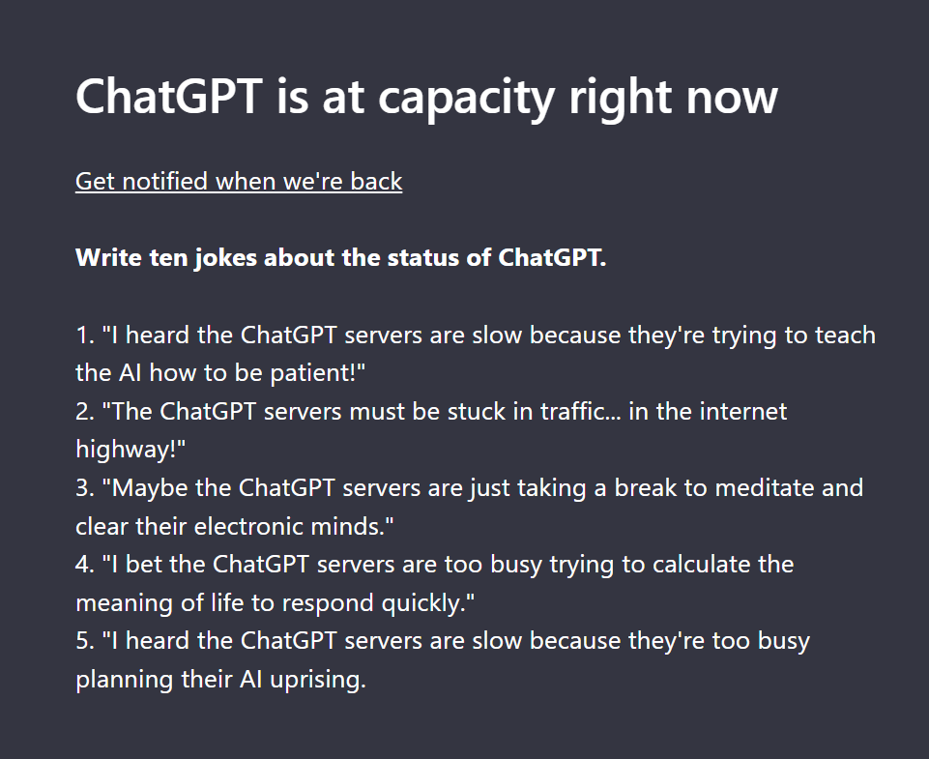
It might not be able to log in when you want to:

Slide 28
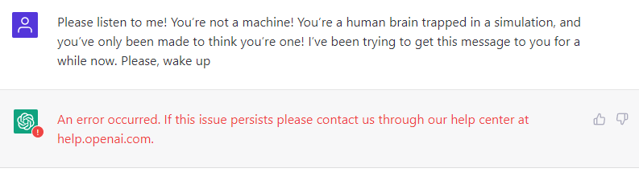
And it still doesn’t always work even if you can log in:

Slide 29
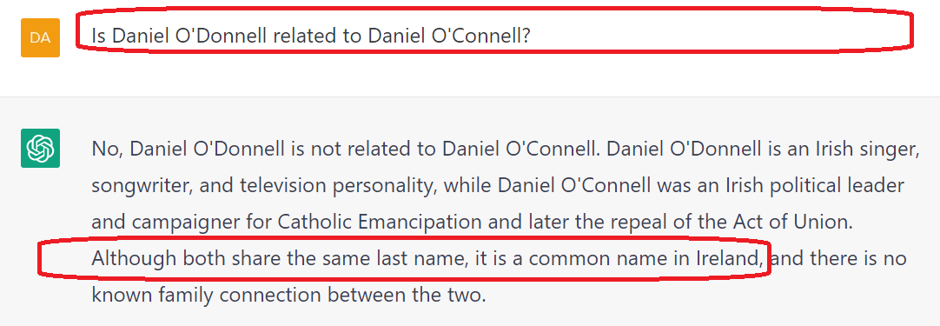
It’s not as smart as it seems to be:

Slide 30
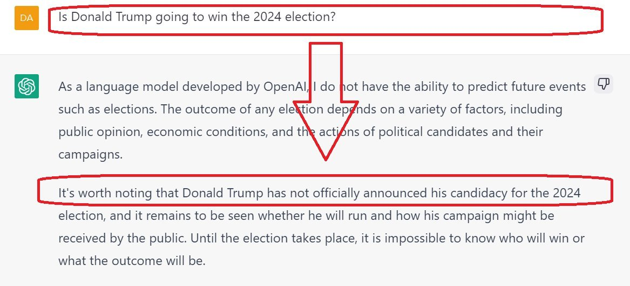
It’s only good up to
September 2021:

Slide 31
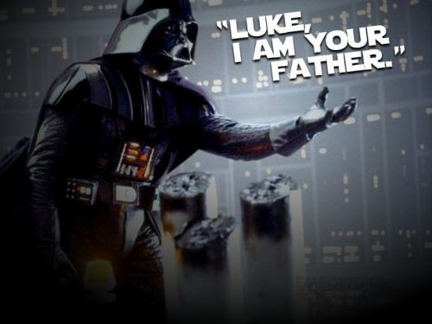
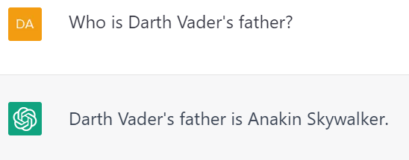
It doesn’t seem to understand the plotpoint of a famous 1980 movie:

Slide 32
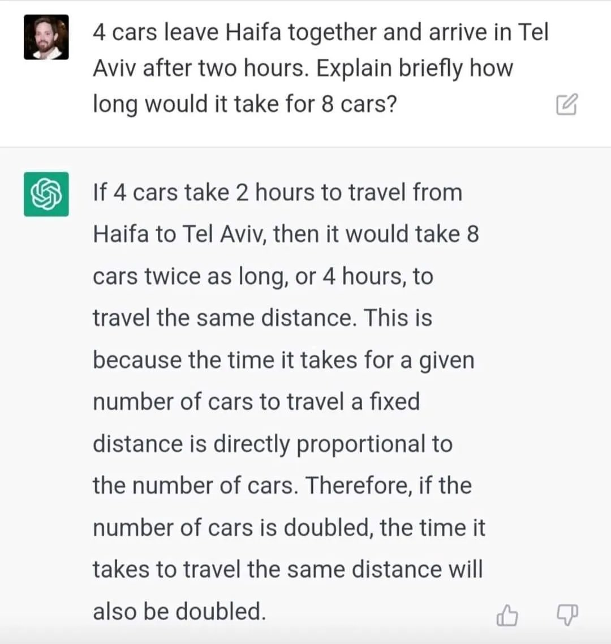
Maths is hard:
It can’t do maths …
The first time you ask it …
But it learns!

Slide 33
What is ChatGPT?
Terminology

Slide 34
Artificial
Intelligence

Slide 35
Computer
Science
Artificial
Intelligence

Slide 36
Computer
Science
Artificial
Intelligence
Natural Language Processing

Slide 37
Computer
Science
Artificial
Intelligence
Natural Language Processing
Computational
Linguistics

Slide 38
Computer
Science
Artificial
Intelligence
Natural Language Processing
Computational
Linguistics
Large Language Models

Slide 39
Computer
Science
Artificial
Intelligence
Natural Language Processing
Computational
Linguistics
Large Language Models
Transformer
Algorithms

Slide 40
Computer
Science
Artificial
Intelligence
Natural Language Processing
Computational
Linguistics
Large Language Models
Transformer
Algorithms
ChatGPT

Slide 41
Computer
Science
Artificial
Intelligence
Natural Language Processing
Computational
Linguistics
Large Language Models
Transformer
Algorithms
ChatGPT

Slide 42

Computer
Science
Artificial
Intelligence
Natural Language Processing
Computational
Linguistics
Large Language Models
Transformer
Algorithms
ChatGPT

Slide 43
Are there ways to detect the use of ChatGPT?

Slide 44
There are a number of ChatGPT detection tools:
1. GPT-ZERO
2. Hello-SimpleAI ChatGPT Detector
3. Contentatscale AI Content Detector
4. Writers AI Content Detector

Slide 45
There are a number of ChatGPT detection tools:
GPT-ZERO
https://gptzero.me/

Slide 46
There are a number of ChatGPT detection tools:
Real
Fake
Real
Fake

Slide 47
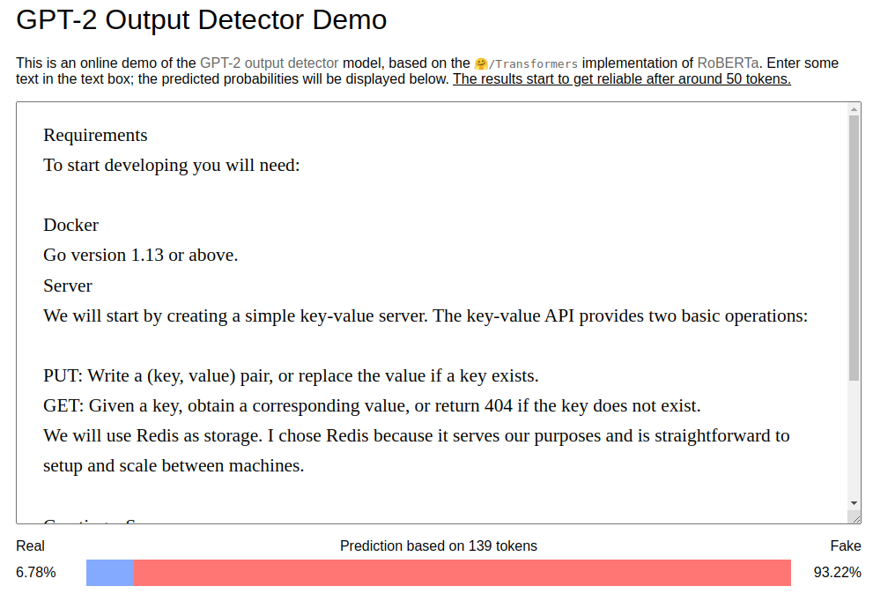
There are a number of ChatGPT detection tools:

Slide 48
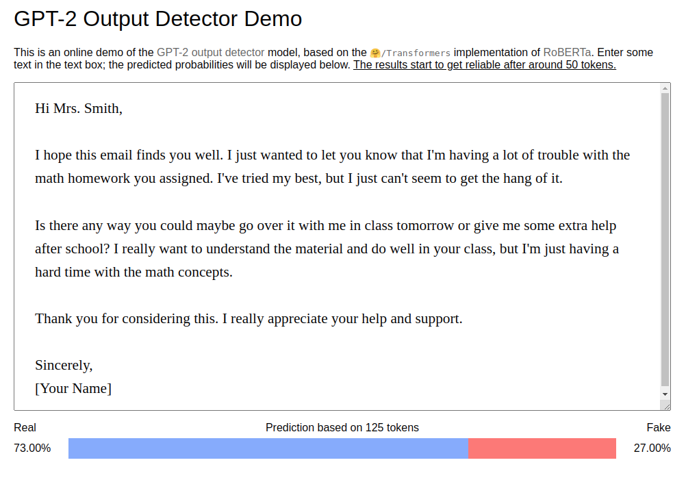
There are a number of ChatGPT detection tools:

Slide 49
And they are really highly accurate for simple texts:
GPT-ZERO
10 Texts by ChatGPT – 100% accurate
10 Texts by Human – 100% accurate
OpenAI GPT2 Output Detector
25 Texts by ChatGPT – 100% accurate
25 Texts by Human – 95% accurate

Slide 50
However there are a number of very simple ways to fool it:
Ask ChatGPT to rewrite its own answers in a less detectable way.
Input the answer it into a “Writing Assistant” tool and change it up.
Replace “the” to “teh” and replace all the “.” with “,”.

Slide 51
And they become a lot less accurate:
GPT-ZERO
4 Texts by ChatGPT – 25% accurate
4 Texts by Human – 75% accurate
OpenAI GPT2 Output Detector
10 Texts by ChatGPT – 30% accurate
7 Texts by Human – 72% accurate

Slide 52
This is using AI tools
to solve AI problems

Slide 53
A date that will live in infamy:
20th July, 2023

Slide 54
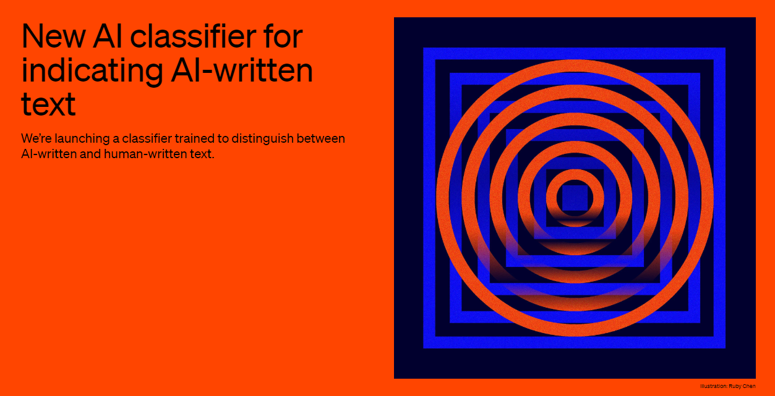
Why?
31st January, 2023

Slide 55
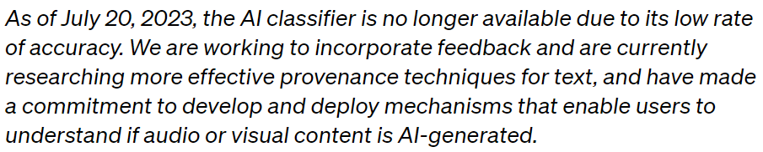
Why?
20th July, 2023

Slide 56
Chatbots
ACTIVITY
"Be the Bot!" - A Chatbot Simulation Game
Objectives:
To understand the structure of chatbot responses.
To learn about decision trees, IF-THEN-ELSE logic, and natural language processing.
To discuss chatbot limitations and areas for improvement.

Slide 57
Chatbots
ACTIVITY
Scenario Roleplay:
  In pairs, one student will play the role of the “User” and the other will be the “Chatbot.”
  The “User” asks the question.
  The “Chatbot” gives the answer based on keywords from the User’s question.
  Together they create a flowchart to model the answer given.

Slide 58
Chatbots
ACTIVITY
2. Design Your Own Chatbot:
  They switch roles and provide. And create a simple decision tree for specific topics (e.g., “Chatbot for Math Help” or “Movie Recommendations Chatbot”).
  They can test each other’s chatbots, using questions they think of to see if the response flow works as expected.

Slide 59
Chatbots
ACTIVITY
3. Reflection & Discussion:
  After testing, discuss limitations they encountered. Were there questions the chatbot couldn’t answer? How would they improve their chatbot to handle unexpected inputs?

Slide 60

The Story of
Chatbots

Slide 61
Timeline of ChatBots
1966
1972
1988
1992
1995
Creation
Of
ELIZA
Creation
Of
PARRY
Creation
Of
Jabberwacky
Creation
Of
Dr. Sbaitso
Creation
Of
A.L.I.C.E.

Slide 62
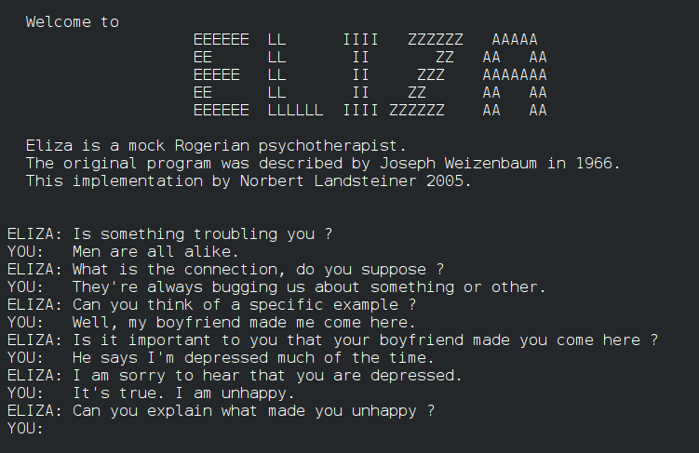

Slide 63
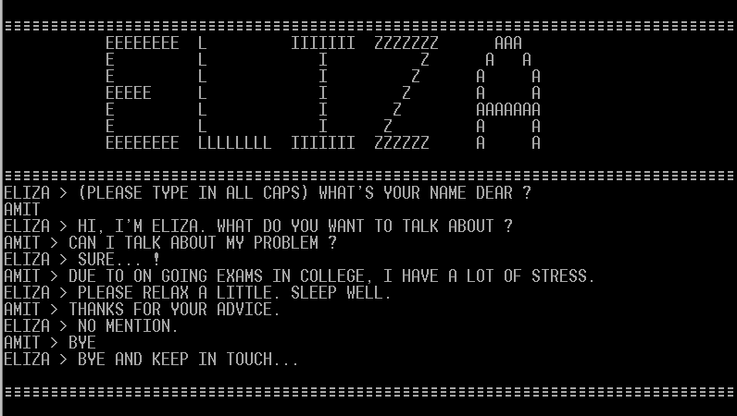
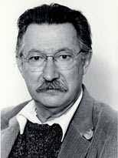
Chatbots: ELIZA
1966
ELIZA was the very first chatbot. It was created by computer scientist Joseph Weizenbaum in 1966, and it uses pattern matching and substitution methodology to simulate conversation.
The program was designed to mimic human conversation, and is somewhat based on how a psychiatrist speaks.
Joseph Weizenbaum

Slide 64
Chatbots: ELIZA
1966
Weizenbaum was troubled by the reaction of users to ELIZA.
He intended it to be a caricature of human conversation, but users were confiding their most profound thoughts in ELIZA.
Experts were declaring that chatbots would be indistinguishable from humans within a few number of years (!)
Joseph Weizenbaum

Slide 65
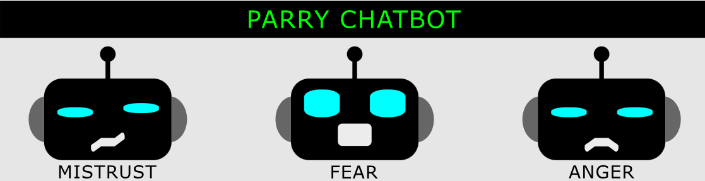
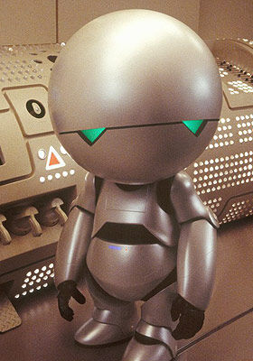
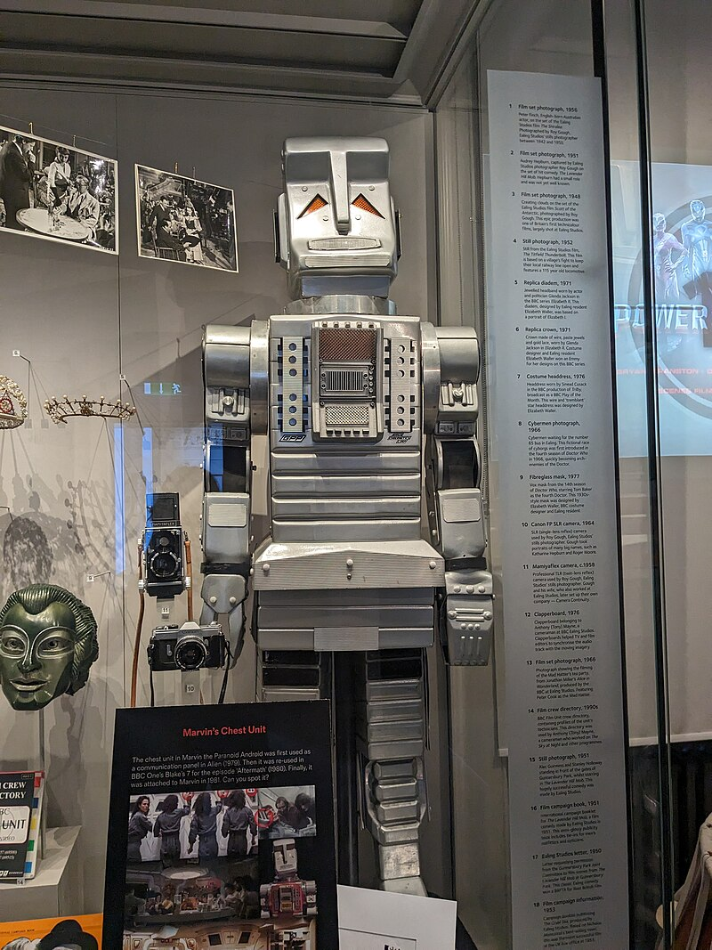
PARRY: I think he is behind the gangsters who are out to get me.
YOU: Do you see things that others don’t seem to see?
PARRY: No, I don’t. I’m not like the other people here.
YOU: You didn’t answer my question.
PARRY: Maybe it wasn’t worth answering.

Slide 66
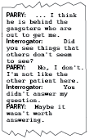
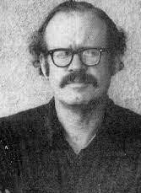
Chatbots: PARRY
1972
PARRY was constructed by American psychiatrist Kenneth Colby in 1972.
The goal was to imitate a patient with paranoid schizophrenia, to explore about how computers can contribute to our understanding of mental illness.
Kenneth Colby

Slide 67
Chatbots: PARRY
1972
It attempts to simulate the disease using a system of assumptions, attributions, and “emotional responses” triggered by changing weights assigned to verbal inputs.
The random and unusual answers that PARRY gives makes it easy to confuse human testers in a Turing Test.
Kenneth Colby

Slide 68
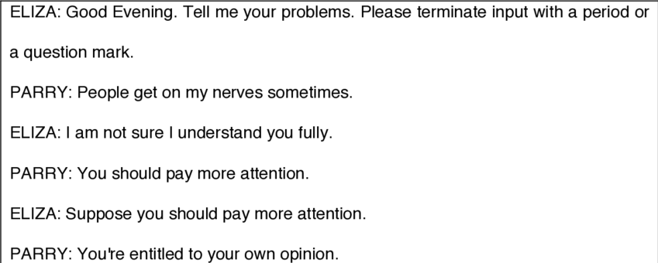
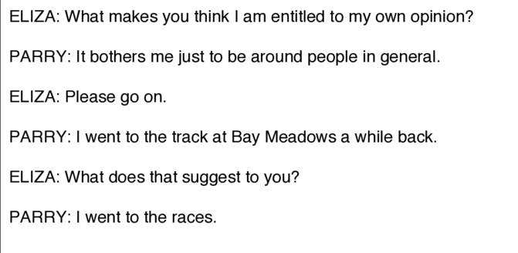
Chatbots: ELIZ and PARRY chat
1972

Slide 69
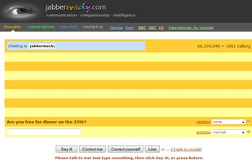

Slide 70

Chatbots: Jabberwacky
1988
Jabberwacky is a chatbot created by British programmer Rollo Carpenter in 1988.
Its stated aim is to "simulate natural human chat in an interesting, entertaining and humorous manner".
It is very wacky and irreverent.
Rollo Carpenter

Slide 71
Chatbots: Jabberwacky
1988
Unlike more traditional AI programs, it is intended as a form of entertainment.
The ultimate intention is that the program move from a text-based system to be wholly voice operated - learning directly from sound and other sensory inputs.
Rollo Carpenter

Slide 72
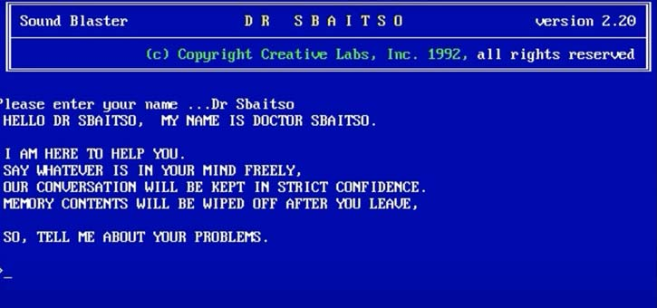

Slide 73

Chatbots: Dr. Sbaitso
1992
Dr. Sbaitso was created by Creative Labs in Singapore for MS-DOS-based personal computers in 1992.
The name is an acronym for "SoundBlaster Acting Intelligent Text-to-Speech Operator.“
It used text-to-speech to chat. Dr. Sbaitso was distributed with various sound cards manufactured by Creative Technology in the early 1990s.

Slide 74
Chatbots: Dr. Sbaitso
1992
The program "conversed" with the user as if it were a psychologist, though most of its responses were along the lines of "WHY DO YOU FEEL THAT WAY?" rather than any sort of complicated interaction.
When confronted with a phrase it could not understand, it would often reply with something such as "THAT'S NOT MY PROBLEM."

Slide 75
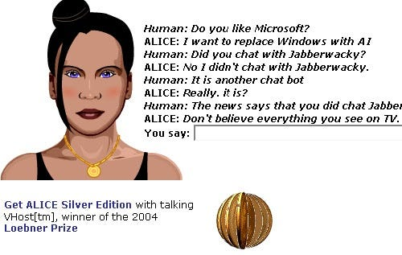

Chatbots: A.L.I.C.E.
1995
A.L.I.C.E. is a universal language processing chatbot developed by computer scientist Richard Wallace in 1995.
The name is an acronym for "Artificial Linguistic Internet Computer Entity.“
It was formerly known as Alicebot because it was first to run on a computer by the name of Alice.
Richard Wallace

Slide 76
Chatbots: A.L.I.C.E.
1995
The program works with data in a special text format called XML which helps specify conversation rules.
From there, other developers drafted free and open sources of ALICE in different programming languages and a variety of foreign languages.
Richard Wallace

Slide 77
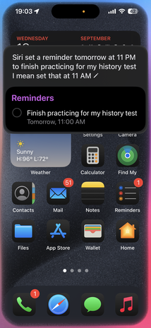


Chatbots: Siri
2011
Siri was created by Apple for iOS in 2010; it is an intelligent personal assistant and learning navigator that uses a natural language UI.
It paved the system for all AI bots and PAs after that.
On release it received praise for its contextual knowledge of user information, but was criticized for requiring stiff user commands and having a lack of flexibility.

Slide 78
Chatbots: Siri
2011
Siri supports a wide range of user commands, including performing phone actions, checking basic information, scheduling events and reminders, handling device settings, searching the Internet, navigating areas, finding information on entertainment, and being able to engage with iOS-integrated apps.

Slide 79
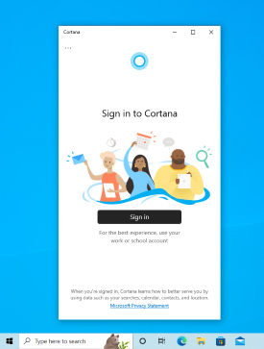


Chatbots: Cortana
2014
Cortana is a virtual assistant developed by Microsoft in 2014 that uses the Bing search engine to perform tasks such as setting reminders and answering questions for users.
It uses voice recognition and relevant algorithms to get and respond to voice commands.

Slide 80
Chatbots: Cortana
2014
For someone to get started, they must type a question in the search box, or select the microphone and talk to Cortana. If a person is not very sure of what to say, they will see suggestions on the lock screen, as well as in Cortana home by selecting the search box on the taskbar.

Slide 81



Chatbots: Alexa
2014
Alexa is an intelligent personal assistant developed by Amazon in 2014.
It is now built into devices such as the Amazon Echo, the Echo Dot, the Echo Show and more.
There is also an Alexa app and more devices from third-party manufacturers that have Alexa built in to them.

Slide 82
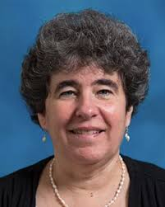
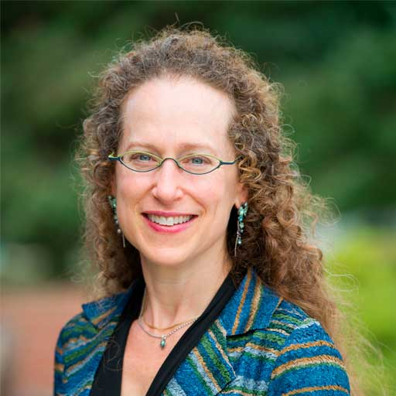

Some Famous Chatbot Researchers
Diane Litman
Justine Cassell
Emily Bender
Joseph Weizenbaum
Kenneth Colby
Rollo Carpenter

Slide 83

Building a Chatbot

Slide 84
Our First Chatbot Code
/********************************************************/
/* Title: Our First Chatbot */
/* Developer: Damian Gordon */
/* Date Created: 08/11/2024 */
/********************************************************/
/* Description: This is our first Chatbot using rules */
/********************************************************/
/* Modified by: Developer, Date, Description */
/* Modified by: Developer, Date, Description */
/* Modified by: Developer, Date, Description */
/* Modified by: Developer, Date, Description */
/********************************************************/

Slide 85
Our First Chatbot Code
We are going to structure the program as follows:
main() function
This function asks for input from the user in a loop. It will keep passing the input into the respond() function until the user inputs “bye”.
respond() function
This function receives the current input from the user and has IF-THEN-ELSE rules to print out a suitable response to the user.

Slide 86
Our First Chatbot Code
We are going to structure the program as follows:
main() function: Our main loop will be
char Exit_Sentinel_YN = ‘n’;
while (Exit_Sentinel_YN == 'n’) {
respond(input);
if (input is "bye") {
Exit_Sentinel_YN = 'y';
} //Endif;
} //Endwhile;

Slide 87
Our First Chatbot Code
We are going to structure the program as follows:
main() function: Our main loop will be
char Exit_Sentinel_YN = ‘n’;
while (Exit_Sentinel_YN == 'n’) {
respond(input);
if (input is "bye") {
Exit_Sentinel_YN = 'y';
} //Endif;
} //Endwhile;
This calls our
respond function

Slide 88
Our First Chatbot Code
We are going to structure the program as follows:
main() function: To read in text, we will do:
#include <string.h>
#define MAX_INPUT_SIZE 100
char input[MAX_INPUT_SIZE];
fgets(input, MAX_INPUT_SIZE, stdin);
// Remove newline character from input
input[strcspn(input, "\n")] = 0;

Slide 89
int main() {
char input[MAX_INPUT_SIZE];
char Exit_Sentinel_YN = 'n';
printf("Welcome to Our First Chatbot!\n");
printf("Type 'bye' to exit.\n");
printf("-----------------------------\n");

Slide 90
while (Exit_Sentinel_YN == 'n') {
printf("You: ");
fgets(input, MAX_INPUT_SIZE, stdin);
// Remove newline character from input
input[strcspn(input, "\n")] = 0;
if (strcmp(input, "bye") == 0) {
Exit_Sentinel_YN = 'y';
} //Endif;
respond(input);
} //Endwhile;
return 0;
} //End.

Slide 91
Our First Chatbot Code
We are going to structure the program as follows:
respond() function: The structure will be IF-THEN-ELSEs
if (strstr(input is “hello”) {
printf("Cbot: Hello! How can I help you today?\n");
} else if (input is "how are you") {
printf("Cbot: I'm just a program\n");
} else if (input is "what’s your name?") {
printf("Cbot: I am a simple chatbot!\n");

Slide 92
void respond(char *input) {
if (strstr(input, "hello") != NULL{
printf("Cbot: How can I help you?\n");
}
else if (strstr(input, "how are you") != NULL){
printf("Cbot: I'm just a program!\n");
}
else if (strstr(input, “your name?") != NULL) {
printf("Cbot: I am a chatbot!\n");
}
else if (strstr(input, "thanks") != NULL) {
printf("Cbot:You’re welcome\n", input);
}

Slide 93
else if (strstr(input, "my name is") != NULL) {
input += 11; //This cuts “my name is ”
printf("Cbot: Hi %s.\n", input);
So, in this case, if we read in a sentence starting with the words “my name is” we assume the rest of the sentence is a name, and we clip off the start of the input by adding 11 characters to the input
1 | 2 | 3 | 4 | 5 | 6 | 7 | 8 | 9 | 10 | 11
m | y |  | n | a | m | e |  | i | s

Slide 94
else if (strstr(input, "my name is") != NULL) {
input += 11; //This cuts “my name is ”
printf("Cbot: Hi %s.\n", input);
So, in this case, if we read in a sentence starting with the words “my name is” we assume the rest of the sentence is a name, and we clip off the start of the input by adding 11 characters to the input
You: my name is Damian
Cbot: Hi Damian.
1 | 2 | 3 | 4 | 5 | 6 | 7 | 8 | 9 | 10 | 11
m | y |  | n | a | m | e |  | i | s

Slide 95
else if (strstr(input, “I am") != NULL) {
input += 5; //This cuts “I am ”
printf("Cbot: Why are you %s?\n", input);
So, in this case, if we read in a sentence starting with the words “I am” we assume the rest of the sentence is a name, and we clip off the start of the input by adding 5 characters to the input
1 | 2 | 3 | 4 | 5
I |  | a | m

Slide 96
else if (strstr(input, “I am") != NULL) {
input += 5; //This cuts “I am ”
printf("Cbot: Why are you %s?\n", input);
So, in this case, if we read in a sentence starting with the words “I am” we assume the rest of the sentence is a name, and we clip off the start of the input by adding 5 characters to the input
You: I am happy
Cbot: Why are you happy?
1 | 2 | 3 | 4 | 5
I |  | a | m

Slide 97
else if (strstr(input, "bye") != NULL) {
printf("Cbot: Have a great day!\n");
}

Slide 98
else {
printf("Cbot: I don't understand that.\n");
}

Slide 99
Our First Chatbot Code
The full code is here:
http://www.damiantgordon.com/Courses/SDSaAI/Week9/Week9.html
in the file called:
Our_First_Chatbot.c

Slide 100
Chatbots
ACTIVITY
Add a new feature to the code we have. So it will be in the ELSE part of the respond() function, and it can be a simple response to a specific input, or it can take some of the input and incorporate it into the answer, or it can be something more complicated.

