Slide 1
Universal Design for Learning: Multiple Means of Representation
Damian Gordon

Slide 2
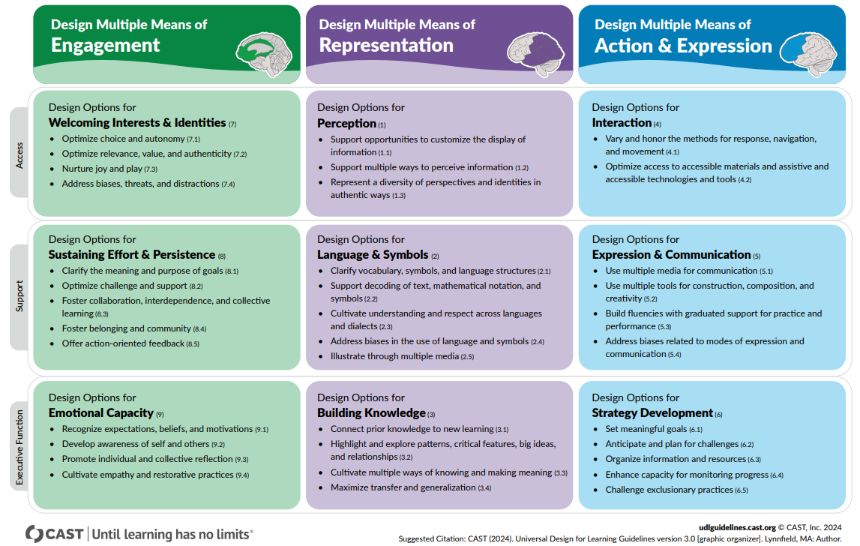
UDL 3.0

Slide 3
UDL 3.0
Multiple means of Representation
Guideline 1: Design Options for Perception
Guideline 2: Design Options for Language & Symbols
Guideline 3: Design Options for Building Knowledge

Slide 4
UDL 3.0
REPRESENTATION
Perception
Language & Symbols
Building Knowledge
The
“WHAT”

Slide 5
UDL 3.0
Multiple means of Representation
Guideline 1: Design Options for Perception

Slide 6
UDL 3.0
1. Design Options for Perception
Support opportunities to customize the display of information
Support multiple ways to perceive information
Represent a diversity of perspectives and identities in authentic ways

Slide 7
UDL 3.0
e.g. change the font size, type, and colour. Also change the background
e.g. change the speed of a video or an audio file
1. Design Options for Perception
Support opportunities to customize the display of information
Support multiple ways to perceive information
Represent a diversity of perspectives and identities in authentic ways
e.g. create captions, and allow text-to-speech. Consider tactile interfaces
e.g. follow accessibility standards (DAISY, NIMAS, etc.)

Slide 8
UDL 3.0
Multiple means of Representation
Guideline 2: Design Options for Language & Symbols

Slide 9
UDL 3.0
2. Design Options for Language & Symbols
Clarify vocabulary, symbols, and language structures
Support decoding of text, mathematical notation, and symbols
Cultivate understanding and respect across languages and dialects
Address biases in the use of language and symbols
Illustrate through multiple media

Slide 10
UDL 3.0
e.g. pre-teach vocabulary and symbols, so that it connects to the students
e.g. make explicit links between parts of the teaching content
2. Design Options for Language & Symbols
Clarify vocabulary, symbols, and language structures
Support decoding of text, mathematical notation, and symbols
Cultivate understanding and respect across languages and dialects
Address biases in the use of language and symbols
Illustrate through multiple media
e.g. provide access to alternative representations of mathematical notations.
e.g. provide links to online translation tools and multilingual glossaries.

Slide 11
UDL 3.0
Multiple means of Representation
Guideline 3: Design Options for Building Knowledge

Slide 12
UDL 3.0
3. Design Options for Building Knowledge
Connect prior knowledge to new learning
Highlight and explore patterns, critical features, big ideas, and relationships
Cultivate multiple ways of knowing and making meaning
Maximize transfer and generalization

Slide 13
UDL 3.0
e.g. link topics to student’s previous knowledge and cross-curricular topics
e.g. to emphasise critical content, use multiple examples, and non-examples
3. Design Options for Building Knowledge
Connect prior knowledge to new learning
Highlight and explore patterns, critical features, big ideas, and relationships
Cultivate multiple ways of knowing and making meaning
Maximize transfer and generalization
e.g. “chunk” information into smaller elements, and memory mnemonics and tools
e.g. provide a visual organiser to show a sequence of topics, but give the students the choice of “entry-point”

