Slide 1
Software Development Methodologies (1950s – 1970s)
Damian Gordon

Slide 2
Timeline of Methodologies
1950s Code & Fix
1960s Design-Code-Test-Maintain
1970s Waterfall Model
1980s Spiral Model
1990s V-Model/Rapid Application Development
2000s Agile Methods

Slide 3
Timeline of Methodologies
1950s Code & Fix
1960s Design-Code-Test-Maintain
1970s Waterfall Model
1980s Spiral Model
1990s V-Model/Rapid Application Development
2000s Agile Methods

Slide 4
1950s: Code & Fix

Slide 5
Code-and-Fix
Aka “Code-like-Hell”
Specification (maybe),
Code (yes),
Release (maybe)
Suitable for prototypes or throwaways

Slide 6
Code-and-Fix
Advantages
No overhead
Requires little expertise
Disadvantages
No process, quality control, etc.
Highly risky

Slide 7
1960s: Design-Code-Test-Maintain

Slide 8
Design-Code-Test-Maintain
Design:
Specify requirement diagrammatically
Code:
Write the code
Test:
Check if it is working
Maintain:
Keep it up-to-date

Slide 9
Design-Code-Test-Maintain
Advantages
More process control
Less risky
Disadvantages
More Overhead
Requires more expretise

Slide 10
1970s: Waterfall Model

Slide 11
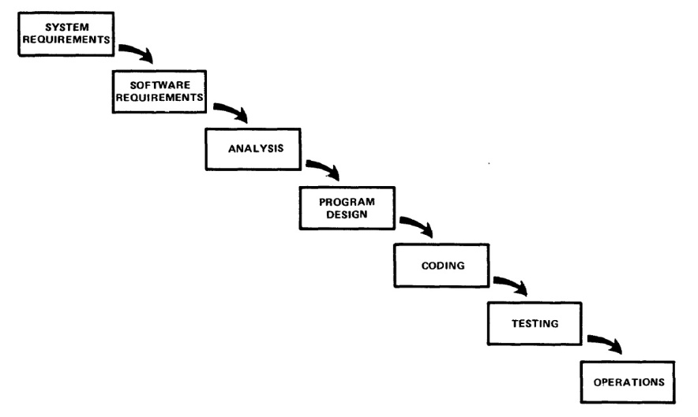
Managing the Development of Large Software Systems by W.W. Royce

Slide 12
Reference
Royce, W.W., 1970, "Managing the Development of Large Software Systems", Proceedings of IEEE WESCON 26 (August), pp.1–9.

Slide 13
Winston W. Royce
Born in 1929.
Died in 1995.
An American computer scientist, director at Lockheed Software Technology Center in Austin, Texas, and one of the leaders in software development in the second half of the 20th century.
He was the first person to describe the “Waterfall model” for software development, although Royce did not use the term "waterfall" in that article, nor advocated the waterfall model as a working methodology.

Slide 14
Introduction
“I am going to describe my personal views about managing large software developments.
I have had various assignments during the past nine years, mostly concerned with the development of software packages for spacecraft mission planning, commanding and post-flight analysis.
In these assignments I have experienced different degrees of success with respect to arriving at an operational state, on-time, and within costs.
I have become prejudiced by my experiences and I am going to relate some of these prejudices in this presentation.”

Slide 15
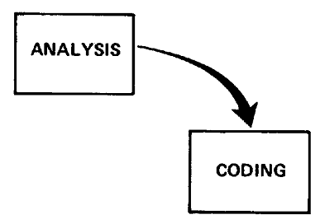
Small Developments
For a small development, you only need the following steps
Typically done for programs for internal use

Slide 16
Large Developments

Slide 17
Large Developments
System Requirements: Identify, select and document functional, scheduling and financial requirements.

Slide 18
Large Developments
Software Requirements: Identify, select and document the software features necessary to satisfy the system requirements.

Slide 19
Large Developments
Analysis: Methodically work through the details of each requirement.

Slide 20
Large Developments
Program Design: Use programming techniques to design software and hardware within the constraints and objectives set in the earlier stages.

Slide 21
Large Developments
Coding: Implement the program as designed in the earlier stages.

Slide 22
Large Developments
Testing: Test the software and record the results.

Slide 23
Large Developments
Operations: Deliver, install and configure the completed software.

Slide 24
Large Developments

Slide 25
Large Developments
"I believe in this concept,
but the implementation
described above is risky
and invites failure."

Slide 26
Iterative Relationship between Successive Development Phases

Slide 27
Iterative Relationship between Successive Development Phases
Each step progresses and the design is further detailed, there is an iteration with the preceding and succeeding steps but rarely with the more remote steps in the sequence.
The virtue of all of this is that as the design proceeds the change process is scoped down to manageable limits.

Slide 28
Unfortunately the design iterations are never confined to the successive steps

Slide 29
Unfortunately the design iterations are never confined to the successive steps
The testing phase which occurs at the end of the development cycle is the first event for which timing, storage, input/output transfers, etc., are experienced as distinguished from analyzed.
These phenomena are not precisely analyzable.
Yet if these phenomena fail to satisfy the various external constraints, then invariably a major redesign is required.

Slide 30
How do we fix this?

Slide 31
Five Steps
Program Design comes first
Document the Design
Do it twice
Plan, Control and Monitor Testing
Involve the Customer

Slide 32
1. Program Design comes first
A preliminary program design phase has been inserted between the Software Requirements Generation phase and the Analysis phase.

Slide 33
1. Program Design comes first

Slide 34
1. Program Design comes first
The following steps are required:
1) Begin the design process with program designers, not analysts or programmers.
2) Design, define and allocate the data processing modes.
3) Write an overview document that is understandable, informative and current.

Slide 35
2. Document the Design
“How much documentation?"
“Quite a lot"
More than most programmers, analysts, or program designers are willing to do if left to their own devices.
The first rule of managing software development is ruthless enforcement of documentation requirements.

Slide 36
2. Document the Design

Slide 37
3. Do It Twice
Create a pilot study
If the computer program in question is being developed for the first time, arrange matters so that the version finally delivered to the customer for operational deployment is actually the second version insofar as critical design/operations areas are concerned.

Slide 38
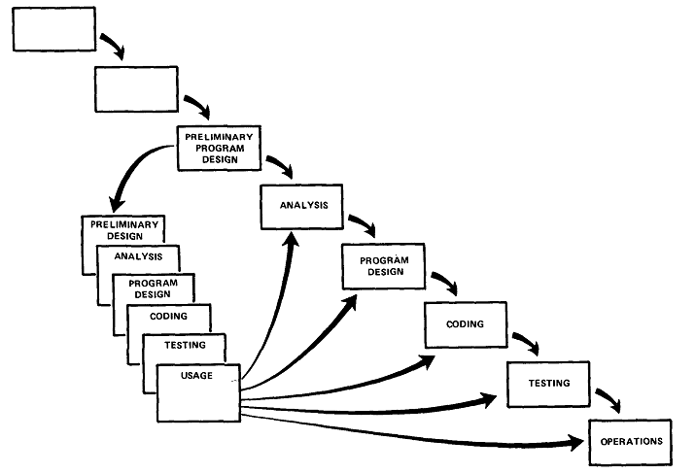
3. Do It Twice

Slide 39
4. Plan, Control and Monitor Testing
Without question the biggest user of project resources, whether it be manpower, computer time, or management judgment, is the test phase. It is the phase of greatest risk in terms of dollars and schedule.

Slide 40
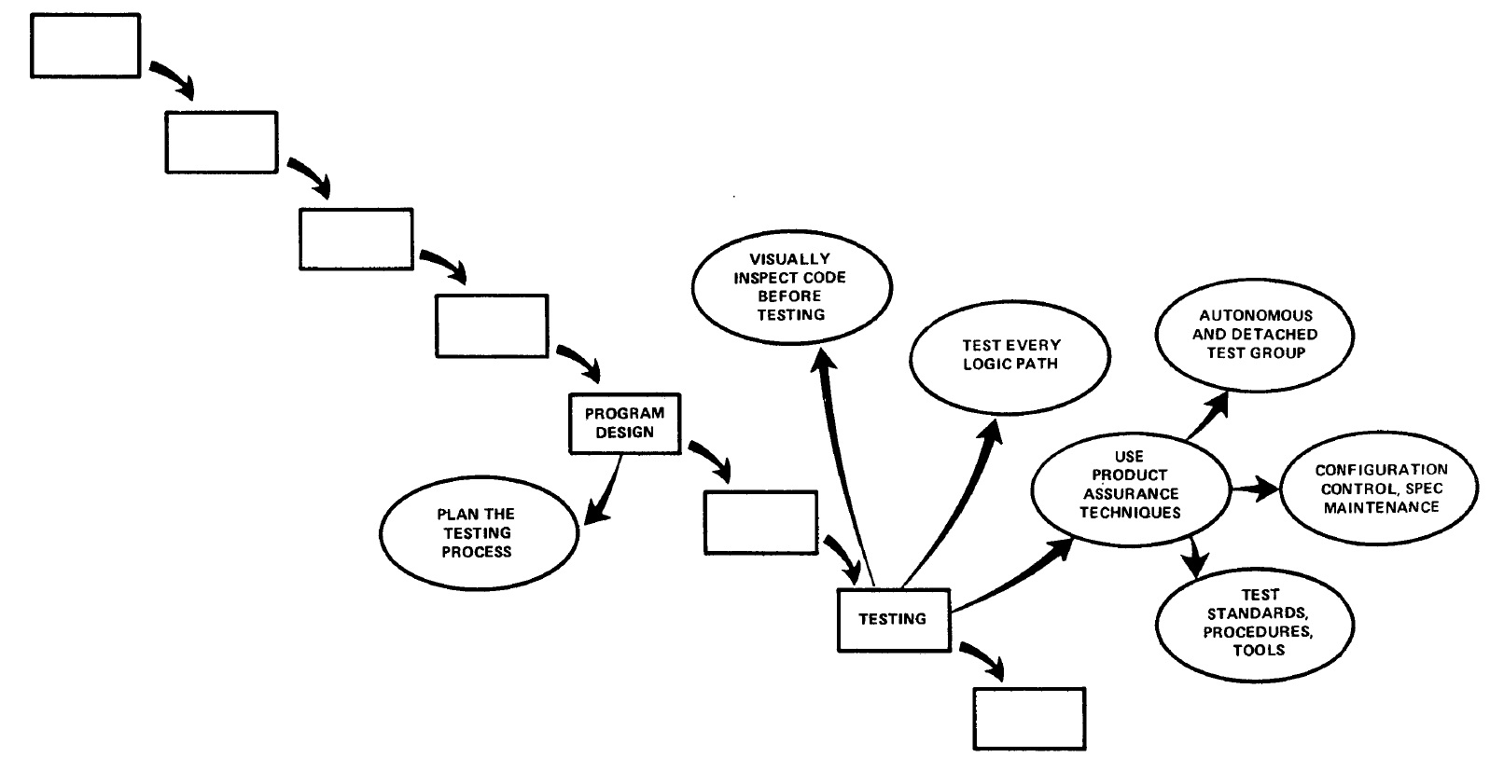
4. Plan, Control and Monitor Testing

Slide 41
4. Plan, Control and Monitor Testing
1) Many parts of the test process are best handled by test specialists who did not necessarily contribute to the original design.
2) Most errors are of an obvious nature that can be easily spotted by visual inspection.
3) Test every logic path in the computer program at least once with some kind of numerical check.
4) After the simple errors (which are in the majority, and which obscure the big mistakes) are removed, then it is time to turn over the software to the test area for checkout purposes.

Slide 42
5. Involve the Customer
For some reason what a software design is going to do is subject to wide interpretation even after previous agreement.
It is important to involve the customer in a formal way so that he has committed himself at earlier points before final delivery.
To give the contractor free rein between requirement definition and operation is inviting trouble.

Slide 43
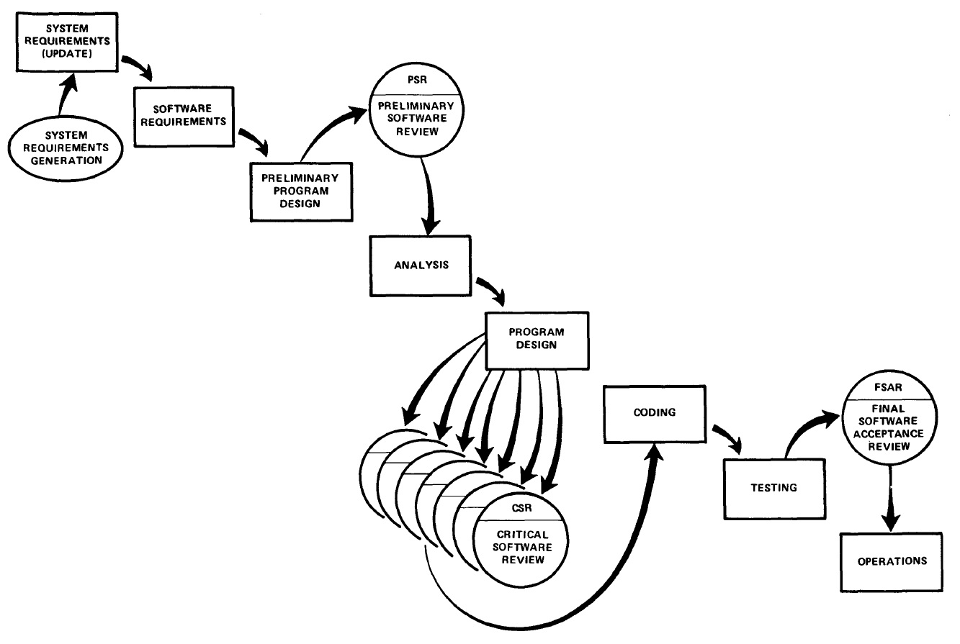
5. Involve the Customer

Slide 44
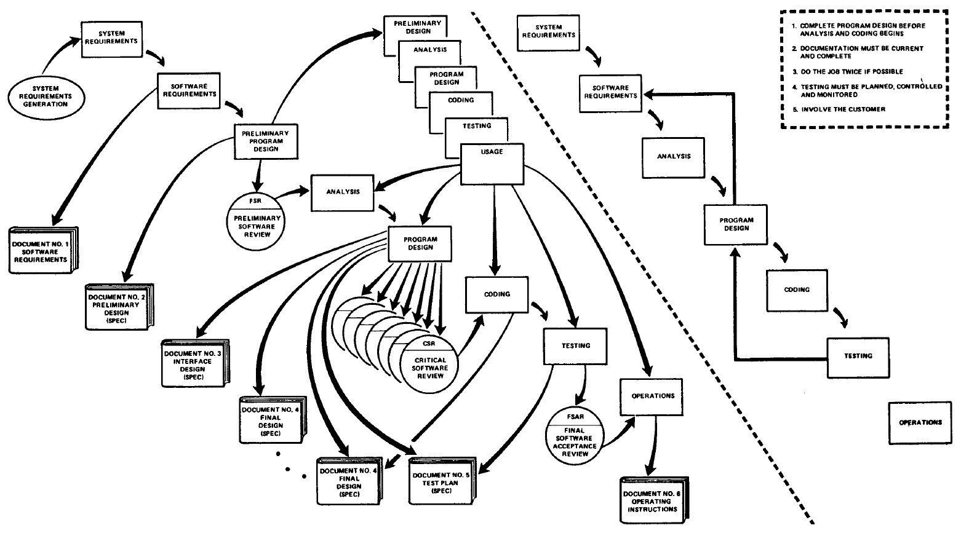
Summary

Slide 45
etc.

