Slide 1
Universal Design In Computer Science
Damian Gordon

Slide 2
Equitable Use
Flexibility in Use
Simple and Intuitive
Perceptible Information
Tolerance for Error
Low Physical Effort
Size & Space for Approach and Use

Slide 3
Equitable Use
Overriding Philosophy
Flexibility in Use
Simple and Intuitive
Perceptible Information
Tolerance for Error
Low Physical Effort
Size & Space for Approach and Use

Slide 4
Equitable Use
Overriding Philosophy
Flexibility in Use
General Principles for Realising Philosophy
Simple and Intuitive
Perceptible Information
Tolerance for Error
Low Physical Effort
Size & Space for Approach and Use

Slide 5
Equitable Use
Overriding Philosophy
Flexibility in Use
General Principles for Realising Philosophy
Simple and Intuitive
Perceptible Information
Tolerance for Error
Low Physical Effort
Principles for Realising Philosophy within the Built Environment Domain
Size & Space for Approach and Use

Slide 6
Equitable Use
Overriding Philosophy
Flexibility in Use
General Principles for Realising Philosophy
Simple and Intuitive
Perceptible Information
Tolerance for Error
Low Physical Effort
Principles for Realising Philosophy within the Built Environment Domain
Size & Space for Approach and Use

Slide 7
Equitable Use
Overriding Philosophy
Flexibility in Use
General Principles for Realising Philosophy
Simple and Intuitive
Perceptible Information
Tolerance for Error
Low Physical Effort
Principles for Realising Philosophy within the Built Environment Domain
Size & Space for Approach and Use

Slide 8
Equitable Use
Overriding Philosophy
Flexibility in Use
General Principles for Realising Philosophy
Simple and Intuitive
Perceptible Information
Tolerance for Error
Use of Patterns
Principles for Realising Philosophy within the Computer Science Domain
Consideration for Users

Slide 9
Equitable Use
Overriding Philosophy
Flexibility in Use
General Principles for Realising Philosophy
Simple and Intuitive
Perceptible Information
Tolerance for Error
Use of Patterns
Principles for Realising Philosophy within the Computer Science Domain
Consideration for Users

Slide 10
Equitable Use
One product designed well for everyone.
These are in essence End-User
Guidelines
Flexibility in Use
Configurable interface, adapts to user needs, variety of ways of achieving the same thing (e.g. hotkeys)
Simple and Intuitive
Navigation pathways, metaphor, number of clicks, breadcrumbs, etc.
Perceptible Information
The use of colours, use of clear language, etc.
Tolerance for Error
Catching, preventing error, clear error messages.
Use of Patterns
Repeated themes in terms of navigation and functionality
Consideration for Users
Understand the users’ needs, consider personas, speak their language

Slide 11
…and just focuses on the user interface…

Slide 12
…and just focuses on the user interface…
What about the code itself?

Slide 13
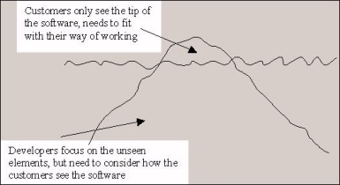

Slide 14
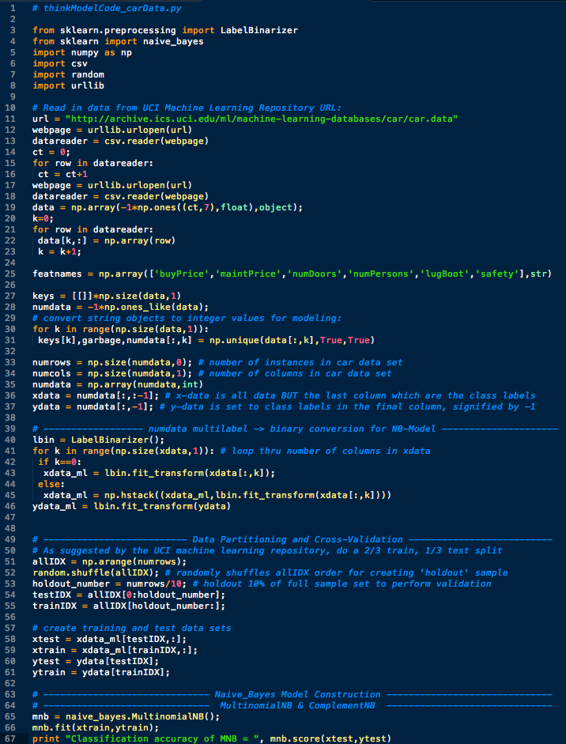

Slide 15
End-User
Guidelines
Developer
Guidelines

Slide 16
Equitable Use
End-User Guidelines
Developer Guidelines
Provide the same means of use for all users: identical whenever possible; equivalent when not.
Avoid segregating or stigmatizing any users.
Make provisions for privacy, security, and safety equally available to all users.
Make the design appealing to all users.
Provide a range of IDEs and development environments.
Ensure that all the necessary assistive technologies needed are provided.
Provide versioning software, document backup facilities, and undelete features.
Ensure the software is as readable and clear as possible.

Slide 17
Flexibility in Use
End-User Guidelines
Developer Guidelines
Provide choice in methods of use.
Accommodate right- or left-handed access and use.
Facilitate the user's accuracy and precision.
Provide adaptability to the user's pace.
Provide a range of IDEs and development environments.
Provide a range of input devices, e.g. keyboards, voice synthesis
Provide code standards checking tools
Develop in a modular, component based approach

Slide 18
Simple and Intuitive
End-User Guidelines
Developer Guidelines
Eliminate unnecessary complexity.
Be consistent with user expectations and intuition [Navigation pathway, breadcrumbs]
Accommodate a wide range of literacy and language skills.
Arrange information consistent with its importance.[Metaphors]
Provide effective prompting and feedback during and after task completion.
Implement features in common, expected ways, don’t obfuscate.
Be consistent with developer expectations.
Accommodate a wide range of literacy and language skills.
Arrange information consistent with its importance.
Use software libraries when possible.

Slide 19
Perceptible Information
End-User Guidelines
Developer Guidelines
Use different modes (pictorial, verbal, tactile) for redundant presentation of essential information.
Maximize “legibility” of essential information.
Differentiate elements in ways that can be described (i.e., make it easy to give instructions or directions).
Provide compatibility with a variety of techniques or devices used by people with sensory limitations.
Comment the code prolifically.
Use clear variable names and module names.
Build in help features into the code.
Provide compatibility with a variety of techniques or devices used by people with sensory limitations.

Slide 20
Tolerance for Error
End-User Guidelines
Developer Guidelines
Arrange elements to minimize hazards and errors: most used elements, most accessible; hazardous elements eliminated, isolated, or shielded
Provide warnings of hazards and errors.
Provide fail safe features.
Discourage unconscious action in tasks that require vigilance.
Develop software using the principles of defensive programming.
Catch errors where possible.
Give detailed and clear error messages.
Avoid global variables, and modules that cause side-effects.

Slide 21
Use of Patterns
End-User Guidelines
Developer Guidelines
Provide repeated themes in terms of navigation.
Provide repeated themes in terms of functionality.
Provide standard screen formats.
Provide visual cues.
Use software design patterns.
Use the same coding approaches.
Use the same naming standards for variables and modules.
Use standard library functions.

Slide 22
Consideration for Users
End-User Guidelines
Developer Guidelines
Understand the users’ needs.
Consider the use of personas.
Speak the End-users’ language.
Provide help features.
Develop modular code to help the developers
Develop easily extensible code.
Adhere to coding standards
Comment complex elements of the code, and refer to design documents.

Slide 23
etc.

