Slide 1
Object-Orientated Design: Part 2
Damian Gordon

Slide 2
Information Hiding

Slide 3
Object

Slide 4
Attributes
Methods

Slide 5
Encapsulation
Attributes
Methods

Slide 6
Dog
Weight
Height
Eye Colour
Hair Colour
Length
Lie Down( )
Fetch( )
Roll Over( )
Sit( )
Bark( )

Slide 7
Information
Hiding
OTHER CLASSES
Weight
Height
Eye Colour
Hair Colour
Length
Lie Down( )
Fetch( )
Roll Over( )
Sit( )
Bark( )

Slide 8
Object Orientation
An OBJECT is made up of ATTRIBUTES and METHODS. Some of these can be private to the CLASS, and some can be public and used by other classes.
The public elements (ATTRIBUTES and METHODS) of the CLASS are referred to as the INTERFACE (or PUBLIC INTERFACE).

Slide 9
OTHER CLASSES
Weight
Height
Eye Colour
Hair Colour
Length
Lie Down( )
Fetch( )
Roll Over( )
Sit( )
Bark( )

Slide 10
Public
Interface
OTHER CLASSES
Weight
Height
Eye Colour
Hair Colour
Length
Lie Down( )
Fetch( )
Roll Over( )
Sit( )
Bark( )

Slide 11
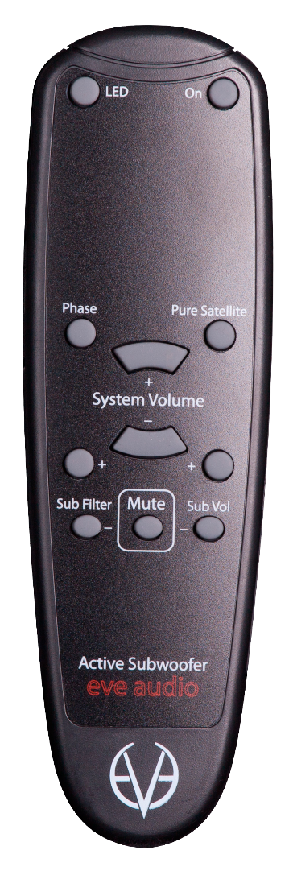
Object Orientation
A common real-world example is the television. Our interface to the television is the remote control.
Each button on the remote control represents a method that can be called on the television object.

Slide 12
Object Orientation
The public interface is very important, we have to design it carefully, because it can be difficult to change in the future, and changing it will cause problems for any client objects that are calling it.
We can change the internals as much as we like (e.g. to make it more efficient, or to access data over the network as well as locally) and the client objects will still be able to talk to it, unmodified, using the public interface.

Slide 13
Abstraction

Slide 14
Object Orientation
ABSTRACTION means dealing with the level of detail that is most appropriate to a given task.
For example, a DRIVER of a car needs to interact with steering, gas pedal, and brakes. The workings of the motor, drive train, and brake subsystem don't matter to the driver. A MECHANIC, on the other hand, works at a different level of abstraction, tuning the engine and bleeding the breaks.

Slide 15
Object Orientation
Driver
Car
Mechanic
Car
+brakes
+accelerator
+disc_brakes
+engine
+transmission
drives >
fixes >
+steer( )
+change_gears( )
+apply_brakes( )
+adjust_breaks( )
+change_oil( )

Slide 16
COMPOSITION

Slide 17
Object Orientation
COMPOSITION is the act of collecting several objects together to create a new one.
Composition is usually a good choice when one object is part of another object.

Slide 18
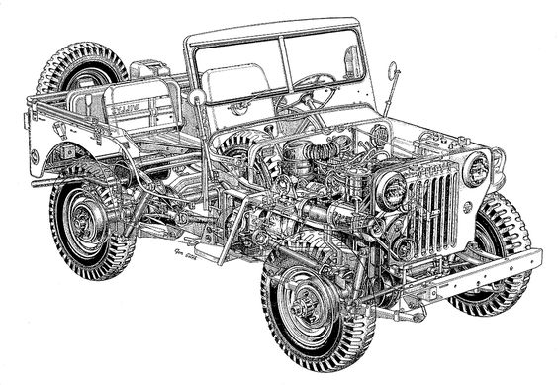

Slide 19
Object Orientation
A car is composed of an engine, transmission, starter, headlights, and windshield, among numerous other parts.
The engine, in turn, is composed of pistons, a crank shaft, and valves. In this example, composition is a good way to provide levels of abstraction.
The car object can provide the interface required by a driver, while also providing access to its component parts, which offers the deeper level of abstraction suitable for a mechanic.

Slide 20
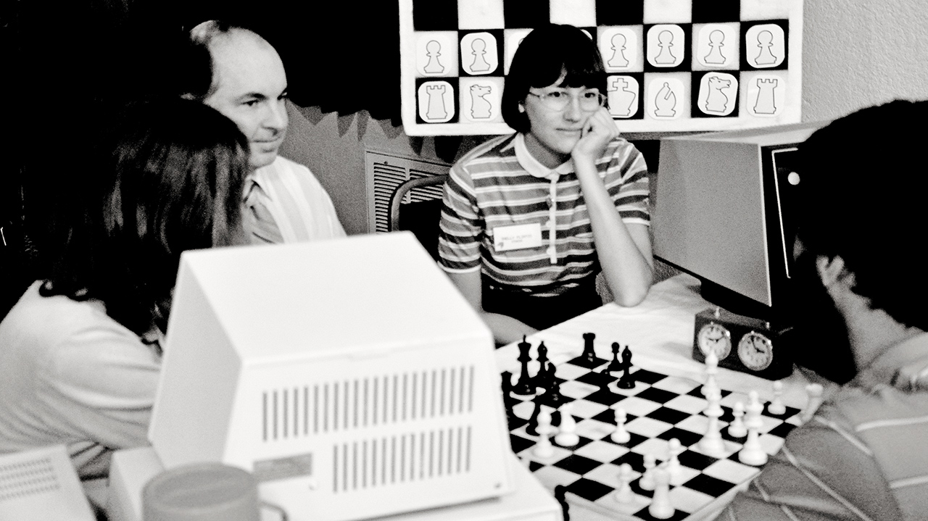

Slide 21
Object Orientation
Let’s try modelling computer chess as a CLASS DIAGRAM:

Slide 22
Object Orientation
Let’s try modelling computer chess as a CLASS DIAGRAM:
Player
Chess Set
2
1
make_move >

Slide 23
Object Orientation
The diagram shows that exactly two players can interact with one chess set.
This also indicates that any one player can be playing with only one chess set at a time.

Slide 24
Object Orientation
Just for fun, let’s try to model at an object level instead of at a class level.
For this we use an OBJECT DIAGRAM.

Slide 25
Class
Player

Slide 26
Class
Objects
Player 1
Player
Player 2

Slide 27
Object Orientation
This is an OBJECT DIAGRAM (or INSTANCE DIAGRAM):
make_move
Player 2
Chess Set
make_move
Player 1

Slide 28
Object Orientation
An OBJECT DIAGRAM or INSTANCE DIAGRAM describes the system at a specific state in time, and is describing specific instances of objects, not the interaction between classes.

Slide 29
Object Orientation
Lets return to the class diagram:

Slide 30
Object Orientation
Lets return to the class diagram:
Player
Chess Set
2
1
make_move >

Slide 31
Object Orientation
Thinking about the composition of a Chess Set we know it’s made up of a board and 32 pieces.
The board further comprises 64 positions.
The composition relationship is represented in UML as a solid diamond.

Slide 32
Object Orientation
Player
2
make_move >
1
Chess Set

Slide 33
Object Orientation
Player
2
make_move >
1
1
Chess Set
32
Piece

Slide 34
Object Orientation
Player
2
make_move >
1
1
Chess Set
1
32
Piece
1
Board

Slide 35
Object Orientation
Player
Position
2
64
make_move >
1
1
Chess Set
1
1
32
Piece
1
Board

Slide 36
Object Orientation
Finally let’s add some attributes to the class diagram:

Slide 37
Object Orientation
Player
Position
2
+chess_board: Board
make_move >
64
1
1
1
Chess Set
1
32
Board
Piece
+pieces: list
+board: Board
1
+chess_set: ChessSet
+positions: Position
+chess_set: ChessSet

Slide 38
INHERITANCE

Slide 39
Object Orientation
INHERITANCE is the last type of relationship we’ll look at.
Inheritance is simple, it means that one class can inherit attributes and methods from another class.
So often we look for classes that have a lot in common, and create a single class with those commonalities, and use that class to give those features to all the other classes.

Slide 40
Object Orientation
Let’s look at an example of chess pieces:
We know that all PIECES are part of a CHESS_SET and have a COLOUR (so they should be in our BASE CLASS).
Each piece has a different SHAPE attribute and a different MOVE method to move the piece to a new position on the board at each turn.

Slide 41
Object Orientation
Piece
Castle
+chess_set: ChessSet
+colour: Sting
Pawn
+shape: String
+shape: String
+move(Board)
+move(Board)
Bishop
Queen
King
Knight
+shape: String
+shape: String
+shape: String
+shape: String
+move(Board)
+move(Board)
+move(Board)
+move(Board)

Slide 42
Object Orientation
Inheritance also gives us POLYMORPHISM.
Polymorphism is the ability to treat a class differently depending on which subclass is implemented.
All the board has to do is call the move() method of a given piece, and the proper subclass will take care of moving it as a Knight or a Pawn.

Slide 43
etc.

