Slide 1

Hyperparameter Tuning in Neural Networks
Damian Gordon

Slide 2



What is Tuning?

Slide 3

What is Tuning?

Slide 4
Contents
Introduction to Hyperparameters
Tuning Methods
Best Practices

Slide 5
Hyperparameters

Slide 7
Hyperparameters
Parameters

Slide 8
Hyperparameters
Parameters
Things that get set before
the training starts.
Things that change
during the training.

Slide 9
Hyperparameters
Parameters
Number of neurons
Number of layers
Learning rate
Activation functions
Weights
Biases
Things that get set before
the training starts.
Things that change
during the training.

Slide 10
Hyperparameters vs. Parameters
Hyperparameters: Manually set; control how the model learns
Parameters: Weights and biases learned during training
Crucial for convergence, performance, and generalization

Slide 11
What Are Hyperparameters?
Hyperparameters are the settings chosen before training of a neural network begins learning.
So, they are not learned by the model during training (like Weights and Biases)
They help control the learning process and model structure

Slide 12

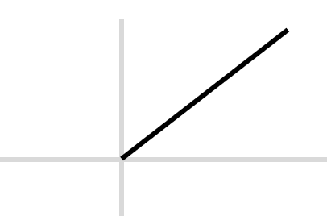
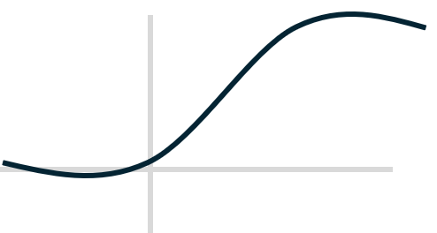
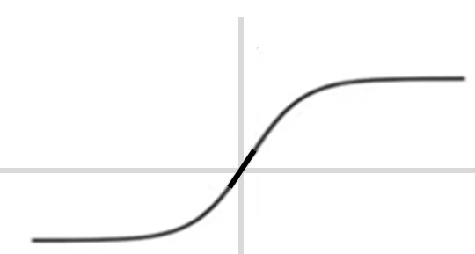
Hyperparameters: Examples
We have seen some already
  Number of neurons
  Number of layers
  Learning rate
  Activation functions

Slide 13
Hyperparameters: Examples
And others include:
  Batch size
  Dropout rate
  Optimizer type

Slide 14
Hyperparameters: Examples
And others include:
  Batch size - we can process the training examples in batches.
  Dropout rate - the fraction of neurons to randomly deactivate during each training step to prevent overfitting.
  Optimizer type – the rate at which the weights get adjusted

Slide 15
Optimizer Types
Optimizer | Description | Key Traits
Stochastic Gradient Descent | Basic optimizer, updates weights per sample or batch | Simple but can be slow to converge
Momentum | Builds up speed in weight updates | Helps escape local minima
RMSProp | Adapts learning rate based on recent gradients | Works well for RNNs
Adaptive Moment Estimation | Combines momentum + adaptive learning rates | Most widely used today
Adagrad Adadelta | Adaptive learning rates | Good for sparse data

Slide 16
What Are Hyperparameters?
More formally:
A hyperparameter is a configuration that is set before the training process begins and influences how a neural network learns. Unlike parameters (like weights and biases, which the model learns automatically), hyperparameters are manually defined by the user and are crucial in shaping the training dynamics and model performance.

Slide 17
Why Hyperparameter Tuning Matters
A good model can perform poorly with bad hyperparameters
Prevents overfitting or underfitting
Improves accuracy, loss, convergence time
Essential in real-world deployments for optimal results

Slide 18
Tuning Methods

Slide 19
Hyperparameter Tuning Methods
Manual Search: Trial and error, intuition-driven
Grid Search: Try all combinations from a set of values
Random Search: Sample values randomly from the search space
Bayesian Optimization: Model the performance function and update with new data
Automated Tuning Tools (e.g., Optuna, Ray Tune)

Slide 20
Manual Search
Trial and error
Intuition-driven

Slide 21
Grid Search
Try all combinations from a set of values
Exhaustive, easy to parallelize
Computationally expensive

Slide 22
Random Search
Sample values randomly from the search space
More efficient in high-dimensional spaces
Often finds good results faster

Slide 23
Bayesian Optimization
Model the performance function and update with new data
Models the objective function (e.g., accuracy) with a surrogate (e.g., Gaussian Process)
Chooses next hyperparameter set based on expected improvement
More efficient but more complex

Slide 24
Tools for Hyperparameter Tuning
Optuna
Ray Tune
Keras Tuner
scikit-learn GridSearchCV / RandomizedSearchCV
Weights & Biases Sweeps
Google Vizier, Hyperopt, Ax (Meta)

Slide 25
Other Techniques
Hyperband / Successive Halving: Early stopping of poor configurations
Genetic Algorithms: Evolutionary search
Neural Architecture Search (NAS): Explore both architecture and hyperparameters

Slide 26
Best
Practices

Slide 27
Best Practices
Start with coarse tuning, then fine-tune
Monitor validation loss/accuracy
Use cross-validation
Track experiments (e.g., with W&B or MLflow)
Set realistic compute and time budgets

Slide 28
Summary & Takeaways
Hyperparameters strongly influence model performance
Tuning is a mix of science and art
Tools and strategies exist to automate the process
Experimentation and tracking are key to success

