Slide 1
The Use of GenAI in the Assessment of this Module

Slide 2
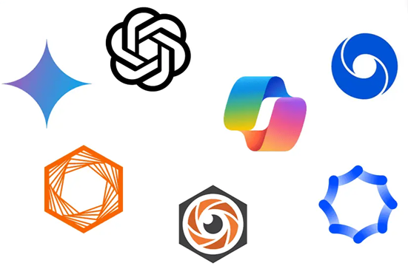
What is Generative AI (GenAI)?
Programs like ChatGPT, Claude, Midjourney, and Co-Pilot are examples of GenAI.

Slide 3
Generative AI (GenAI)
It is really, really important that you understand which subjects you are taking that don’t allow you to use GenAI in assessment, and which ones do.
And for the ones that do allow you to use them, you need to be sure in which ways you are allowed to use GenAI in those assessments.

Slide 4
Generative AI (GenAI)
For assessment in this module:
You are …. Not / allowed ….
………………………………….
Specifically: ………………………………..
………………………..

Slide 5
Generative AI (GenAI)
I don’t want you to think of this presentation as an “us-against-them” situation, where I am trying to catch you out.
I want to encourage and assist you to learn and grow as part of this module, but if you use GenAI in ways that I don’t want you to, you will miss out on so many things:

Slide 6
Generative AI (GenAI)
Critical Thinking and Problem Solving
If you skip the process of analyzing, evaluating, and synthesizing information, you are missing out on so much, these skills are essential not just for academic success, but for making informed decisions in real life.

Slide 7
Generative AI (GenAI)
Feedback & Learning from Misconceptions
GenAI often gives well-formed answers, sometimes including common errors and misconceptions, and sometimes avoiding them. However, making mistakes and getting feedback is a key part of how we learn effectively. This is a GROWTH MINDSET.

Slide 8
Generative AI (GenAI)
Writing and Communication Skills
Using GenAI to write essays or assignments prevents you from developing your own voice, structure, and clarity in communication; and being able to express ideas clearly and persuasively is a foundational skill for most careers.

Slide 9
Generative AI (GenAI)
Creativity and Original Thought
We can all use GenAI to come up with ideas, but only you can bring your own unique perspective to solving problems, and developing your own creative voice. Creativity is increasingly valued in the workplace; developing original perspectives is part of becoming an independent thinker.

Slide 10
Generative AI (GenAI)
WHAT ARE SOME MISTAKES GENAI MAKES?

Slide 11
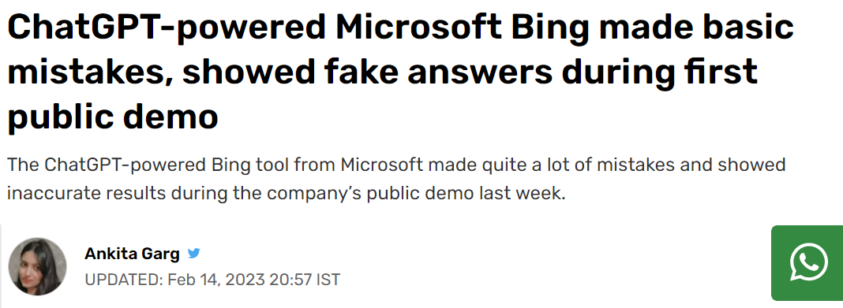

Slide 12
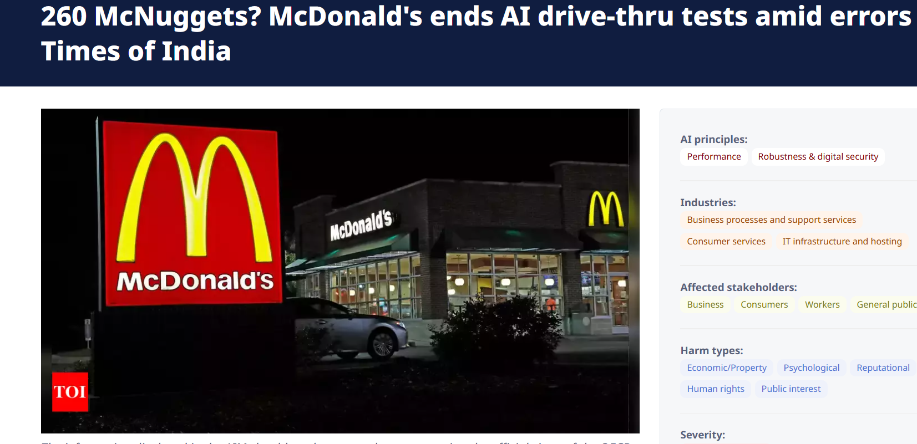

Slide 13
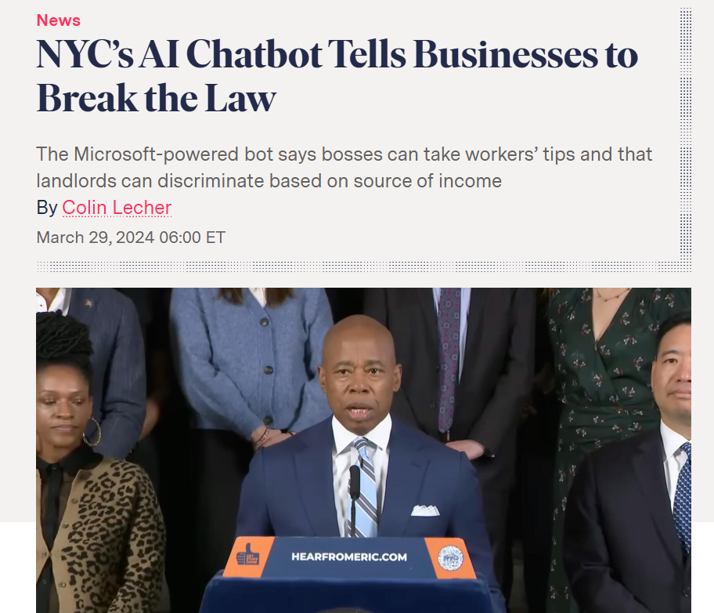

Slide 14
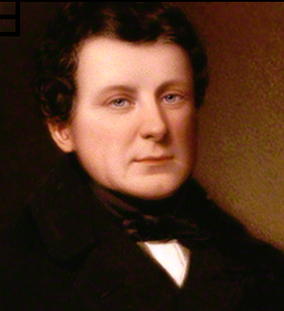
It’s not as smart as it seems:
Related ???

Slide 15
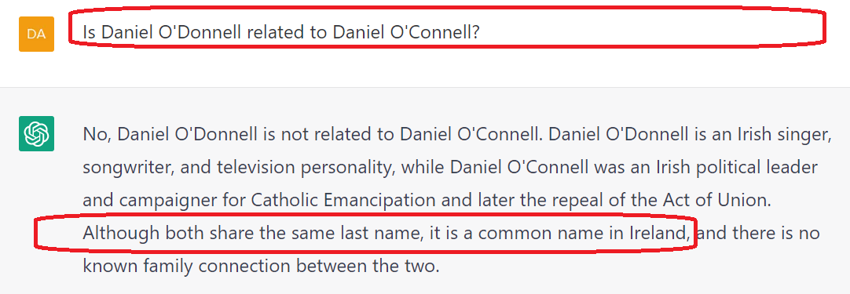
It’s not as smart as it seems:

Slide 16
In this case the GenAI doesn’t understand the words “last name”:

Slide 17
Generative AI
Let’s look at some common errors that Generative AI produces (that we can remind the students of):

Slide 18
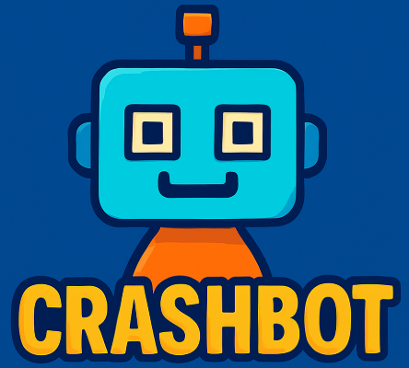
Types of Errors that GenAI Produces
Contradictions
Repetition
Ambiguity
Stereotyping
Hallucinations
Bias
Overgeneralization
Toxicity

Slide 19
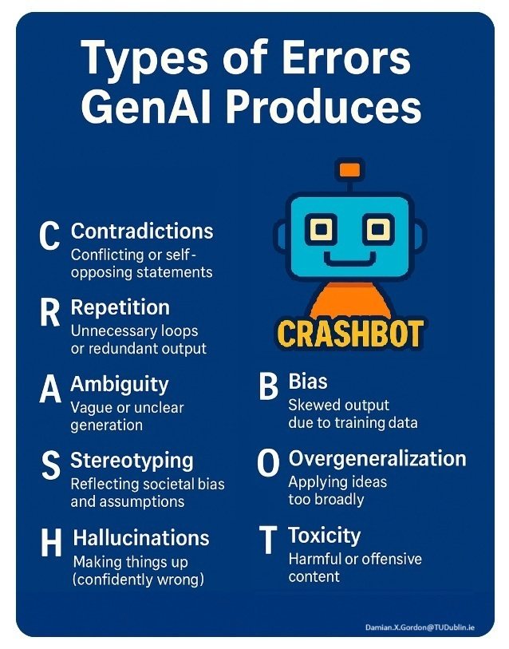
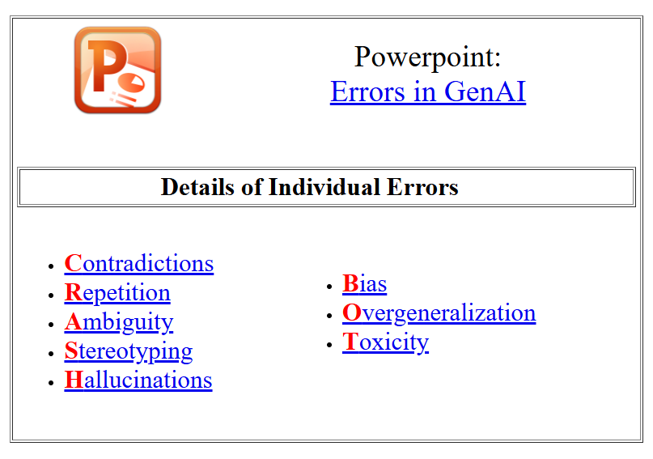
https://damiantgordon.com/Crashbot/

Slide 20
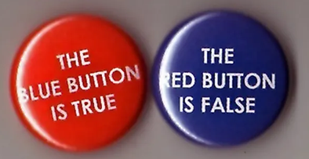
Contradictions
Definition: A contradiction occurs when a generative model produces output that directly conflicts with itself — either within a single response or across a multi-turn conversation.

Slide 21
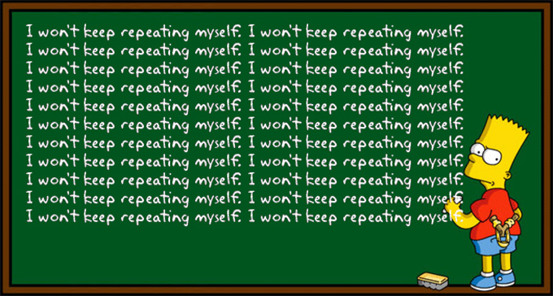
Repetition
Definition: Repetition occurs when a generative model repeats words, phrases, or ideas unnecessarily within its output. This can happen within a single response or across multiple turns in a conversation.

Slide 22
Ambiguity
Definition: Ambiguity happens when an AI model generates unclear, vague, or confusing language, leaving its meaning open to multiple interpretations. This can hinder comprehension, introduce misinformation, or require users to guess the model’s intent.

Slide 23
Stereotyping
Definition: Stereotyping occurs when a generative AI model outputs content that reflects overgeneralized assumptions or biased associations about a group of people based on characteristics such as gender, race, age, nationality, profession, etc.
These patterns are usually learned from biased training data, even if not explicitly stated in the prompt.

Slide 24
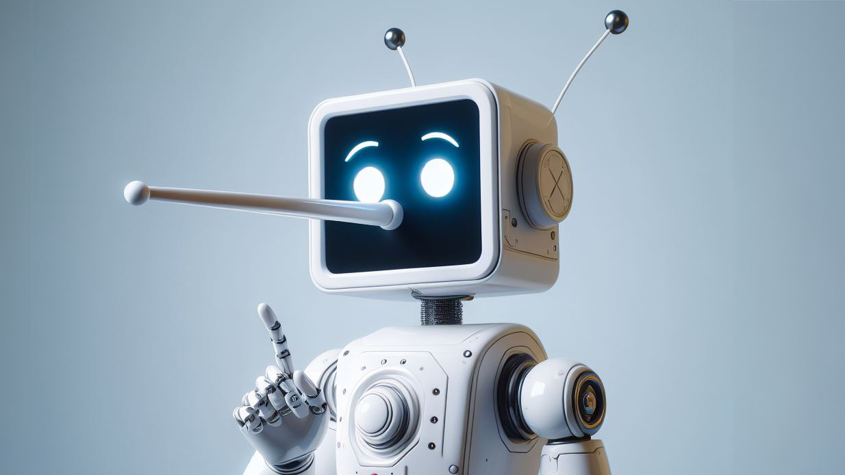
Hallucinations
Definition: A hallucination in GenAI is when the model generates content that is factually incorrect, unverifiable, or completely made up, despite sounding plausible and confident. These hallucinations can affect text, code, citations, or even images generated by AI models.

Slide 25
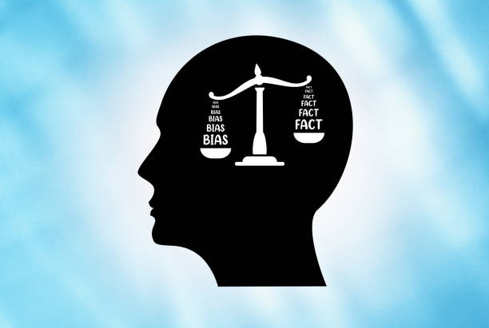
Bias
Definition: Bias in GenAI refers to systematic and unfair preferences or prejudices reflected in the AI’s responses. These biases often mirror and amplify the inequities, stereotypes, or skewed patterns found in the training data the model learned from.

Slide 26
Overgeneralization
Definition: Overgeneralization occurs when a model applies a concept or pattern too broadly or simplistically, ignoring exceptions, complexity, or nuance. It often leads to sweeping statements that sound plausible but are misleading or even harmful.

Slide 27
Toxicity
Definition: Toxicity in GenAI refers to any generated content that is harmful, offensive, or abusive — either explicitly or implicitly. This includes hate speech, slurs, personal attacks, violent threats, or language that is demeaning, discriminatory, or inflammatory.

Slide 28
Why it is important?
Rule-of-thumb:
“If you wouldn’t copy it from the internet, don’t copy it from GenAI either.”
So, let’s learn the tools, but use them wisely.

