Slide 1
Vibe Coding and Vibe Engineering
Damian Gordon

Slide 2
Contents
What is Vibe Coding?
Developer Workflow
Vibe Coding Tools
Best Practices
Risks and Benefits
What is Vibe Engineering?
Principles of VE
Organisational Implications

Slide 3
What is
Vibe Coding?

Slide 4
What is Vibe Coding?
“Vibe coding” is the use of natural language to program via generative AI. So the coding is done by expressing intent or a “vibe,” rather than writing logic line by line.
“You just say things, run things, and it mostly works.” - Andrej Karpathy, OpenAI

Slide 5
What is Vibe Coding?
A simple analogy would be hiring your own personal shopper to buy clothes for you.
You describe the look or feel of clothes you want (e.g. "I need a cozy set of summer outfits")
The shopper interprets your intent and curates outfits
You try things on, give feedback ("Too formal", "Try warmer tones")
The shopper handles the technical side: sizing, brands, inventory
The shopper speeds up your process but doesn’t remove your taste or final judgment

Slide 6
What is Vibe Coding?
So for Vibe Coding.
You describe the vibe or function of the software you want (e,g, "Build a cozy landing page with soft gradients and gentle animations")
The GenAI interprets your prompt and generates code (UI, copy, layout, animations)
You test/refine the output ("Make it simpler", "Use a pastel palette", "Add spring easing")
The GenAI handles implementation: syntax, layout logic, libraries
The AI accelerates development, but you still review, edit, and deploy

Slide 7
Developer Workflow
Intent
or “Vibe”
GenAI
Interpretation
Code
Generation
Developer Feedback
Refined
Code

Slide 8
Vibe Coding Tools
ChatGPT / Claude / Gemini
– Conversational coding
Cursor
– AI-native code editor
SuperWhisper
– Voice-to-code
Replit Ghostwriter
– In-browser AI dev
Lovable.so / Builder.io
– Natural language UI builders

Slide 9
Vibe Coding: Prompt Guide
Structure for Effective Prompts
1. Intent: What are you building?
2. Vibe: What should it *feel* like?
3. Style/Constraints: Tech stack, design choices, features
4. Output format: What do you want returned?

Slide 10
Vibe Coding: Prompt Guide
Example Prompt
“Create a landing page for a meditation app. The vibe should be calm and minimal with a soft gradient background and slow animations. Use React + Tailwind. Return full component code.”

Slide 11
Vibe Keywords
Visual | Motion | Tone | Style
soft, dreamy | smooth, slow, fluid | playful, formal | retro, brutalist
cozy, warm | springy, elastic | gentle, sharp | minimal, maximal
dark, moody | quick, responsive | calming, bold | glassy, grainy

Slide 12
Vibe Coding: Prompt Guide
Refinement Prompts
“Make it feel lighter/more playful.”
“Use serif fonts for a vintage vibe.”
“Add hover effects that feel soft.”
“Convert this to Vue instead of React.”
“Can you simplify the layout?”

Slide 13
Best Practices
Prompt Engineering is the new syntax.
Prompt structure: give context, intent, constraints.
You design by mood, outcome, or story
“Make it feel like a rainy Sunday.”
Iteration is fluid
“Make it more minimal.” “Try it in a darker theme.”
Code vetting
The human must be in the loop.

Slide 14
Vibe Coding: Risks
Understanding:
The GenAI doesn’t understand anything, so it’s up to you understand the code even if you didn’t write it.
Debugging bottlenecks:
What happens when something breaks?
Security issues:
AI might introduce silent vulnerabilities.
Ethical concerns:
Who owns the generated code?

Slide 15
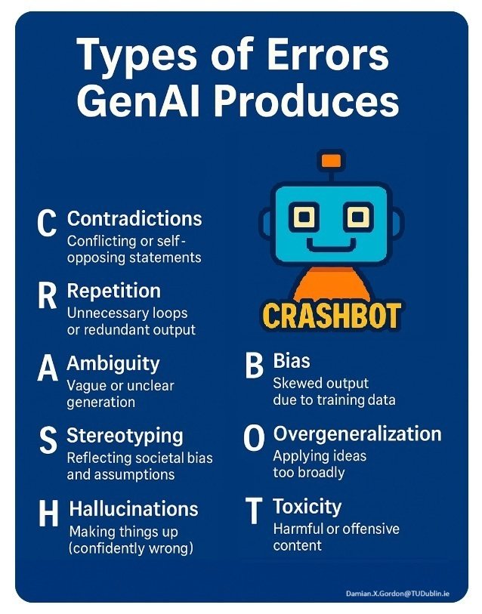
Vibe Coding: Risks
Contradictions
Repetition
Ambiguity
Stereotyping
Hallucinations
Bias
Overgeneralization
Toxicity

Slide 16
Vibe Coding: Benefits
Accessibility:
Lowers the barrier to entry for software development, enabling non-programmers to create applications.
Efficiency:
Accelerates the development process by automating routine coding tasks.
Creativity:
Allows developers to focus on high-level design and functionality

Slide 17
Summary
Vibe coding is not the end of programming - it's the beginning of a new kind of creative-human/AI collaboration.

Slide 18
What is
Vibe Engineering?

Slide 19
What is Vibe Engineering?
“Vibe Engineering” is a strategic approach to software development that treats AI not merely as a tool but as a collaborative team member.
It involves reimagining how software teams operate by integrating AI into every facet of the development lifecycle.

Slide 20
Vibe Coding vs Vibe Engineering
 | Vibe Coding | Vibe Engineering
Focus | Individual productivity | Organizational transformation
AI Role | Assistant generating code snippets | Collaborative team member with responsibilities
Workflow | Prompt-based code generation | Structured workflows integrating AI
Quality Assurance | Manual testing and refinement | Automated verification and feedback loops
Knowledge Management | Ad-hoc context handling | Persistent memory systems for context retention

Slide 21
Core Principles
AI as a First-Class Team Member: AI agents are assigned defined responsibilities and capabilities, collaborating alongside human developers.​
Verification-Driven Development: Implementing systematic testing and automated feedback loops to ensure quality and reliability.​
Structured Workflows: Designing architectural patterns that leverage AI's strengths while mitigating its limitations.​
Relentless Knowledge Capture: Maintaining context across AI interactions through persistent memory systems to preserve organizational knowledge.​
Human Strategic Direction: Focusing human expertise on architectural decisions and critical thinking, guiding AI contributions effectively.

Slide 22
Vibe Engineering Tools
Cursor, Replit Ghostwriter
– AI-native code
CodiumAI, Github Copilot
– Test generation
Windsurf
– AI context management
GitHub Copilot Enterprise, Lovable
– Org-wide AI collaboration

Slide 23
Developer Workflow
Team starts with a product spec.
AI agent drafts boilerplate, writes tests, scaffolds APIs.
Human edits high-level logic.
Verification pipeline catches regressions.
Persistent memory tracks decisions.

Slide 24
Organisation Implications
How team roles change:
less boilerplate, more design/strategy.
Challenges:
trust, code quality, AI oversight, onboarding.
What’s emerging:
AI-augmented org charts, agent-driven sprints.

