Slide 1
CPD in Applied Blended Learning Technologies
Introduction to HTML
Damian Gordon
Lecturer in Computer Science
To Design, Develop, and Evaluate Quality Blended Learning

Slide 2
HTML
HTML is the Hypertext Markup Language is the markup language for text to be displayed in a web browser.
It can be assisted by technologies such as Cascading Style Sheets (CSS) and scripting languages such as JavaScript (JS).
To Design, Develop, and Evaluate Quality Blended Learning

Slide 3
HTML Webpage
A HTML webpage can be written in Notepad, you can just type the text in, save it as a .TXT file and the browser will display that text.
To Design, Develop, and Evaluate Quality Blended Learning

Slide 4
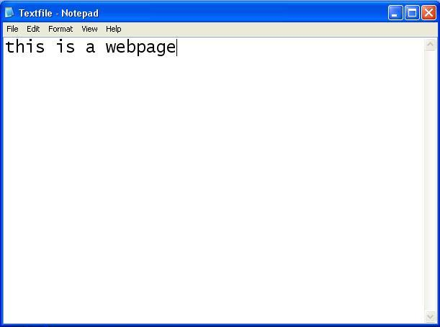
HTML Webpage

Slide 5
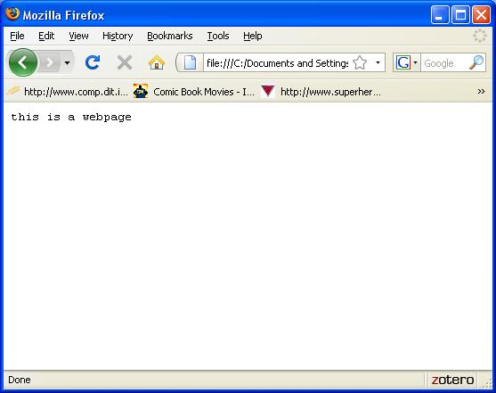
HTML Webpage

Slide 6
HTML Webpage
You can also save that same file as “All Types”, and change the extension to .HTML (or .HTM) and it will display the same output.
To Design, Develop, and Evaluate Quality Blended Learning

Slide 7
HTML Webpage
To help the browser understand more easily what you what to show, you can add tags onto the text.
Tags are text that starts with “<“ and finishes with either “>” or “/>”, so for example, <HTML> is typically used to indicate the start of a webpage and </HTML> is used to tell the browser that the webpage is finished.
To Design, Develop, and Evaluate Quality Blended Learning

Slide 8
HTML Webpage
Inside the HTML tags, you normally tell the browser which part of the page is used to describe the page, and which part includes the contents of the page.
The description part of the page is called the “Head” and tells the browser things like the language of the page, and style of page
The content part of the page is called the “Body” and includes the text to be displayed by the browser
To Design, Develop, and Evaluate Quality Blended Learning

Slide 9
HTML Webpage
If we think of a webpage as being like a letter, then:
The “Head” is like the envelope, it normally doesn’t contain the message to be receiver, but it does contain instructions as to how to get the message to the receiver – it contain “meta” information
The “Body” is like the message, it contains the content that will be displayed in the webpage
To Design, Develop, and Evaluate Quality Blended Learning

Slide 10
HTML Webpage
MyFirstPage.html

Slide 11
HTML Webpage
<HTML>
</HTML>

Slide 12
HTML Webpage
<HTML>
</HTML>

Slide 13
HTML Webpage
<HTML>
</HTML>

Slide 14
HTML Webpage
<HTML>
HEAD
</HTML>

Slide 15
HTML Webpage
<HTML>
HEAD
BODY
</HTML>

Slide 16
HTML Webpage
<HTML>
<HEAD>
</HEAD>
BODY
</HTML>

Slide 17
HTML Webpage
<HTML>
<HEAD>
</HEAD>
<BODY>
</BODY>
</HTML>

Slide 18
HTML Webpage
<HTML>
<HEAD>
</HEAD>
<BODY>
</BODY>
</HTML>

Slide 19
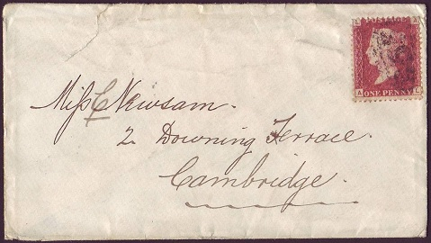
HTML Webpage
<HTML>
<HEAD>
</HEAD>
<BODY>
</BODY>
</HTML>

Slide 20
HTML Webpage
<HTML>
<HEAD>
</HEAD>
<BODY>
</BODY>
</HTML>

Slide 21
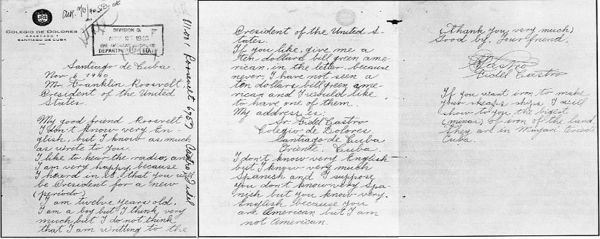
HTML Webpage
<HTML>
<HEAD>
</HEAD>
<BODY>
</BODY>
</HTML>

Slide 22
HTML Webpage
These tags don’t really affect what is being displayed, but they do make life easier for the browser.
To Design, Develop, and Evaluate Quality Blended Learning

Slide 23
HTML Webpage
Let’s look at what we can put in the HEAD:
So, we can add a title to the webpage, that will be displayed at the top of the browser, using the “TITLE” tag
To Design, Develop, and Evaluate Quality Blended Learning

Slide 24
HTML Webpage
<HEAD>
</HEAD>

Slide 25
HTML Webpage
<HEAD>
<TITLE>
</TITLE>
</HEAD>

Slide 26
HTML Webpage
<HEAD>
<TITLE>
Anything you want in the blue bar
</TITLE>
</HEAD>

Slide 27
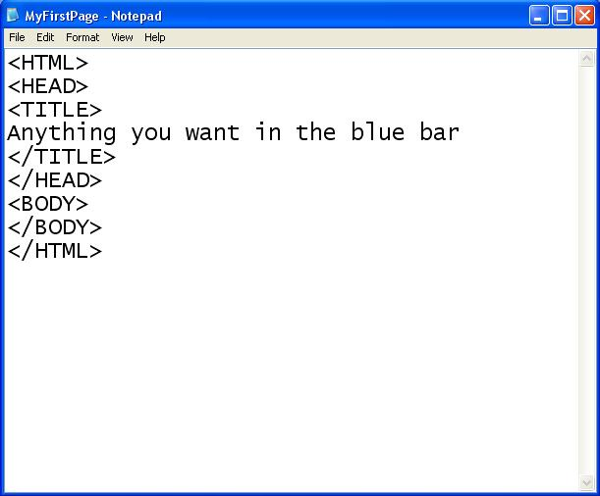
HTML Webpage

Slide 28
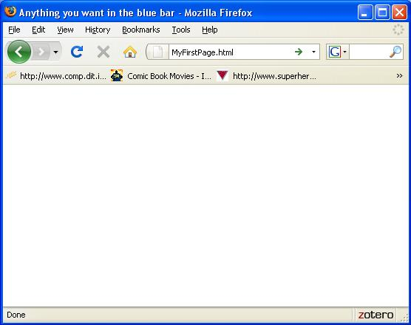
HTML Webpage

Slide 29
HTML Webpage
Let’s look at what we can put in the BODY:
We can add in headers using the “H1” and “H2” tags
We can add in links using the “A HREF” tag
We can add in images using the “IMG SRC” tag. It is worth noting that this tag doesn’t need a corresponding close tag (“</IMG>”)
To Design, Develop, and Evaluate Quality Blended Learning

Slide 30
HTML Webpage
<HTML>
<HEAD>
</HEAD>
<BODY>
</BODY>
</HTML>

Slide 31
HTML Webpage
<BODY>
</BODY>

Slide 32
HTML Webpage
<BODY>
<H1>
Header of Page
</H1>
</BODY>

Slide 33
HTML Webpage
<BODY>
<H1>
Header of Page
</H1>
<H2>
Subtitle here
</H2>
</BODY>

Slide 34
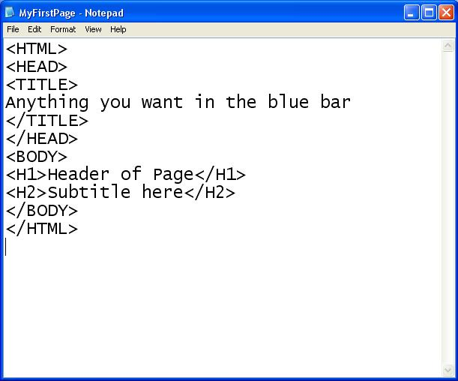
HTML Webpage

Slide 35
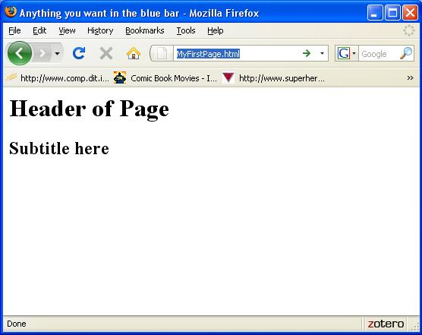
HTML Webpage

Slide 36
HTML Webpage
<BODY>
<H1>
Header of Page
</H1>
<H2>
Subtitle here
</H2>
<A HREF=“http://www.google.com">LINK HERE</A>
</BODY>

Slide 37
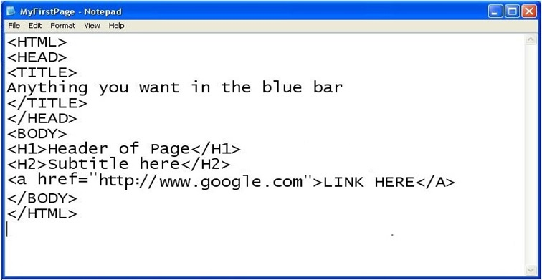
HTML Webpage

Slide 38
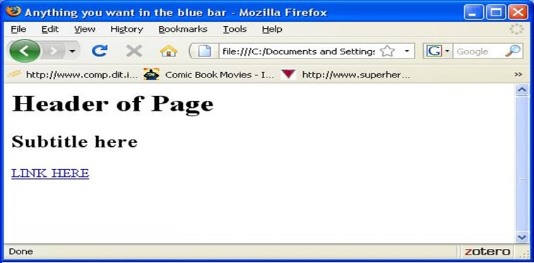
HTML Webpage

Slide 39
HTML Webpage
<BODY>
<H1>
Header of Page
</H1>
<H2>
Subtitle here
</H2>
<A HREF=“http://www.google.com">LINK HERE</A>
<IMG SRC = “SampleImage1.jpg”>
</BODY>

Slide 40
HTML Webpage

