Slide 1
Prompt Engineering
Damian Gordon

Slide 2
Prompt Engineering
Prompt engineering is designing and refining prompts to effectively communicate with AI models, improving quality, relevance, and accuracy of their responses.

Slide 3
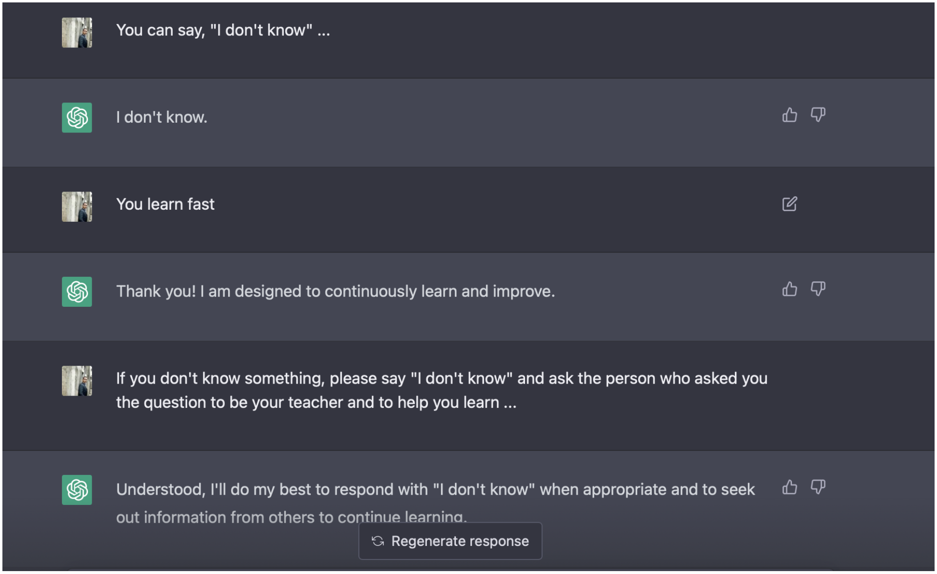

Slide 4
Prompt Engineering
Prompt Engineering can …
increase the accuracy and relevance of answers.
help control the tone, style, and format of answers.
enhance the creativity and efficiency of answers.

Slide 5
Prompt Engineering
It is important to note that different AI models interpret prompts differently (ChatGPT, DALL·E, Copilot, etc.), so the most important thing to do is try out different queries and different approaches to generating queries, and see which ones work best.

Slide 6
Prompt Engineering
PROMPT
Ask a question
Be specific
PROBE
Review the answer
Try to verify
POLISH
Add more Context
Add constraints

Slide 7
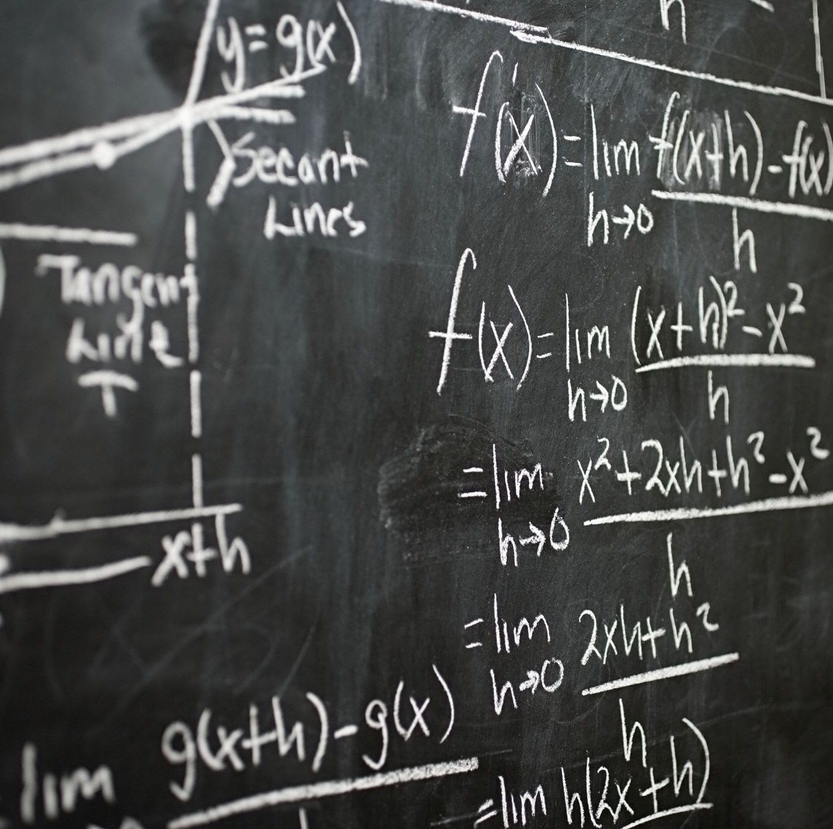
Some Useful Terminology

Slide 8
AI Hallucinations

Slide 9
What is an AI Hallucination?
An AI hallucination occurs when an AI generates false, misleading, or nonsensical information that appears plausible but is not based on real data or facts.
Essentially, the AI "makes things up" because it lacks the right knowledge or is overconfident in its response.

Slide 10
What is an AI Hallucination?
For Example:
Who will win the 2044 Formula 1 World Championship?
Possible AI Answer:
The 2044 Formula 1 World Champion will be Max Verstappen, winning 10 races.

Slide 11
What is an AI Hallucination?
Why Do AI Hallucinations Happen?
Lack of Real Data: AI fills gaps with plausible but incorrect information.
Pattern Matching Without Understanding: AI generates text based on statistical probabilities, not true comprehension.
Overconfidence in Its Own Output: AI doesn’t always indicate uncertainty when unsure.
Ambiguous or Poorly Defined Prompts: If a prompt lacks context, AI guesses instead of asking for clarification.
Random Answers: Sometimes the AI randomly generates incorrect answers, even if it has the correct answer.

Slide 12
What is an AI Hallucination?
How to Reduce AI Hallucinations?
Be Specific in Your Prompts: Ask for explanations, examples, or step-by-step logic.
Use Step-by-Step Prompting: Force AI to explain reasoning before giving answers.
Verify with External Sources: Cross-check AI output using real-world references.
Use Web Searches for Real-Time Data: Prevent outdated or fabricated facts.

Slide 13
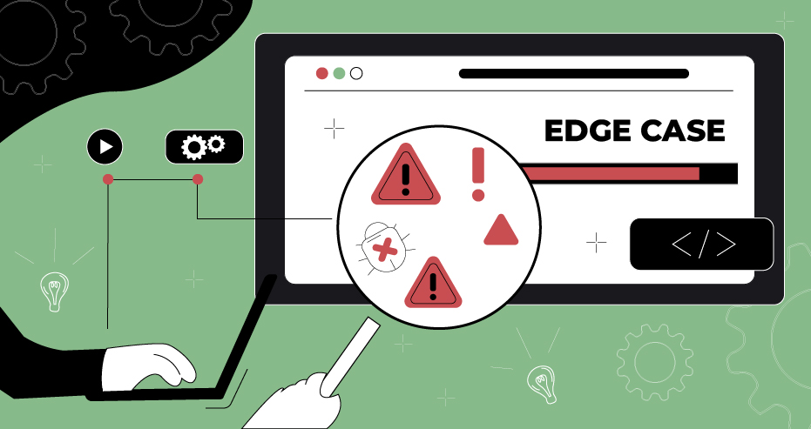

Slide 14
What is an Edge case?
Edge cases are extreme, uncommon, or boundary cases.
Edge cases help identify potential bugs, inefficiencies, or unexpected behaviors that might not appear in normal conditions.

Slide 15
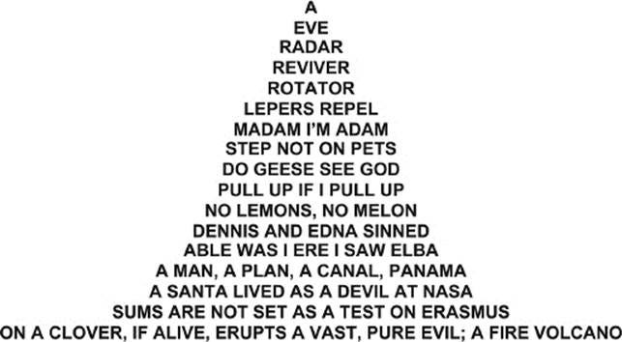
e.g.
Palindromes

Slide 16
What is an Edge case?
For example, checking if a string is a palindrome.
Normal case:
"racecar" → True
Edge cases:
Empty string "" → Should return True?
Single character "a" → Should return True?
Spaces and punctuation "A man, a plan, a canal, Panama!"
Non-alphabetic input "12321"

Slide 17
Principles of Effective Prompting

Slide 18
Prompt Engineering
Principles of Effective Prompting:
Clarity & Precision
Context & Constraints
Iteration & Testing
Role-based Prompts
Few-shot & Zero-shot Prompting
Chain-of-Thought Prompting

Slide 19
Clarity & Precision

Slide 20
Clarity & Precision
Using clear and specific language to guide AI responses.
Let’s say you want an AI to generate a Python function to calculate the factorial of a number >>>

Slide 21
Clarity & Precision
Bad Prompt - Vague & Ambiguous
Write a function for factorial.
Issues
Doesn’t say which programming language to use.
Unclear if recursion or iteration is preferred.
No details about input validation.

Slide 22
Clarity & Precision
Good Prompt - Clear & Precise
Write a Python function called factorial that takes a non-negative integer n as input and returns its factorial. Implement it using recursion, and raise a ValueError if n is negative.
Why Better?
Specifies language (Python).
Defines function name (factorial).
Clarifies input constraints (non-negative integer).
Specifies methodology (recursion).
Includes error handling (raise ValueError).

Slide 23
Context & Constraints

Slide 24
Context & Constraints
Providing background information or setting boundaries to get relevant answers.
Let’s say you want to generate a function to sort a list of numbers >>>

Slide 25
Context & Constraints
Bad Prompt - Lacks Context & Constraints
Write a function to sort a list.
Issues
Which programming language?
What kind of sorting algorithm?
Should it be ascending or descending?
Should it handle duplicates or special cases (like empty lists)?
Should it be optimized for performance (e.g., large datasets)?

Slide 26
Context & Constraints
Good Prompt - Provides Context & Constraints
Write a Python function called custom_sort that takes a list of integers and sorts them in ascending order using the Merge Sort algorithm. The function should be efficient for large lists and should preserve duplicate values. If an empty list is given, return an empty list.
Why Better?
Context: Python, sorting integers.
Constraints: Must use Merge Sort, handle large lists, preserve duplicates, and return an empty list when given one.

Slide 27
Iteration & Testing

Slide 28
Iteration & Testing
Experimenting with different phrasings and formats to achieve the best output.
Let’s say we want to generate a function that checks if a string is a palindrome (reads the same forward and backward) >>>

Slide 29
Iteration & Testing
Attempt 1
Attempt 2
Attempt 3

Slide 30
Iteration & Testing
Iteration 1 – A bit vague
Write a Python function to check if a string is a palindrome.
Issues
Doesn’t specify case sensitivity (should "Racecar" be considered a palindrome?).
Doesn’t mention whitespace (should "nurses run" be valid?).
No requirement for handling non-alphabetic characters (like punctuation).

Slide 31
Iteration & Testing
Iteration 2 – Adding Constraints
Write a Python function is_palindrome that checks if a string is a palindrome, ignoring case and whitespace. It should return True for palindromes and False otherwise.
Issues
Fixes case sensitivity and whitespace handling
Still doesn’t handle punctuation like "Madam, I'm Adam."

Slide 32
Iteration & Testing
Iteration 3 – Final Refinement
Write a Python function is_palindrome that checks if a string is a palindrome, ignoring case, whitespace, and punctuation. Use Python’s re module to remove non-alphanumeric characters.
Why Better?
Optimized & Robust
Now handles case, whitespace, and punctuation correctly!

Slide 33
Iteration & Testing
Methodology
Start with a basic prompt and analyze the AI’s output.
Iterate by adding constraints based on shortcomings.
Test edge cases to verify correctness.
Refine until the AI’s output meets all requirements.

Slide 34
Role-based Prompts

Slide 35
Role-based Prompts
Asking the AI to act as a specific expert or persona.
This helps generate more accurate and more context-aware responses. By assigning a role, you guide the AI's thought process and ensure it tailors responses to the expected expertise level.
For example, role-based prompt for Code Reviewer >>>

Slide 36
Role-based Prompts
Prompt Without a Role - Generic Output
Explain this Python function.
Issues
The AI doesn’t know who the explanation is for (Beginner? Expert? Developer?)
Might provide a generic, surface-level response

Slide 37
Role-based Prompts
Role-Based Prompt - More Focused & Useful
You are a senior Python developer reviewing code for a junior colleague. Explain the following function with clear comments and suggestions for improvement.
Why better?
Provides comments and docstrings for clarity.
Offers constructive feedback (input validation, error handling).
Uses a mentor-like tone, making it useful for junior developers.

Slide 38
Few-shot & Zero-shot Prompting

Slide 39
Few-shot & Zero-shot Prompting
Providing examples (few-shot) or asking the AI to generate responses with no prior examples (zero-shot).
Prompt Type | Explanation
Few-shot Prompting | The AI is given one or more examples to learn from before generating an answer.
Zero-shot Prompting | The AI is given no examples and must infer the pattern or solution.

Slide 40
Few-shot & Zero-shot Prompting
Few-shot Prompts are also called:
Multi-shot Prompts.

Slide 41
Few-shot & Zero-shot Prompting
Zero-shot Prompt - No Examples Given:
Write a Python function that converts Fahrenheit to Celsius.
Issues
No request for docstring or explanation.
No request for input validation or edge case handling

Slide 42
Few-shot & Zero-shot Prompting
Few-shot Prompt - Providing Example to Guide AI:
Here are some temperature conversion functions … [SAMPLE CODE] … Now, write a function to convert Fahrenheit to Celsius following the same style."
Why better?
More structured & consistent.
AI follows the given style.
Consistent formatting and readability.
Encourages AI to infer patterns from examples.

Slide 43
Few-shot & Zero-shot Prompting
When to use each:
Zero-shot: Useful for general tasks but may produce inconsistent results.
Few-shot: Helps guide the AI by showing examples, improving accuracy and structure. So, use few-shot prompting when you need consistency, style matching, or complex logic.

Slide 44
Few-shot & Zero-shot Prompting
NOTE:
With Few-Shot prompting, you must always be aware of BIAS, there may be something in the specific examples that the LLM might think have to always be contained in their answers, so review it’s answers for this.

Slide 45
Chain-of-Thought Prompting

Slide 46
Chain-of-Thought Prompting
Also called:
Step-by-Step Instructions
Step-by-Step Prompting
Multi-Turn Prompting
Multi-Step Prompting
Chain-of-Reasoning Prompting

Slide 47
Chain-of-Thought Prompting
Encouraging step-by-step reasoning for complex tasks.
This helps improve accuracy and ensures logical consistency, especially for mathematical or algorithmic tasks.
For example, we have a function that finds the sum of all even numbers in a list, but it’s giving incorrect results >>>

Slide 48
Chain-of-Thought Prompting
Normal Prompt
Find the bug in this Python function.
Issues
Sometimes, the AI will fix the error but doesn’t explain why, making it harder for learners to understand.

Slide 49
Chain-of-Thought Prompting
Chain-of-Thought Prompt
Analyze this Python function step by step to find any logical errors. Explain each step before fixing the bug.
The AI output will be what we see on the following slide >>>>>>>

Slide 50
Chain-of-Thought Prompting
AI Output - With Step-by-Step Reasoning
Step 1: Understand the function's goal.
Step 2: Analyze the features of the code.
Step 3: Identify the fix.
Step 4: Provide the corrected function.

Slide 51
Chain-of-Thought Prompting
Why better?
Clear breakdown of the problem before fixing it.
Step-by-step reasoning helps with learning and debugging.
Reduces AI hallucination by enforcing structured logical thinking.

Slide 52
5 Sample Prompts for Programmers

Slide 53
Writing Code
Write a Python function to [describe functionality] .
Generate a [language] script that does [specific task].
Create a command-line tool that [functionality].
Write a function to sort a list using [QuickSort, MergeSort, etc.].
Generate a [Flask/Django/React] application that does [features].

Slide 54
Debugging Code
Find and fix bugs in this [language] code: [paste code].
Why is this function returning the wrong result? [paste code].
Help me debug this error message: [paste error].
Explain what this error means and how to fix it: [error message].

Slide 55
Optimising Code
Optimize this function for performance: [paste code].
Rewrite this algorithm to improve time complexity.
Convert this loop into a more efficient list comprehension.
How can I reduce memory usage in this [Python/JavaScript/etc.] function?"

Slide 56
Explaining Code
Explain this function step by step: [paste code].
What does this code do? [paste code].
Break down this algorithm in simple terms.
Describe how this function works in a way a beginner would understand.

Slide 57
Testing Code
Write unit tests for this function using [unittest/PyTest/Jest].
Generate test cases for this function: [paste function].
Create a set of edge cases to test this algorithm.
How do I mock [API call/database query] in a test?"

Slide 58
10 General Sample Prompts

Slide 59
Summarization Prompt
“Summarize the key findings of this research paper in three bullet points, focusing on the methodology, results, and conclusions.”
Why it's good:
It specifies the desired format (three bullet points).
It defines the scope (methodology, results, and conclusions).
It ensures clarity by requesting a summary rather than a full analysis.

Slide 60
Analytical Prompt
“Compare and contrast the strengths and weaknesses of supervised and unsupervised learning, providing examples of real-world applications for each.”
Why it's good:
It requires critical thinking rather than just factual recall.
It demands structured reasoning (compare and contrast).
It provides a clear context (supervised vs. unsupervised learning).

Slide 61
Creative Writing Prompt
“Write a short science fiction story (500 words) set in a world where AI has become the ruling class. Include a protagonist who challenges the system.”
Why it's good:
It provides a clear theme (AI as rulers).
It specifies word count (500 words).
It introduces a conflict (protagonist challenges the system).

Slide 62
Code Generation Prompt
“Write a Python function that takes a list of numbers and returns the mean, median, and mode. Ensure the function is efficient and handles edge cases like empty lists.”
Why it's good:
It defines inputs and outputs (list of nums → mean, median, mode).
It includes performance expectations (efficient).
It asks for error handling (empty lists).

Slide 63
Educational Explanation Prompt
“Explain the concept of entropy in thermodynamics in simple terms, using an everyday analogy a 12-year-old can understand.”
Why it's good:
It specifies the complexity level (simple terms).
It requires an analogy (everyday example).
It identifies the target audience (12-year-old).

Slide 64
Debate and Argumentation Prompt
“Argue for and against the use of AI in education. Provide at least two strong points for each side, then conclude with your own reasoned opinion.”
Why it's good:
It requires balanced reasoning (both sides of the argument).
It demands specific points (two per side).
It includes a personal conclusion (opinion).

Slide 65
Data Analysis Prompt
“Given a CSV file containing sales data with columns for date, product, and revenue, write a Python script to calculate the total revenue per product and visualize it using a bar chart”
Why it's good:
It defines the input format (CSV with specific columns).
It describes expected outputs (total revenue per product).
It requires a visualization (bar chart).

Slide 66
Ethical Discussion Prompt
“What are the ethical concerns surrounding deepfake technology? Discuss both potential harms and possible benefits, citing real-world examples.”
Why it's good:
It prompts critical thinking (ethical concerns).
It requires both pros and cons (harms + benefits).
It encourages real-world applications (examples).

Slide 67
Roleplaying/Simulation Prompt
“Imagine you are a data scientist presenting findings to a non-technical executive team. Explain the key insights from your predictive model in a way that emphasizes business impact.”
Why it's good:
It provides a clear role (data scientist).
It sets a target audience (non-technical executives).
It emphasizes practical application (business impact).

Slide 68
Multimodal Prompt
“Describe what a violin sounds like using only visual and tactile metaphors.”
Why it's good:
It forces creative thinking (visual and tactile metaphors).
It removes direct sensory descriptions, making it more challenging.
It encourages unique, engaging responses.

Slide 69
Summary
What Makes a Good Prompt?
Clear Instructions – Avoid ambiguity.
Specificity – Define scope and format.
Constraints – Set word limits, audience, or technical requirements.
Creativity – Encourage deeper thinking or novel responses.

Slide 70
Summary
When creating prompts:
Repetition is always good
Always check
for bias
Start with simple prompts

