Slide 1
Prompt Engineering
Damian Gordon

Slide 2
Contents
Introduction to Prompt Engineering
Principles of Effective Prompting
Prompting Methodologies
10 General Sample Prompts

Slide 3
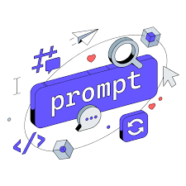
Prompt Engineering
Prompt engineering is designing and refining prompts to effectively communicate with GenAI models, improving quality, relevance, and accuracy of their responses.

Slide 4
Prompt Engineering
Prompt Engineering can …
increase the accuracy and relevance of answers.
help control the tone, style, and format of answers.
enhance the efficiency of answers.

Slide 5
Prompt Engineering
It is important to note that different GenAI models interpret prompts differently (ChatGPT, DALL·E, Copilot, etc.), so the most important thing to do is try out different queries and different approaches to generating queries, and see which ones work best.

Slide 6
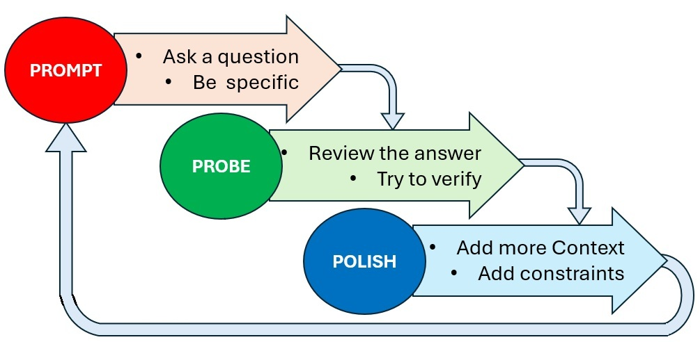
Prompt Engineering
3Ps of Prompt
Engineering

Slide 7
Principles of Effective Prompting

Slide 8
Prompt Engineering
Principles of Effective Prompting:
Clarity & Precision
Context & Constraints
Validation & Verification
Repetition & Repetition

Slide 9
Clarity & Precision

Slide 10
Clarity & Precision
Using clear and specific language to guide GenAI responses.
Let’s say you want an GenAI to generate a Python function to calculate the factorial of a number >>>

Slide 11
Clarity & Precision
Bad Prompt - Vague & Ambiguous
Write about photosynthesis.

Slide 12
Clarity & Precision
Good Prompt - Clear & Precise
Explain the process of photosynthesis in plants, including the role of sunlight, chlorophyll, water, and carbon dioxide.

Slide 13
Context & Constraints

Slide 14
Context & Constraints
Providing background information or setting boundaries to get relevant answers.
Let’s say you want to generate a function to sort a list of numbers >>>

Slide 15
Context & Constraints
Bad Prompt - Lacks Context & Constraints
Generate a recipe for pasta.

Slide 16
Context & Constraints
Good Prompt - Provides Context & Constraints
Generate a vegetarian pasta recipe that serves 2 people, can be cooked in under 30 minutes, and does not use any dairy products. Include a list of ingredients and step-by-step instructions.

Slide 17
Validation & Verification

Slide 18
Validation & Verification
Verifying the output of Generative AI (GenAI) is crucial to ensure accuracy, reliability, and ethical integrity.
Here's a structured approach to critically assess AI-generated content >>>

Slide 19
Validation & Verification: Check the Facts !!!
Verify Key Information: Scrutinize names, dates, statistics, and claims by comparing them with credible sources like academic journals, official reports, or reputable news outlets.
Validate Citations: If the GenAI provides references, ensure they exist and accurately support the content. GenAI models can sometimes fabricate citations or misattribute information.
Use Fact-Checking Tools: Leverage platforms such as FactCheck.org, Snopes, or Google Fact Check Tools to confirm the veracity of the information

Slide 20
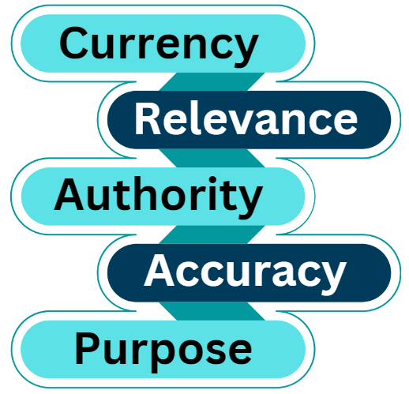
Validation & Verification: Check the Facts !!!
Take the CRAAP Test!!!
Currency
Relevance
Authority
Accuracy
Purpose
https://damiantgordon.com/CheckSheets/CHECKSHEET-CRAAP-Test.pdf

Slide 21
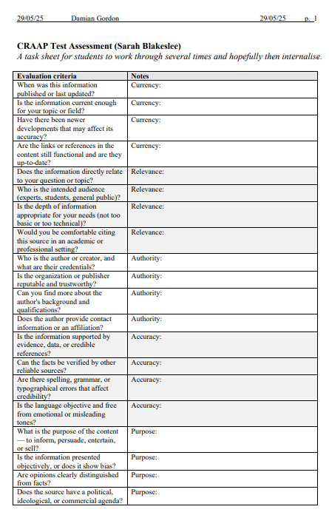
Validation & Verification
https://damiantgordon.com/CheckSheets/
Again, lots of Checklists on my website, these can be really helpful for some learners to actively and authentically engage with content and models:

Slide 22
Repetition & Repetition

Slide 23
Repetition & Repetition
Repetition can help improve prompts — but it depends on how and why you use it.
Here’s how repetition can enhance prompt effectiveness, especially with GenAI >>>

Slide 24
Repetition & Repetition
Clarifying Intent
Repeating or rephrasing your request can reinforce what’s important.
Example:
“Give me three bullet points. Just three clear, short bullet points.”

Slide 25
Repetition & Repetition
Guiding Structure
GenAI responds well to consistent patterns.
Example:
“Write a short story. Make it short, with a clear beginning, middle, and end.”

Slide 26
Repetition & Repetition
Stressing Constraints
Repetition can highlight limits (like tone, format, or length).
Example:
“Use plain language. No jargon. Really, keep the language plain and simple.”

Slide 27
Repetition & Repetition
Prompt Tuning
You can repeat an adjusted version of a prompt to refine the GenAI's direction.
First prompt:
“Summarize this article.”
Follow-up:
“Summarize it again, but focus only on the economic implications.”

Slide 28
Prompting Methodologies

Slide 29
Prompt Engineering
Prompting Methodologies:
Iteration & Testing
Role-based Prompts
N-Shot Prompting
Chain-of-Thought Prompting

Slide 30
Iteration & Testing

Slide 31
Iteration & Testing
Experimenting with different phrasings and formats to achieve the best output.
Let’s say we want to generate a function that checks if a string is a palindrome (reads the same forward and backward) >>>

Slide 32
Iteration & Testing
Attempt 1
Attempt 2
Attempt 3

Slide 33
Iteration & Testing
Iteration 1 – A bit vague
Summarize this article.

Slide 34
Iteration & Testing
Iteration 2 – Adding Constraints
Summarize the main argument of the article in 3 bullet points, each no longer than 20 words.

Slide 35
Iteration & Testing
Iteration 3 – Final Refinement
Summarize the main argument of the article in 3 bullet points, each no longer than 20 words, and avoid repeating quotes from the text.

Slide 36
Iteration & Testing
Methodology
Start with a basic prompt and analyze the output.
Iterate by adding constraints based on shortcomings.
Test edge cases to verify correctness.
Refine until the GenAI’s output meets all requirements.

Slide 37
Role-based Prompts

Slide 38
Role-based Prompts
Asking the GenAI to act as a specific expert or persona.
This helps generate more accurate and more context-aware responses. By assigning a role, you guide the GenAI's thought process and ensure it presents responses to the expected expertise level.
For example, role-based prompt for Business Guru >>>

Slide 39
Role-based Prompts
Prompt Without a Role - Generic Output
What are some business tips?

Slide 40
Role-based Prompts
Role-Based Prompt - More Focused & Useful
You are a seasoned startup advisor with 15 years of experience in SaaS businesses. What are the top 5 tips you'd give a first-time founder launching a B2B SaaS product?

Slide 41
N-Shot Prompting

Slide 42
N-Shot Prompting
This type of prompting is concerned with whether or not the prompt includes an example …

Slide 43
N-Shot Prompting
Prompt Type | Explanation
Zero-shot Prompting (0) | The GenAI is given no examples and must infer the pattern or solution.
One-shot Prompting (1) | The GenAI is given one example to learn from before generating an answer.
Few-shot Prompting (2-5) | The GenAI is given two to five examples to learn from before generating an answer.
Multi-shot Prompting (5+) | The GenAI is given over five examples to learn from before generating an answer.

Slide 44
N-Shot Prompting
Why is giving examples better?
More structured & consistent.
GenAI follows the given style.
Consistent formatting and readability.
Encourages GenAI to infer patterns from examples.

Slide 45
N-Shot Prompting
Zero-shot Prompt - No Examples Given:
“Write a Python function that converts Fahrenheit to Celsius.”
One-shot Prompt - One Example Given:
“Here is a temperature conversion functions … [SAMPLE CODE] … Now, write a function to convert Fahrenheit to Celsius following the same style.”

Slide 46
N-Shot Prompting
Few-shot Prompt – 2 to 5 Examples Given:
“Here are 2-5 temperature conversion functions … [SAMPLE CODE] … Now, write a function to convert Fahrenheit to Celsius following the same style.”
Multi-shot Prompt – Over 5 Examples Given:
“Here are over five temperature conversion functions … [SAMPLE CODE] … Now, write a function to convert Fahrenheit to Celsius following the same style.”

Slide 47
N-Shot Prompting
When to use each:
Zero-shot: Useful for general tasks but may produce inconsistent results.
One-shot: Useful for specific task where the answer needs to closely match the example.

Slide 48
N-Shot Prompting
When to use each:
Few-shot: Helps guide the GenAI by showing 2-5 examples, improving accuracy and structure. So, use few-shot prompting when you need consistency, style matching, or complex logic.
Multi-shot: Helps guide the GenAI by showing over 5 examples, improving accuracy and structure. So, use multi-shot prompting when you need a very high level of consistency, style matching, or complex logic.

Slide 49
N-Shot Prompting
NOTE:
With Few-Shot and Multi-shot prompting, you must always be aware of BIAS, there may be something in the specific examples that the GenAI might think have to always be contained in their answers, so review its answers for this.

Slide 50
Chain-of-Thought Prompting

Slide 51
Chain-of-Thought Prompting
Also called:
Step-by-Step Instructions
Step-by-Step Prompting
Multi-Turn Prompting
Multi-Step Prompting
Chain-of-Reasoning Prompting

Slide 52
Chain-of-Thought Prompting
Encouraging step-by-step reasoning for complex tasks.
This helps improve accuracy and ensures logical consistency, especially for mathematical or algorithmic tasks.
For example, we have a function that finds the sum of all even numbers in a list, but it’s giving incorrect results >>>

Slide 53
Chain-of-Thought Prompting
Initial Prompt
If there are 3 red balls and 5 blue balls in a bag, and you take out 2 balls without looking, what is the probability that both are red?

Slide 54
Chain-of-Thought Prompting
Chain-of-Thought Prompt
If there are 3 red balls and 5 blue balls in a bag, and you take out 2 balls without looking, what is the probability that both are red? Please explain your reasoning step by step.

Slide 55
Chain-of-Thought Prompting
Chain-of-Thought Prompt
There are a total of 3 red + 5 blue = 8 balls.
The probability that the first ball drawn is red is 3/8.
If the first ball is red, there are now 2 red and 7 total balls left.
So the probability that the second ball is red is 2/7.
Therefore, the probability that both balls are red is (3/8) × (2/7) = 6/56 = 3/28.

Slide 56
Chain-of-Thought Prompting
Why better?
Clear breakdown of the problem before answering it.
Step-by-step reasoning helps with learning and debugging.
Reduces GenAI hallucinations by enforcing structured logical thinking.

Slide 57
10 General Sample Prompts

Slide 58
Summarization Prompt
“Summarize the key findings of this research paper in three bullet points, focusing on the methodology, results, and conclusions.”
Why it's good:
It specifies the desired format (three bullet points).
It defines the scope (methodology, results, and conclusions).
It ensures clarity by requesting a summary rather than a full analysis.

Slide 59
Analytical Prompt
“Compare and contrast the strengths and weaknesses of supervised and unsupervised learning, providing examples of real-world applications for each.”
Why it's good:
It requires critical thinking rather than just factual recall.
It demands structured reasoning (compare and contrast).
It provides a clear context (supervised vs. unsupervised learning).

Slide 60
Creative Writing Prompt
“Write a short science fiction story (500 words) set in a world where AI has become the ruling class. Include a protagonist who challenges the system.”
Why it's good:
It provides a clear theme (AI as rulers).
It specifies word count (500 words).
It introduces a conflict (protagonist challenges the system).

Slide 61
Code Generation Prompt
“Write a Python function that takes a list of numbers and returns the mean, median, and mode. Ensure the function is efficient and handles edge cases like empty lists.”
Why it's good:
It defines inputs and outputs (list of nums → mean, median, mode).
It includes performance expectations (efficient).
It asks for error handling (empty lists).

Slide 62
Educational Explanation Prompt
“Explain the concept of entropy in thermodynamics in simple terms, using an everyday analogy a 12-year-old can understand.”
Why it's good:
It specifies the complexity level (simple terms).
It requires an analogy (everyday example).
It identifies the target audience (12-year-old).

Slide 63
Debate and Argumentation Prompt
“Argue for and against the use of AI in education. Provide at least two strong points for each side, then conclude with your own reasoned opinion.”
Why it's good:
It requires balanced reasoning (both sides of the argument).
It demands specific points (two per side).
It includes a personal conclusion (opinion).

Slide 64
Data Analysis Prompt
“Given a CSV file containing sales data with columns for date, product, and revenue, write a Python script to calculate the total revenue per product and visualize it using a bar chart”
Why it's good:
It defines the input format (CSV with specific columns).
It describes expected outputs (total revenue per product).
It requires a visualization (bar chart).

Slide 65
Ethical Discussion Prompt
“What are the ethical concerns surrounding deepfake technology? Discuss both potential harms and possible benefits, citing real-world examples.”
Why it's good:
It prompts critical thinking (ethical concerns).
It requires both pros and cons (harms + benefits).
It encourages real-world applications (examples).

Slide 66
Roleplaying/Simulation Prompt
“Imagine you are a data scientist presenting findings to a non-technical executive team. Explain the key insights from your predictive model in a way that emphasizes business impact.”
Why it's good:
It provides a clear role (data scientist).
It sets a target audience (non-technical executives).
It emphasizes practical application (business impact).

Slide 67
Multimodal Prompt
“Describe what a violin sounds like using only visual and tactile metaphors.”
Why it's good:
It forces creative thinking (visual and tactile metaphors).
It removes direct sensory descriptions, making it more challenging.
It encourages unique, engaging responses.

