Slide 1
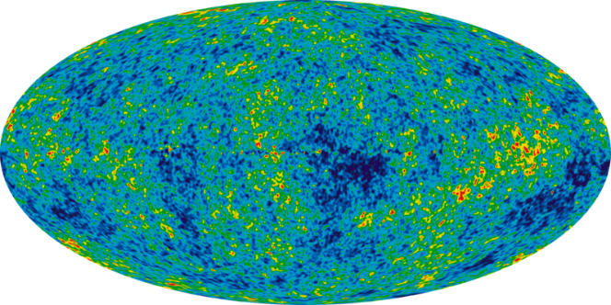
Universal Design for Learning Software Tools
Damian Gordon

Slide 2
Table of Contents
Accessibility Tools
Website Quality Tools

Slide 3
Accessibility Tools

Slide 4
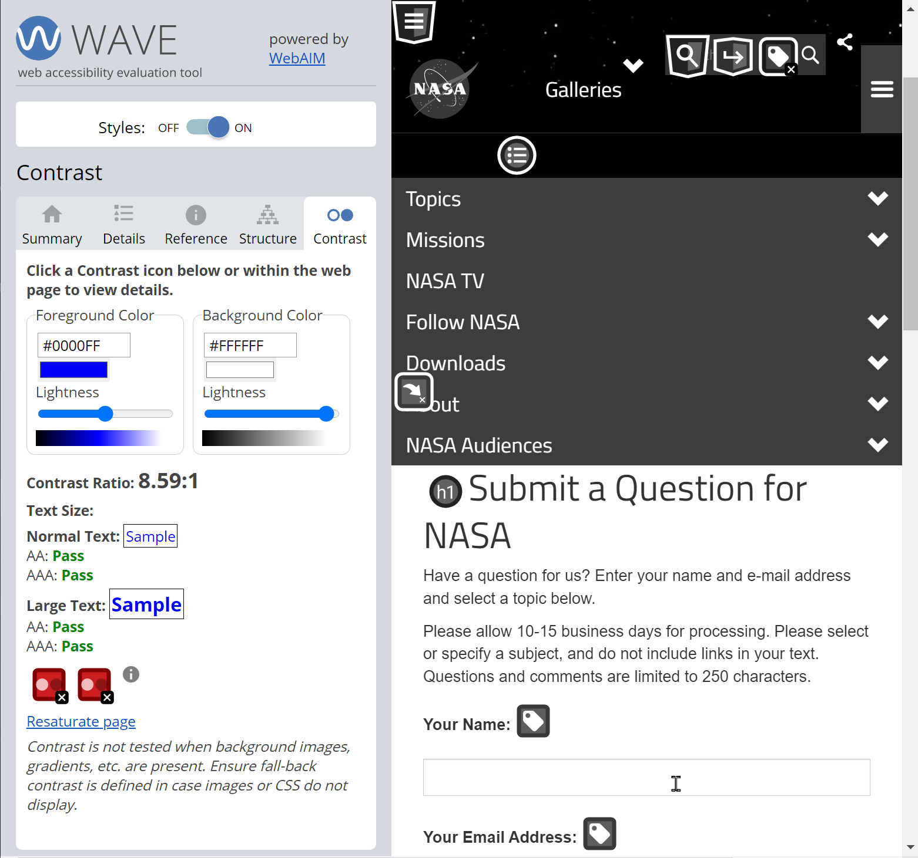
WAVE WebAim
WAVE® is a suite of evaluation tools that helps authors make their web content more accessible to individuals with disabilities. WAVE can identify many accessibility and Web Content Accessibility Guideline (WCAG) errors, but also facilitates human evaluation of web content.

Slide 5
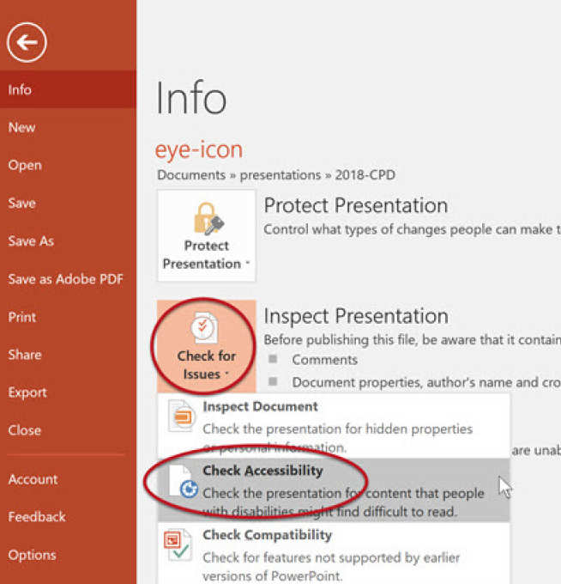
Check PDF Accessibility
A-Checks is a web accessibility reporting and PDF accessibility reporting tool.

Slide 6
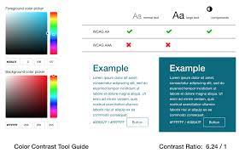
Colour Checker
The tool tests the contrast ratio of background and text colors for accessibility. You can use it to visualize different color combinations for your website design that are in compliance with Web Content Accessibility Guidelines (WCAG)

Slide 7
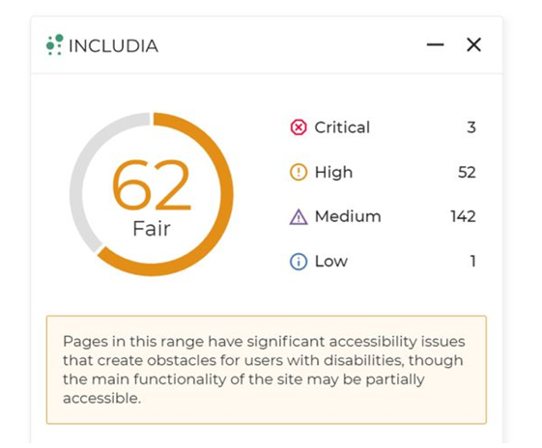
Video Accessibility
Luma empowers content creators to deliver safer, more engaging, and genuinely inclusive video content, making the online experience safer for all viewers.

Slide 8
Website Quality

Slide 9
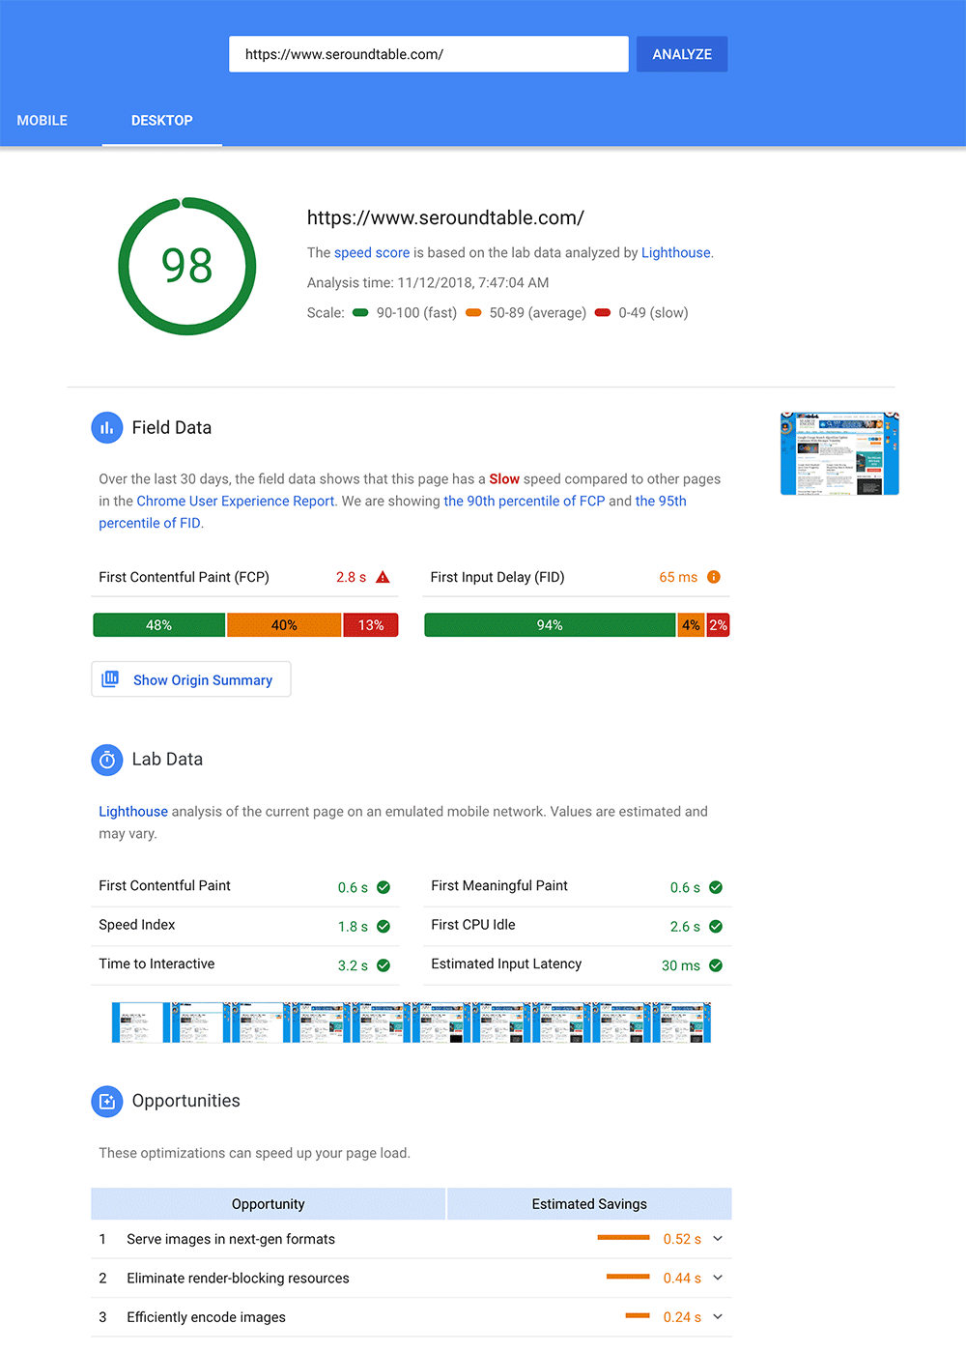
Website Performance
PageSpeed Insights (PSI) reports on the user experience of a page on both mobile and desktop devices, and provides suggestions on how that page may be improved.

Slide 10
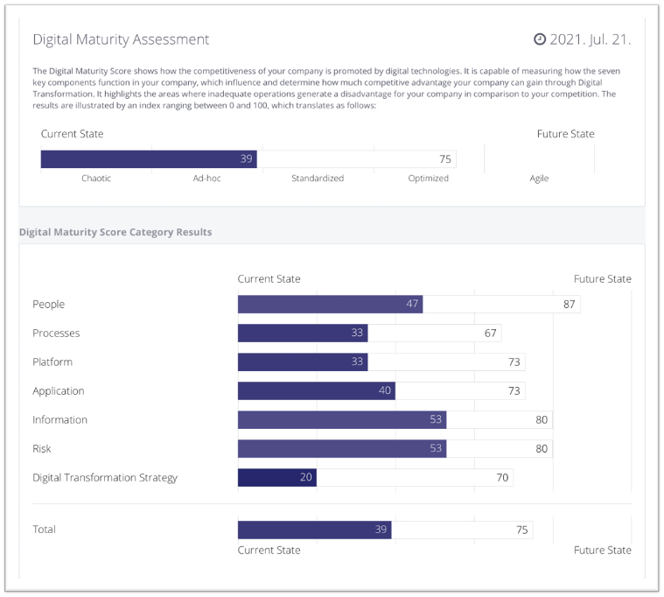
Website Assessment
Take the first step towards improving your site’s performance with this free and easy website assessment tool. Get professional feedback on up to 5 pages of your website* and receive a personalized report instantly.

Slide 11
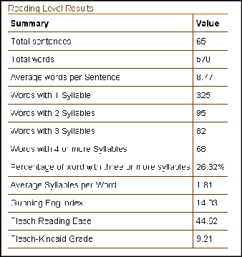
Website Readability
Reading level algorithms only provide a rough guide, as they tend to reward short sentences made up of short words. Whilst they're rough guides, they can give a useful indication as to whether you've pitched your content at the right level for your intended audience.

Slide 12
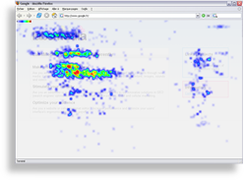
Website Heatmap
ClickHeat is a visual heatmap of clicks on a HTML page, showing hot and cold click zones. ClickHeat is an OpenSource software, released under GPL licence, and free of charge. You may know it as LabsMedia's ClickHeat, that's the very same software, as we developed it (look for the credits in the files!).

